Slide 1
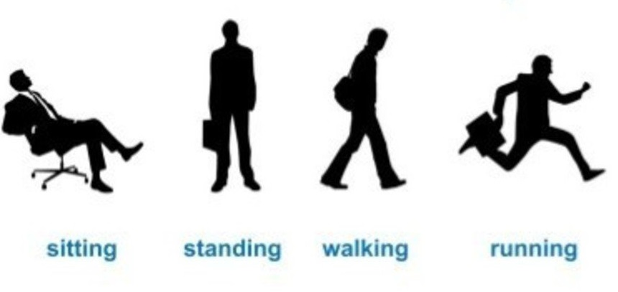
RNN Applications
Human Activity Recognition

Slide 2
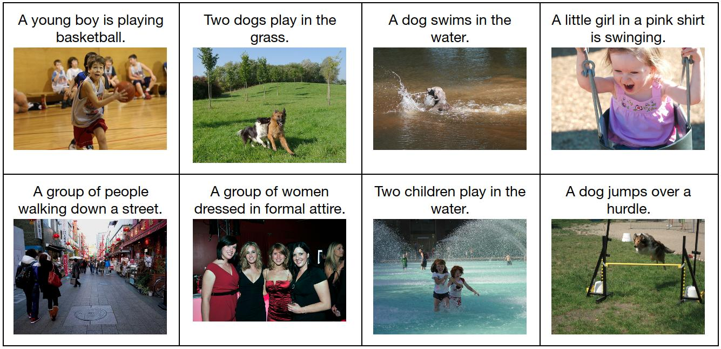
RNN Applications
Image Captioning
Courtesy: Keras-github

Slide 3

RNN Applications
Machine Translation
Courtesy: ciklopea.com

Slide 4
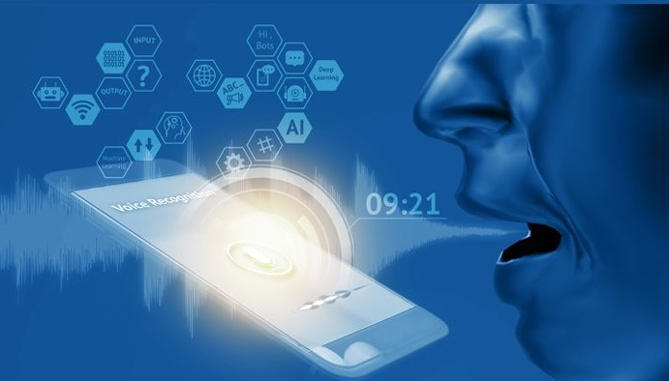
RNN Applications
Speech Recognition
Courtesy: loginworks.com

Slide 5
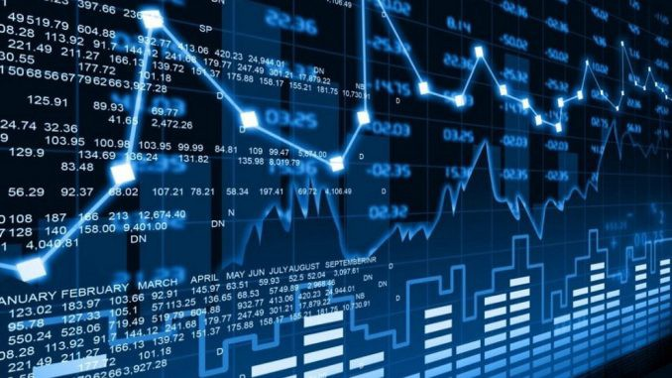
RNN Applications
Stock Price Prediction
Courtesy: hackernoon.com

Slide 6
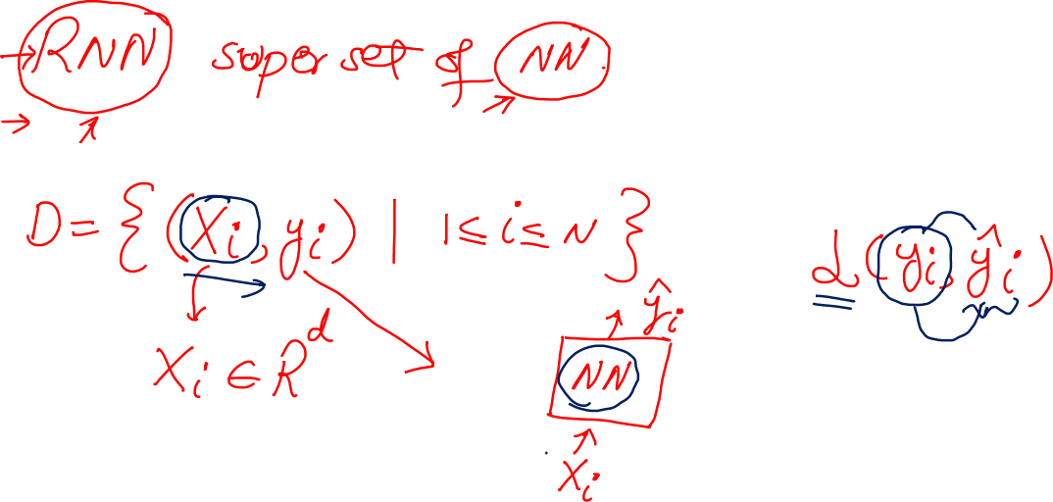
When to model RNN?

Slide 7
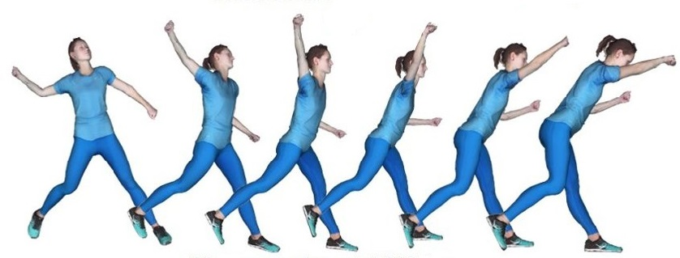
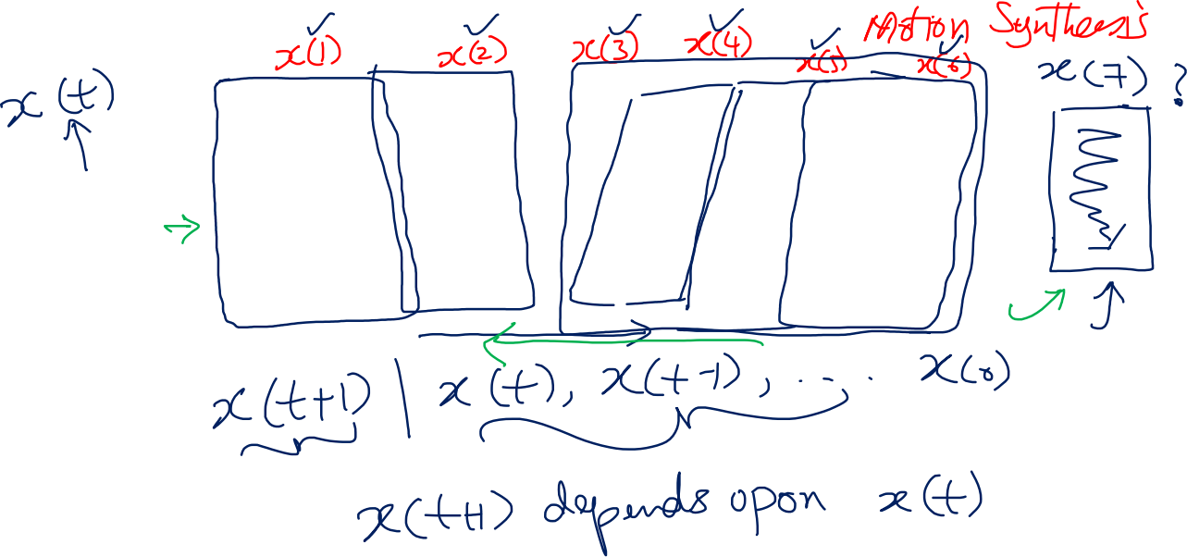
RNN Model
Courtesy: researchgate

Slide 8
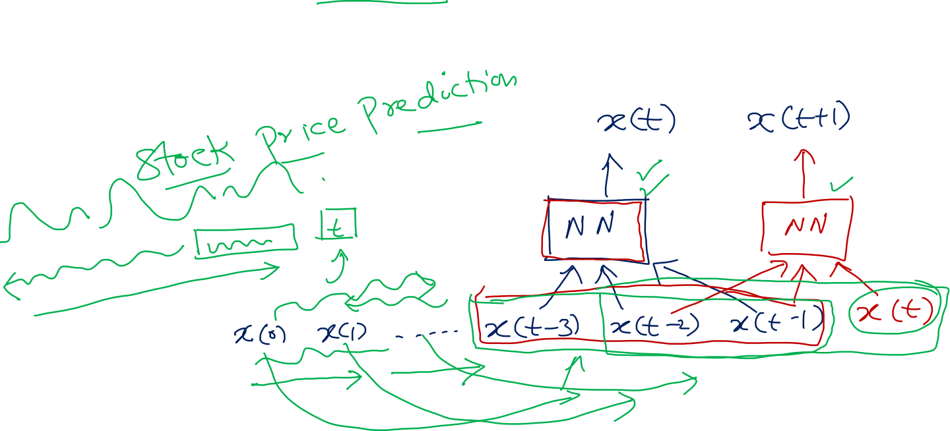
RNN Model

Slide 9
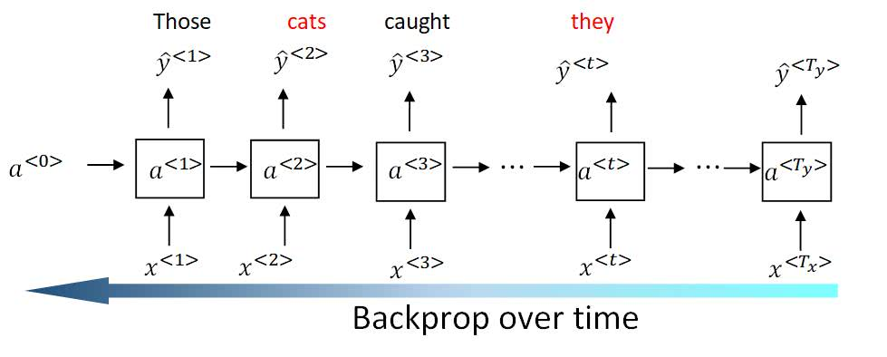
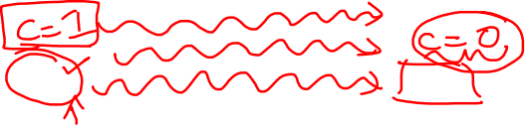
Vanishing Gradient in RNN
Courtesy: dlology.com

Slide 10

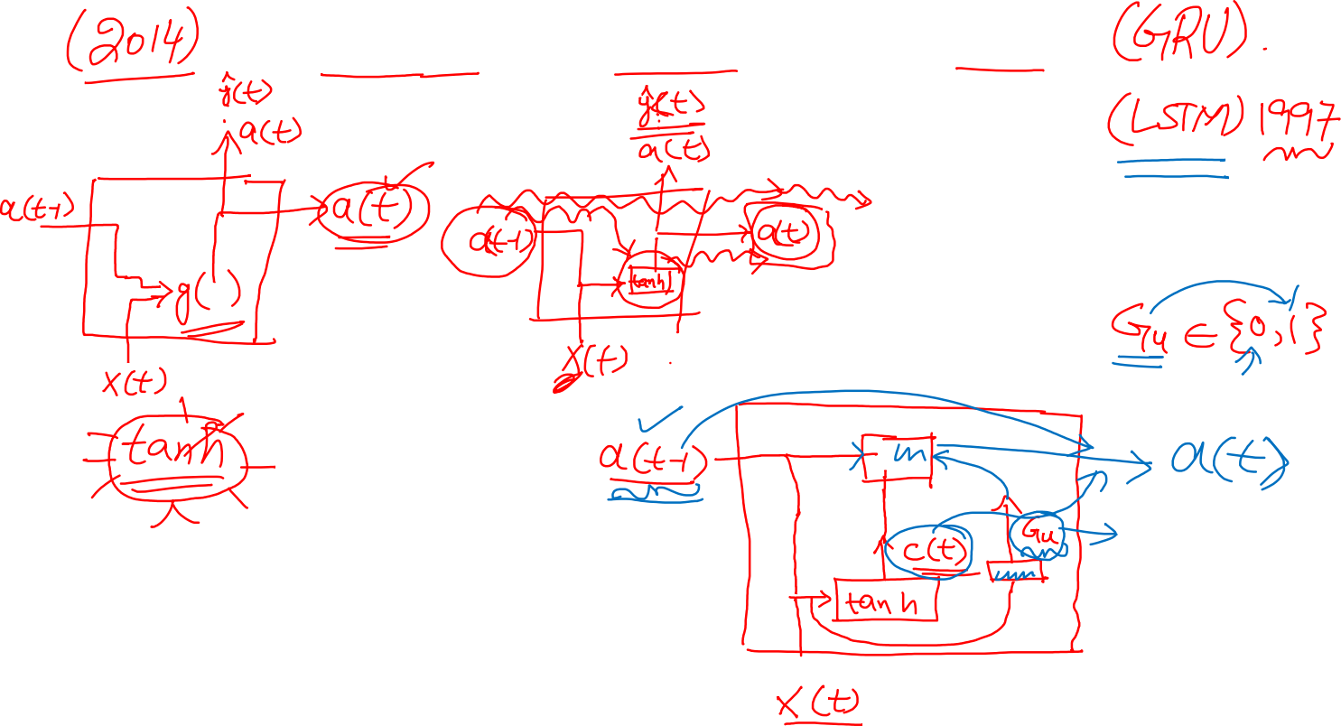
Gated Recurrent Unit

Slide 11

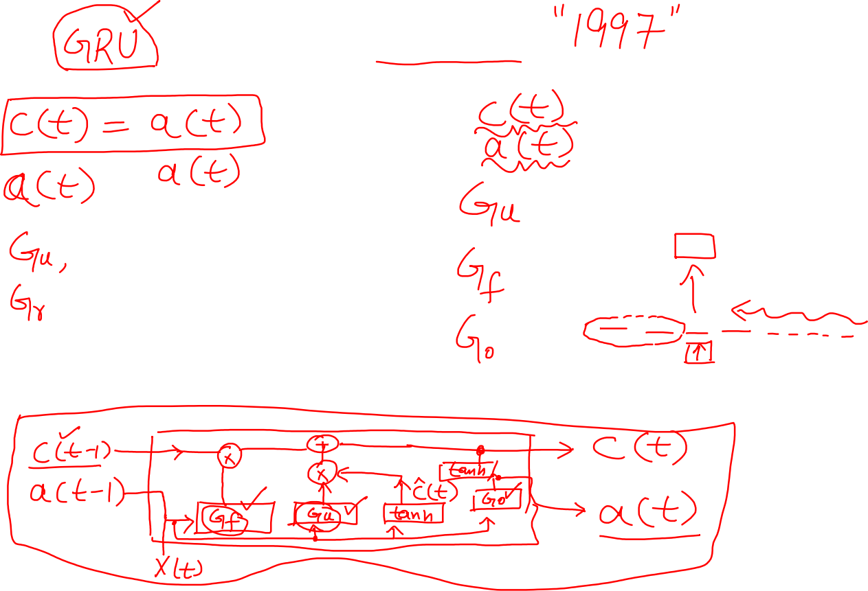
LSTM

Slide 12
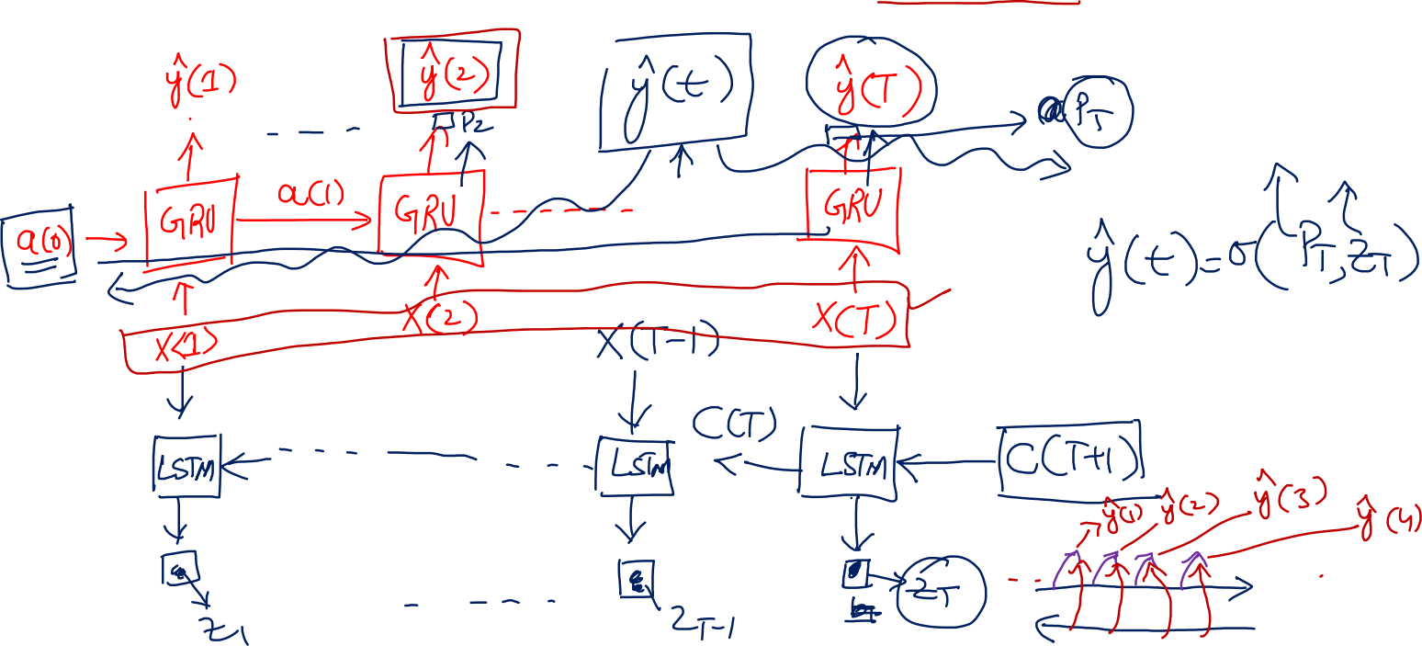
Bidirectional RNN

Slide 13
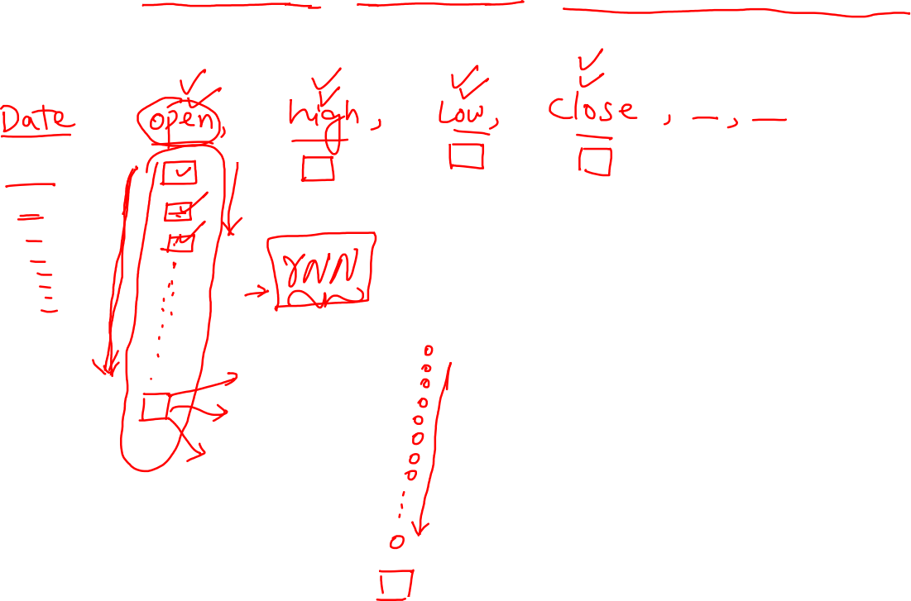
Stock Price Prediction

Slide 14
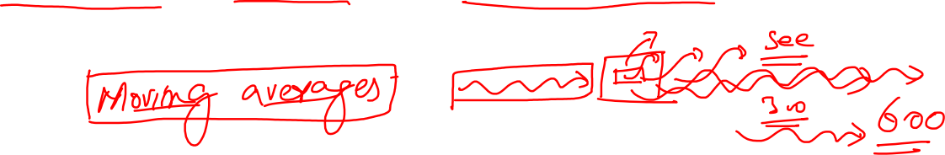
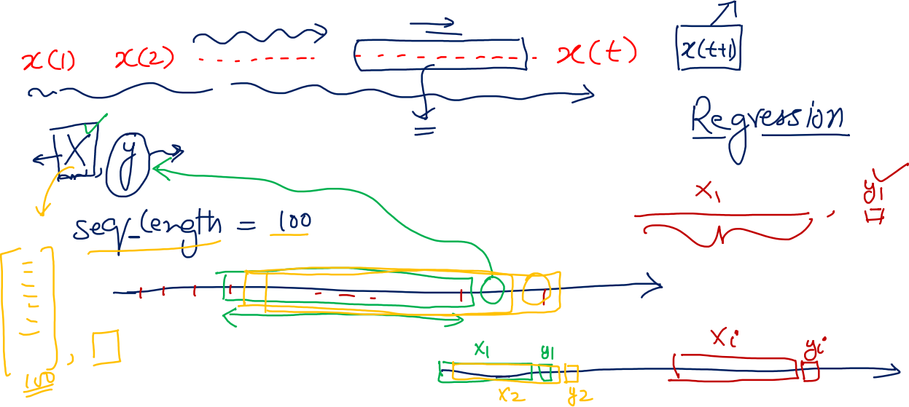
Stock Price Prediction

