Slide 1
NLP - LLM
Using Transformers at Huggingface

Slide 2
Huggingface Hub
Huggingface is an echosystem, providing following services:
Easy APIs for Transformer-based Deep Learning Models
Largest repositary Transformer Models (~400k)
Largest repositary of Language Datasets (~80k)
You can download existing shared models / datasets.
You can upload/share your own Transformer models/datasets
Provides space for Model Deployment
This become particularly useful when we see Large Language Models (LLM) are huge in size and development time could increase dramatically otherwise

Slide 3
Development Support System
Easy APIs
NLP Course
Deep RL Course
Audio Course
Gradio Chapter (gradio is a platform similar to Streamlit)
Gradio is Google Colab friendly (while streamlit isn’t), and as most developers use Colab due high compute requirements, gradio is the most trending platform for NLP product development.
Any model which doesn’t require Colab, can use Streamlit as well.

Slide 4
Basic API
Installation of Packages
Imports
Model selection and model_id checkpointing.
Model instantiating (with appropriate parameters)
Tokeinizer instantiating
Model call with input
Display outputs

Slide 5
Common NLP Tasks
Classifying whole sentences: Getting the sentiment of a review, detecting if an email is spam, determining if a sentence is grammatically correct or whether two sentences are logically related or not
Classifying each word in a sentence: Identifying the grammatical components of a sentence (noun, verb, adjective), or the named entities (person, location, organization)
Generating text content: Completing a prompt with auto-generated text, filling in the blanks in a text for masked words
Extracting an answer from a text: Given a question and a context, extracting the answer to the question based on the information provided in the context
Generating a new sentence from an input text: Translating a text into another language, summarizing a text

Slide 6
The Most Basic Pipelines
from transformers import pipeline
classifier = pipeline("sentiment-analysis")
classifier("I've been waiting for a HuggingFace course my whole life.")
Available pipelines:
feature-extraction (get the vector representation of a text)
fill-mask
ner (named entity recognition)
question-answering
sentiment-analysis
summarization
text-generation
translation
zero-shot-classification

Slide 7
Transformers and LMs
Three basic usage types:
Auto-regressive Transformer models: (i.e. predicts text based on previous input) example: GPT-Like
Auto-encoding Transformer models: (i.e. recreates /classifies original text) BERT-like
Sequence-to-sequence Transformer models: (i.e. translation) BART/T5-like

Slide 8
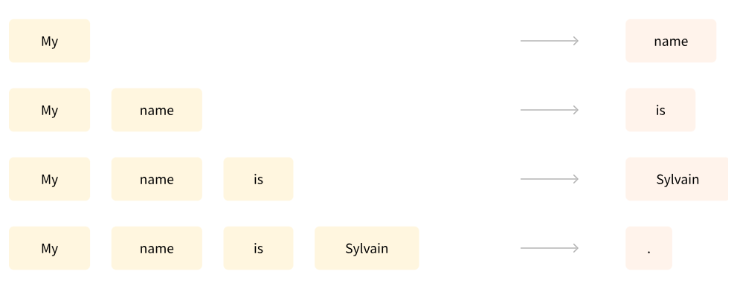
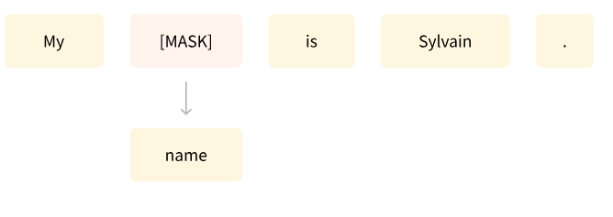
Model Training Types
Causal Language Modeling
Masked Language Modeling

Slide 9
Encoder Models
Encoder models, including ALBERT, BERT, DistilBERT, ELECTRA, and RoBERTa, utilize only the encoder of a Transformer model.
These models exhibit "bi-directional" attention, allowing access to all words in the original sentence at each stage.
Pretraining involves corrupting a sentence (e.g., by masking random words) and tasking the model with reconstructing the initial sentence.
Encoder models are well-suited for tasks requiring a comprehensive understanding of the entire sentence, such as sentence classification, named entity recognition, word classification, and extractive question answering.

Slide 10
Decoder Models
Decoder models, such as GPT-3/-4, Transformer XL, T5 (Text2Text) exclusively utilize the decoder of a Transformer model.
These models are characterized as auto-regressive, with attention layers accessing only preceding words for a given word at each stage.
Pretraining for decoder models typically involves predicting the next word in the sentence.
Well-suited for tasks focused on text generation.

Slide 11
Encoder-Decoder Models
Encoder-decoder models, also known as sequence-to-sequence models, incorporate both encoder and decoder components of the Transformer architecture.
The encoder's attention layers can access all words in the initial sentence, while the decoder's attention layers are limited to words positioned before a given word in the input.
Pretraining involves more complex objectives, as seen in T5, where random spans of text are replaced with a single mask special word, and the objective is to predict the text replaced by this mask word.
Well-suited for tasks like summarization, translation, and generative question answering, where new sentences are generated based on a given input.
Representative models in this category include BART, mBART, Marian, and T5, showcasing the diversity within encoder-decoder architectures.

Slide 12
Biases & Limitations
As extensive pretraining often involves scraping data from the internet, capturing both high-quality and problematic content.
**Illustration with BERT Model:**
BERT model, despite training on seemingly neutral data, exhibits biases in gender-associated predictions on Gender-specific prompts, reflecting potential sexism, racism etc.
**Implications for Production Use:**
Caution is advised when deploying these models in production.
Fine-tuning on specific data doesn't eliminate the original model's intrinsic biases.
Users are encouraged to be aware of ethical considerations in AI use.
**Responsibility in Model Deployment:**
Organizations deploying models bear the responsibility to understand and manage biases.
Regular audits and ethical considerations should be integrated into deployment processes to minimize unintended consequences.

Slide 13
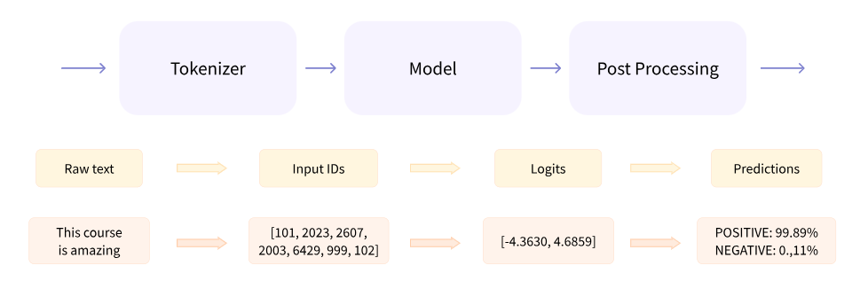
Behind Pipelines

Slide 14
Tokenizqtion
There are different ways to split the text. For example, we could use whitespace to tokenize the text into words by applying Python’s split() function:
tokenized_text = "Jim Henson was a puppeteer".split()
print(tokenized_text)
>>['Jim', 'Henson', 'was', 'a', 'puppeteer']
Token_IDs: Each word gets assigned an ID, starting from 0 and going up to the size of the vocabulary. The model uses these IDs to identify each word. There are challengs though: - for example there are over 500,000 words in the English language, we’d need that many IDs.
- furthermore, words have various representations (dog, dogs)
- we need a custom token to represent words not in our vocabulary, i.e.”[UNK]” or ””.
The goal when crafting the vocabulary is to do it in such a way that the tokenizer tokenizes as few words as possible into the unknown token. Various Approaches

Slide 15
Tokenizers
Each pre-trained Model comes with its associated tokenizer.
Example:
model_id = "bert-base-cased" from transformers import AutoTokenizer tokenizer = AutoTokenizer.from_pretrained(model_id)
tokenizer("Using a Transformer network is simple")
>> {'input_ids': [101, 7993, 170, 11303, 1200, 2443, 1110, 3014, 102],
'token_type_ids': [0, 0, 0, 0, 0, 0, 0, 0, 0],
'attention_mask': [1, 1, 1, 1, 1, 1, 1, 1, 1]}

Slide 16
..Tokenizers
from transformers import AutoTokenizer
tokenizer = AutoTokenizer.from_pretrained("bert-base-cased")
sequence = "Using a Transformer network is simple"
tokens = tokenizer.tokenize(sequence)
print(tokens) # the tokenization is word-piece type
>>['Using', 'a', 'transform', '##er', 'network', 'is', 'simple']
ids = tokenizer.convert_tokens_to_ids(tokens)
print(ids)
>>[7993, 170, 11303, 1200, 2443, 1110, 3014]
decoded_string = tokenizer.decode([7993, 170, 11303, 1200, 2443, 1110, 3014])
print(decoded_string)
>> 'Using a Transformer network is simple'
Colab Example

Slide 17
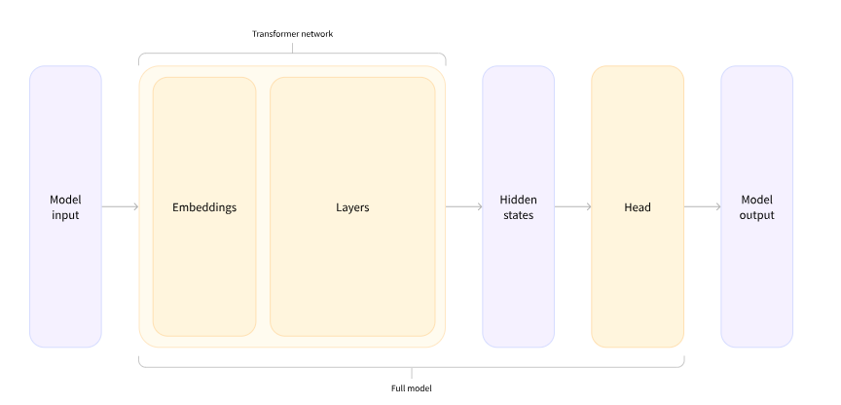
Models’ Architectures
There are many different architectures available in 🤗 Transformers, with each one designed around tackling a specific task. Here is a non-exhaustive list:
*Model (retrieve the hidden states)
*ForCausalLM
*ForMaskedLM
*ForMultipleChoice
*ForQuestionAnswering
*ForSequenceClassification
*ForTokenClassification
and others 🤗
from transformers import AutoModelForSequenceClassification
checkpoint = "distilbert-base-uncased-finetuned-sst-2-english"
model = AutoModelForSequenceClassification.from_pretrained(checkpoint)
outputs = model(**inputs)
print(outputs.logits.shape) # >>torch.Size([2, 2])
predictions = torch.nn.functional.softmax(outputs.logits, dim=-1)
>> tensor([[4.0195e-02, 9.5980e-01],
[9.9946e-01, 5.4418e-04]], grad_fn=<SoftmaxBackward>)
model.config.id2label # >> {0: 'NEGATIVE', 1: 'POSITIVE'}

Slide 18
Models: basic usage flow
import torch
from transformers import AutoTokenizer, AutoModelForSequenceClassification
checkpoint = "distilbert-base-uncased-finetuned-sst-2-english"
tokenizer = AutoTokenizer.from_pretrained(checkpoint)
model = AutoModelForSequenceClassification.from_pretrained(checkpoint)
sequences = ["I've been waiting for a HuggingFace course my whole life.", "So have I!"]
tokens = tokenizer(sequences, padding=True, truncation=True, return_tensors="pt")
output = model(**tokens) COLAB EXAMPLE

Slide 19
Typical Chat Application Flow
Install Packages && Import Packages
Select checkpoint / model_id
Instantiate Model && Instantiate Tokenizer
Check Model
Initialize Text_Generation parameters
Initialized Pipeline && Test Pipeline
Initialize LLM class from langchain / llamaIndex
Create System Prompt Template && Create User Prompt
Create Langchain QA_Chain | Converstaional Chain
Test Chain
Do Prompt Engineering to finetune the response.
Fine-Tune generation and pipeline parameters to get desired response
Create Gradio application for UX Interface

