Slide 1
Data Types in Generative AI

Slide 2
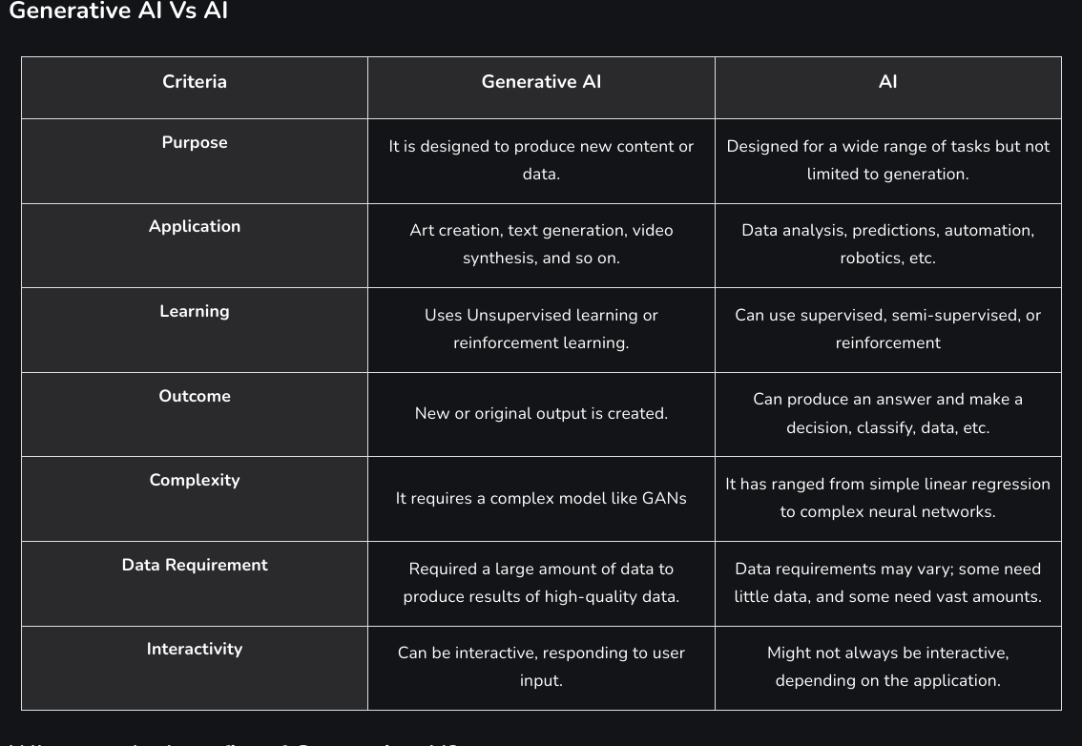

Slide 3
Generative AI - Data Types
Higher Level Data Types
Images / [Videos] → Numpy Arrays
Text – Numpy Array / Data Frames
Sound - Numpy Arrays

Slide 4
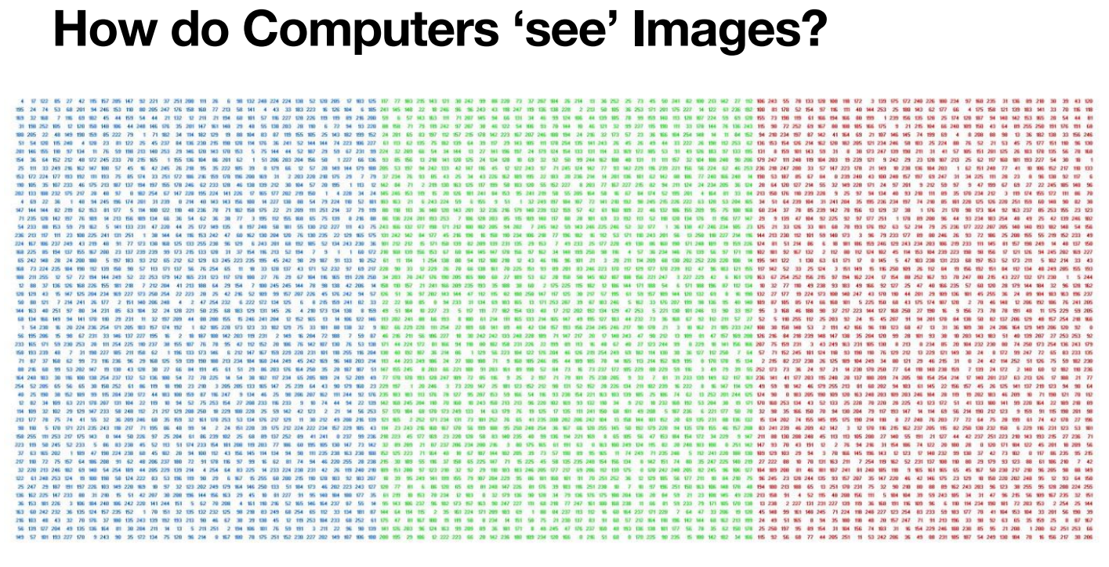
Image Data

Slide 5
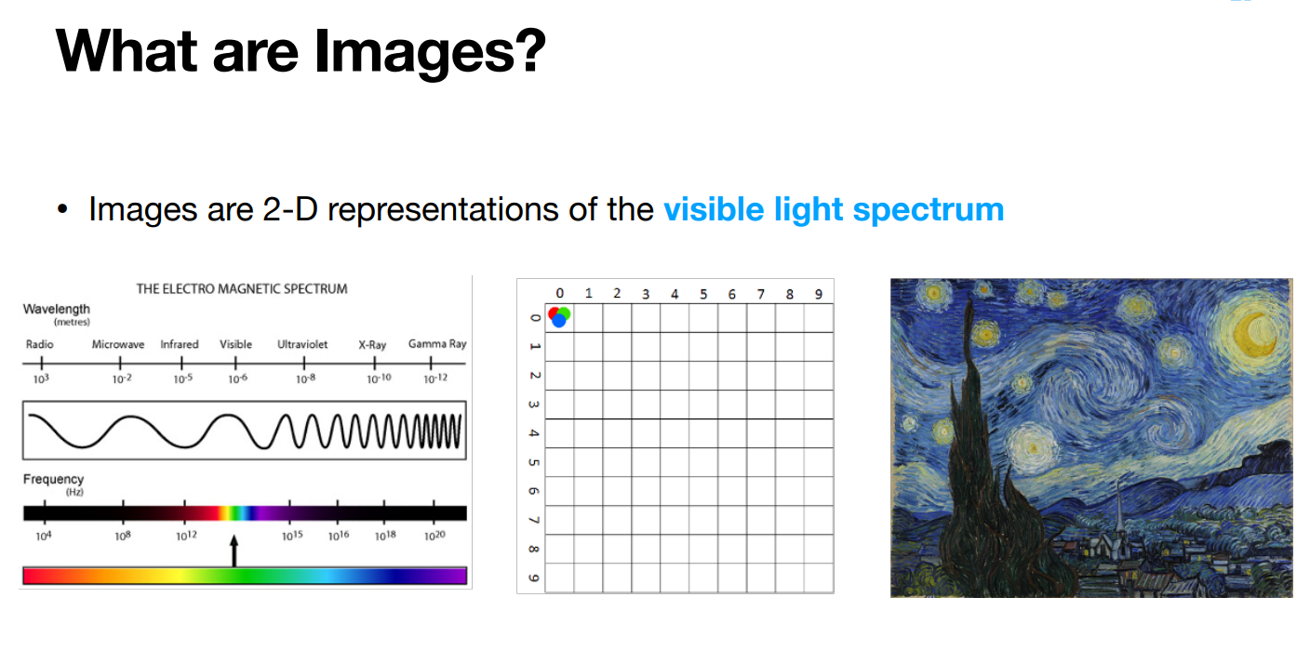

Slide 6
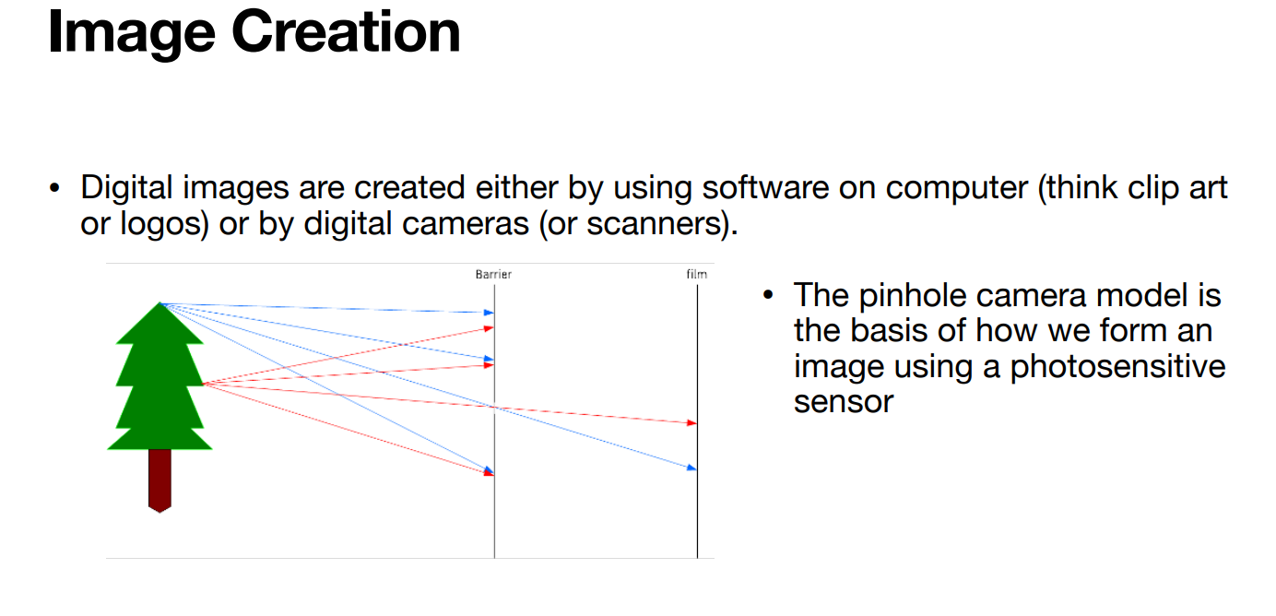

Slide 7
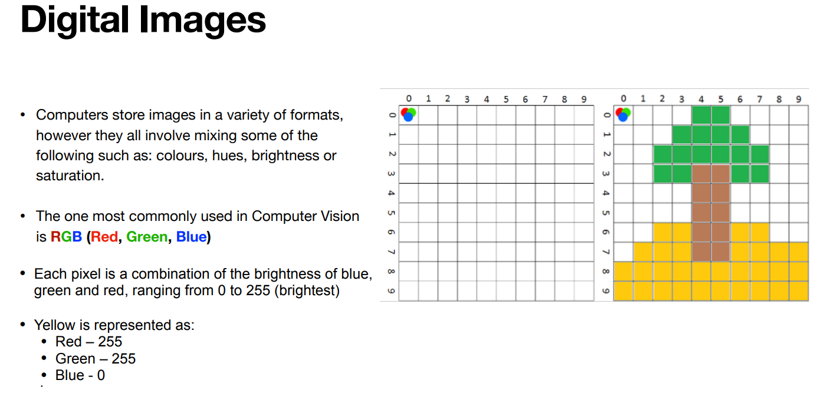

Slide 8
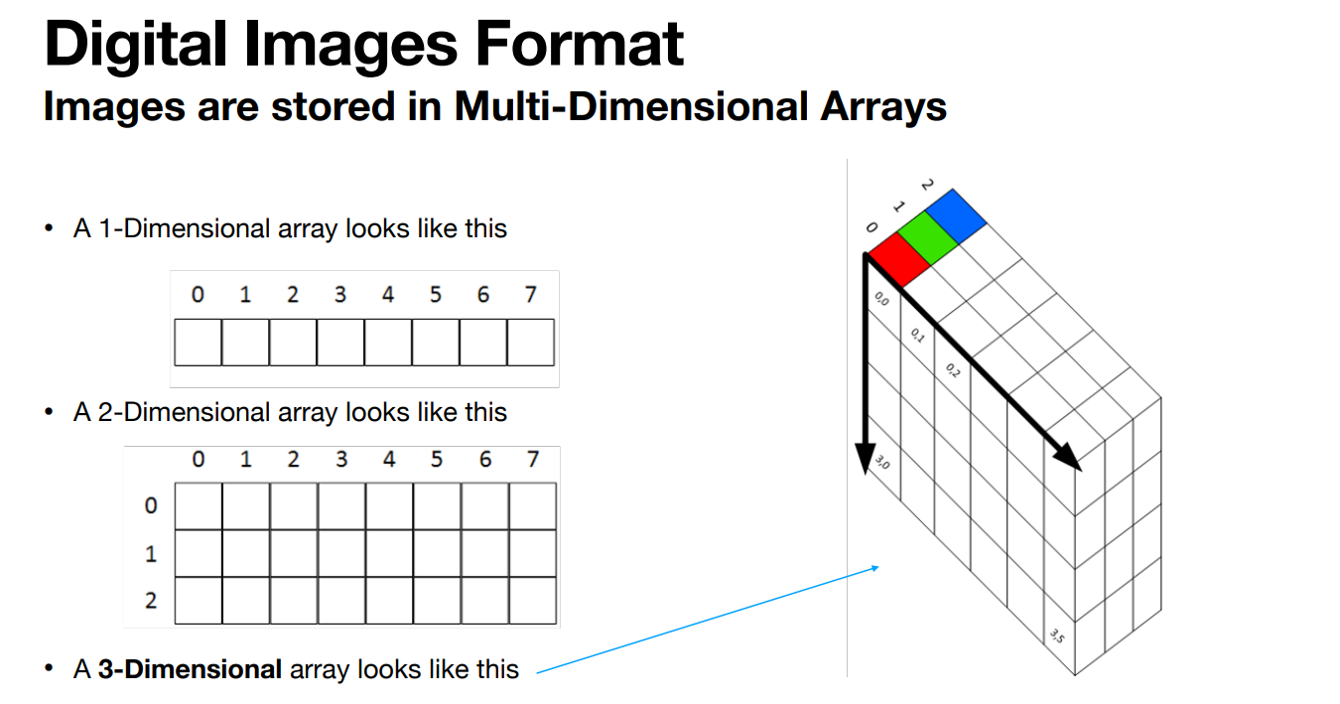

Slide 9
