Slide 1

Topic 11 Air and water

Slide 2
Learning Objectives (Cambridge IGCSE syllabus)
Name some uses of water in industry and at home?
Describe chemical tests for water?
Discuss the implications of water shortage (limit your discussion to water that is used for drinking and irrigation of crops)?
State the composition of clean, dry air?
Describe the separation of oxygen and nitrogen from liquid air by fractional distillation?
State some sources of carbon dioxide?
State the sources of methane?
State that carbon dioxide and methane are greenhouse gases and may contribute to climate change?
Name the common pollutants in the air?
State the source some pollutants such as: Carbon monoxide, Sulfur dioxide, Oxides of nitrogen, Lead compounds?
State the conditions required for the rusting of iron
Describe some methods for rust prevention?
Describe and explain sacrificial protection and galvanising methods for rust prevention?
Describe the need for nitrogen, phosphorous and potassium containing fertilizers?
Describe the Haber Process for making Ammonia?

Slide 3
Importance of Water
Water uses at home:
Drinking, cooking and cleaning
For gardens and plants
Water uses in industry:
Generating Electricity - A solvent for many chemicals
As a coolant to reduce the temperature of some industrial processes
As a solvent in chemical reactions

Slide 4
Water Treatment
Filtration: To separate large insoluble purities from water
Sedimentation: The filtered water is allowed to settle in large sedimentation tanks. Here the water can sit for some time and all the smaller undissolved impurities such as mud and sand settle to the bottom of the tank, forming sediment
Chlorination: Using chlorine to kill germs and bacteria

Slide 5
Effects of water shortage
Food shortages and famine due to a lack of crops which cannot grow without enough water supply
Poor sanitation leads to the spread of bacteria and diseases as drinking and washing water becomes infected

Slide 6
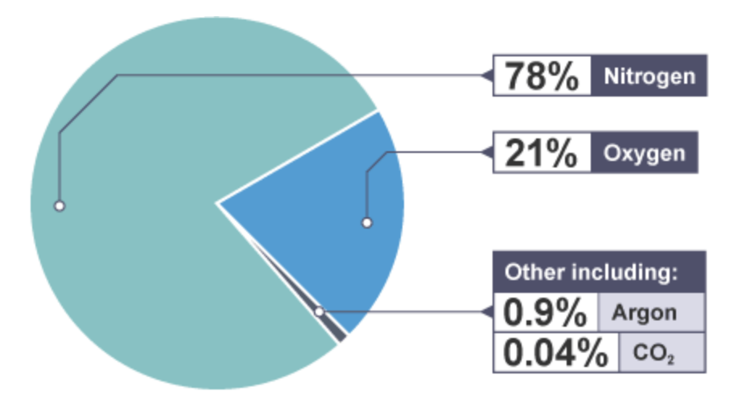
Air as a mixture
Air is a mixture of various gases as shown in the diagram below:

Slide 7
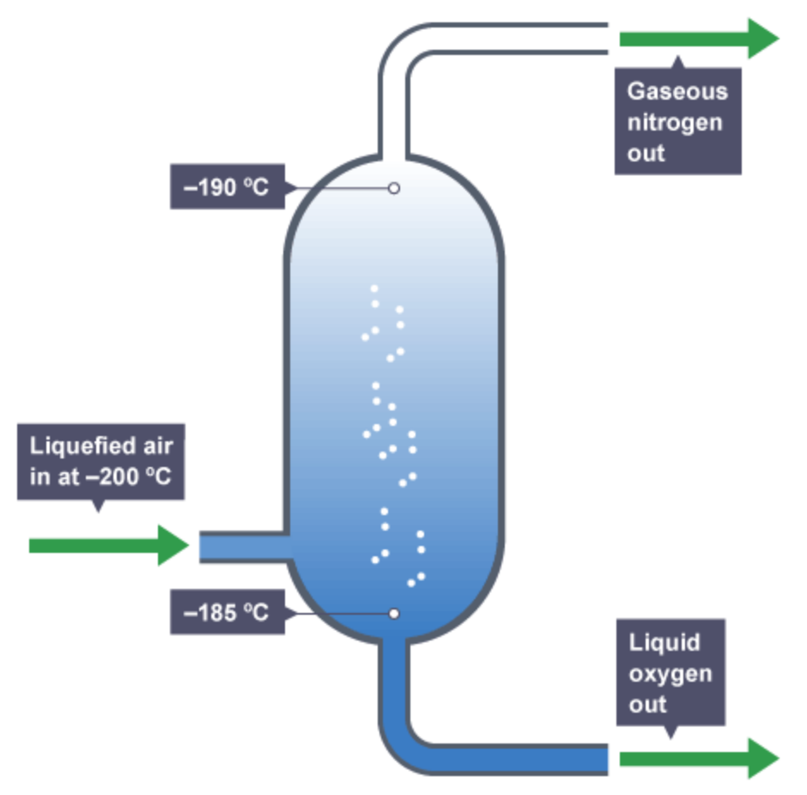
Separating gasses in the air
Fractional distillation:
Air is filtered, cooled and compressed until it becomes liquefied at around -200ºC
The temperature of the fractional distillation column is increased so that when the boiling point of the gases is reached, the gas rises to the top and collected
Oxygen has a boiling point of -183ºC while nitrogen has a boiling point of -196ºC

Slide 8
Air Pollution
Pollution from the combustion of fossil fuels
Polluting gasses such as sulfur dioxide and oxides of nitrogen cause acid rain
Incomplete combustion of fossil fuels gives carbon monoxide which is a poisonous gas
What is Global Warming?
Greenhouse gasses such as carbon dioxide and methane trap heat in the earth’s atmosphere. This leads to increase in the temperature and global warming.
Why using lead in petrol is bad?
Some lead compounds that are produced when burning leaded petrol in car engines can cause health problems

Slide 9
Effects of air pollutants
Pollutant | Causes | Effects
Lead compounds | Burning of leaded-petrol | Causes damage to brain
Oxides of nitrogen | From car exhausts | Breathing problems & acid rain
Sulphur dioxide | Combustions of fossil fuels that contain Sulphur | Irritates eyes and throat
Carbon monoxide | Incomplete combustion of fossil fuels | Death due to oxygen starvation

Slide 10
Reducing air pollutants
Using unleaded petrol
Reacting oxides of Sulphur, in the industries, with alkaline substances such as calcium to neutralize them
Ensure a complete combustion of fossil fuels to reduce the release of carbon monoxide
Finding environment-friendly fuels (instead of burning fossil materials)

Slide 11
Causes of rusting and methods to prevent it
Rusting occurs when iron, oxygen and water combine. This combination leads to iron loses electrons to the oxygen atoms and form the compound Iron Oxide (which is rust)
Methods for preventing rusting:
This can be done using a number of ways including:
Greasing
Painting
Electroplating
Galvanization

Slide 12
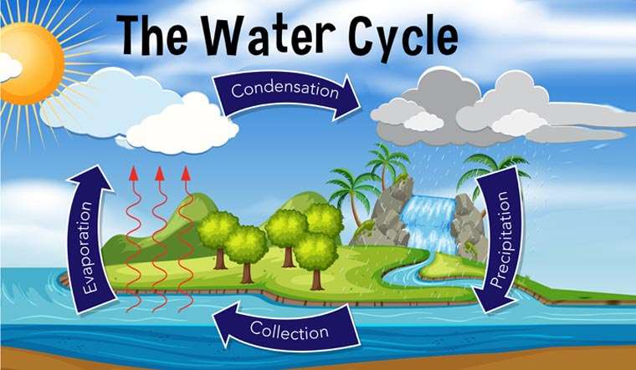
The Water Cycle

Slide 13
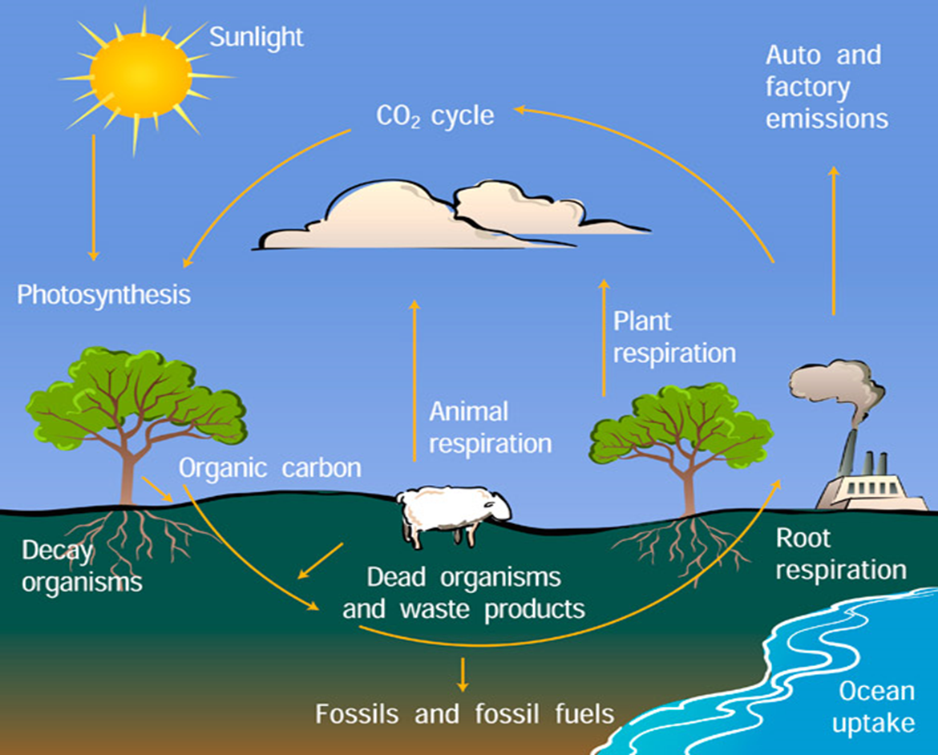
The Carbon Cycle

