Slide 1
Objectives
Understand the following terms and how they affect the performance of a CPU:
Cores
Cache
Clock
Understand the purpose of buses including:
The address bus
The data bus
The control bus

Slide 2
Exam Questions
1(a) Explain the purpose of the CPU.
[1]
To execute / run programs (1), to coordinate and manage the hardware resources (1).

Slide 3
Exam Questions
Here are some statements about the CPU of a computer.
Tick one box in each row to show whether the statement is true or false. [4]
Statement | True | False
CPU stands for Central Programming Unit
The CPU carries out arithmetic and logical instructions
Registers are a type of super-fast memory in the CPU
The Von Neumann architecture only holds data in memory
✓
✓
✓
✓
In the Von Neumann architecture, programs and data share a common memory.

Slide 4
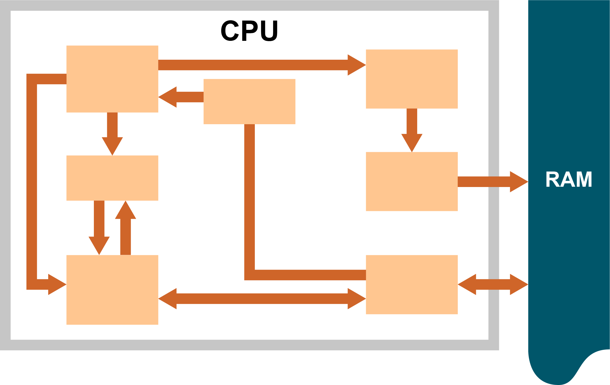
Exam Questions
Name at least five components inside a CPU

Slide 5
Starter
Components in a CPU
Control unit (CU)
Arithmetic Logic Unit (ALU)
Registers
– including PC (program counter)
– MAR (memory address register)
– MDR (memory data register)
– CIR (current instruction register)
– Accumulator (ACC)

Slide 6
Exam Questions
The CPU features a number of registers. Complete the table and describe the purpose of each register [4]
Register | Purpose
Memory Address Register
Memory Data Register
Current Instruction Register
Program Counter
Accumulator
The MAR holds the address of the current instruction being executed and the address of the data that needs to be accessed.
The MDR holds first the instruction, and then the data (if any) to be used in the instruction, copied from RAM.
The CIR holds the instruction that is currently being decoded and executed.
The Program Counter holds the address of the next instruction to be executed.
The accumulator is where arithmetic and logic results are temporarily stored.

Slide 7
Exam Questions
The CPU operates on a cycle.
(a) What is the name of this cycle? [1]
Fetch-decode-execute cycle.

Slide 8
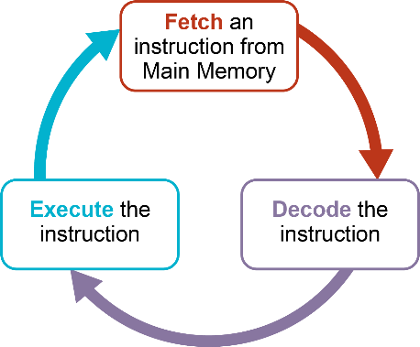
Exam Questions
Explain the different stages of the cycle.
You may draw a diagram to help with your explanation. [5]
1 mark for showing fetch/decode/execute in a cycle. 1 mark for mentioning instruction in each part (e.g. fetch the instruction)
Fetch: The Program Counter (PC) in the CPU specifies where the next instruction to be executed is stored. (1) The CPU fetches the next instruction to be executed from memory. (1) The instruction is transferred to the MDR (1). The address of the instruction being fetched is placed in the MAR (1). The current instruction register (CIR) holds the instruction that is currently being decoded/executed (1).
Decode: It decodes the instruction (1).
Execute: The processor carries out/runs/executes the instruction. (1) The Program Counter is updated/incremented to point to the next instruction. (1)
The process is repeated. (1)
Any 4 points from above.

Slide 9
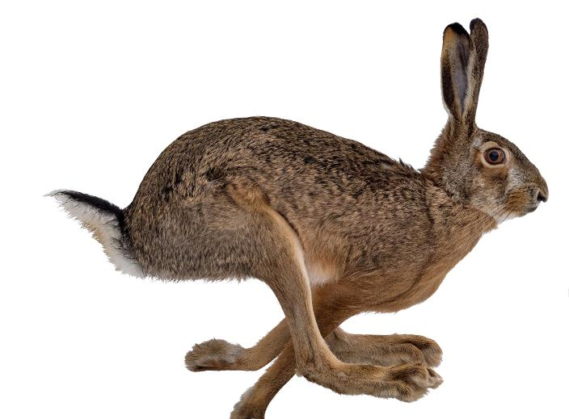
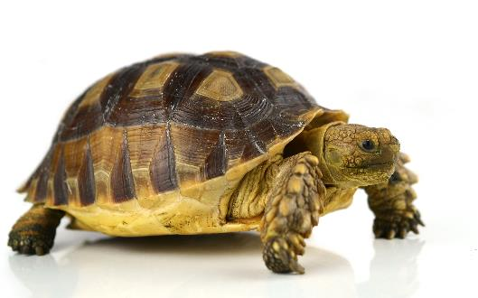
What affects CPU performance?
The following are three of the most common factors which can affect a CPU’s performance
Clock speed
Processor cores
Cache
What is the purpose of each of these components?
How can they affect the performance of the CPU?

Slide 10
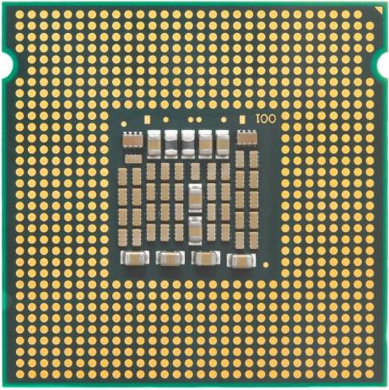
Factors affecting CPU performance
Clock speed
Cache size
Cycles per second
measured in hertz (Hz)
Cache on the CPU is faster than RAM but slower than registers
Number of cores
The number of duplicate
processing units (cores) placed in one CPU

Slide 11


Clock speed
Everything in a computer happens on the pulse of the internal clock
Therefore, the faster the clock speed, the faster the instructions are processed
Clock speed 1GHz
Clock speed 2GHz
Clock
CPU
Clock
CPU
Control Unit
Control Unit

Slide 12
Processor Speed
One cycle per second = 1 hertz (Hz) = 1 instruction carried out each second
1 kilohertz (kHz) = 1000 cycles per second
1 Megahertz (MHz) = 1,000,000 cycles per second
1 Gigahertz (GHz) = 1,000,000,000 cycles per second
How fast is your computer’s processor?
Remember, a 1 GHz processor is performing one billion cycles per second

Slide 13
Multi-core processors
A dual-core processor has two processors in the same integrated circuit, linked together
A dual-core processor has the potential to perform two instructions at the same time
This allows twice as many instructions to be executed, however, it doesn’t always perform at this rate as software may not be able to take full advantage of both cores
A quad-core processor has four linked processors
Which processor would you prefer, a dual-core 1GHz, or a 3 GHz single core processor?

Slide 14
Effect on speed
A quad-core processor working on many different tasks simultaneously, under ideal conditions can be up to four times faster than a single-core processor
If the computer is running a single program, it is not necessarily any faster, since the program may have been designed to only run on one core

Slide 15
Cache memory
Cache is a small amount of very fast, expensive memory in the CPU
It can be accessed faster than regular main memory (RAM)
Why is this useful for recently/frequently used data?
CPU
Cache
Main Memory

Slide 16
Effect on speed of cache
RAM is relatively slow memory to access and it is further away from the processor than cache
It takes longer to retrieve an instruction or data from RAM than from cache
Program instructions and data that are fetched are stored in cache in case they are needed again soon
If you have a ‘while’ loop in a program, for example, having all the instructions in the loop in cache, speeds up execution

Slide 17
Levels of cache memory
There are different ‘levels’ of cache:
Level 1 cache is extremely fast but small (between 2-256KB), located on the CPU. Each core will have its own Level 1 cache
Level 2 cache is usually also given to each core. It is very fast, but a little slower than Level 1 cache. The typical size is 256KB-8MB
Level 3 cache is the slowest type of cache, but still faster than RAM. It is usually located on the CPU and stores 4MB-50MB. The cache is shared between all the cores on the processor

Slide 18
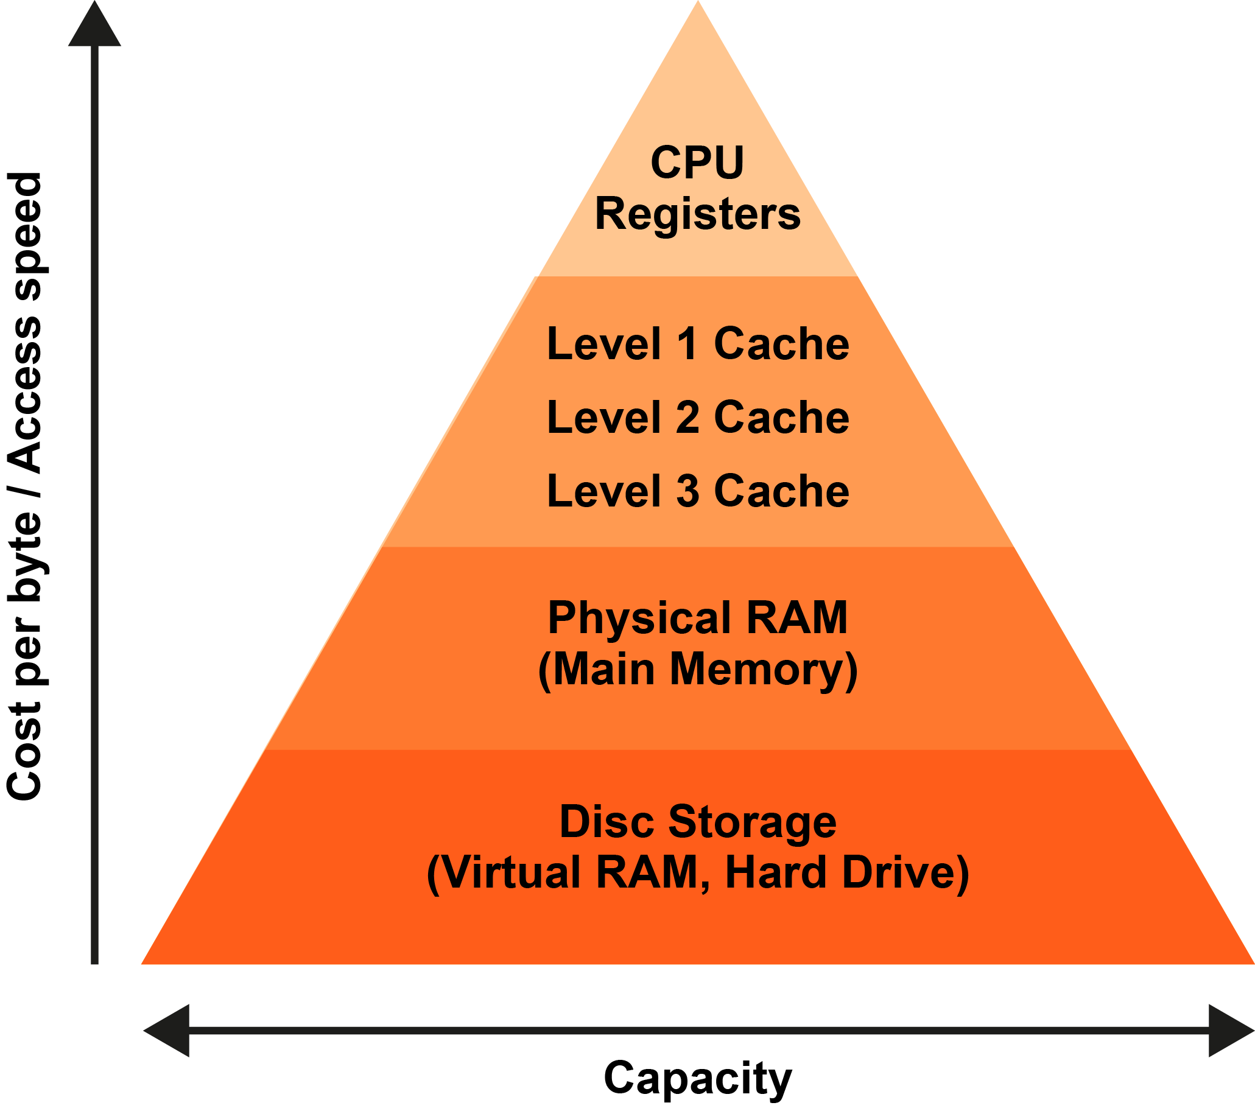
Levels of cache memory

Slide 19
The benefits of cache
The data used most often by the CPU is held in Level 1 cache so is available extremely quickly
In most systems, Level 1 cache is used about 50% of the time, with Level 2 cache being accessed about 90% of the time
This greatly reduces the time that the CPU has to wait for data from main memory
The size of the Level 2 cache is a major factor in determining the performance of the CPU

Slide 20
Which is (theoretically) faster?
A dual core processor running at 2.7GHz with 4MB of shared cache memory
A quad core processor running at 1.5GHz with 8MB of shared cache memory
A single core processor running at 3.2GHz with 2MB of cache memory
A dual core processor running at 3.2GHz with 4MB of shared cache memory
Calculate the maximum number of cycles per second in each case and rank them in order of performance

Slide 21
Worksheet
Complete Task 1 on Worksheet

Slide 22
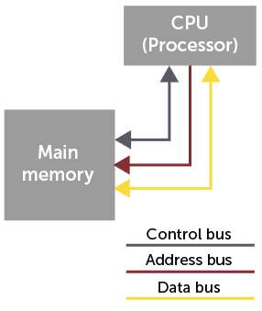
Buses
A bus is a set of parallel wires connecting two or more components of the computer
When the CPU wishes to access a particular main memory location, it sends the address requested to memory on the address bus
The data in that location is then returned to the CPU on the data bus
Control signals are sent along the control bus

Slide 23
System bus
The three buses that make up the system bus are:
Address Bus: stores the address of the memory or device controller to be read from or written to
Data Bus: carries data throughout the computer system
Control Bus: uses control signals to control all activities within the CPU

Slide 24
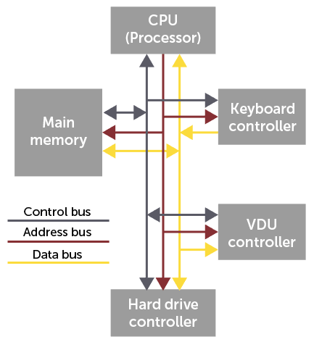
External buses
The CPU is also connected to the external Input-output device controllers by means of the system bus
Only one device can transmit along a bus at any one time
The address bus is one way only, from the CPU
What about the data bus?

Slide 25
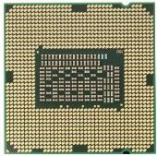

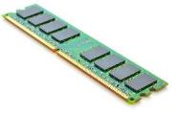
Buses – summary
Explain this diagram:
CPU
‘M’ key pressed
Main memory

Slide 26
Buses – summary
Explain this diagram:
CPU
‘M’ key pressed
Main memory
1. Get ready to store the letter ‘M’ into Main Memory
2. Here is the data: “01011001”
3. Store it in the following memory address location

Slide 27
Worksheet
Complete Task 2 and Task 3 on Worksheet

Slide 28

Plenary
Name three common factors which affect the performance of a CPU
Name three types of bus that are used in computer architecture
Other than the accumulator (ACC), name three registers in a CPU

Slide 29
Plenary
Clock speed, number of cores, cache size
Address bus, data bus and control bus
Three from: PC (program counter), MAR (memory address register), MDR (memory data register), CIR (current instruction register)

