Slide 1
CP PROJECT - OVERVIEW
DIGITAL
NOTEBOOK
1ST SEMESTER
2024
PROJECT NAME
OUR TEAM
MUHAMMAD TARIQUE - 24CS64
NAVEED - 24CS06
MOKASH KUMAR - 24CS30
MUHAMMAD AZAAN - 24CS54

Slide 2


Introduction
DIGITAL
NOTEBOOK
A Digital Notebook built using C++ can be a highly useful tool for students and professionals to organize notes and access them easily.

Slide 3
FEATURES INCLUDED
01
02
03
04
CREATE NOTES
EDIT NOTES
DISPLAY NOTES
SAVE NOTES
05
DELETE SAVED NOTES

Slide 4
NEW FEATURES INCLUDED
06
07
08
09
RESTORE DELETED NOTES
SEARCH NOTES
UNDO
REDO
PASSWORD PROTECTION
10
ADD & DISPLAY STICKY NOTES

Slide 5
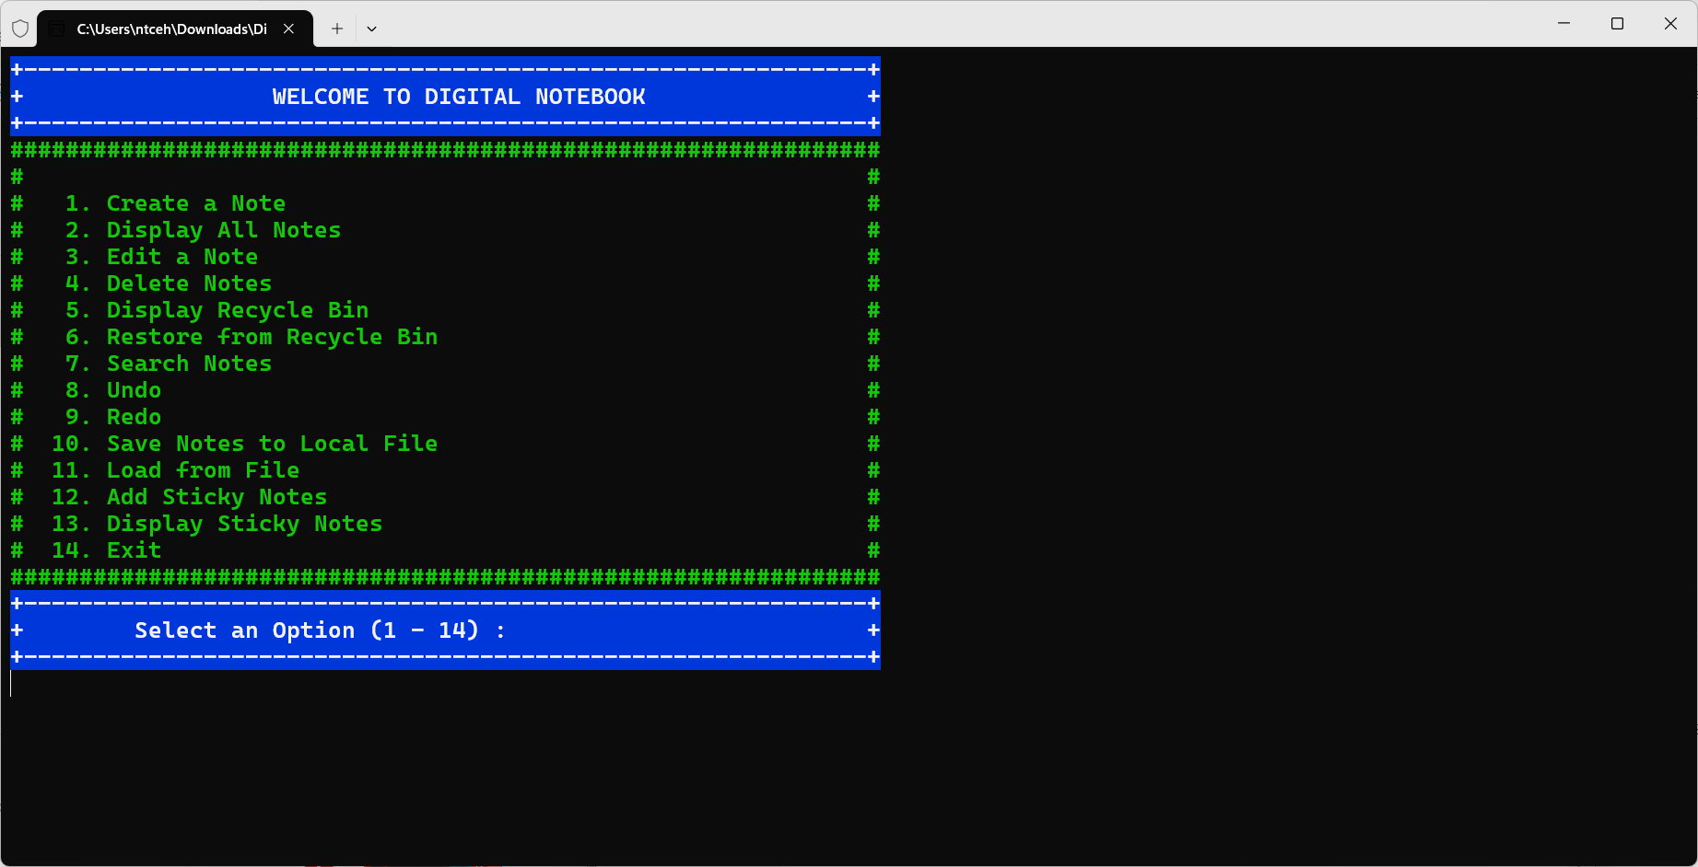
OUTP
uT

Slide 6
HEADER FILES
C++
01
02
03
04
Iostream
Vector
Fstream
String
05
06
07
08
Stack
Iomanip
Cstdlib
Ctime

Slide 7

Features to be..
Required?
Others
Reminders: Use system clock/timer; store timestamps; periodic checks.
File Sharing: Export as .txt or .csv; use Boost. Asio for network transfers.
Reminders
File Sharing

Slide 8
THANKS!

