Slide 1
Designing a Narrowband LPF Filter Using Multirate Concept
EEE 431: Digital Signal Processing II
Group 3-(i)

Slide 2
Submitted To
Dr. Md. Kamrul Hasan
Professor
Department of Electrical and Electronic Engineering Bangladesh University of Engineering and Technology

Slide 3
Submitted By
1006071 – Mohammad Tariqul Islam
1006075 – Shuvo Newaz
1006085 - Md. Maksudur Rahman
1006087 – Md. Rafiul Amin
1006090 - Ahnaf Sakib
1006190 - Moh Sabbir Saadat

Slide 4
Introduction
Designing digital filter is a challenging task. For narrowband filters, the filter length is usually very high which leads to large computational cost.
This cost can be mitigated using filters that operate in different sampling rates. In traditional view, IIR filters are more computationally efficient than FIR filters. However, optimizing computation, FIR filters can be made more efficient than IIR filters for multirate systems.
This presentation shows the techniques of computationally efficient filter design using multirate concept.

Slide 5


Straightforward Approach
For ideal filter we require infinite length. It is not practical.
A practical implementation requires windowing or some other filter design algorithm (e.g. Parks-MacClellan Algorithm).
However, these filters include ripples in passband and stopband. Also, there is a transition band.
For narrowband filters, the required length is very large.
$$x[n]$$
H(z)
$$y[n]$$

Slide 6
Example
A band limited signal (0-2000Hz) has been sampled at 8000Hz.
An LPF filter for the following specifications has to be designed:
Pass band ripple, δ_{p} = 10⁻²
Stop band ripple, δ_{s} = 10⁻⁴
Pass band = 0 – 75 Hz
Transition band = 75 - 80 Hz
The considered signal has frequency components at 1, 10, 50, 100, 300, 1000 and 2000 Hz.

Slide 7
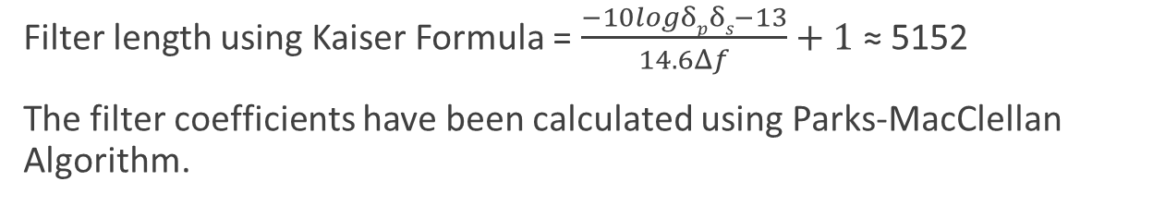
Example: Straightforward Approach
Filter length using Kaiser Formula = $\frac{−10logδpδs−13}{14.6Δf}+1$ ≈ 5152
The filter coefficients have been calculated using Parks-MacClellan Algorithm.
Filter length is very high.
There will be 5152*8000 = 41,216,000 multiplications per second (MPS).
And total storage requitement (TSR) for the filter coefficients is 5152

Slide 8
Reducing Computation
Computations will reduce if-
Filter length can be made low.
Not all indexes are computed and the others are skipped.
Filter length can be made lower using larger transition band.
And some indexes can be skipped due to downsampling.
This idea leads to downsampling of the signal.

Slide 9
The Effect of Downsampling
During downsampling some values are discarded. For example, if downsample factor is M, then in every consecutive M samples, M-1 samples are discarded. Hence, during filtering only the samples that will appear in the downsampled signal are needed to be computed.

Slide 10
FIR or IIR filters?
IIR filters are, in general, computationally more efficient than FIR filters.
However, since values are discarded during downsampling we can use FIR filters to compute only the values that will appear in downsampled signal.
In IIR filter all the values has to be calculated as filter output because it works as a feedback system.
So, for multirate systems FIR filter is mostly preferred.

Slide 11
Single Stage Multirate System
In single stage implementation, let’s assume, filter length = N.
Then only calculating the values that will be present in the downsamples signal, MPS = N * Fs/M
Now, for upsampling, multiplication with zero is skipped. If the anti imaging filter is the same filter as H(z), then MPS = N * Fs/M
So, total multiplication per second = 2 * Fs/M for the whole system.
Fs
H(z)
Fs
↓M
Fs/M
↑M
Fs
Anti Imaging Filter
Fs

Slide 12
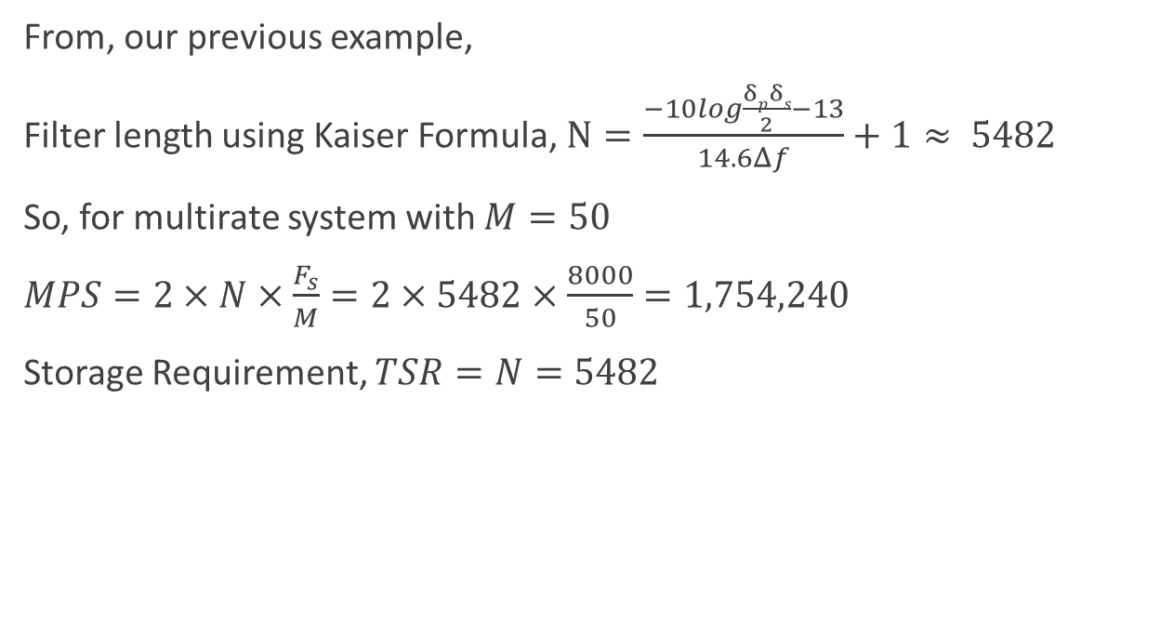
Example: Single Stage Multirate
From, our previous example,
Filter length using Kaiser Formula, $N=\frac{−10log\frac{δpδs}{2}−13}{14.6Δf}+1≈ 5482$
So, for multirate system with $M=50$
$MPS=2×N×\frac{F_{s}}{M}=2×5482×\frac{8000}{50}=1,754,240$
Storage Requirement, $TSR=N=5482$
Fs=8000
H(z)
Fs=8000
↓50
Fs=160
↑50
Fs=8000
50H(z)
Fs=8000

Slide 13

Multistage Multirate System
This is a multistage multirate system. And can achieve MPS and TSR,
$MPS=2\left(\frac{F_{s}}{M_{1}}×N_{1}+\frac{F_{s}}{M_{1}M_{2}}×N_{2}+…\right)$, where $N_{1},N_{2}$ are filter length
$TSR=N_{1}+N_{2}+…$
Fs
H₁(z)
Fs
↓M₁
Fs/ M₁
H₂(z)
Fs/ M₁
↓M₂
Fs/ (M₁ M₂)
↑M₂
Fs/ M₁
M₂ H₂(z)
Fs/ M₁
↑M₁
Fs
M₁ H₁(z)
Fs
Fs/ (M₁ M₂)

Slide 14
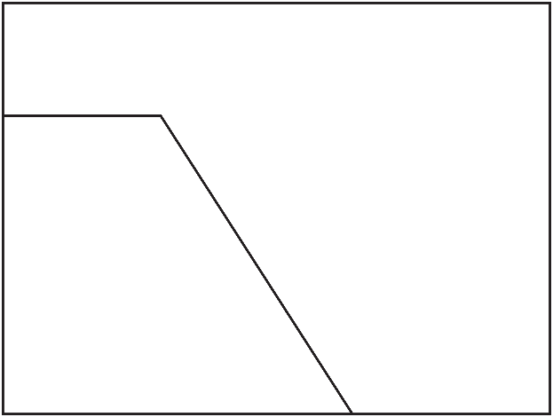

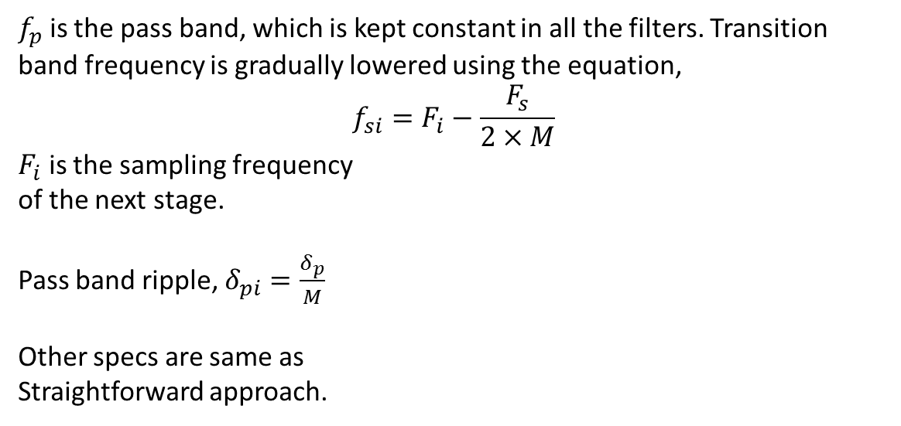

Selecting Filter Specs
$f_{p}$ is the pass band, which is kept constant in all the filters. Transition band frequency is gradually lowered using the equation,
$$f_{si}=F_{i}−\frac{F_{s}}{2×M}$$
$F_{i}$ is the sampling frequency
of the next stage.
Pass band ripple, $δ_{pi}=\frac{δ_{p}}{M}$
Other specs are same as
Straightforward approach.
1
Amplitude
$$f_{p}$$
$$F_{i}−\frac{F_{s}}{2×M}$$
Frequency

Slide 15
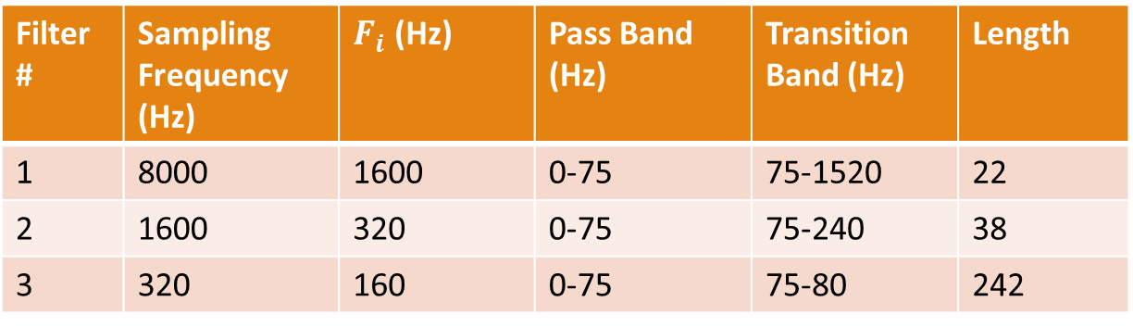
Example: Three Stage Filtering
Filter # | Sampling Frequency (Hz) | $F_{i}$ (Hz) | Pass Band (Hz) | Transition Band (Hz) | Length
1 | 8000 | 1600 | 0-75 | 75-1520 | 22
2 | 1600 | 320 | 0-75 | 75-240 | 38
3 | 320 | 160 | 0-75 | 75-80 | 242

Slide 16
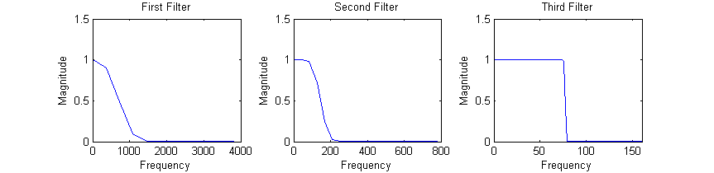

Example: Three Stage Filtering
$MPS=2\left(\frac{F_{s}}{M_{1}}×N_{1}+\frac{F_{s}}{M_{1}+M_{2}}×N_{2}+\frac{F_{s}}{M_{1}+M_{2}+M_{3}}×N_{3}\right)=172,160$
$TSR=N_{1}+N_{2}+N_{3}=302$

Slide 17
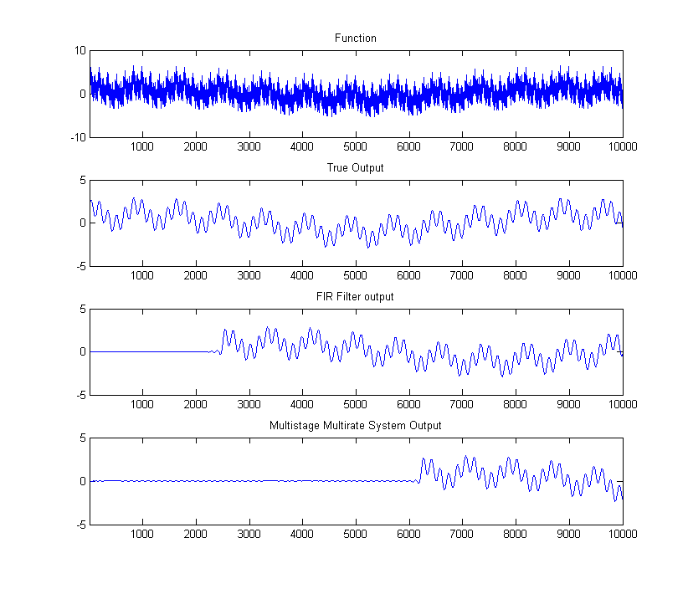
Example: Time Domain Output

Slide 18
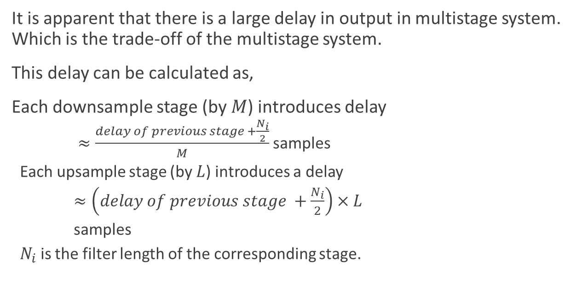
The Delay Tradeoff
It is apparent that there is a large delay in output in multistage system. Which is the trade-off of the multistage system.
This delay can be calculated as,
Each downsample stage (by $M$) introduces delay
$≈\frac{delay of previous stage +\frac{N_{i}}{2}}{M}$ samples
Each upsample stage (by $L$) introduces a delay
$≈\left(delay of previous stage +\frac{N_{i}}{2}\right)×L$
samples
$N_{i}$ is the filter length of the corresponding stage.

Slide 19
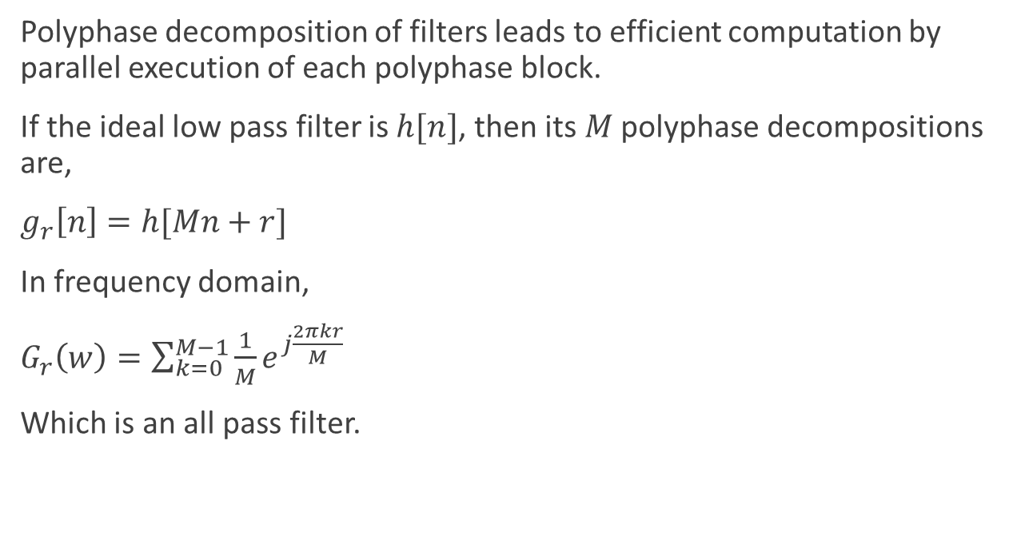
Polyphase Filters
Polyphase decomposition of filters leads to efficient computation by parallel execution of each polyphase block.
If the ideal low pass filter is $h[n]$, then its $M$ polyphase decompositions are,
$g_{r}\left[n\right]=h[Mn+r]$
In frequency domain,
$G_{r}\left(w\right)=\sum_{k=0}^{M−1}{\frac{1}{M}e^{j\frac{2πkr}{M}}}$
Which is an all pass filter.

Slide 20


Polyphase Structure
$$x[n]$$
↓M
G₀(z)
$$y[n]$$
+
z⁻¹
↓M
G₁(z)
z⁻¹
z⁻¹
↓M
G_{M-1}(z)

Slide 21
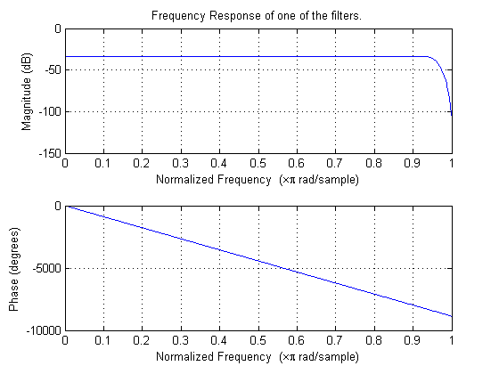

Example: Polyphase Implementation
For the example case, $M=50$
So, we achieve 50 decomposed filters.
In real all pass filters cannot be
achieved by real filters as they
have transition band.

Slide 22
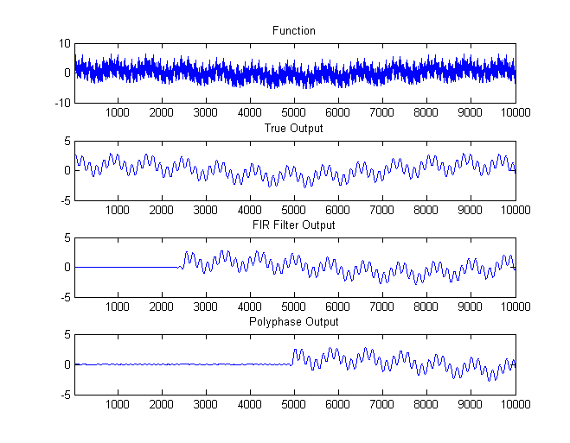
Example: Polyphase Implementation

Slide 23
Thank You!!!
Special thanks to
Dr. Kamrul Hasan
sir for giving us an opportunity to work on the problem.

