Slide 1
Presentation On Network Intrusion Detection Using Classical Supervised Machine Learning Techniques
Presented By:
Md. Tariqul Islam Shanta Bhuiyan Tapas Biswas
ID:151010400040 ID:13310193 ID:142010400014
Dept. of IT Dept. of IT Dept. of IT
Supervised By:
Md. Mynoddin
Lrcturer
Dept. of IT

Slide 2
Outline
Intrusion Detection
Types of IDS
Methodology
Approaches
Data Set Analysis
Experimental Result

Slide 3
What is an intrusion?
An intrusion can be defined as “any set of actions that attempt to compromise the:
Integrity
confidentiality, or
availability
of a resource”.
.

Slide 4
What is an intrusion Detection?
Intrusion Detection is the process of monitoring the events occurring in a computer system or network & analyzing them for signs of intrusion.

Slide 5
Attack Types of IDS
The simulated attacks are divided in four main
categories:
1) Denial of Service attack (DoS)
2) User to Root attack (U2R): Unauthorized access to local super user privileges, e.g., various ``buffer overflow'' attacks;
3) Remote to Local attack (R2L):Unauthorized access from a remote machine, e.g. guessing password;
4) Probing attack:Surveillance and other probing, e.g., port scanning.
Notes:
Buffer-overflow
Although it may occur accidentally through programming error, buffer overflow is an increasingly common type of security attack on data integrity. In buffer overflow attacks, the extra data may contain codes designed to trigger specific actions, in effect sending new instructions to the attacked computer that could, for example, damage the user's files, change data, or disclose confidential information. Buffer overflow attacks are said to have arisen because the C programming language supplied the framework, and poor programming practices supplied the vulnerability.
In July 2000, a vulnerability to buffer overflow attack was discovered in Microsoft Outlook and Outlook Express. A programming flaw made it possible for an attacker to compromise the integrity of the target computer by simply it sending an e-mail message. Unlike the typical e-mail virus, users could not protect themselves by not opening attached files; in fact, the user did not even have to open the message to enable the attack. The programs' message header mechanisms had a defect that made it possible for senders to overflow the area with extraneous data, which allowed them to execute whatever type of code they desired on the recipient's computers. Because the process was activated as soon as the recipient downloaded the message from the server, this type of buffer overflow attack was very difficult to defend. Microsoft has since created a patch to eliminate the vulnerability
Denial of Service
http://www.cert.org/tech_tips/denial_of_service.html
IP Spoofing
http://www.ciac.org/ciac/bulletins/f-08.shtml

Slide 6
Attack Types of IDS Contd.
Attack Types:
Host-based attacks
Gain access to privileged services or resources on a machine.
Data from sources internal to a computer .operating system level.
Network-based attacks
Make it difficult for legitimate users to access various network services.
Data from network traffic & packate streams.

Slide 7
IDS Categories
Intrusion detection systems are split into two groups:
Anomaly detection systems
Searching for something defined to be bad.
Detect attacks by observing deviations from the normal behavior of the system.
Misuse detection systems
Searching for rare or unusual.
Detect known attack using predefined attack patterns & signatures.
Notes:
Intrusion detection systems are split into two groups, anomaly detection systems and misuse detection systems. Anomaly detection is the attempt to identify malicious traffic based on deviations from established normal network traffic patterns [12, 27, 28, 29, 30]. Misuse detection is the ability to identify intrusions based on a known pattern for the malicious activity [18, 26]. These known patterns are referred to as signatures. Anomaly detection is capable of catching new attacks. However, new legitimate behavior can also be falsely identified as an attack, resulting in a false positive. Since most efforts so far have been targeted at network based systems our research will focus on network level systems. The problem with current state of the art is to reduce false negative and false positive rate (i.e., we wish to minimize “abnormal normal” behavior). At the same time, a real-time intrusion detection system should be considered. It is difficult to achieve both.

Slide 8
Problem Statement
Goal of Intrusion Detection Systems (IDS):
To detect an intrusion as it happens and be able to respond to it.
False positives:
A false positive is a situation where something abnormal (as defined by the IDS) happens, but it is not an intrusion.
Too many false positives
User will quit monitoring IDS because of noise.
False negatives:
A false negative is a situation where an intrusion is really happening, but IDS doesn't catch it.

Slide 9
KDD99 dataset
Designed for evaluation of intrusion in computer network
Includes a wide variety of intrusion simulated in a military network environment
KDD99 is the most used dataset in IDS & Machine Learning areas

Slide 10
Our Approach:
SVM Class Training
Testing
Class
Training
Data
Problem???
Testing Data

Slide 11
Our Approach:
Hierarchical
Clustering (DGSOT)
SVM Class Training
Testing
Class
Training
Data
Testing Data

Slide 12
System Model:
Composed of feature selection and learning algorithm.
Knowledge using the result found from the feature selection component.
Using the training dataset, the model gets trained and builds its intelligence.

Slide 13
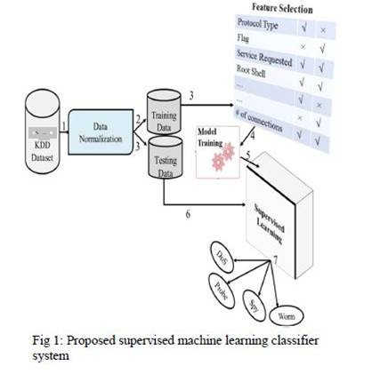
System Model Contd.

Slide 14
Support Vector Machine:
Support Vector Machines (SVM)
One of the most powerful classification techniques
Find hyper-plane that separates classes
Based on the idea of mapping data points to a high dimensional feature space where a separating hyper-plane can be found

Slide 15
SVM Limitations
Long training time limits its use
Clustering has a positive impact
Reduce training time
Degrade generalization -- we use a fewer number of points.

Slide 16
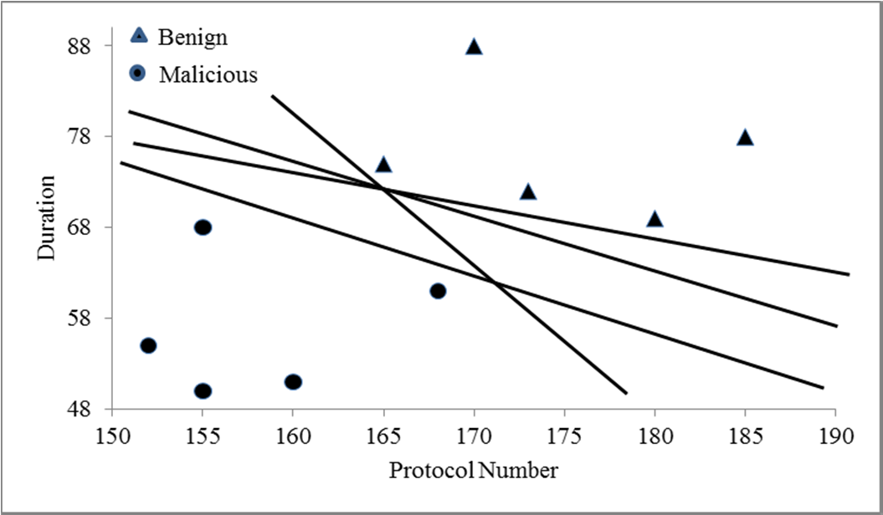
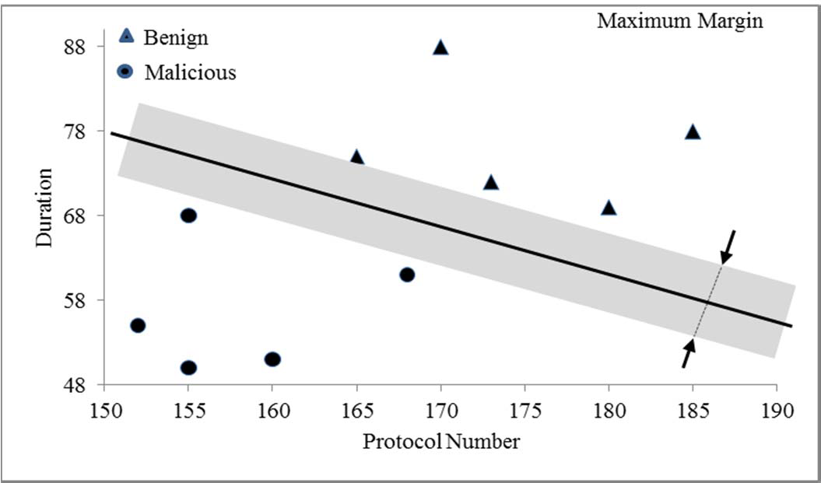
SVM Classifier in Two Dimensional Problem Spaces:

Slide 17
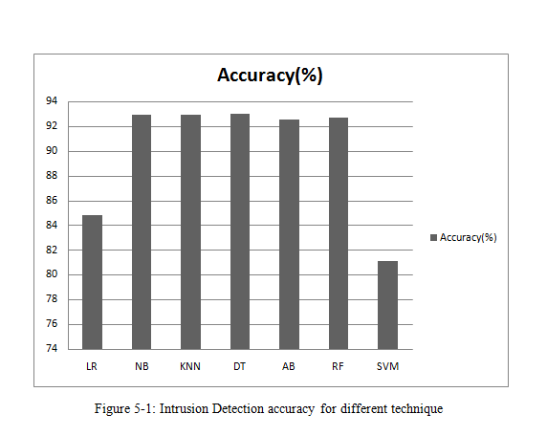
Training Set

Slide 18
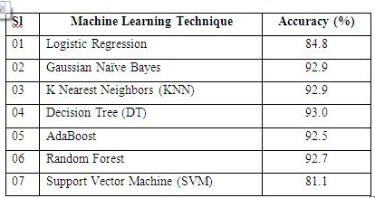
Results of Classification

Slide 19
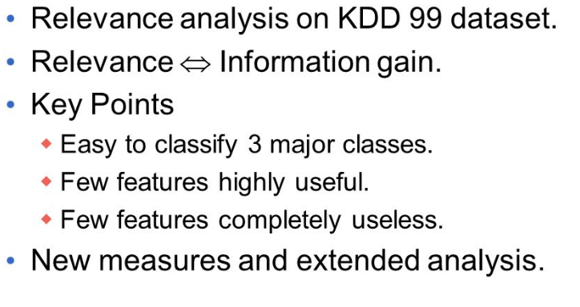
Conclusion

Slide 20
THANK YOU Any Question…???

