Slide 1
ICT1442 – FIBER OPTICAL TECHNOLOGY – OPTICAL SOURCES AND DETECTORS
Department of ICT
School Of Education, Humanity
And Social Sciences
EDEN UNIVERSITY

Slide 2
TOPIC 4
Optical Sources and Detectors
Light sources: LEDs and lasers
Photodetectors: PIN diodes and APDs
Performance characteristics and selection criteria

Slide 3
Optical Sources and Detectors - Introduction
In fiber optics technology, the efficiency and effectiveness of data transmission rely heavily on the quality of optical sources and detectors.
Optical sources convert electrical signals into light signals that travel through optical fibers, while optical detectors convert the received light signals back into electrical signals for processing.
The key components in these systems are light sources, such as LEDs and lasers, and photodetectors, such as PIN diodes and APDs.
Understanding the roles of these components and how they function is crucial for the design and optimization of fiber optic communication systems.

Slide 4
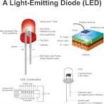
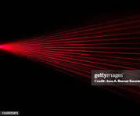
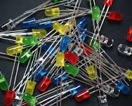
Light Sources
Light sources in optical communication systems are responsible for converting electrical signals into optical signals that can be transmitted through optical fibers.
The two most commonly used light sources are Light Emitting Diodes (LEDs) and Lasers.

Slide 5
Light Sources Cont.
Light Emitting Diodes (LEDs) - Principle of Operation:
LEDs generate light through the process of electroluminescence.
When a forward bias is applied to the semiconductor junction, electrons and holes recombine, releasing energy in the form of photons (light).
Key Characteristics:
Wavelength:
LEDs emit light over a broad spectrum, usually in the range of 850 nm to 1300 nm.
Output Power:
LEDs produce lower optical power compared to lasers, typically in the range of a few milliwatts.

Slide 6
Light Sources Cont.
Speed:
LEDs have slower response times, making them suitable for low to moderate data rate applications (up to a few hundred Mbps).
Cost:
LEDs are cost-effective and easy to manufacture, making them ideal for short-distance and cost-sensitive applications.
Applications:
Local Area Networks (LANs):
LEDs are commonly used in short-distance optical communication systems such as LANs, where cost-effectiveness and moderate data rates are prioritized.

Slide 7
Light Sources Cont.
Lasers – Principle of Operation:
Lasers generate light through the process of stimulated emission.
When a semiconductor material is excited by an electrical current, it produces a coherent and monochromatic beam of light.
Key Characteristics:
Wavelength:
Lasers emit light at specific wavelengths, typically in the range of 1310 nm to 1550 nm, which are optimal for long-distance transmission in optical fibers.
Output Power:
Lasers can produce high optical power, often ranging from a few milliwatts to several watts, depending on the type.

Slide 8
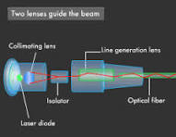
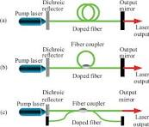
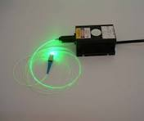
Light Sources Cont.
Speed:
Lasers have fast response times, making them suitable for high-speed data transmission (up to several Gbps).
Cost:
Lasers are more expensive and complex to manufacture, making them suitable for long-distance and high-performance applications.

Slide 9
Light Sources Cont.
Application:
Telecommunication Networks:
Lasers are widely used in long-haul telecommunication networks where high data rates and long transmission distances are required.
Undersea Communication Cables:
Lasers are used in undersea fiber optic cables where long-distance, high-capacity communication links are required, such as those connecting continents.

Slide 10
Photodetectors in Fiber Optics
Photodetectors are used to convert incoming light signals back into electrical signals.
The two main types of photodetectors used in fiber optics are PIN diodes and Avalanche Photodiodes (APDs).
PIN Diodes
Working Principle:
A PIN diode consists of an intrinsic (undoped) semiconductor layer between a p-type and an n-type semiconductor.
When photons hit the intrinsic layer, electron-hole pairs are generated, resulting in a current flow that represents the optical signal.

Slide 11
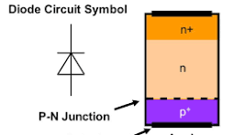
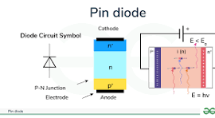
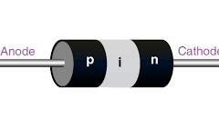
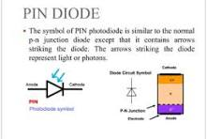
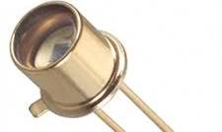
Photodetectors in Fiber Optics Cont.

Slide 12
Photodetectors in Fiber Optics Cont.
Characteristics:
Responsivity:
PIN diodes offer moderate responsivity, meaning they effectively convert incident light into electrical current.
Speed:
PIN diodes have high-speed response capabilities, making them suitable for high-data-rate applications.
Noise:
They have low noise characteristics, which is beneficial for maintaining signal integrity.
Cost:
PIN diodes are relatively inexpensive and are commonly used in a wide range of fiber optic applications.

Slide 13
Photodetectors in Fiber Optics Cont.
Application:
Optical Receivers in Fiber Optic Links:
PIN diodes are widely used in optical receivers for high-speed data communication in fiber optic networks, including both metro and access networks.
Avalanche Photodiodes (APDs)
Working Principle:
APDs function similarly to PIN diodes but include an internal gain mechanism.
When photons generate electron-hole pairs, the electrons are accelerated by a strong electric field, causing a cascade of secondary electron-hole pair creation, which amplifies the photocurrent.

Slide 14
Photodetectors in Fiber Optics Cont.
Characteristics:
Responsivity:
APDs have higher responsivity due to their internal gain, making them sensitive to low-level optical signals.
Speed:
APDs are also fast, suitable for high-speed communications, but with enhanced sensitivity compared to PIN diodes.
Noise:
APDs have higher noise levels due to the avalanche multiplication process, which can affect the signal-to-noise ratio.
Cost:
APDs are more expensive and require precise control over operating conditions, such as temperature and bias voltage.

Slide 15
Photodetectors Cont.
Application:
Long-Haul Optical Communication Systems:
APDs are used in long-haul optical communication systems, where signal strength may be low after traveling long distances, and high sensitivity is required for accurate signal detection.
PIN" in PIN diodes stands for P-type, Intrinsic, and N-type.
P-type: This is the positively doped semiconductor region where holes are the majority carriers.
Intrinsic (I): This is the undoped (pure) semiconductor region sandwiched between the P-type and N-type regions.
N-type: This is the negatively doped semiconductor region where electrons are the majority carriers.

Slide 16
Performance Characteristics & Selection Criteria
Choosing the right optical source and detector depends on various performance characteristics and the specific requirements of the fiber optic communication system.
Performance Characteristics of Light Sources
Wavelength:
The wavelength affects how light propagates through the fiber, with certain wavelengths experiencing less attenuation and dispersion.
For long-haul communications, 1310 nm and 1550 nm are typically used.
Optical Power:
Higher optical power is necessary for long-distance communication to compensate for attenuation in the fiber.

Slide 17
Performance Characteristics & Selection Criteria
Modulation Speed:
The required data transmission speed will dictate whether an LED or a laser is more appropriate.
Lasers are preferred for high-speed applications.
Spectral Width:
A narrow spectral width reduces chromatic dispersion in the fiber, making lasers more suitable for long-distance communication.
Performance Characteristics of Photodetectors
Responsivity:
High responsivity is critical for detecting low-power signals, which is essential in long-distance communication systems.
Speed:
High-speed detectors are required for systems with high data rate demands.

Slide 18
Performance Characteristics & Selection Criteria
Noise:
Low noise is important for maintaining signal quality, particularly in systems with low optical power.
Operating Voltage:
Lower operating voltage reduces power consumption and may simplify the design of the overall system.
Selection Criteria
Application Requirements:
For short-distance, low-cost systems, such as local area networks, LEDs and PIN diodes are often sufficient.
For high-performance, long-distance systems, lasers and APDs are preferred due to their superior performance characteristics.

Slide 19
Performance Characteristics & Selection Criteria
Cost Considerations:
The budget available for the system will influence the choice of components.
LEDs and PIN diodes are more cost-effective, while lasers and APDs provide better performance but at a higher cost.
Environmental Factors:
Consider the operating environment, as some components may require temperature stabilization or protection from environmental conditions, adding to the overall cost and complexity.
The choice of optical sources and detectors in fiber optics technology depends on a balance between performance, cost, and application-specific requirements.

