Slide 1
Android
Block-1
Unit-1

Slide 2
Introduction of Android:
Android is an open-source software stack for mobile devices that includes an operating system, middleware and key applications.
Google Inc. purchased the initial developer of the software, Android Inc (incorporated legally established as a corporation), in 2005.
Android's mobile operating system is based upon a modified version of the Linux kernel.
Google and other members of the Open Handset Alliance collaborated on Android's development and release.
The Android Open Source Project (AOSP) is tasked with the maintenance and further development of Android.
The Android SDK provides the tools and APIs necessary to begin developing applications on the Android platform using the Java programming language.

Slide 3
History of Android:
Android, Inc. was founded in Palo Alto, California, United States in October, 2003 by Andy Rubin, Rich Miner, etal. to develop, in Rubin's words "...smarter mobile devices that are more aware of its owner's location and preferences.“
Other early key employees include Andy McFadden, who worked with Rubin at WebTV, and Chris White, who led the design and interface of WebTV, before helping to found Android.
Rubin, a co-founder of Danger Inc., Miner, a co-founder of Wildfire Communications, Inc. and former vice-president of Technology and innovation at Orange, and the other early employees brought considerable wireless industry experience to the company.
Despite the obvious past accomplishments of the founders and early employees, Android Inc. operated secretively, admitting only that it was working on software for mobile phones.

Slide 4
History of Android:
Android Inc. acquired by Google
Google acquired Android Inc. in August, 2005, making Android Inc. a wholly-owned subsidiary of Google Inc. Key employees of Android Inc., including Andy Rubin, Rich Miner and Chris White, stayed at the company after the acquisition.
At the time of the acquisition, because little was known about the work of Android Inc., some guessed that Google was planning to enter the mobile phone market.
Development accelerates
At Google, the team led by Rubin developed a mobile device platform powered by the Linux kernel.
Google marketed the platform to handset makers and carriers on the premise of providing a flexible, upgradable system.
Google had lined up a series of hardware component and software partners and signaled to carriers that it was open to various degrees of cooperation on their part.

Slide 5
History of Android:
Speculation about Google's intention to enter the mobile communications market continued to build through December 2006.
Reports from the BBC and The Wall Street Journal noted that Google wanted its search and applications on mobile phones and it was working hard to deliver that. Print and online media outlets soon reported rumors that Google was developing a Google-branded handset.
Some speculated that as Google was defining technical specifications, it was showing prototypes to cell phone manufacturers and network operators.
In September 2007, InformationWeek covered an Evalueserve study reporting that Google had filed several patent applications in the area of mobile telephony.
Open Handset Alliance
"Today's announcement is more ambitious than any single 'Google Phone' that the press has been speculating about over the past few weeks.
Our vision is that the powerful platform we're unveiling will power thousands of different phone models."

Slide 6
History of Android:
On the November 5, 2007 the Open Handset Alliance, a consortium of several companies which include Texas Instruments, Broadcom Corporation, Google, HTC, Intel, LG, Marvell Technology Group, Motorola, Nvidia, Qualcomm, Samsung Electronics, Sprint Nextel and T-Mobile unveiled itself.
The goal of the Open Handset Alliance is to develop open standards for mobile devices.
On the same day, the Open Handset Alliance also unveiled their first product, Android, a mobile device platform built on the Linux kernel version 2.6.
On December 9, 2008, 14 new members joined, including PacketVideo, ARM Holdings, Atheros Communications, Asustek Computer Inc, Garmin Ltd, Softbank, Sony Ericsson, Toshiba Corp, and Vodafone Group Plc.
Licensing
With the exception of brief update periods, Android has been available under a free software / open source license since 21 October 2008.
Google published the entire source code (including network and telephony stacks) under an Apache License. Google also keeps the reviewed issues list publicly open for anyone to see and comment

Slide 7
Version history
Android has seen a number of updates since its original release. These updates to the base operating system typically fix bugs and add new features.
Generally each new version of the Android operating system is developed under a code name based on a dessert item.
The most recent released versions of Android are:
1.0, Released 23 September 2008
1.1, On 9 February 2009, Android 1.1 update for Android was released for T-Mobile G1 Only. Included in the update were ,Multiple resolved issues, API changes, Maps adds details and reviews,Screen timeout , longer when using speakerphone,"Show" & "Hide" Dialpad included in-call menu
1.5 (Cupcake), On 30 April 2009, the official 1.5 (Cupcake) update for Android was released, Bluetooth, A new soft-keyboard with text-prediction, Animated screen transitions

Slide 8
Features of Android
Application framework: enabling reuse and replacement of components
Dalvik virtual machine: optimized for mobile devices
Integrated browser: based on the open source WebKit engine
Optimized graphics: powered by a custom 2D graphics library; 3D graphics based on the OpenGL ES 1.0 specification (hardware acceleration optional)
SQLite: for structured data storage
Media support: for common audio, video, and still image formats (MPEG4, H.264, MP3, AAC, AMR, JPG, PNG, GIF)
GSM Telephony: (hardware dependent)
Bluetooth, EDGE, 3G, and WiFi: (hardware dependent)
Camera, GPS, compass, and accelerometer: (hardware dependent)
Rich development environment: including a device emulator, tools for debugging, memory and performance profiling, and a plugin for the Eclipse IDE

Slide 9
Why Android?
Google’s Android mobile phone software platform may be the next big opportunity for application software developers.
Google announced the Open Handset Alliance and the Android platform in November of 2007, releasing the first beta version of the Android Software Development Kit (SDK) at the same time.
Within a matter of a few months, over 1 million people had downloaded versions of the SDK from Google’s website.
In the United States, T-Mobile announced the G1 Android mobile phone in October of 2008, and estimates are that several hundred thousand G1s were sold before the end of that year.
There are already several competing mobile phone software stacks in the market, so why is there such interest in Android?
Android has the potential for removing the barriers to success in the development and sale of a new generation of mobile phone application software.
Just as the the standardized PC and Macintosh platforms created markets for desktop and server software, Android, by providing a standard mobile phone application environment, will create a market for mobile applications—and the opportunity for applications developers to profit from those applications.

Slide 10
Android Architecture
The main components of the Android architecture:
Applications
Application Framework
Libraries
Runtime Android
Kernel – Linux

Slide 11
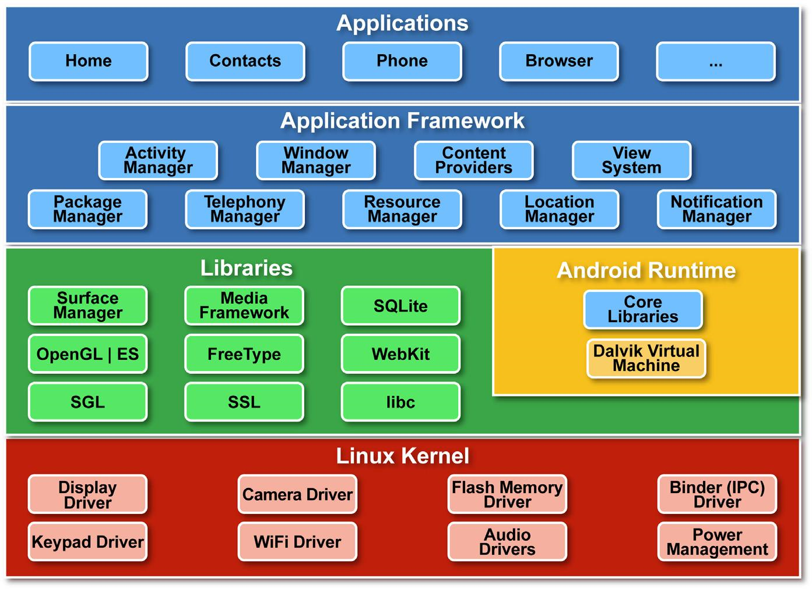

Slide 12
Linux Kernel
The basic layer is the Linux kernel. The whole Android OS is built on top of the Linux 2.6 Kernel with some further architectural changes made by Google.
It is this Linux that interacts with the hardware and contains all the essential hardware drivers.
Drivers are programs that control and communicate with the hardware. For example, consider the Bluetooth function.
All devices has a Bluetooth hardware in it. Therefore the kernel must include a Bluetooth driver to communicate with the Bluetooth hardware.
The Linux kernel also acts as an abstraction layer between the hardware and other software layers.
Android uses the Linux for all its core functionality such as Memory management, process management, networking, security settings etc.
As the Android is built on a most popular and proven foundation, it made the porting of Android to variety of hardware, a relatively painless task.

Slide 13
Libraries
The next layer is the Android’s native libraries. It is this layer that enables the device to handle different types of data. These libraries are written in c or c++ language and are specific for a particular hardware.
Some of the important native libraries include the following:
Surface Manager: It is used for compositing window manager with off-screen buffering. Off-screen buffering means you cant directly draw into the screen, but your drawings go to the off-screen buffer. There it is combined with other drawings and form the final screen the user will see. This off screen buffer is the reason behind the transparency of windows.
Media framework: Media framework provides different media codecs allowing the recording and playback of different media formats
SQLite: SQLite is the database engine used in android for data storage purposes
WebKit: It is the browser engine used to display HTML content
OpenGL: Used to render 2D or 3D graphics content to the screen

Slide 14
Android Runtime
Android Runtime consists of Dalvik Virtual machine and Core Java libraries.
Dalvik Virtual Machine
It is a type of JVM used in android devices to run apps and is optimized for low processing power and low memory environments.
Unlike the JVM, the Dalvik Virtual Machine doesn’t run .class files, instead it runs .dex files. .dex files are built from .
class file at the time of compilation and provides hifger efficiency in low resource environments. The Dalvik VM allows multiple instance of Virtual machine to be created simultaneously providing security, isolation, memory management and threading support. It is developed by Dan Bornstein of Google.
Core Java Libraries
These are different from Java SE and Java ME libraries. However these libraries provides most of the functionalities defined in the Java SE libraries.

Slide 15
Application Framework
These are the blocks that our applications directly interacts with. These programs manage the basic functions of phone like resource management, voice call management etc. As a developer, you just consider these are some basic tools with which we are building our applications.
Important blocks of Application framework are:
Activity Manager: Manages the activity life cycle of applications
Content Providers: Manage the data sharing between applications
Telephony Manager: Manages all voice calls. We use telephony manager if we want to access voice calls in our application.
Location Manager: Location management, using GPS or cell tower
Resource Manager: Manage the various types of resources we use in our Application

Slide 16
Applications
Applications are the top layer in the Android architecture and this is where our applications are gonna fit. Several standard applications comes pre-installed with every device, such as:
SMS client app
Dialer
Web browser
Contact manager
As a developer we are able to write an app which replace any existing system app. That is, you are not limited in accessing any particular feature.
You are practically limitless and can whatever you want to do with the android (as long as the users of your app permits it).
Thus Android is opening endless opportunities to the developer.

Slide 17
Android Application Components
These are the main Android Application Components:
Activities
Services
Content Providers
Broadcast Receivers
Intents
Activities
Activity is an individual user interface screen in an Android application where visual elements called Views (also known as widgets) can be placed and the user can perform various actions by interacting with it.

Slide 18
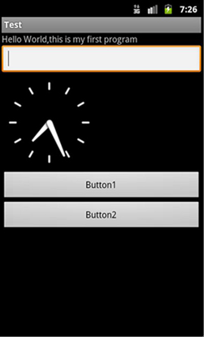
Consider the figure. The whole window gives the user an interface to interact with and therefore this complete screen makes an Activity.
The controls placed in the window allows the user to perform certain actions and are called Views or Widgets. In this example, there are five widgets, they are – TextView, EditText AnalogClock and two Buttons.
The widgets in an Activity can be created in two different ways, by pure java code and by adding XML code to define the UI.
The latter is always preferred. An application can have more than one Activity and each Activity operates independently, but can be linked to one another and each Activity you create must be defined in your application’s manifest file.
Each Activity in android will be subclass of Activity class defined in Android SDK.

Slide 19
Services
A service is an Android application component that run in background and has no visual UI. Services are used to perform the processing parts of your application in the background.
While the user is working on the foreground UI, services can be used to handle the processes that need to be done in the background.
A service can be started by another Android application components such as an activity or other services and it will continue to run in the background even after the user switches to another application.
Thus services are less likely to be destroyed by Android system to free resources, than Activities.
One typical example for the use of services is a music player application.
We can use an activity to select a music track from the SD card and to play it. When it starts playing, the user is able to open another applications and the music plays in the background.
This can be made possible only by the use of Android Services. The Activity that chooses the music track actually invokes a service that works in the background.

Slide 20
Then it will continue playing in the background even after the frontend activity gets destroyed.
At any time the user is able to come back to the activity and use the seek bar to seek the track, select another track, or end playback.
This means that the service and the Activity that invoked the service are not completely independent, instead the Activity is able to fully control the Service. Another example for a service is the downloading of file from the internet.
It should run in the background and continue downloading even after we switches to another applications.All Android services are implemented as a subclass of Service class defined in Android SDK.
There are two types of services in Android.
They are:
Unbound Services
Its a type of service which is not bounded to any components. Once started, it will run in the background even after the component that started the service gets killed. It can be run in the background indefinitely and should stop by itself after the operation its intended to carry out is completed.
Bound Services
Its bound to other components and runs only till the component to which it is bounded runs.

Slide 21
Content Providers
Content providers in Android provides a flexible way to make data available across applications. Suppose you are creating any type of data in your application
(For example consider you are creating a to do list in your application, then the list of things is a data) and you are storing it at any storage location, it may be in the data base, file system or in any online storage space.
Then through content providers other applications are able to query, access or even modify the data you’ve created, as long as your content provider allows it.
In a similar way you can access the data that other utilities have created, by using content providers. Example for content provider in Android is the contacts database.
The Content provider of contacts database allows other applications to query, read, modify, and write the contacts info.
Android comes with several other built in Content providers that we can use in our application. All content providers are implemented as a subclass of ContentProvider class which is defined in Android SDK.

Slide 22
Broadcast Receivers
Broadcast receivers are one of Android application components that is used to receive messages that are broadcasted by the Android system or other Android applications.
There are many broadcasts that are initiated by the Android system itself and other applications can receive by using Broadcast receiver.
Examples of broadcasts initiated by the system are:
1. Warning that the battery is getting low
2. Screen turned off
3. Change of time zone
4. The camera has been used to take a picture
While programming, we can use Broadcast receivers to receive these broadcasted messages and behave accordingly. Applications can also initiate broadcasts.
We can initiate as many broadcasts as we want and there’s no limits for that.

Slide 23
Intents
Actually intents are not one of Android application components, instead it is the component activating mechanism in Android.
It constitutes the core message system in Android and defines a message to activate a particular component. For example, if you want to invoke a new activity from your current activity, you need to fire an intent specifying the new activity.
And if you want to start other application from your activity, then also you need to fire an intent. That is by firing an intent, you are telling the Android system to make something happen.
There are two types of Intents in Android:
Explicit Intents:
In explicit Intent, we are highly specific. We specify which activity should get active on receiving the intent. These are usually used for application’s internal communications.
Implicit Intents:
In implicit Intent we are sending a message to the Android system to find a suitable Activity that can respond to the intent. For example, to send an e-mail, we can use an intent. We will also specify the data to be operated on, with the intent. On receiving the Intent, Android system will invoke an Activity which is able to send e-mail messages with the data that we specified. If there is more than one activity is capable of receiving the Intent, the system presents a chooser to the user so that he can select which Activity/Application should handle it.

