Slide 1
Country Information Bot
Learn About Countries
Tarlan Soltanov

Slide 2

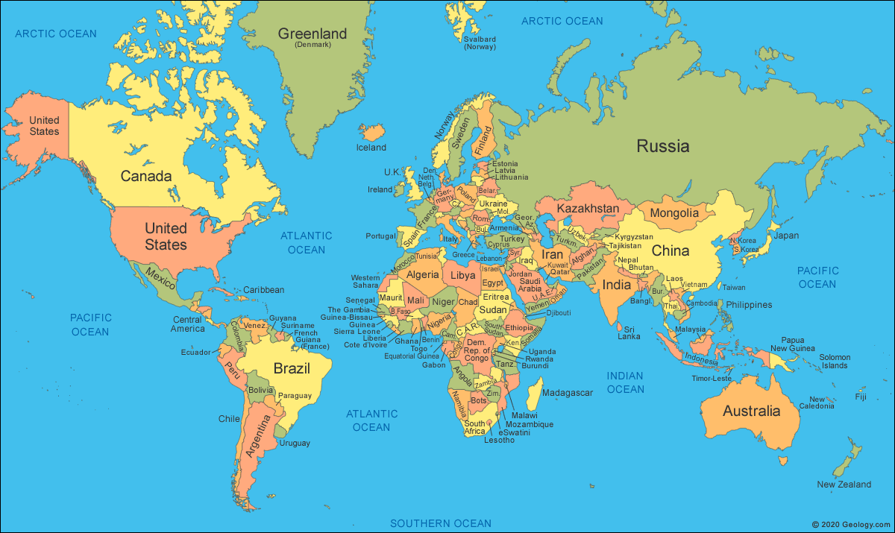
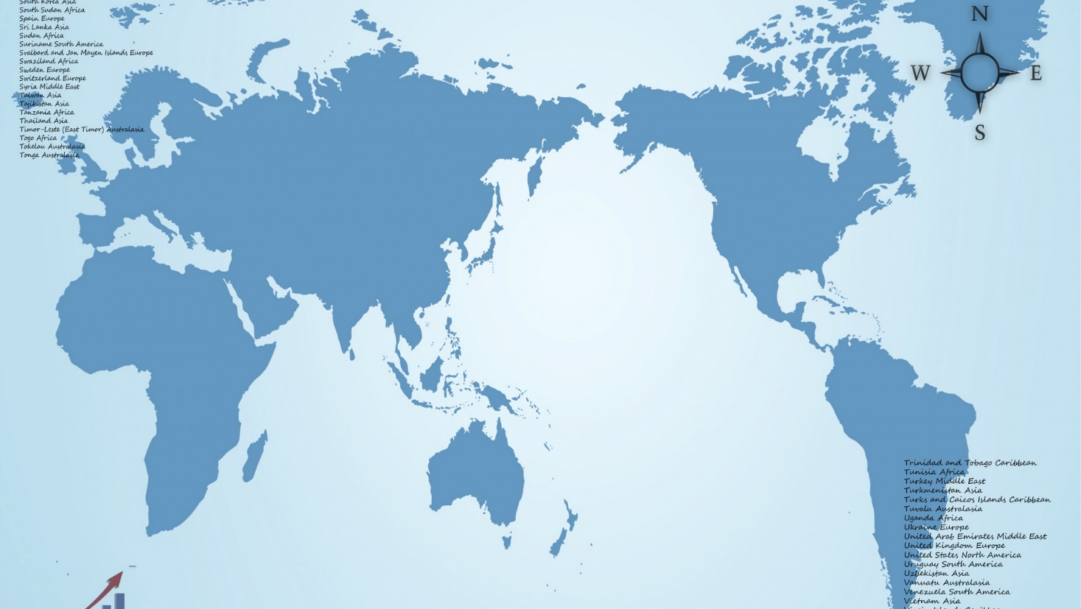
The idea
There are a lot of information about countries and there is different websites for every kind of information. Idea is bringing together all of this information in one place.

Slide 3

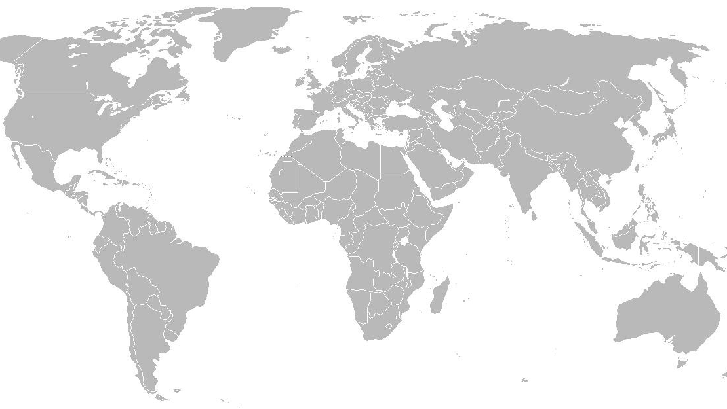
The Result
The result of the idea is creating a telegram bot for getting information about countries. You can get any information about a country in the bot. Name, Flag, Coat Of Arms, Currency, Language and etc. Also there is different kind of population detail graphs.

Slide 4
Interface

Slide 5

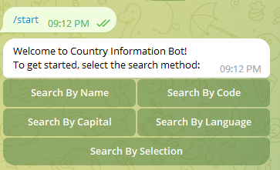
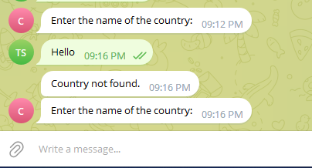
Searching
There is different searching methods for finding country information. You can search by name, capital, ISO 3166-1 alpha code (example : POL), Language and Selection
For the first 4 options (Name, Code, Capital and Language) you have enter a text to search
And if you didn’t enter correct value it asks you again to enter correct value

Slide 6
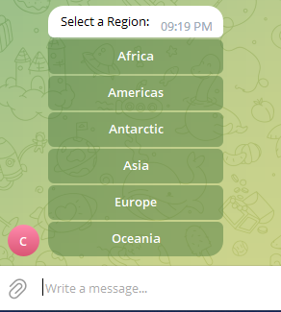
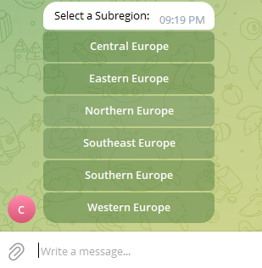
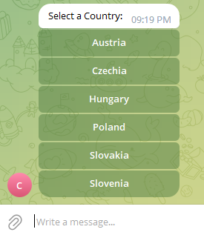
Search By Selection
In this search method, unlike other methods, you only have to know geographical location of the country to get the data.
First, you have to select a region:
Then you have to select a subregion:
And finally, you have to select the country.

Slide 7
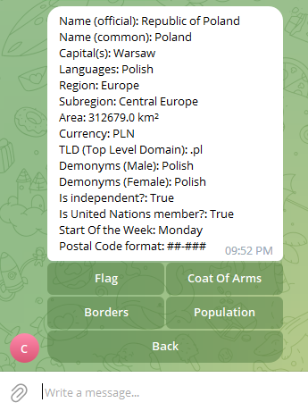
Country Info
When you find the country you were searching for, you see a lot of information about it in this kind of screen.
Here we have the information like:
Official name
Common Name
Capital cities
Languages
Region
Subregion
Area
Currency
Top Level Domain
Demonyms for Male and Female
Is independent country or not
Is it member of United Nations
Start Day of The Week
Postal Code format
Also We have menu for other kind of informations

Slide 8
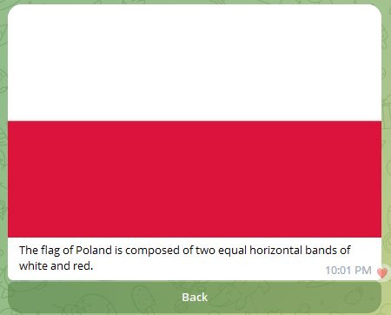

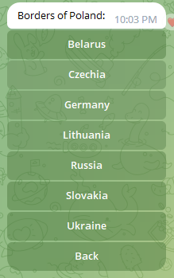
Detailed Information
And also we can see information like:
The Flag of country
Coat Of Arms
Border Countries

Slide 9
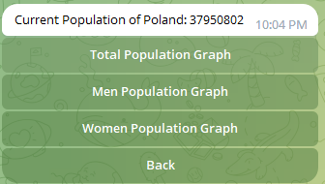
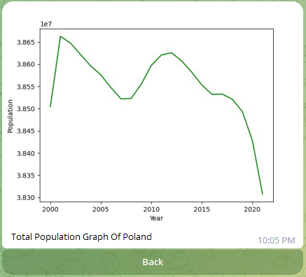
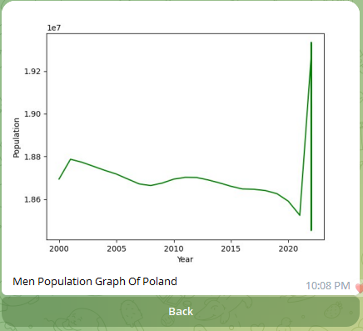
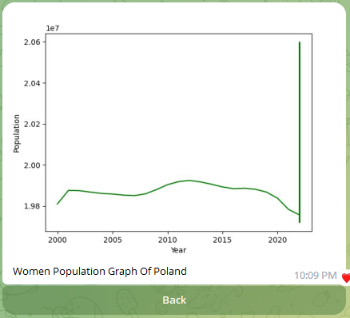
Statistical information
Also we can see statistical population information:
The Population
Total Population Graph
Men Population Graph
Women Population Graph
Note: This Statistical data is taken from Official website of UN : https://population.un.org/

Slide 10
Future Plans
This result is only a normal version of the idea and it can be improved in many ways in the future. Many Graphical data and other kind of Country Information can be added to the bot. At this this stage this is a version that I can think of and I am always open to ideas that can improve this project

Slide 11
Thank you for your attention!
I am happy to answer any questions

