Slide 1
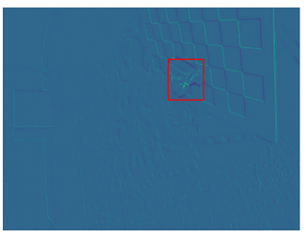

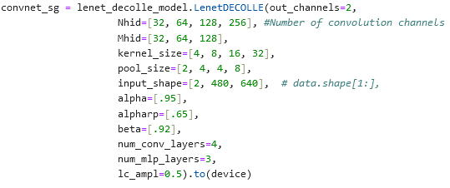
Last Week: EVIMO For Image Classification
EVIMO Data: (703, 2, 480, 640)
Using just 1 sequence
703 total bins, 5000 microseconds each
Using 5000 because masks used to see if object in frame are generated at rate corresponding to 703 bins
Labels for Image Classification:
Assigning label of 1 if object in frame, 0 otherwise
Lenet-Decolle Model:
Increased model size to accommodate larger image sizes
Moved code over to desktop for GPU acceleration
Modified model & parameter initialization for new data dimensions
Previously (100, 100, 2, 28, 28)
Now (703, 2, 480, 640)
Model not yet exceeded 53.61% accuracy (after 40 epochs)

Slide 2
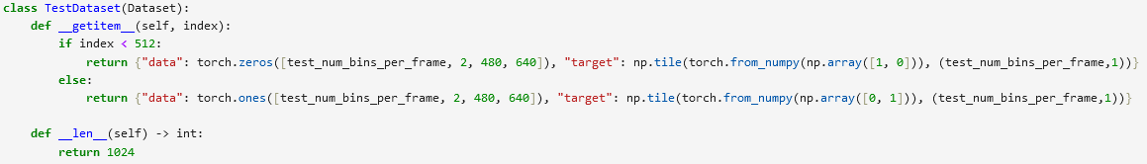
This Week
Further modified EVIMO data for input into model
Splitting each frame into bins
EVIMO now of format: (Frames/batch size, Bins per frame, p, x, y)
NMNIST data of format: (T, batch size, p, x, y)
Fixed alignment of frames in dataset
EVIMO frames are not all same length
Set up test dataset
50% all 0’s, 50% all 1’s
Model accuracy still not improving
Highest accuracy ~55%

Slide 3


EVIMO For Image Classification, 10/31
EVIMO Image Classification works & trains
Accuracy ~90% after 1 epoch for 2 label classification
Using NMNIST Data:
Found I was using too few bins per frame for EVIMO data
Was using 4, found 16 worked well, 100 was too many
Updated EVIMO data storage process
Significantly sped up data load time, allowing faster training
~12 min epoch
Previously:
Now:

Slide 4
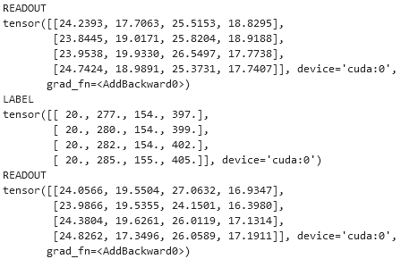
EVIMO for Object Detection 11/7
Should be able to get both bounding boxes and class from one model
Single Shot MultiBox Detectors able to model object detection as regression/classification program
Preliminary tests of using bounding box as target:
Model unable to adjust quickly enough for the large values of x, y
During training, saw variations of up to 5 in readouts, when target bounding boxes have x, y of 300
Tried with several learning rates
May try adding Softmax loss
Updated model accuracy / error to be based on IoU

Slide 5
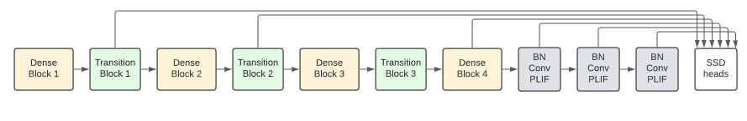
EVIMO for Object Detection 11/14
Updated event representation to Voxel Grid
Created SSD Heads for object detection model
Using same LIFLayer Conv2D from Lenet-Decolle Model
Working on using current Lenet-Decolle model as backbone for SSD Heads
Implementation of loss function for object detection model?

Slide 6
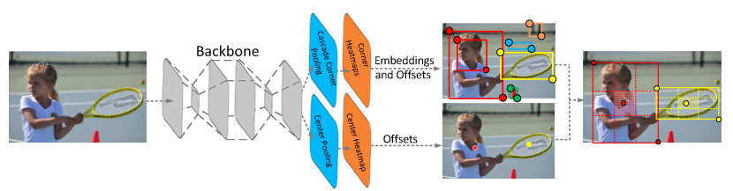
Alternate Object Representations 11/28
Current method:
Use bounding boxes (x, y, h, w)
Anchor boxes in model used to get final bounding box
Keypoint Triplets (CenterNet):
Use corners to determine object
Center point determines class
No anchor boxes
Cascade R-CNN:
Use bounding boxes
No anchor boxes
Model has sequence of detectors with increasing IoU thresholds to filter to best bounding boxes

Slide 7
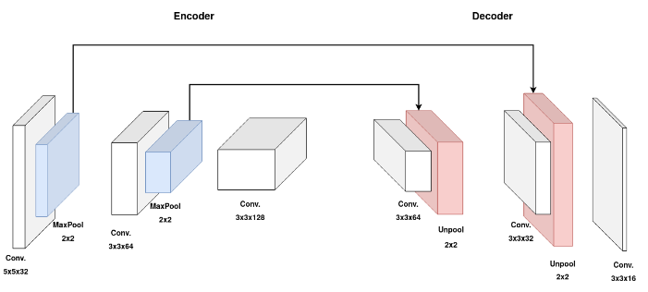
Potential Models for Obj Det 12/5
CenterNet (Keypoint Triplets):
Use corners to determine object
Center point determines class
No anchor boxes
Can predict multiple boxes
Paper used images
Encoder-Decoder DECOLLE:
Using bounding boxes
Only predicts one bounding box
Paper used events from rate-coded images

Slide 8
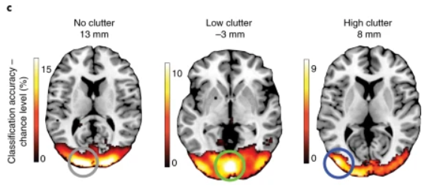
Human Object Perception 2/8
Object representations in the lateral occipital cortex
Representations are multimodal
Blind people show similar representations
Selective for object shape
Object location in ventral stream
Locations appear later in ventral stream in complex scenes
Recurrent processing
Locations may appear early in simple scenes
Next Steps:
Look into object embeddings
Look into adding multiple camera input to model
Notes:
Image segmentation on evimo with local rule learning

Slide 9
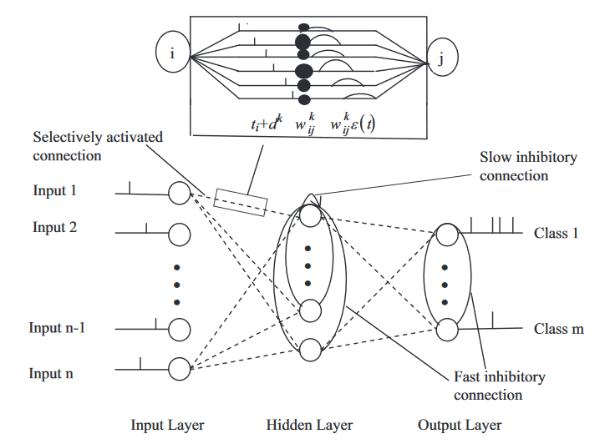
STDP for SNNs
Recent unsupervised STDP models able to achieve 98% accuracy on MNIST
Supervised STDP models can use global feedback without backprop
Potentially usable for initial training
Possible to add more neurons hidden layers based on timing thresholds
Would this be adjustable to neuromorphic devices?
Notes:
https://www.sciencedirect.com/science/article/pii/S0893608023003301#b51
https://www.sciencedirect.com/science/article/pii/S0925231214005785
Image segmentation: https://ieeexplore.ieee.org/document/9833331

Slide 10
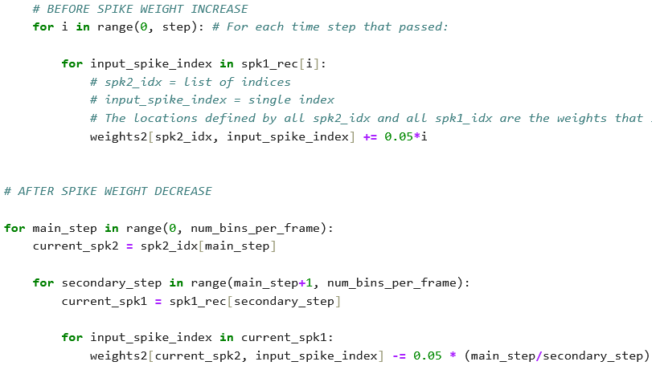
Adding STDP to snnTorch Model 3/28
Currently:
Code has both pre-spike weight increases & post-spike weight decreases
Code works for 1 layer case
Working on:
Generalizing code to each layer
Choosing better values for increases/decreases

Slide 11
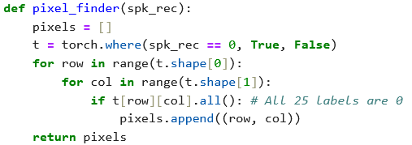
Continual Learning: Adding New Labels 4/4
Identifying pixels that did not spike for any of the current 25 classes
Plan to add new label and associated weights to model with low initial value but increase them with STDP
Notes:
Try train on some of the event dataset (from autonomous driving), subset of dataset try the continual learning tasks Try EVIMO with normal NN, not spiking, see accuracy and time (if no papers, try this first)

Slide 12
