Slide 1
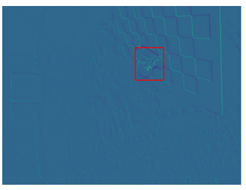

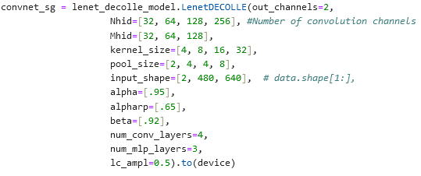
EVIMO For Image Classification
EVIMO Data: (703, 2, 480, 640)
Using just 1 sequence
703 total bins, 5000 microseconds each
Using 5000 because masks used to see if object in frame are generated at rate corresponding to 703 bins
Trimmed off first 285 bins to have equal number of labels
Labels for Image Classification:
Assigning label of 1 if object in frame, 0 otherwise
Lenet-Decolle Model:
Increased model size to accommodate larger image sizes
Moved code over to desktop for GPU acceleration
Modified model & parameter initialization for new data dimensions
Previously (100, 100, 2, 28, 28)
Now (703, 2, 480, 640)
Model not yet exceeded 53.61% accuracy (after 40 epochs)

Slide 2
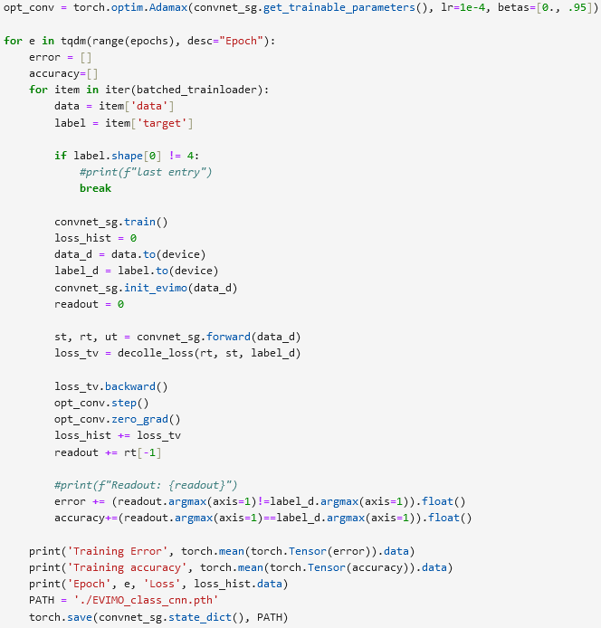
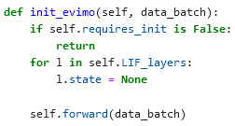
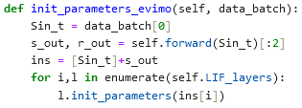
Next Steps
Expand/shrink training data
Increase learning rate
Train on if there is any object, instead of a specific one
Get first x ms of data from each bin/sequence, use that

