Slide 1
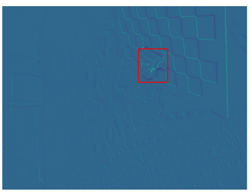

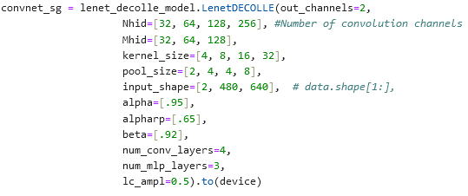
Last Week: EVIMO For Image Classification
EVIMO Data: (703, 2, 480, 640)
Using just 1 sequence
703 total bins, 5000 microseconds each
Using 5000 because masks used to see if object in frame are generated at rate corresponding to 703 bins
Labels for Image Classification:
Assigning label of 1 if object in frame, 0 otherwise
Lenet-Decolle Model:
Increased model size to accommodate larger image sizes
Moved code over to desktop for GPU acceleration
Modified model & parameter initialization for new data dimensions
Previously (100, 100, 2, 28, 28)
Now (703, 2, 480, 640)
Model not yet exceeded 53.61% accuracy (after 40 epochs)

Slide 2
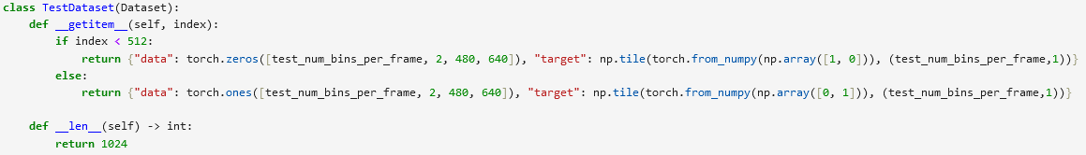
This Week
Further modified EVIMO data for input into model
Splitting each frame into bins
EVIMO now of format: (Frames/batch size, Bins per frame, p, x, y)
NMNIST data of format: (T, batch size, p, x, y)
Fixed alignment of frames in dataset
EVIMO frames are not all same length
Set up test dataset
50% all 0’s, 50% all 1’s
Model accuracy still not improving
Highest accuracy ~55%

