Slide 1
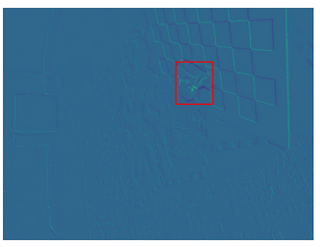

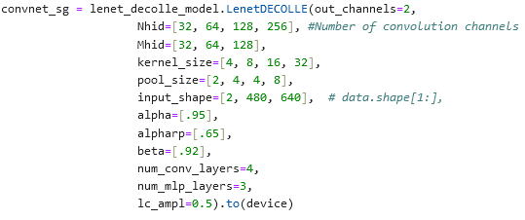
EVIMO For Image Classification
EVIMO Data: (703, 2, 480, 640)
Using just 1 sequence
703 total bins, 5000 microseconds each
Using 5000 because masks used to see if object in frame are generated at rate corresponding to 703 bins
Trimmed off first 285 bins to have equal number of labels
Labels for Image Classification:
Assigning label of 1 if object in frame, 0 otherwise
Lenet-Decolle Model:
Increased model size to accommodate larger image sizes
Moved code over to desktop for GPU acceleration
Modified model & parameter initialization for new data dimensions
Previously (100, 100, 2, 28, 28)
Now (703, 2, 480, 640)
Model not yet exceeded 53.61% accuracy (after 40 epochs)

Slide 2
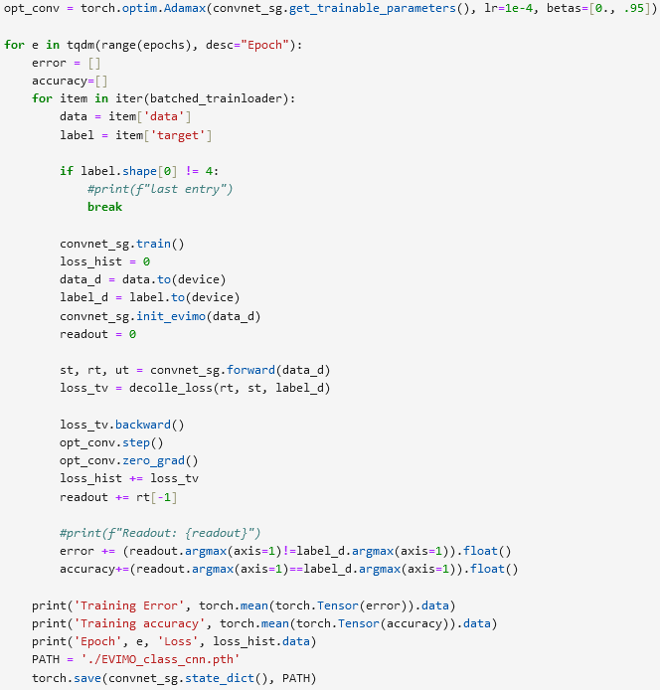
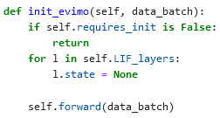
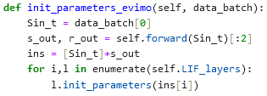
Next Steps
Expand training data
Only training on 418 bins currently
May generate masks at higher rates so that we can have more bins per sequence
Pull in more sequences of EVIMO data
Increase learning rate
Sanity check with different PyTorch model
Ensure I am preprocessing data correctly

