Slide 1
Knotweed Checker
Spot invasive Japanese knotweed from a phone photo
AI for Good, Hackathon 7: Eyes on Earth · Roboflow · SDG 15

Slide 2
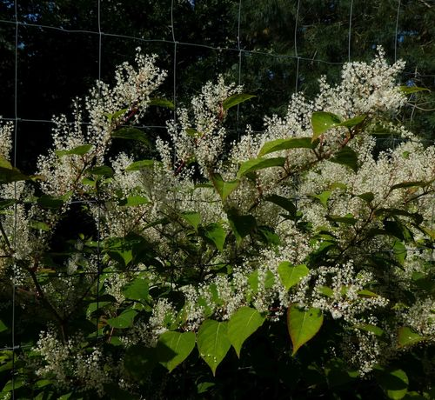
The problem
• Japanese knotweed pushes out native plants, can damage river banks and paving, and regrows from tiny root pieces
• Amsterdam set aside €8.2 million to fight it; Ameland and Heusden ask residents to report where it grows
• Patches are cheapest to remove when found early
• But most people cannot tell knotweed from look-alikes such as bindweed
Source: gemeente.nu, 2019, 'Strijdplan Japanse duizendknoop samen met inwoners'. SDG 15, target 15.8: invasive alien species.

Slide 3
Who it is for (and who not)
• For: residents and park volunteers in the Netherlands who see a suspicious plant and want to know in seconds whether to report it
• They have a phone, no botany knowledge, and little time
• Not for: municipal staff or contractors deciding whether to remove a plant; that needs an expert on site
• Not for: identifying other species

Slide 4
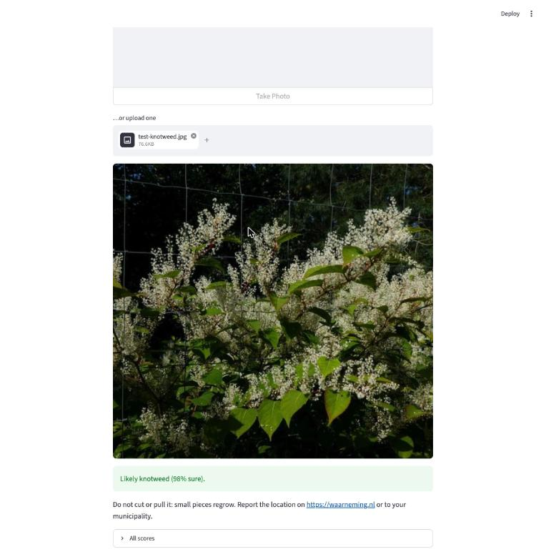
How it works
• 1. Take or upload a photo in the app
• 2. The app sends it to our Roboflow model: the step that decides 'knotweed or not'
• 3. 70%+ → 'Likely knotweed: don't cut it, report it on waarneming.nl'
• below 70% → 'Maybe: take a closer photo' · otherwise 'Probably not'
• Why not Google Lens? It gives a species name and stops. Ours answers 'should I report this?' and was tested on the look-alikes

Slide 5
Data and model
• 832 Dutch iNaturalist photos, community-confirmed species, Creative Commons licences (credits in sources.csv)
• 302 knotweed · 530 look-alikes: bindweed, Persicaria, Bistorta, Fallopia, bramble, nettle, ivy
• Bug we caught: iNaturalist's search mixed knotweed and bindweed, so ~70 photos had the wrong label
• Split by plant, not by photo (587 / 172 / 73), so the test never shows a plant the model already saw
• Roboflow classification, ViT model, training photos doubled with flips, rotations and brightness changes

Slide 6
Results on 73 photos it never saw
• 95% right overall (but always saying 'no' would already score 64%)
• Found 24 of 26 knotweed photos
• Wrongly flagged 2 of 47 other plants
• Both misses: young spring shoots (April, May)
• Worst mistake: a bindweed called knotweed with 98% confidence

Slide 7
Ethics: what could go wrong, and what we did
• Missed knotweed → patch keeps spreading (the expensive mistake)
• False alarm → someone cuts or poisons a harmless plant; cutting real knotweed spreads it
• What we did: 70% threshold with a 'maybe' zone; the app never tells you to remove anything, only to report it
• Every answer warns it can be wrong; we report missed knotweed, not just accuracy
• Photos go to Roboflow's servers, so don't photograph people or house numbers
• Next: test on our own spring photos; add spring and winter images

Slide 8
Live demo and what we learned
• Demo: upload a photo → answer in a few seconds
• Learned: the labels you scrape can be wrong; check them before training
• Learned: a high score can hide the mistakes that matter; count the misses
• What surprised us: OUR_OWN_LESSON

