Slide 1
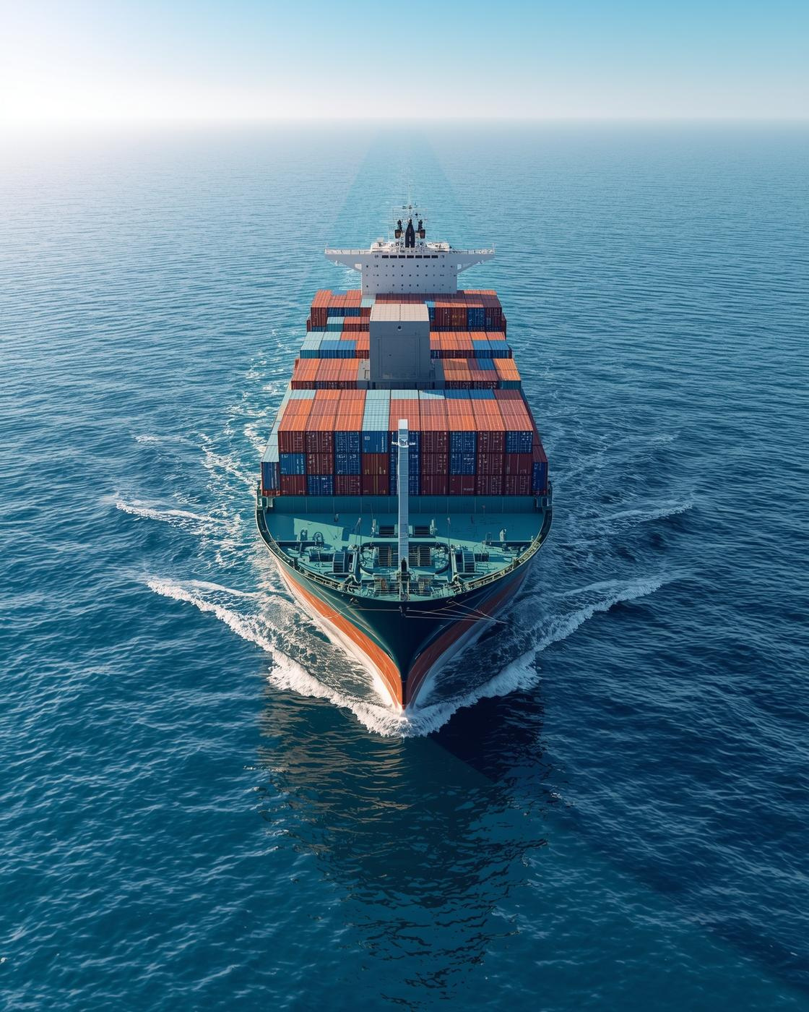
A.P Maersk GenAI Assignment
Assignment Overview
Presented by :-Tarun Naik

Slide 2

E-commerce Efficiency
Enhancing operational workflows and customer experience
The goal is to optimize processes within e-commerce platforms, resulting in faster deliveries, reduced costs, and improved customer satisfaction, ultimately driving sales and fostering loyalty in a competitive market.
INSIGHTS AND STRATEGIES
2

Slide 3

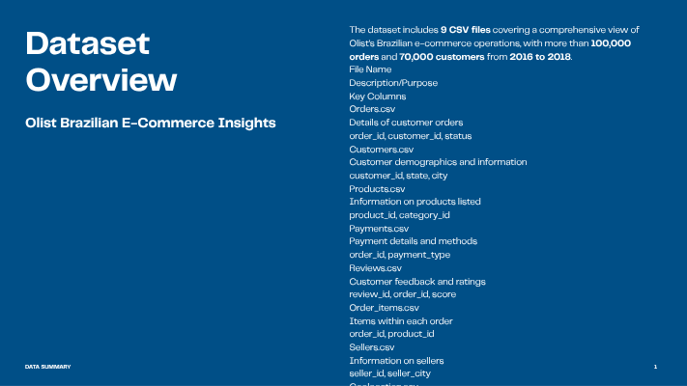
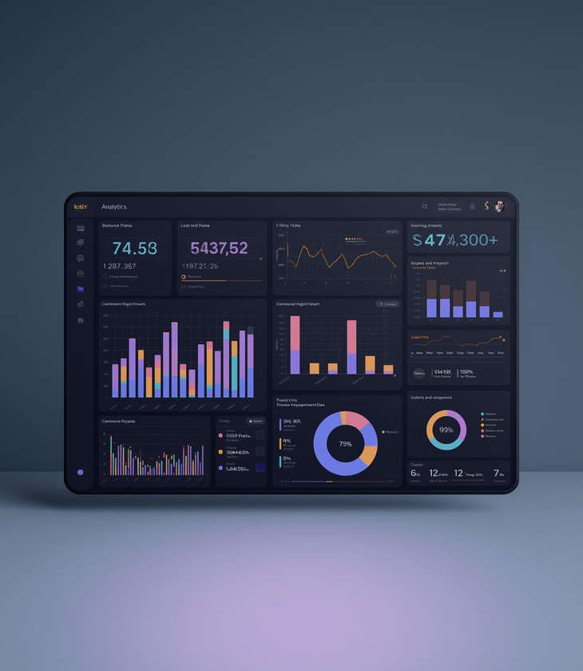
Olist Dataset Overview
3

Slide 4
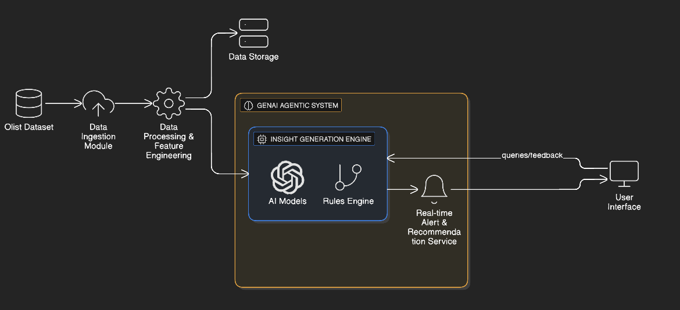
System Architecture
Overview of the design Architecture:-
5

Slide 5
Tech Stack Overview
Python
Streamlit
Pandas
Python serves as the core programming language, providing a versatile and powerful environment for developing the backend of the application, ensuring efficient data processing and algorithm implementation.
Streamlit allows for the rapid development of interactive web applications, enabling users to visualize data insights effectively while facilitating a smooth user experience with intuitive interfaces.
Pandas is utilized for data manipulation and analysis, allowing for efficient handling of large datasets, ensuring accurate data cleaning, transformation, and insightful exploration of e-commerce data.
OpenAI
Gemini
ChromaDB
OpenAI provides advanced AI models that enhance the application’s capabilities, enabling functionalities like natural language processing and machine learning to offer personalized user experiences and intelligent recommendations.
Gemini offers a robust framework for managing AI applications, integrating seamlessly with other technologies in the stack, enhancing the project’s scalability and overall performance for processing complex data.
ChromaDB supports the efficient storage and retrieval of data, ensuring that the application can quickly access necessary information, enhancing user interactions with responsive features and real-time data access.
4

Slide 6
GenAI Implementation
Overview of the framework components used
1️⃣ Objective
The goal of this system is to build an Agentic GenAI-powered analytics assistant capable of understanding natural language questions and providing accurate, data-backed insights from structured e-commerce datasets.
This makes analytics accessible to non-technical users by letting them “chat” directly with the data.
2️⃣ Core Implementation Workflow
The system is designed around five main stages:
Step 1: Data Ingestion & Preprocessing
All 9 CSV files from the Olist Brazilian E-commerce dataset are loaded into the system.
Data is cleaned using Pandas, removing nulls and ensuring consistent formats for merging and querying.
Each dataset (orders, customers, products, payments, etc.) is stored in memory for dynamic analysis.
Step 2: Intent Detection & Question Understanding
The user inputs a natural language query through the Streamlit interface.
The AI identifies intent categories such as payments, delivery, reviews, orders, sellers, etc.
Example: “Which payment method is most used?” → Intent detected: Payment Analysis.
Step 3: Data Linking & Query Execution
Based on intent, the relevant dataframes are automatically joined and filtered.
The system performs computations like groupby, sum, mean, or value_counts() to generate numerical results.
Example: For average order value → join order_items + products datasets, then compute mean(price).
Step 4: AI Reasoning Layer (Explainability)
A reasoning module generates step-by-step explanations of how the answer was derived.
This ensures transparency, where users see both the logic and the final insight.
Example Output:
“I found that credit_card was used in 76% of 100K+ payments across 2016–2018.”
6

Slide 7
Step 5: Insight Generation & Visualization
Final summarized insight is returned through the Streamlit UI.
Users see two panels:
  AI Explanation Panel – Natural language reasoning
  Final Answer Panel – Clean, highlighted result
Optional visualizations (charts/maps) can be integrated for deeper analytics.
System Flow (Architecture Summary) :-
User → Streamlit Frontend → GenAI Agent (Intent & Logic) → Pandas Engine → Dataset → AI Explanation + Answer → UI
5️⃣ Innovation Highlights
✅ Conversational Analytics — Query data in plain English.
✅ Agentic AI Logic — Uses reasoning before answering.
✅ Dataset-aware Insights — Pulls real numbers from CSVs, not assumptions.
✅ Explainable AI — Transparent step-by-step logic.
✅ Scalable Design — Easily extendable to other domains or APIs.
6️⃣ Conclusion
This GenAI-based agentic system demonstrates how structured e-commerce data can be transformed into human-like insights using AI.
It bridges the gap between data analytics and natural conversation, aligning perfectly with Maersk’s innovation goals in AI-driven automation.
7

Slide 8
Challenges & Future Enhancements
🚀 Future Development Roadmap
1️⃣ Integrate Large Language Models (LLMs)
Use APIs like Google Gemini or OpenRouter (GPT-4, Claude) to interpret complex natural language questions and provide deeper,
context-aware insights directly from the e-commerce dataset.
2️⃣ Add RAG (Retrieval-Augmented Generation)
Implement a vector database (e.g., ChromaDB or FAISS) to store embeddings of dataset summaries, enabling the AI agent to retrieve
the most relevant data segments before answering.
3️⃣ Interactive Visual Analytics Dashboard
Enhance the Streamlit interface with interactive charts and graphs (using Plotly or Altair) for real-time visual exploration
of order trends, payments, and customer demographics.
4️⃣ Conversational Memory and Personalization
Introduce session-based memory so the agent remembers previous user queries and tailors follow-up responses,
offering personalized analytical experiences.
5️⃣ Cloud Deployment & Scalability
Host the solution on Streamlit Cloud or AWS/GCP, integrate with a scalable backend (e.g., PostgreSQL),
and enable multi-user access with secure authentication.
8

Slide 9

Thank you
Website:-
https://www.maersk.com/

