Slide 1
1
Presentation skills
2
Opening speech
3
Introducing keynote speaker
目 录
CONTENTS
4
Keynote speech
5
Q&A session
6
Introducing laboratory
7
Closing speech

Slide 2
Presentation skills
Academic presentation is a prepared and formal talk given by a speaker in public.
It is a powerful way to transmit your message to an audience in a clear and structured way within a time limit.
An effective presentation usually includes the following parts:
1.Tell the audience what you are going to tell them (introduction)
2.Tell them (body/development)
3.Tell them what you’ve told them (conclusion)

Slide 3
During the presentation
3K principles
-Know your subject matter
-Know your audience
-Know yourself
Develop a theme/the purpose
Prepare the scripts
Select the proper visual aids
Plan your body & hand positions
Rehearse your presentation

Slide 4
3V aspects
-Verbal aspect
-Vocal aspect
-Visual aspect
Stay relaxed
Before the presentation
Dos
Do speak loudly, clearly, confidently and positively.
Do keep eye contact with the audience.
Do smile.
Do avoid technical jargon unless you’re sure it is familiar to the audience.
Do repeat where necessary to highlight your strong points.
Do give a strong ending by summarizing your best points.
Don’ts
Do not run overtime.
Do not overuse your body movement and hand gesture.
Do not speak towards the screen.
Do not disappear from the vision of your audience.
Do not ignore your audience.

Slide 5
Opening speech
The opening speech is a prelude to the conference, setting the keynote of the conference and telling the participants about the conference.
In the opening speech, the speaker would extend warm welcome to all participants, give thanks to the parties and individuals concerned, state the organizing background, characteristics and purpose of the conference, and finally express sincere wishes to all.
Points probably included in an opening speech
self-introduction (not necessary if you’ve already been introduced, mostly by the presider of the conference/session)
welcoming words to all the participants
thanks given to the organizations and individuals involved (optional)
significance or uniqueness of the conference
information about the background, contents, and purposes of the conference
good wishes to the conference and the participants

Slide 6
Introducing keynote speaker
Preparation
Ask the speaker what they’d like you to say.
job & position (title, duty, etc.) present job, work experience
academic background, academic qualifications (degree, university…), academic achievements (papers, books...), academic experiences (speeches, visits…), honors and awards
others (hobbies, interests…)
2. Find out what subject the speaker will cover.
3. Avoid using sensitive or embarrassing information without approval.
4. Find other speeches the speaker has given.
5. Include a surprising detail if it fits in your introduction.
6. Master pronouncing the speaker’s name.
7. Check for any special titles the speaker has

Slide 7
Keynote speech
1. What does keynote mean?
The keynote of a speech is the main theme of a speech or the part that is emphasized the most.
2. What is keynote speech / keynote address?
a speech setting forth the keynote, containing a central or the most important idea
3. What is a keynote speaker?
a very distinguished speaker introducing the meeting or its subject

Slide 8
How to conclude
It is very important to leave your audience with a clear summary of what you have presented.
It is also important not to let the talk just fizzle out. Make it obvious that you have reached the end of the presentation.
1. Summarize the main points again, using phrases like:
“To sum up...”, “So, in conclusion...”
2. Restate the purpose of your talk, and say that you have achieved your aim:
“My research aim is ... Now it should be clear that ...”
3. Give thanks to the audience, and invite questions:
“Thank you. Any questions?”

Slide 9
Present your main points one by one in logical order.
Pause at the end of each point (give people time to take notes, or time to think about what you are saying).
Make it absolutely clear when you move to another point. For example: “The next point is that …....”
Sum up what you have presented so that the audience are prepared for Question session.
pay attention to your body language when delivering a keynote speech.

Slide 10
If you are not using a microphone, speak sufficiently loudly so that the furthest member of your audience can hear clearly.
If you are using a microphone, speak at normal volume, but a little more slowly and distinctly
Break your distracting habits:
e.g. “uh”, “you know”, or put the hands in pockets, or jingle the keys too often without stop.
Never apologize for your nervousness:
If you don't advertise any weaknesses in your style or content, they probably won't be noticed.
Have a very clear structure:
A good technique is to tell your audience in advance what you are going to present.

Slide 11
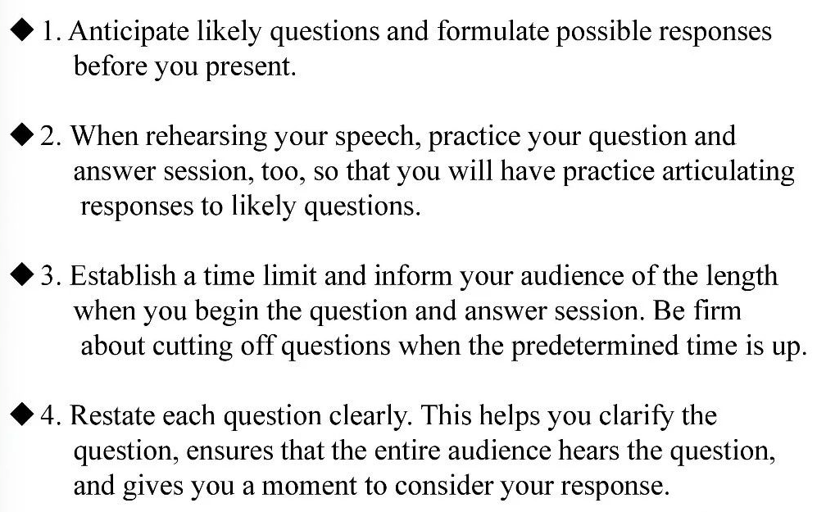
Q&A session

Slide 12
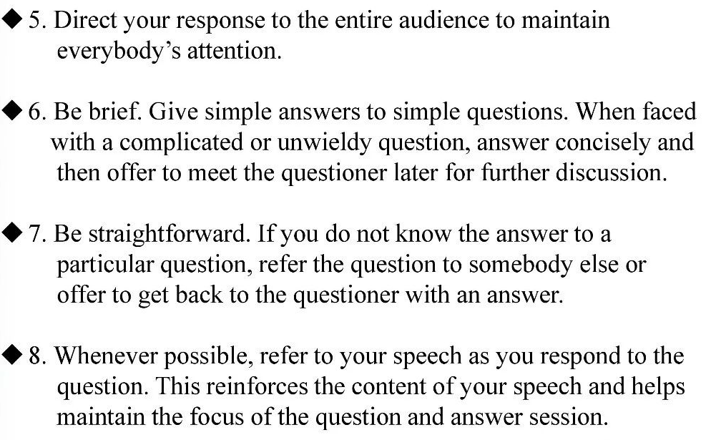

Slide 13
Introducing laboratory
Key elements in a speech introducing a lab
★History
★Location
★Organization
★Research
★Directors
★Achievements (some topics for discussion)
★A general introduction of the lab (big, advanced, world-first-class, newly equipped, spacious and bright, etc.
★When was it founded? (Why was it set up?)
★Compared with what you have today, what was it like at the very beginning? (size, apparatuses, equipment, functions, etc.)
★What kind of experiments can be done here in the lab?
★What kind of important/successful/influential experiments have been done here? And who is in charge of them?
★Are you satisfied with your lab? Why or why not?

Slide 14
Closing speech
At a closing session of an academic conference, the organizer or sponsor would deliver a closing speech, expressing thanks to all the people concerned, summarizing the accomplishments of the conference, commenting on the contributions of the conference, announcing the next conference, extending invitation to the participants and declaring the conference closed.
Paying compliments to the distinguished guests and all the participants
Expressing thanks to the participants, keynote speakers, chairpersons, distinguished guests, etc.
Congratulating on the success of the conference
Summarizing the contents and accomplishments of the conference
Inviting the participants to the next conference announced
Extending best wishes to the participants

Slide 15
Definition of Technical Communication
1
General communication vs. Technical communication
2
目 录
CONTENTS
3
Objectives of TC
4
Characteristics of TC
5
Brief introduction to ethics

Slide 16
Definition of Technical Communication
What is meant by “communication”?
the exchange of information, ideas, and knowledge between a sender and a receiver
Communication in oral or written form
What is meant by “Technical Communication”?
the process of making and sharing information and ideas in the workplace
a set of applications — the documents that are written.

Slide 17
GC vs. TC
What are the difference between general communication and technical communication?
General communication
Contains a general message
Informal in style and approach
No set pattern of communication
Mostly oral
Not always for a specific audience
involve no technical vocabulary or graphics, etc.
Technical communication
Contains a technical message
Mostly formal
Follows a set pattern
Both oral and written
Always for a specific audience
Frequently involves jargon, graphics, etc.

Slide 18
Objectives of TC
What are the objectives of technical communication?
To provide organized information that aids in quick decision-making
To invite corporate joint ventures
To disseminate knowledge in oral or written form

Slide 19
Characteristics of TC
What are the characteristics of technical communication?
correct
accurate
clear
appropriate
to the point
brief and arranged sequentially

Slide 20
Levels of communication
At what levels does communication take place?
Extra-personal communication（超人际沟通）
communication between human beings and non-human entities
Intrapersonal communication（内部沟通）
communication within an individual
Interpersonal communication（人际交往）
communication among people
Organizational communication（组织沟通）
communication in an organization at different hierarchical levels
internal-operational, external-operational, and personal communication
Mass communication（大众传播）
communication through mass media such as journals, books, television, newspapers

Slide 21
Flow of communication in an organization
How does communication flow in an organization?
horizontal/lateral communication
vertical communication
diagonal communication

Slide 22
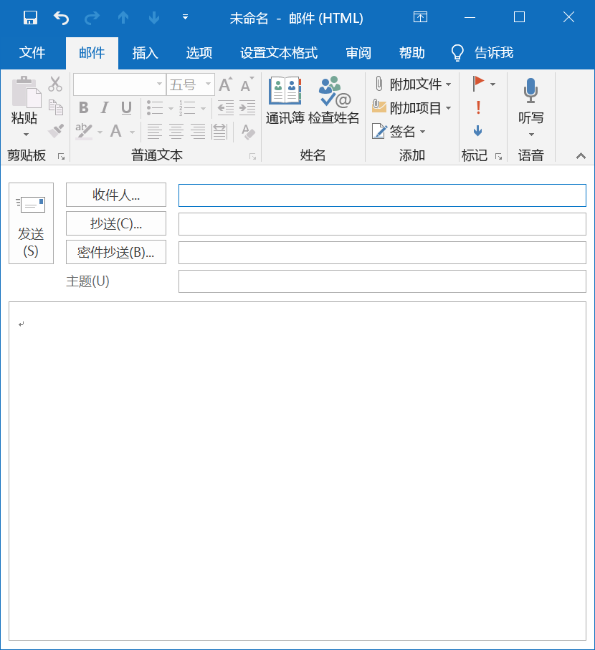
To
CC=courtesy copy
BC or BCC=blind courtesy copy
Subject
1. Suppose the team leader writes an email to all the members who have to read the mail, in which box should the writer put the members’ address?
2. Suppose the team leader writes an email to the monitor, he/she wants his/her members to know this, but he doesn’t want the monitor and his/her members to know that he/she also sends the email to the teacher, in which box should the writer put the monitor, his/her members and the teacher respectively?
To: All Members
To: Monitor
CC: All Members
BCC: Teacher

Slide 23
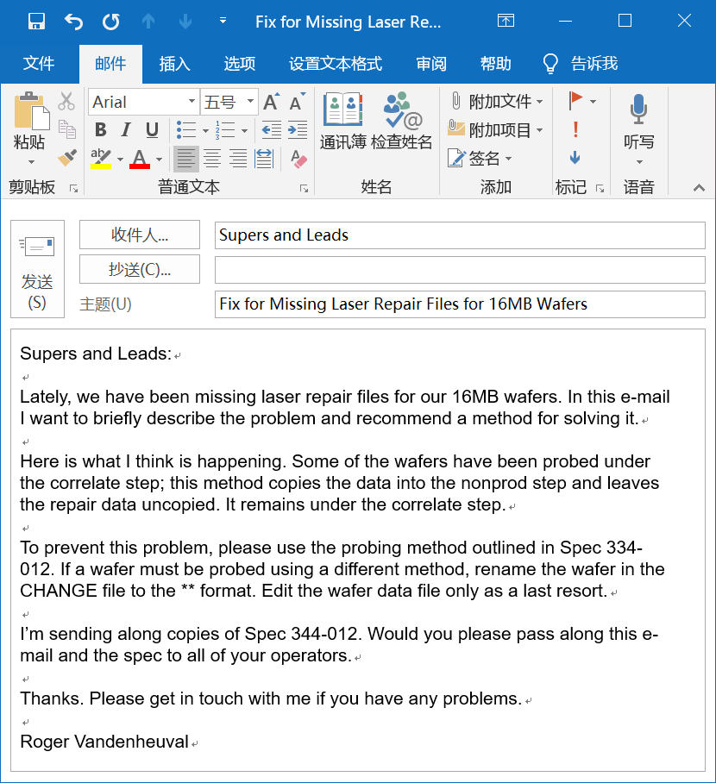
The subject line and first paragraph clearly state the writer’s purpose.
Double-spacing between paragraphs makes the e-mail easier to read.
The writer concludes politely.

Slide 24
Style, Structure, and Content
From: To: Cc: Bcc: Sent: Subject: Attachment:
Always take the time to consider the effect that the tone, style, grammar, and spelling of a mail may have on the recipient.
Header
salutation
Body
message
close
Name
Office title
Address
Phone number
signature
signature block

Slide 25

Lead-in
What are the Four important channels through which information flows within the various sections of an organization?
Face-to-face communication
Communication over telephone
Communication through email
Communication through an inter-office memo
What is the efficient way to reach so many people at so many levels at once in an organization?
MEMO

Slide 26
1
Definition and Functions
2
Classification of memos
目 录
CONTENTS
3
Purposes of Memos
4
Elements in a memo
5
Useful Tips to Prepare Memos

Slide 27
Definition of memo
a document frequently used in a company or an organization for internal communication to convey information and deal with business

Slide 28
Functions of memos
facilitate communication about various operations
help arrive at some quick decisions
help solve problems
enable the information to flow in 3 types of communication:
help bridge the communication gap
serve as permanent record of information

Slide 29
Classification of memos
Documentary memos
mainly used for conveying information
Congratulatory memos
Used to give credit to employees of an organization for outstanding work they have accomplished
Disciplinary memos
issued to the employees who violate the rules or breach the code of conduct in an organization, for which they will be served with a severe warning or any other punishment as decided by the management

Slide 30
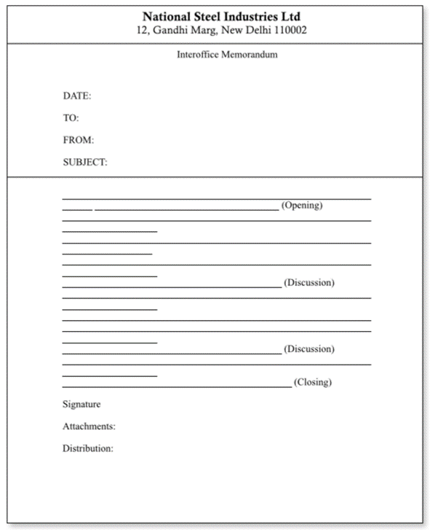
Name of the organization and address (printed)
Elements of a memo
(complete and current date)
(designation to the recipient)
(designation of the sender)
1. Heading
(what the memo is about)
2. Opening
3. Discussion
4. Closing
5. Signature
Optional

Slide 31
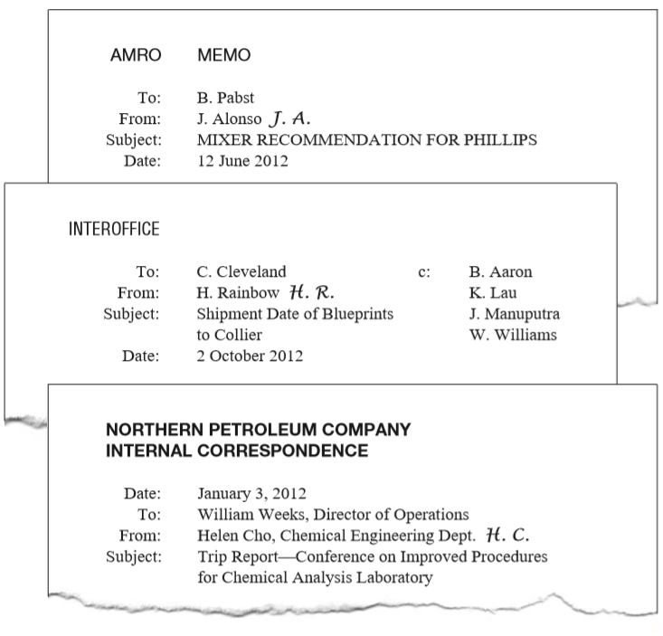
Write out the month instead of using the all-numerical format.
It should be specific but concise
in alphabetical order (from A to Z)
in descending order of organizational rank.
To show that they have reviewed the memo and accept responsibility for it

Slide 32
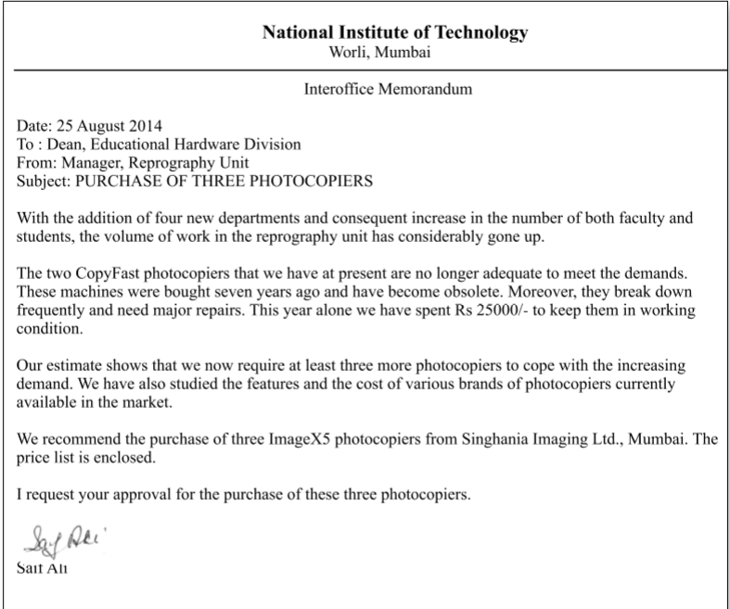
Sample memo 1
Read and analyze
Heading
background and problem
Reasons for the purchase
Request for the purchase
Recommendation for the purchase
Directive close
Signature
(written and printed)

Slide 33
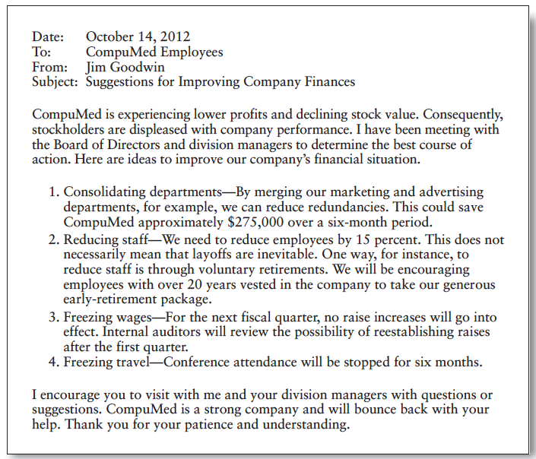
Revised version
MEMORANDUM
J G

Slide 34

Lead-in
Suppose you’re going to graduate from university and hunt for a job, what should you have to get ready in advance?
Résumé
Job application letter/cover letter
Photocopies of Certificates
Academic record/transcript
Recommendation form/letter
What can help the prospective employer to shortlist the candidates to be considered?
A well-prepared résumé

Slide 35
1
Résumé vs. Curriculum Vitae
2
Preparation for a Résumé
3
Types of Résumés
目 录
CONTENTS
4
Résumé Design and Structure
5
Element in a Résumé
6
Questions for Review

Slide 36
Types of Résumés
Chronological résumé（时间顺序）
Functional/skills résumé（功能/技能）
Hybrid/combination résumé（混合/组合）

Slide 37
Résumé Design and Structure
A résumé communicates in two ways:
through its content
through its appearance
What is the main purpose of the résumé?
to gain the opportunity for an interview.
A résumé should appear neat and professional.
Résumés must be informative and attractive.

Slide 38
Elements in a Résumé
While résumés can be organized in more than one way, they will almost always contain the same basic information.
Identifying information (personal/contact information)
Objectives or summary of qualifications (Career/professional objective)
Education (Educational/academic qualifications)
Employment history (Work experience /Professional and technical skills)
Interests and activities
References

Slide 39

Personal information
The first thing an employer needs to know is who you are and where you can be reached.
Make sure that the information allows an interested employer to reach you easily.
Full name
All letters or initial letters are capitalized
Address
A permanent postal address should be provided.
Phone number Home or cell phone is preferable.
Email address
Ensure that it sounds professional rather than frivolous.

Slide 40
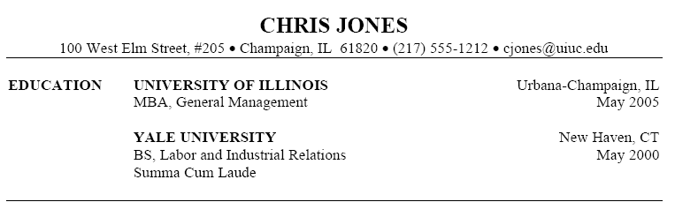
Educational/academic qualification
The degree earned + major and minor fields of study
The institution—identify it by its full name
The location of the institution. Include the city and state
The date of graduation—”Anticipated date of graduation”
Begin with the most recent education and work backward.

Slide 41
1
Writing Instructions
A
Defining Instructions
B
Designing a Set of Instructions
目 录
CONTENTS
C
Planning for Safety
D
Drafting Effective Instructions
E
Revising, Editing and Proofreading
2
Writing Manuals

Slide 42
Defining Instructions
Instructions are process descriptions written to help readers perform a specific task.
explain how to do something
explain how something happens

Slide 43
Planning for Safety
What is our most important responsibility when the subject we are writing about involves safety risks?
do everything we can to ensure our readers’ safety.
The best way to keep our readers safe is to be honest and write clearly.
If the readers will encounter safety risks, explain what those risks are and how to minimize them.
Protecting our readers’ safety is
a question of rights
a question of law
When writing safety information, be clear and concise; avoid complicated sentences.
Sometimes a phrase works better than a sentence.

Slide 44
Drafting Effective Instructions
Most set of instructions contain four elements:
Drafting Titles
simple and clear
Drafting General Introductions
The general introduction provides the preliminary information readers will need to follow in the instructions safely and easily.
Drafting Step-by-Step Instructions
Include graphics.
Do not omit articles (a, an, the) to save space.
Drafting Conclusions

Slide 45
Revising, Editing, and Proofreading Instructions
Revise, edit and proofread all the documents to make sure they are honest, clear, accurate, comprehensive, accessible, concise, professional in appearance, and correct.
When you write instructions, you should be extra careful for two reasons:
Your readers rely on your instructions to carry out the task.
Your readers rely on you to help them complete the task safely.
If possible, carry out usability testing on the instructions.

Slide 46
Writing Manuals
There is no absolute distinction between a set of instructions and a manual.
A manual includes much of the same sort of information found in a set of instructions.
The two share a main purpose: to explain how to carry out a task safely, effectively, and efficiently.
A set of instructions is typically shorter and more limited in its subject.
Manuals tend to be longer and more involved than instructions.
Both kinds of documents can include safety information.
The main difference between the two is that a manual has more elaborate front matter and back matter.

