Slide 1

Biró Barnabás
(Project Manager)
Taródi Benjámin István
Juhász Sándor Lorenzó
MADE BY

Slide 2
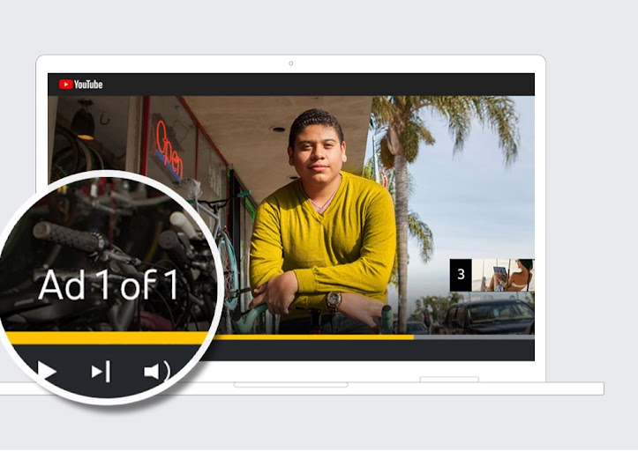
How did the idea come to do this as our project?
We were tired of watching annoying ads on YouTube
We wanted a platform which supports high quality video(4K) without any limitations
YouTube is collecting couple of unnecessary data from you
Missing PiP(Picture-in-Picture) mode, which would help multitasking

Slide 3
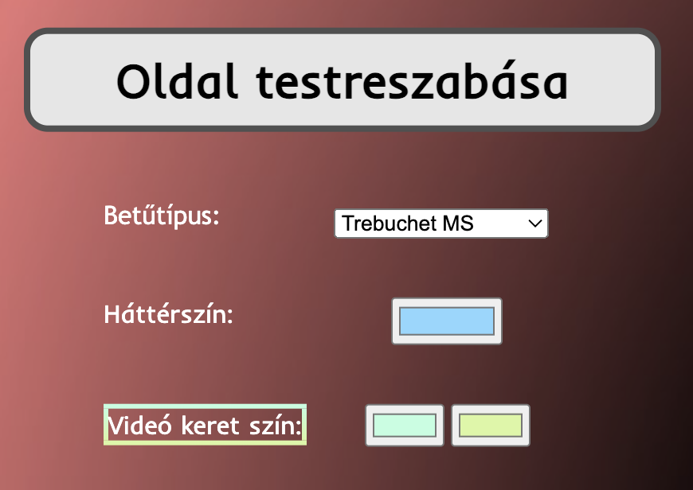
”Why is our platform better than YouTube?”
We can’t say it’s better, but there are a lot of great features our app includes
Our app supports up to 4K streaming with better FPS rates than YouTube or other platforms*
PiP (Picture-in-Picture) mode is available, which provides seamless watching experience while gaming or working as well
Ability to create playlists with favourite videos and with those you want to watch later
If you created a good style for your account, you can share it to the others for usage
And the best is: Our platform is AVOIDING ANNOYING ADS!!**
Nearly everything is easily customizable on our page, which customs are saved for your own account

Slide 4
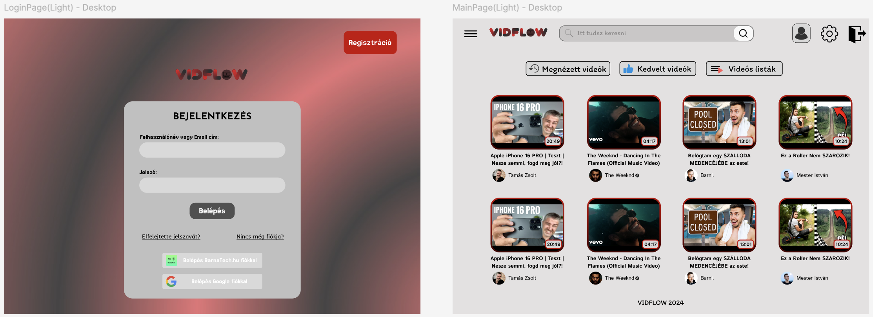
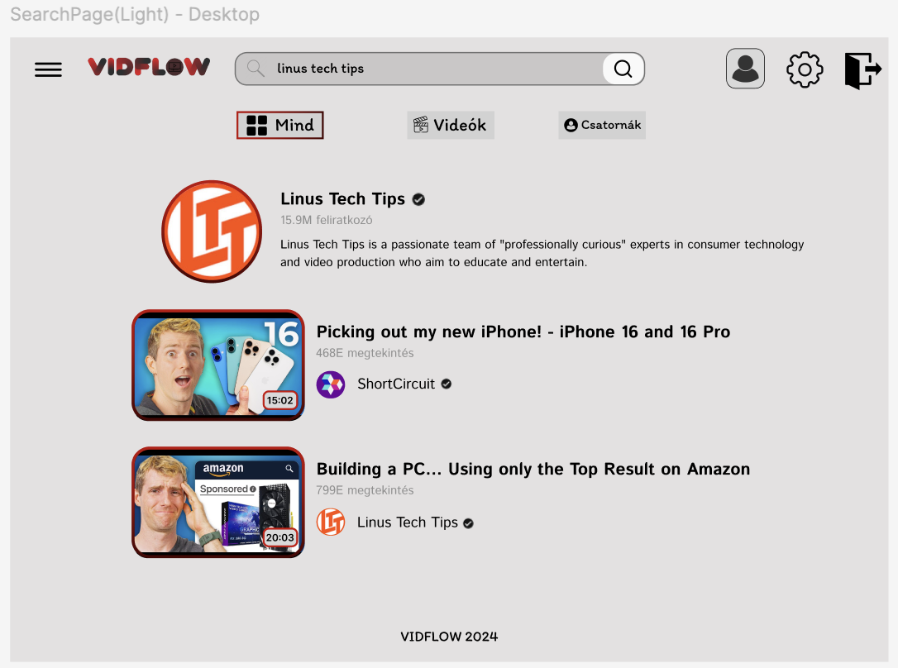
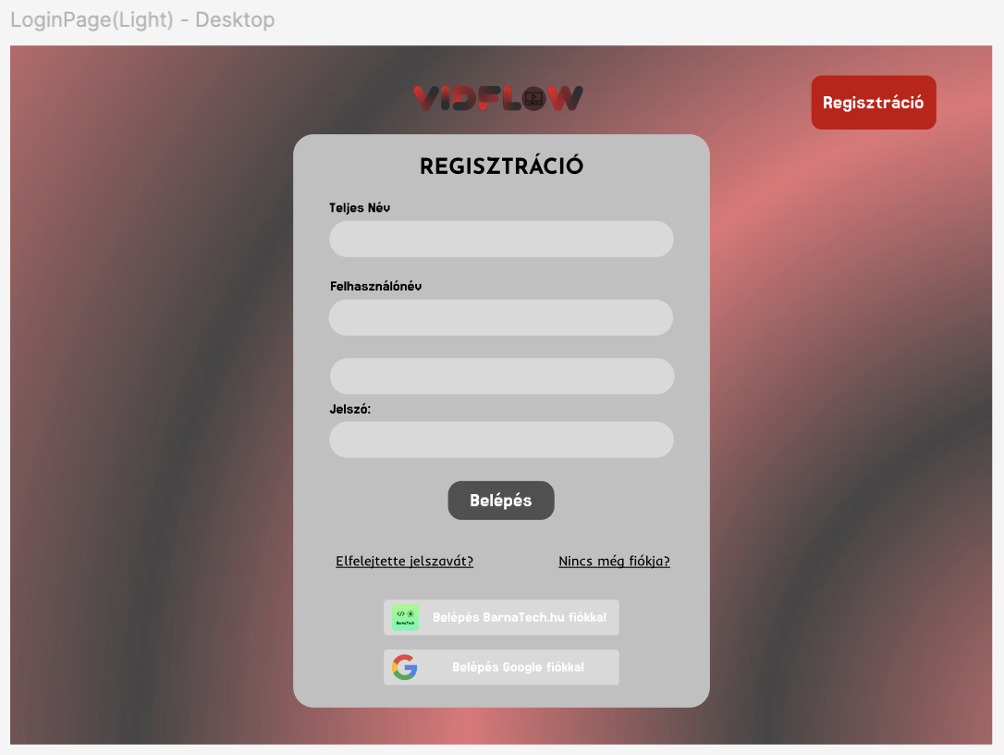
What were the plans? How we pre-designed the page?
Well, we’ve spent lot of time with the Figma creation of our project, but after all, we’ve created the same design as the final release going to look like at the end

Slide 5
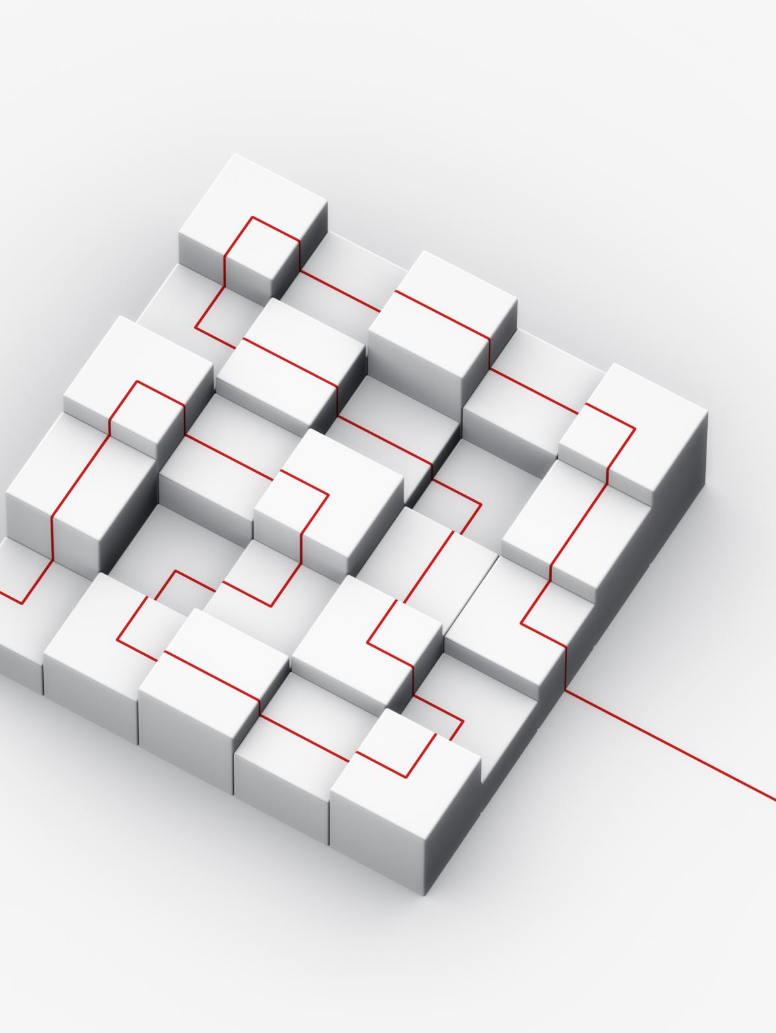
Our future plans for this enormous project
We would add the ability to share playlists, create joint playlists for 2 or more person
More outworked style options with extended number of elements to be able to customize
Embedding third-party logins into the site, like Google
(now login will work only through the site or with barnatech.hu account)

Slide 6

Wanna try out the product?
Here you go. Click on the link and take a look at the process of what we’ve done yet
https://vidflow.barnatech.hu
Thank you for the help from the following services that are used to make everything work:
youtube-dl, YouTube API, NordVPN

