Slide 1
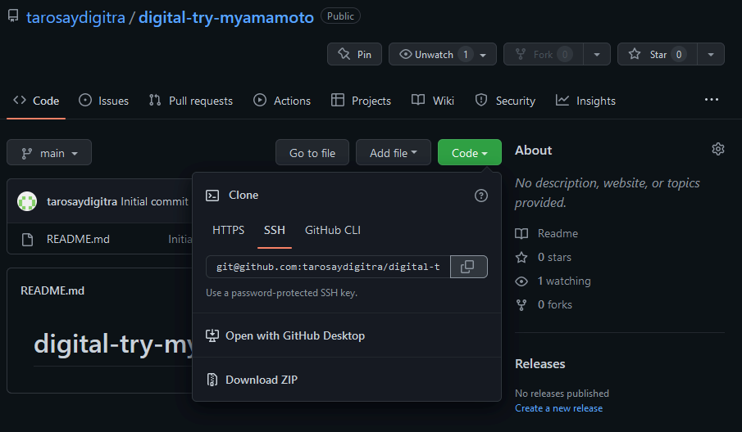

Slide 2
初めて、Git Bashでgit clone する
$ git clone git@github.com:tarosaydigitra/digital-try-myamamoto.git
Cloning into 'digital-try-myamamoto'...
The authenticity of host 'github.com (20.27.177.113)' can't be established.
ED25519 key fingerprint is SHA256:+DiY3wvvV6TuJJhbpZisF/zLDA0zPMSvHdkr4UvCOqU.
This key is not known by any other names
Are you sure you want to continue connecting (yes/no/[fingerprint])?
Are you sure you want to continue connecting (yes/no/[fingerprint])? SHA256:+DiY3wvvV6TuJJhbpZisF/zLDA0zPMSvHdkr4UvCOqU
fingerprintは、SHA256から始まる赤字の部分をコピーして入力する。最後の点は、入れない。
Warning: Permanently added 'github.com' (ED25519) to the list of known hosts.
remote: Enumerating objects: 3, done.
remote: Counting objects: 100% (3/3), done.
remote: Total 3 (delta 0), reused 0 (delta 0), pack-reused 0
Receiving objects: 100% (3/3), done.
cloneできました。

