Slide 1
Swarmfest ‘99
Tutorial
Session I: Introduction
Benedikt Stefansson
<benedikt at ucla.edu>
revised version 0.3
by YABUKI Taro for Java

Slide 2
First session
Background
History and overview of Swarm project
Contributions of Swarm
General structure of simulations in Swarm
Quick and dirty introduction to Java
Documentation, resources, user community

Slide 3
Focus for the day
General structure of a Swarm simulation
Main contributions of the Swarm project:
  Event management: Swarms, Activity library
  Information management: Probes
  Graphical input and output: GUI objects
  Memory management: Creation/destruction
  Support for multiple languages

Slide 4
What is the point?
To study complex nonlinear systems e.g.
  An ecosystem
  International conflict
  Financial crisis
Agent based models allow us to study
  Spatial interaction
  Adaptive, heterogeneous agents
  Agents which face costs of information acquisition and processing
  Nested subsystems - economy, markets, firms, plants, employees
  etc.

Slide 5
Bottom up modeling
If
<cond>
then
<action1>
else
<action2>
Inanimate agents
Animate agents
Observer
Data
Organizations of agents
Artificial world

Slide 6
History of Swarm
Launched in 1994 by Chris Langton at Santa Fe Institute in New Mexico (Contributors: Chris Langton, Roger Burkhart, Nelson Minar, Manor Askenazi, Glen Ropella, Sven Thommesen, Marcus Daniels, Alex Lancaster, Vladimir Jojic )
Objectives
  Create a shared simulation platform for ABM
  Facilitate the development of models
Released in beta in ‘95, 1.0 release in January ‘97, 1.1 with Win95/NT support April ‘98, 2.0 with Java April ‘99

Slide 7
Basic facts
Swarm is a collection of object oriented software libraries which provide support for simulation programming
Users build simulations by incorporating Swarm library objects in their own programs
Libraries are written in
  Java : The main island of Indonesia
  Tcl/Tk: Scripting language and GUI widgets (transparent to user)
Available for Unix and Windows 95/98/NT.

Slide 8
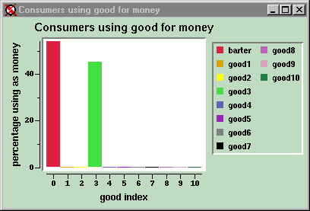

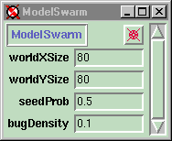
Swarm modeling
Inanimate agents
Animate agents
Organizations of agents
Model
Observer

Slide 9
Object Oriented Programming
Message
State
Variables
Behavior
Methods
An object
A program

Slide 10
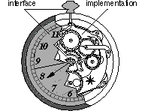
Interface vs. implementation
User only has to be familiar with the interface of an object, not it’s implementation
Objects hide their functions and data

Slide 11
Some terminology
Class
  The definition of an object and the object factory
Superclass
  A class that an object inherits behavior and variables from (recursive)
Subclass
  A class that inherits behavior and variables from a superclass
Instance
  An object (instance of a class) that has been created and exists in memory
Instance variable
  A variable available to all functions in an object
Method
  A function. Can be called by sending message to an object of this class

Slide 12
The three principles of OOP
Encapsulation
  Objects hide their functions (methods) and data (instance variables and method variables)
Inheritance
  Each subclass inherits all variables of its superclass
Polymorphism
  Multiple instances of same class, sharing behavior but not state or memory
Super class
Sub classes

Slide 13
Discrete event simulation
Simulation proceeds in discrete time steps
Interaction between agents or procedures within simulation may have own event schedule

Slide 14
Simulation in procedural language
get parameters
initialize
  for 1 to timesteps do:
    for 1 to num_agents do:
      agent-i-do-something
    end for
    show state
  end for
quit
Generally set’s up data structures and support for output
Here must provide data structure to save agent’s state and implement behavior
Implementation of output often left to the programmer

Slide 15
The (Swarm) OOP way
The event loop is now embedded in an object that sends messages to agents and objects
Each agent saves his own behavior and state and acts when called upon by scheduler or other agents

Slide 16
The Swarms
A Swarm is an object that implements
  memory allocation
  event scheduling
A basic Swarm simulation consists of
  Observer Swarm
  Model Swarm
Widgets
Probes
Observer
Agents
Model
Inanimate objects

Slide 17
A Swarm as a virtual computer
A computer’s CPU executes program instructions
Swarm kernel is virtual CPU running model and GUI events
Nested Swarms merge activity schedules into one
GUI
Model
Swarm kernel
Operating System
CPU

Slide 18
The Activity framework
Provides abstractions that allow programmer to treat event scheduling in the artificial world as objects, separate from elements of model
Provide some useful shorthand to group actions and sort according to the desired order of events
Since schedules are objects, all agents in simulation can communicate with them, to schedule future events or cause actions to be dropped based on specified contingencies

Slide 19
Elements of Activity library
ActivityGroup
  Unordered set of “simultaneous” events
Schedules
  Ordered set of events or groups of events
SwarmActivity
  Underlying VM executing schedules
Sleep
Eat
Dream

Slide 20
Merging schedules in Swarms
The schedules of each sub Swarm are merged into the schedule of next level Swarm
Finally all schedules are merged in the top level Swarm
Allows you to treat the model as a nested hierarchy of models
Schedule
Top level Swarm
Agent
Sub Swarm

Slide 21
Managing memory in Swarms
The allocation and deallocation of memory is a necessary feature in an OO system
Swarm provides libraries for this purpose which make the process transparent to user
Basic feature: Objects are created and destroyed using a notion of memory zones
By dropping a memory zone can drop entire collections or sub Swarms

Slide 22
The recursive structure of Swarms
Schedule
The Model
Probes
Swarm
The Interface
Agent
Sub-Swarm
Sub-sub-Swarm

Slide 23
The Probes
All agents and objects in Swarm can be probed
Probe attaches itself to an agent, can send a message, change a variable or retrieve values by calling agent or reading variable directly
Probe
var=10.2
Agent

Slide 24
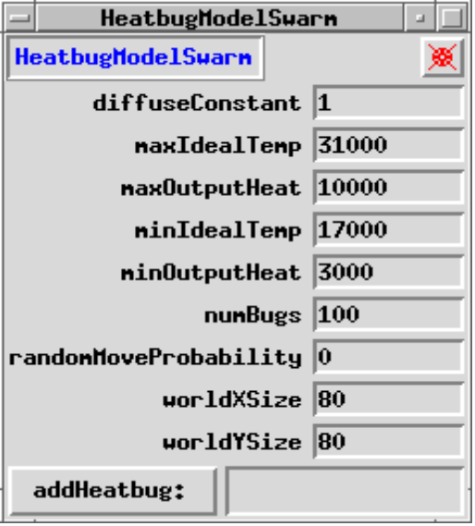
Probes and the GUI
A probe can be used to communicate with objects in real time through a graphical widget
A default probe map of agent shows all variables and functions - can also customize display
Open probe for class
Close probe
Probe
Input value for variable
Agent
Executes method

Slide 25
Probes without a GUI
Probes are also used to gather information dynamically from single agents or collection of agents
Among other features is the ability to define and execute method calls on the fly at runtime
Object that analyzes data
Probe
Object that
acts on data
Agents
A collection object

Slide 26
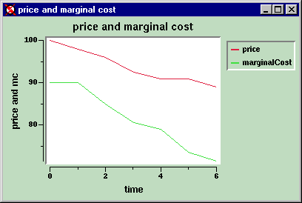
The Graphical User Interface
Objects provided to create and manage
  Line graphs
  Histograms
  Raster images
  Digraphs
Data collection, calculation and updating is provided through support objects to the GUI widgets

Slide 27
Feeding data to the GUI widgets
Output on graphs or other widgets relies heavily on the probes and dynamic access to agent’s data
Swarm collection objects also facilitate process
Graph
widget
Averager
for cost
Averager
for price
Probe
Probe
Agent
Collection

Slide 28
Why Java?
History: Refer to JAVA inside story (http://www.hotwired.co.jp/wiredmagazine/2.03/java.html)
Main difference between C++ and Java:
  Java doesn’t have operator overloading
  Java doesn’t support a template class
  Java has garbage collection

Slide 29
Writing objects in Java
A program or project consists of a collection of object definitions (*.java)
Declaration
of instance
variables
and methods
*.java

Slide 30
A few Java basics
public class Bug extends SwarmObjectImpl {
int xPos, yPos;
int worldXSize, worldYSize;
id foodSpace;
public Bug(Zone aZone){
super(aZone);
}//constructor
public Object setX$Y(int x,int y){
...
}
public Object step(){
...
}
}
Super class
Sub classes
Instance
Variables
Methods

Slide 31
Some basic syntax
public class Bug extends
SwarmObjectImpl {
int xPos, yPos;
int worldXSize,worldYSize;
FoodSpace foodSpace;
public Bug(Zone aZone){
super(aZone);
}//constructor
public Object step(){
...
}
public Object setX$Y
(int x,int y){
...
}
}
type message()
  declares a method called `message'. E.g. ‘Object step(){}’
type message((type) v)
  declares method called ‘message(v)’ that takes one argument
type setX$Y(int x,int y)
  declares method called ‘setX$Y(x,y)’ that takes two arguments

Slide 32
More Java syntax
Defining methods
  type aMessage((type) v){...}
  type aMessage$with$and((type)v1,(type)v2, (type) v3){...}
Calling methods
  object.aMessage(val)
  object.aMessage(val1,val2,val3)

Slide 33
The Object variable type etc.
Default variable type for object in Java is Object
Think of this as a special variable type (which is actually a pointer to a special data structure - namely the object)
All objects can refer to themselves by
  this.
All objects can refer to superclass by
  super.

Slide 34
Declaring and Defining a class
1
public class Name
extends SuperClass{
  type Iv1
  type Iv2
  ...
  type IvN
  public Name(Zone aZone){
  super(aZone);
  }//constructor
  public (type) bMethod((type) v1){
  ...
  }
}
The header file or interface declares
  Class name
  It’s superclass
  Instance variables
  Methods
2
3
1
2
3
4
4

Slide 35
Typical small Java project
Appli.java
ClassA.java
ClassB.java
main()

Slide 36
Russian roulette
Two players A and B alternate aiming revolver at themselves
Gun starts empty
Before pulling trigger each player must load new bullet in revolver
If revolver doesn’t go off player hands gun over to opponent

Slide 37
Survival probabilities
A
1/6
5/6
B
2/6
4/6
A
3/6
3/6
B
4/6
2/6
A
1/6
5/6
B

Slide 38
Example project: Russian roulette
RR.java
Player.java
Revolver.java
main()

Slide 39
The objects: Player
Variables: Player knows
  His own name
  Whether he is alive
  Idenity of other player
Behavior: Player can
  Set variables
  Respond to “alive?”
  Use revolver
public class Player extends SwarmObjectImpl{
int name;
int alive;
Player other;
public Player(Zone aZone){...}
public void init(int n){
...
}
public void setOther(Player o){
...
}
public boolean isAlive(){
...
}
public void play(Revolver r){
...
}
}

Slide 40
The objects: Revolver
Variables: Revolver knows
  Number of bullets
Behavior: Gun can
  Empty bullets
  Load new bullet
  Engage trigger and return result (fired, didn’t fire)
public class Revolver extends SwarmObjectImpl{
int bullets;
public Revolver(Zone aZone){...}
public void empty(){
...
}
public void load(){
...
}
public boolean trigger(){
...
}
}

Slide 41
How it works
Objects are created in RR.java
RR hands empty revolver object off to player A
Player A loads bullet and pulls trigger
If player A is alive hands gun to B else returns herself to RR
Player B loads bullet and pulls trigger
If player B is alive hands gun to A else returns herself
etc...

Slide 42
How it works (cont)
RR
A
=Player A
If A dead
B
A
A
=Player B
=Revolver
B
B
If B dead
A
A
B
B
If A dead

Slide 43
How it works (cont)
IF heads THEN return 1
ELSE return 0
IF 1 THEN return self
Player
Revolver
Player
send message R: load
send message R: trigger
B
IF 0 THEN send message B play: R

Slide 44
Other resources
Java
  Many textbooks available because…
  Main resource: Sun website (http://java.sun.com/)
Swarm
  Main website at SDG: Code, manuals, links
  User community, mailinglists (and archives)
  Beg, steal and borrow other people’s code!

Slide 45
Where to find help
Main Swarm website
  http://www.swarm.org/
The Java manual
  http://java.sun.com/
Subscribing to mailinglist
  Send mail to majordomo at santafe.edu with
    subscribe swarm-support <Your E-mail>

