Slide 1
TIME TABLE NOTIFICATION SYSTEM
TEAM MEMBERS:
SHYAM M-241801267-AI&DS
SRIMAN A – 241801276 – AI&DS
TARRUN B – 241801291 – AI&DS

Slide 2
INTRODUCTION
In modern educational institutions, students often face difficulties keeping track of class schedules, especially when the timetable frequently changes. This project addresses that issue by creating an automated reminder system using a Java application connected to an Oracle database. The application retrieves class schedules from the database and sends reminders before each class through Telegram Bot notifications. This reduces human dependency and ensures timely communication.
The system allows the user to:
View the daily timetable for a specific batch.
      Automatically send Telegram alerts before class start times.
      Configure reminder intervals as per user preference.

Slide 3
ABSTRACT
This project titled “Timetable Notification System” is designed to automate the process of reminding students about their upcoming classes through Telegram notifications. The system integrates Oracle Database for backend data storage and Java (JDBC) for the frontend logic. It retrieves the class schedule for a given batch, displays the daily timetable, and automatically sends reminders to students before each class. The integration with Telegram’s API ensures instant and reliable communication. This system eliminates the need for manual timetable checking and helps improve punctuality and class attendance.

Slide 4
MODULE
Module 1: Database Design
The Oracle backend consists of five main tables: batch, course, teacher, classroom, and timetable.
The schema maintains relationships between these entities using foreign keys.
Each timetable entry maps a course, teacher, classroom, and batch for a specific day and time.
Module 2: Timetable Display
The Java frontend connects to Oracle using JDBC.
Users can input their batch ID and day of the week to display the full timetable.
Timetable results are sorted by class start time.

Slide 5
Module 3: Telegram Notification System
The program integrates with Telegram Bot API using HTTP requests.
Users configure reminder time (in minutes before class).
The system continuously checks the current time and compares it with class start times.
When a class is about to begin, a Telegram notification is automatically sent to the group or chat.
Module 4: Reminder Loop
Runs in the background continuously.
Sends notifications once per class (avoiding duplicates using a hash set).
Checks for the next upcoming class every minute.

Slide 6
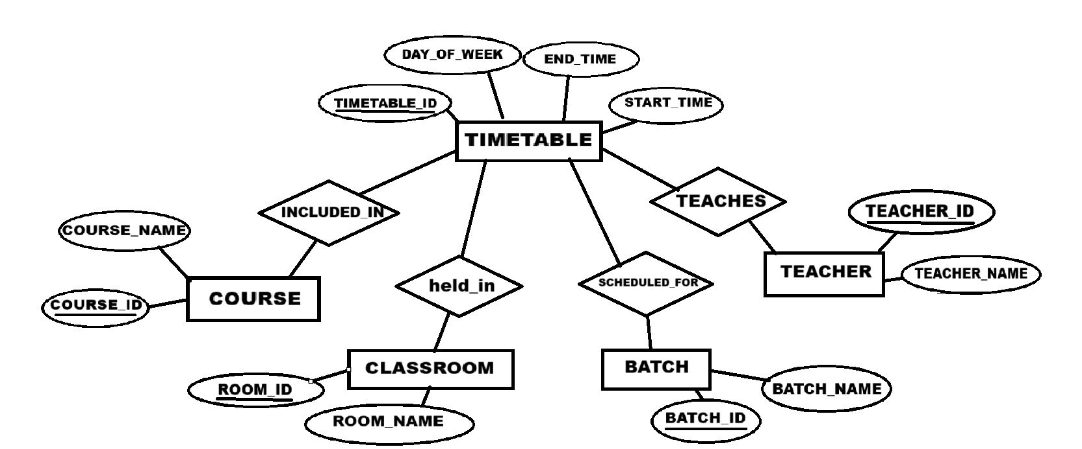
ER DIAGRAM

Slide 7
Conclusion

