Slide 1

Tossed Bumpers and Scrambled Lanes: Predicted Peak-Hour Collisions in Seattle
By Claudia Panarello
September 14th, 2020

Slide 2
Introduction
Motor vehicle collisions have always been untimely and unfortunate circumstances, not only for the driver or drivers involved, but for the countless bystanders left with no choice to reroute, detour, and delay their arrival to their destinations.
More automobiles are in circulation during rush hour, which might suggest that the mere presence of more vehicles would result in more collisions. It would be imperative to schedule enough traffic officers, first responders, and towing contractors to work during these peak hours if that is true.

Slide 3
Data
From the Seattle Department of Transportation and gathered by the Seattle Police Department’s traffic records
Updated weekly
Focus:
Timestamp of recorded collisions
PEAK HOURS: 6:00 am – 9:00 am and 3:00 pm and 6:00 pm
Weather
Light
Road conditions
Number of samples: 147,698

Slide 4
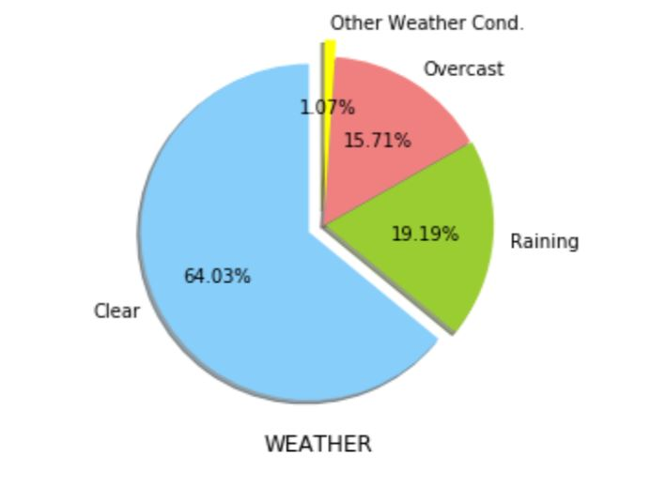
Methodology - Weather
Majority of 64.03% of collisions occurred when it was reported to be clear outside
Remaining weather conditions include rain at 19.19% of all collisions, then overcast at 15.71%
The last 1.07% of all collisions:
snow
fog, smog, smoke
sleet, hail, freezing rain
blowing sand and/or dirt
severe crosswind
partly cloudy
other unspecified conditions in the data

Slide 5
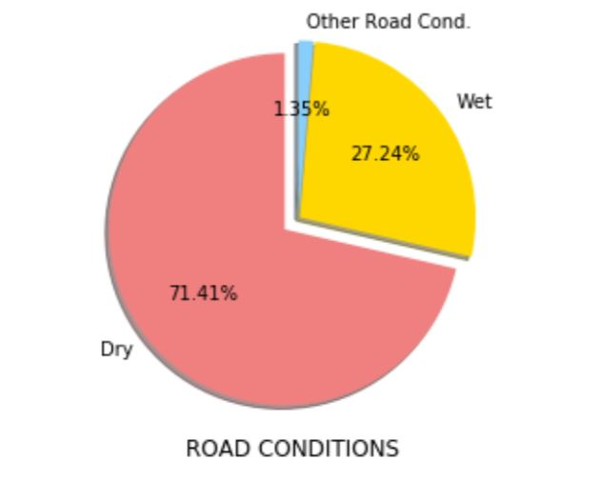
Methodology – Road Conditions
Majority of all collisions occurred on dry roads at 71.41%
Only 27.24% of all collisions for wet and 1.35% for other road conditions, including:
ice
snow/slush
standing water
oil
sand, mud and dirt
other unreported conditions
Correlation between wet road conditions and rain is approximately 76.83%

Slide 6
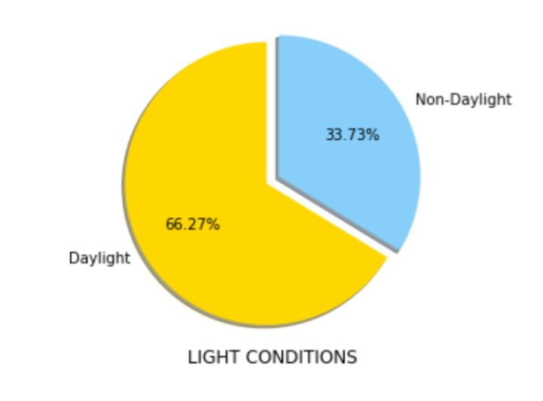
Methodology – Light Conditions
66.27% of collisions were reported during the day
Only an approximate 22.48% correlation between daylight and peak hours

Slide 7
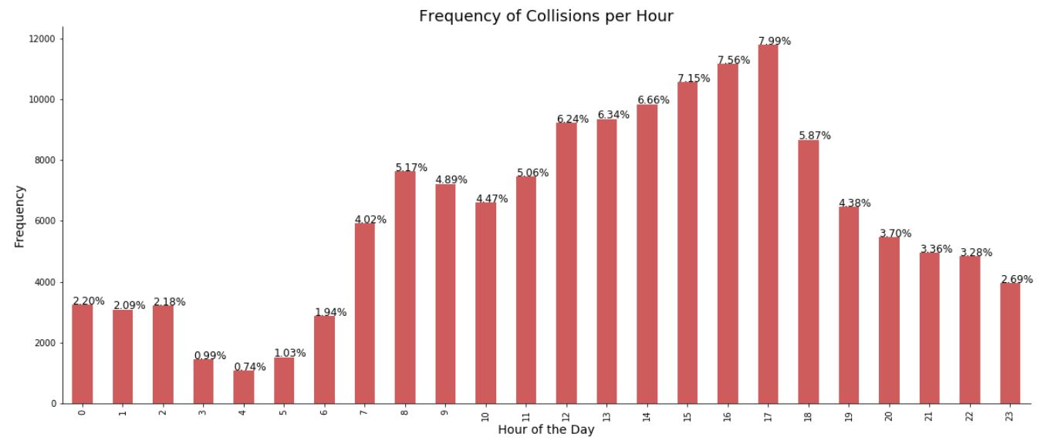
Methodology - Time
7.99% of all samples fall between 5:00 pm and 6:00 pm, which is the highest proportion
The second- and third-highest proportions are 4:00pm-5:00pm and 3:00pm-4:00pm, respectively
Peak hours comprise 33.83% of all collisions

Slide 8
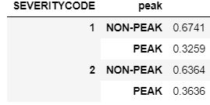
Methodology – Severity Code
2 types
1 – property damage
2 – injury
Relative difference of -1.81% of property damage during peak hours
Relative difference of 10.25% of injuries

Slide 9
Methodology – ML Approach
Data is categorical
Logistic regression since target is binary: peak vs. non-peak
20% test size:
118,158 samples for training
29,540 for testing
C-parameter = 0.02
Predictors: daylight, weather, road condition observations, and the severity code categories

Slide 10
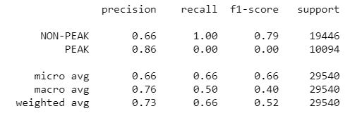
Results
J-similarity score: 65.85%
Weighted avg. F1: 52.31%
Weighted avg. Precision: 73%
Weighted avg. Recall: 66%

Slide 11
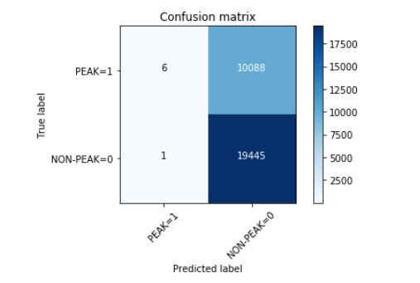
Results
Log-loss score: 0.6151
24.26% accuracy

Slide 12
Remarks
L-R model inadequate in predicting whether collisions are likely to occur during peak hours
Weak percentage accuracy
Abundance of Type I errors
Might be due to lack of explanatory power from predictors
Very strong ability to detect true negatives
J-similarity score, weighted precision are satisfactory
F1-score is unremarkable
OVERALL: model fails to support the hypothesis that the proportion of collisions during rush hour times is predicted by environmental factors and the collisions’ severity

Slide 13
Conclusion
This research can predict the likelihood of vehicle collision during rush hour times of 6:00 am-9:00 am and 3:00 pm-6:00 pm in Seattle by 24.26% via a machine-learning classification algorithm, specifically logistic regression.
However, this model and its predictors failed to confirm the likelihood of collisions during peak traffic hours.
While this research's primary goal is to provide a suggestion to first responders, traffic police, and towing contractors to improve commuters' well-being, its second goal is to encourage others to keep investigating.

