Slide 1
Comparison of histograms

Slide 2
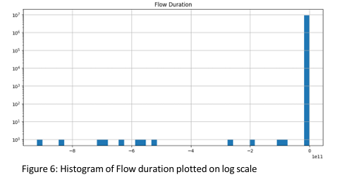
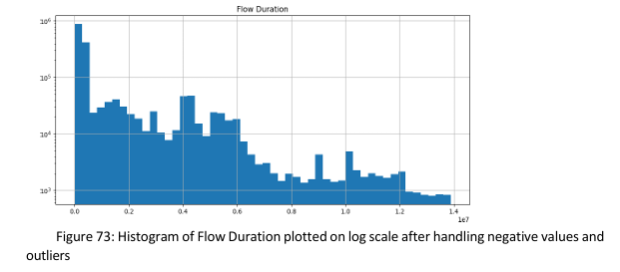
Flow Duration

Slide 3
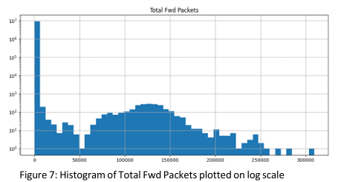
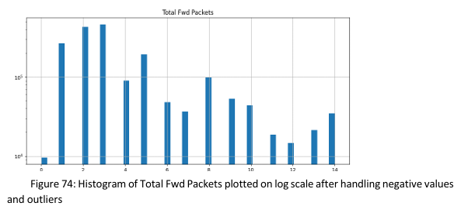
Total Fwd Packets

Slide 4
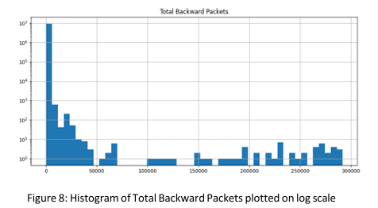
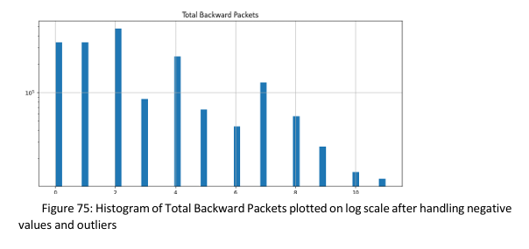
Total Backward Packets

Slide 5
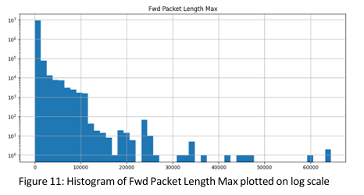
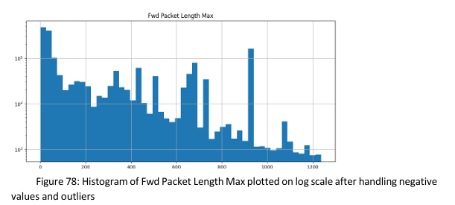
Fwd Packets Length Max

Slide 6
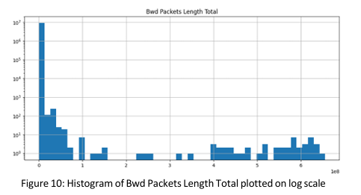
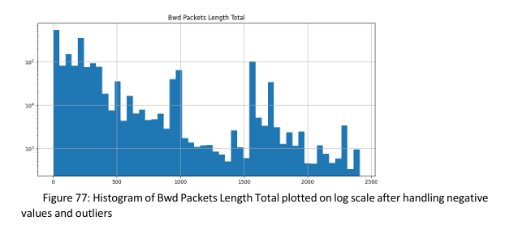
Bwd Packets Length Total

Slide 7
Fwd Packet Length Max

Slide 8
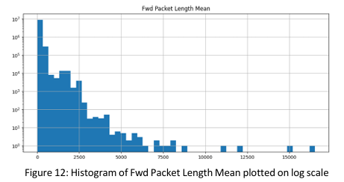
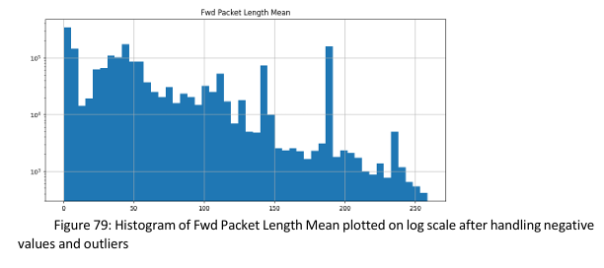
Fwd Packet Length Mean

Slide 9
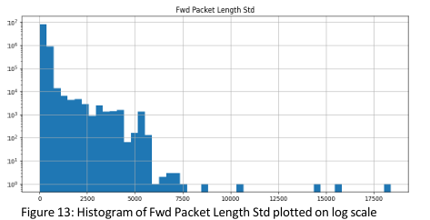
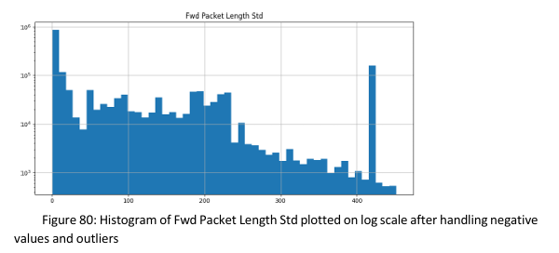
Fwd Packet Length Std

Slide 10
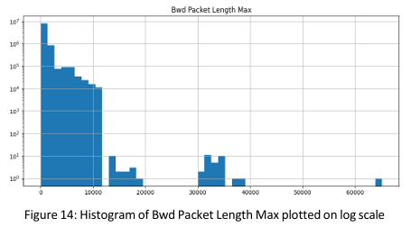
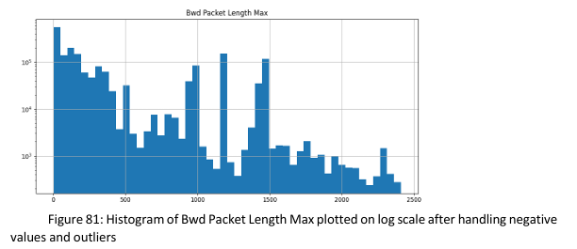
Bwd Packet Length Max

Slide 11
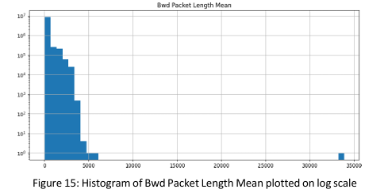
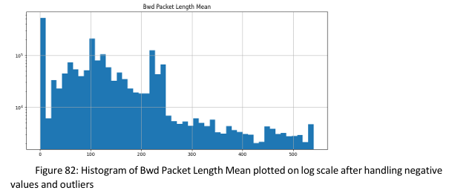
Bwd Packet Length Mean

Slide 12
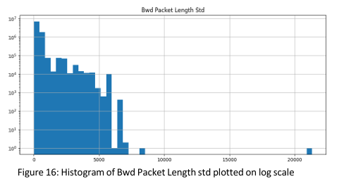
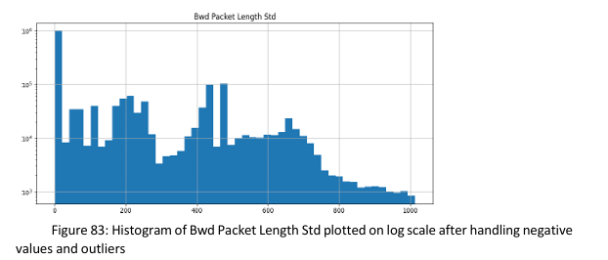
Bwd Packet Length Std

Slide 13
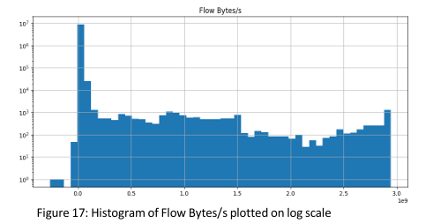
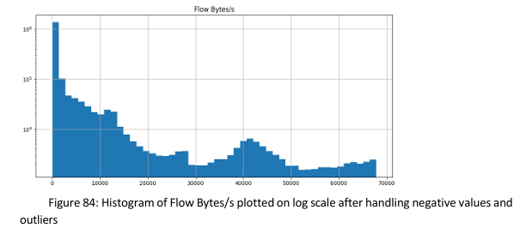
Flow Bytes/s

Slide 14
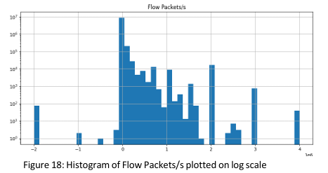
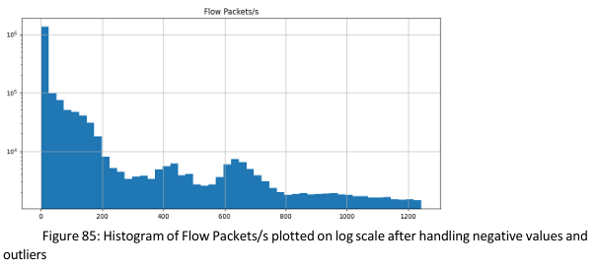
Flow Packets/s

Slide 15
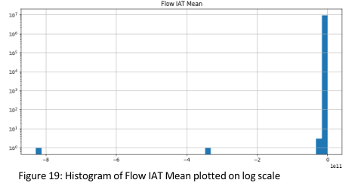
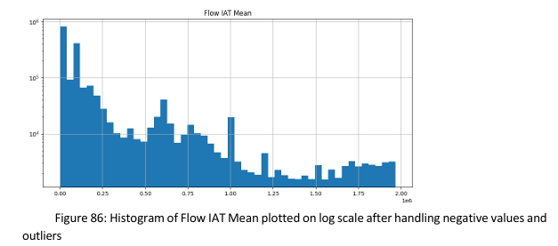
Flow IAT Mean

Slide 16
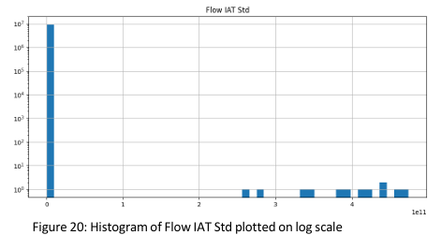
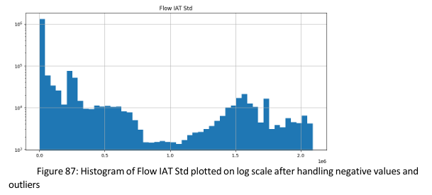
Flow IAT Std

Slide 17
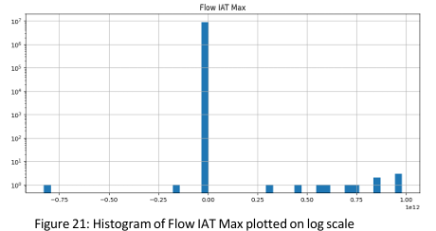
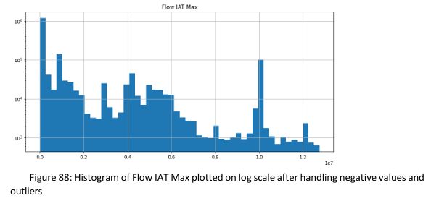
Flow IAT Max

Slide 18
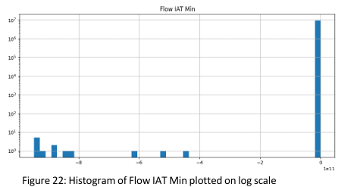
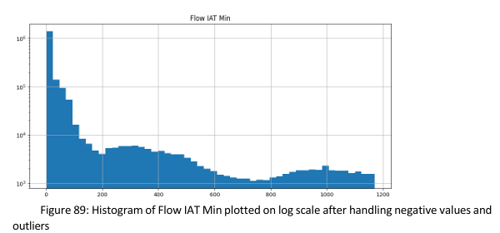
Flow IAT Min

Slide 19
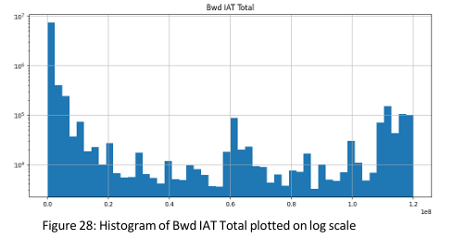
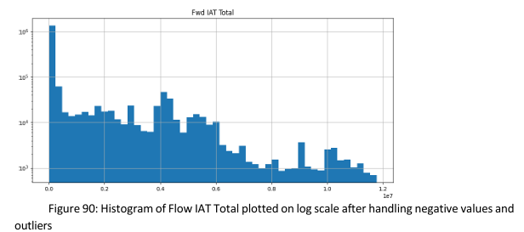
Fwd IAT Total

Slide 20
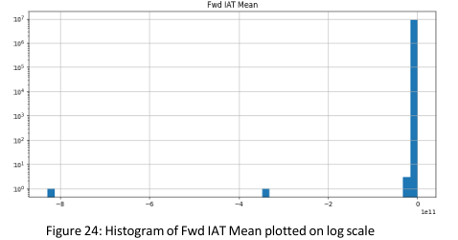
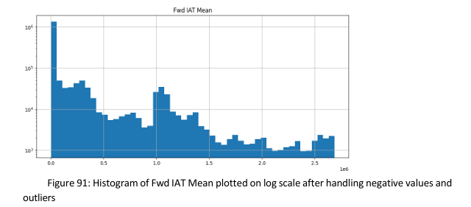
Fwd IAT Mean

Slide 21
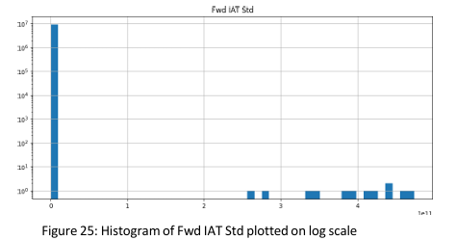
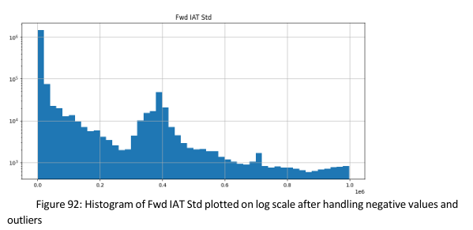
Fwd IAT Std

Slide 22
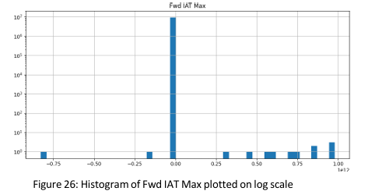
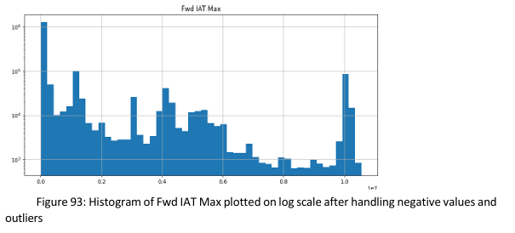
Fwd IAT Max

Slide 23
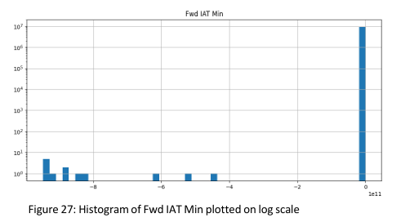
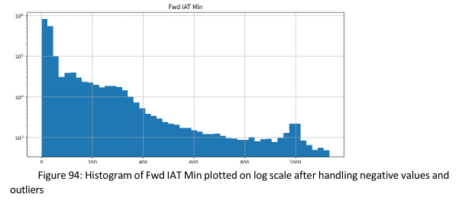
Fwd IAT Min

Slide 24
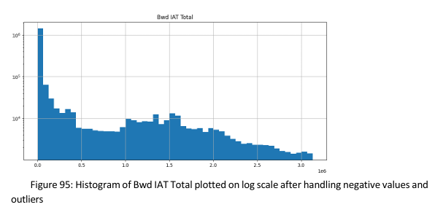
Bwd IAT Total

Slide 25
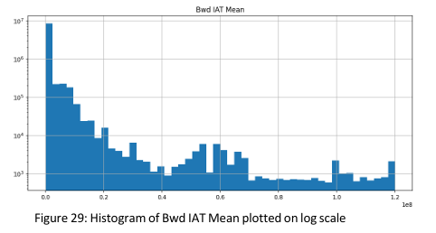
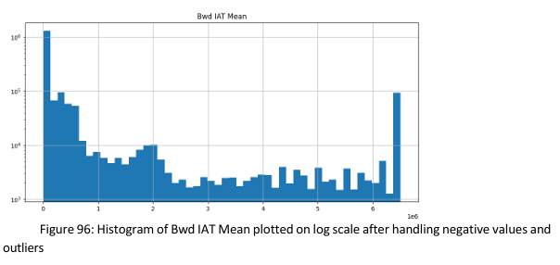
Bwd IAT Mean

Slide 26
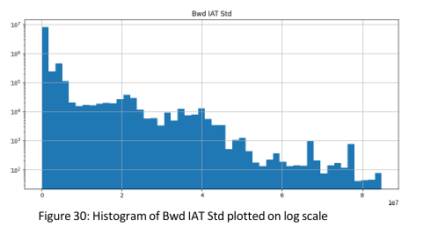
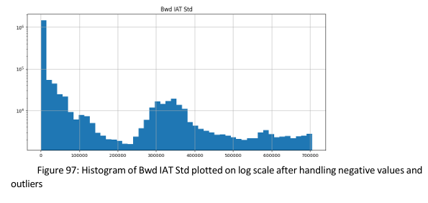
Bwd IAT Std

Slide 27
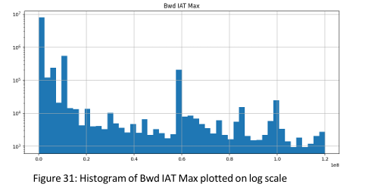
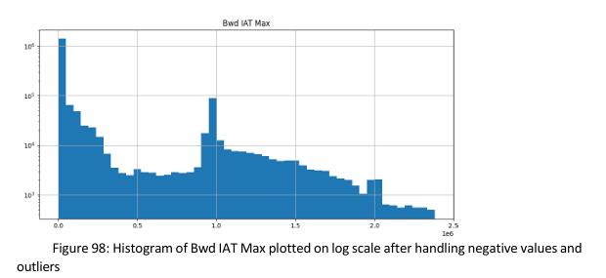
Bwd IAT Max

Slide 28
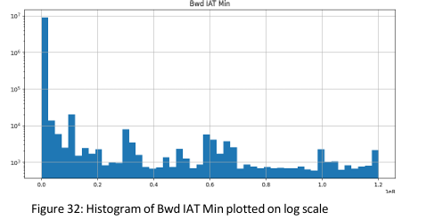

Bwd IAT Min

Slide 29


Fwd PSH Flags

Slide 30


Fwd Header Length

Slide 31


Bwd Header Length

Slide 32


Fwd Packets/s

Slide 33


Bwd Packets/s

Slide 34


Packet Length Max

Slide 35


Packet Length Mean

Slide 36


Packet Length Std

Slide 37


Packet Length Variance

Slide 38


SYN Flag Count

Slide 39


URG Flag Count

Slide 40


Avg Packet Size

Slide 41


Avg Fwd Segment Size

Slide 42


Avg Bwd Segment Size

Slide 43


Subflow Fwd Packets

Slide 44


Subflow Fwd Bytes

Slide 45


Subflow Bwd Packets

Slide 46


Subflow Bwd Bytes

Slide 47


Init Fwd Win Bytes

Slide 48


Init Bwd Win Bytes

Slide 49


Fwd Act Data Packets

Slide 50


Fwd Seg Size Min

Slide 51


Active Mean

Slide 52


Active Std

Slide 53


Active Max

Slide 54

Active Min

Slide 55


Idle Mean

Slide 56


Idle Std

Slide 57


Idle Max

Slide 58


Idle Min

