Slide 1
Introduction to OAuth
OAuth (Open Authorization) is an open standard for secure access delegation, allowing applications to access user data from another service without requiring direct credential sharing. It is widely used for authentication and authorization in web and mobile applications, enabling users to log in with third-party providers like Google, Facebook, or Microsoft. Instead of sharing passwords, OAuth uses access tokens to grant limited permissions to external applications, enhancing security and user experience.
Originally developed for API authorization, OAuth has become the backbone of modern identity management systems, including Single Sign-On (SSO) and API security frameworks. The most commonly used version, OAuth 2.0, simplifies the authentication process by using token-based authorization rather than complex cryptographic signatures.
The Role of OAuth in Securing Applications and Services
OAuth plays a crucial role in enhancing security by enabling applications to authenticate users and authorize access without exposing sensitive credentials. It provides a secure and efficient way for users to grant permissions to third-party applications while maintaining control over their data.
1. Eliminates Password Sharing
2. Token-Based Authentication
3.Reduces Credential Theft Risks
4.Enables Secure Single Sign-On (SSO)

Slide 2
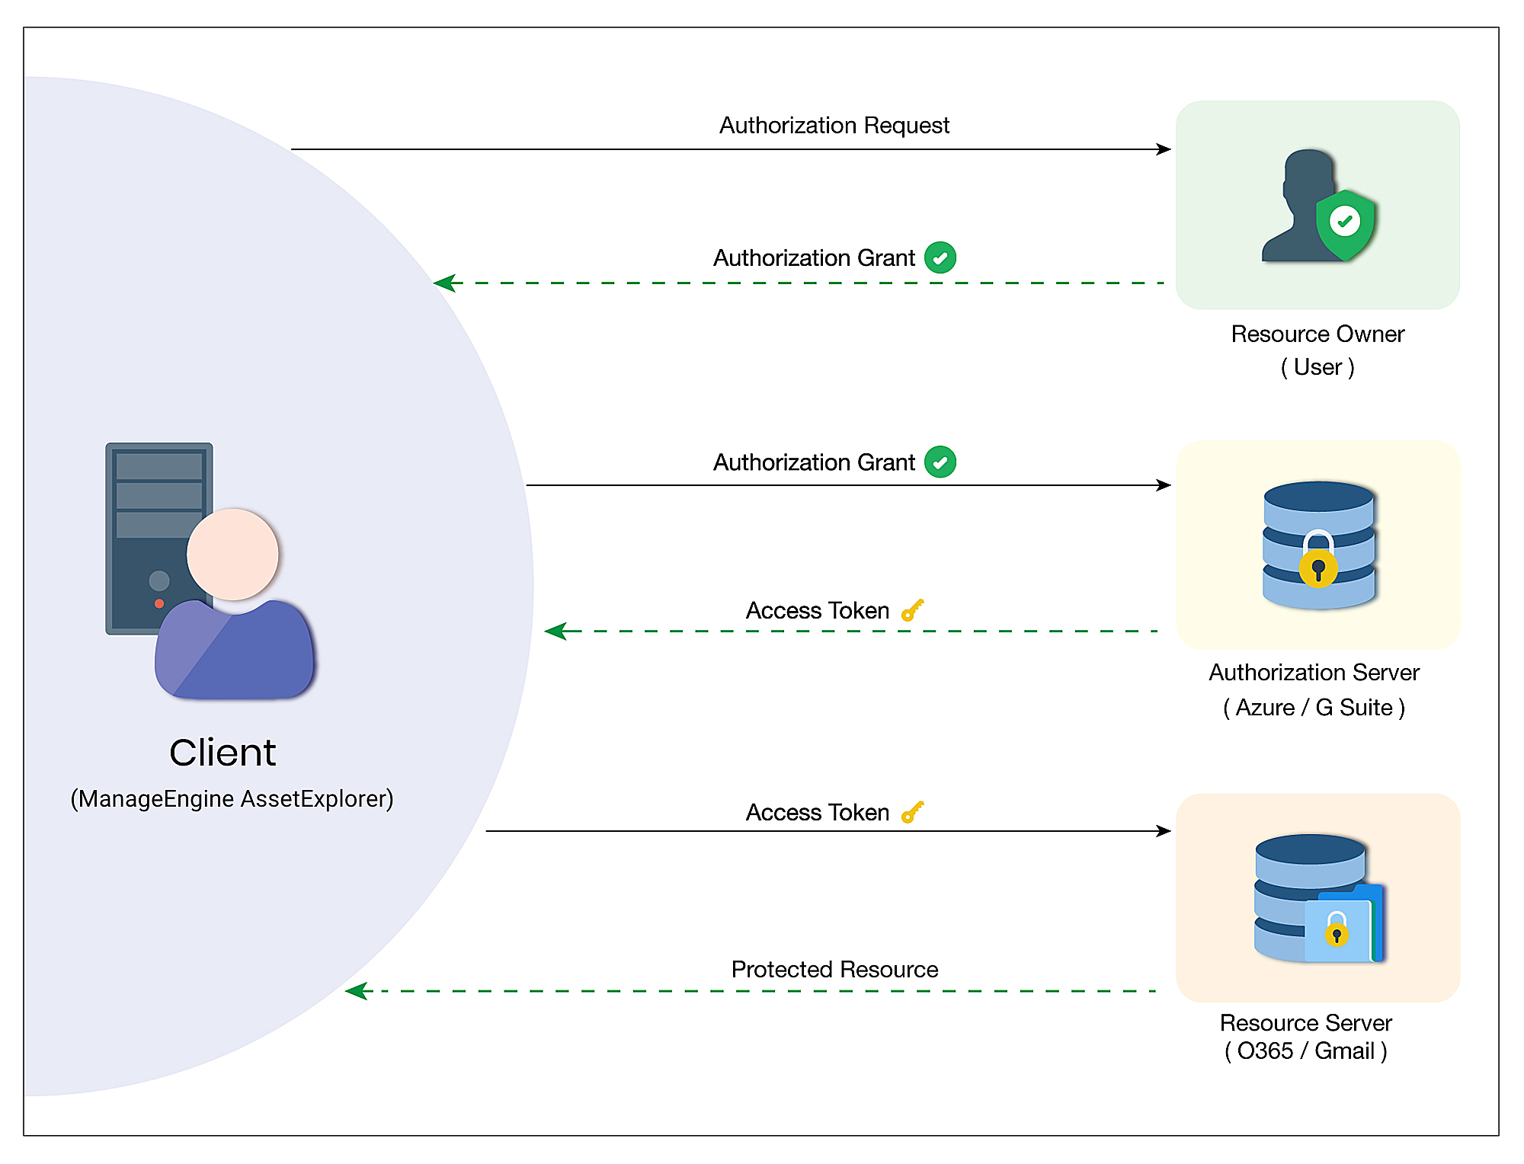
OAuth Flow (Authorization Code Grant)
The Authorization Code Grant is a widely used OAuth 2.0 flow, particularly for web applications. It involves a two-step process:
User Authorization
The client app redirects the user to an Authorization Server (e.g., Google).
The user logs in and grants permission.
The server responds with an authorization code.
Token Exchange
The client sends this code (along with its credentials) to the Authorization Server.
The server verifies the request and issues an access token (and optionally a refresh token).
The client then uses this token to access protected resources.
Security Benefit: The access token is never exposed in URLs, reducing the risk of interception.

Slide 3
OAuth Implementation
OAuth was implemented using Google OAuth 2.0 with Passport.js in an Express.js application.
Setup & Configuration:
Used passport-google-oauth20 strategy.
Credentials (GOOGLE_CLIENT_ID, GOOGLE_CLIENT_SECRET) were stored in environment variables.
Authentication Flow:
The /auth/google route initiates authentication by redirecting users to Google.
Google returns user info to /auth/google/callback, where Passport processes the response.
If successful, the user is serialized into the session.
Session Handling:
express-session stores user authentication data.
passport.serializeUser() and passport.deserializeUser() manage session persistence.
UI & Routes:
A simple login page (/) with a "Login with Google" button.
After authentication, users are redirected to the /profile page, displaying their name and email.
Logout functionality is implemented via /logout.
Security Considerations:
Session secret stored in .env.
Properly handling session resumption and logout.

Slide 4
Problems Solved by OAuth
Before OAuth, applications had limited and insecure ways to access user data from other services. OAuth solved key security and usability issues by providing a standardized, secure, and efficient method for authentication and authorization.
No more sharing passwords – Apps can access what they need without you giving them your password.
Safer logins – Even if a website gets hacked, your main account stays safe.
Less password hassle – Use one login (Google, Facebook, etc.) for many apps instead of creating new accounts everywhere.
Limited access – Apps only get the permissions you allow, not full control of your account.
Easier third-party connections – You can link apps securely without manual setup.

