Slide 1
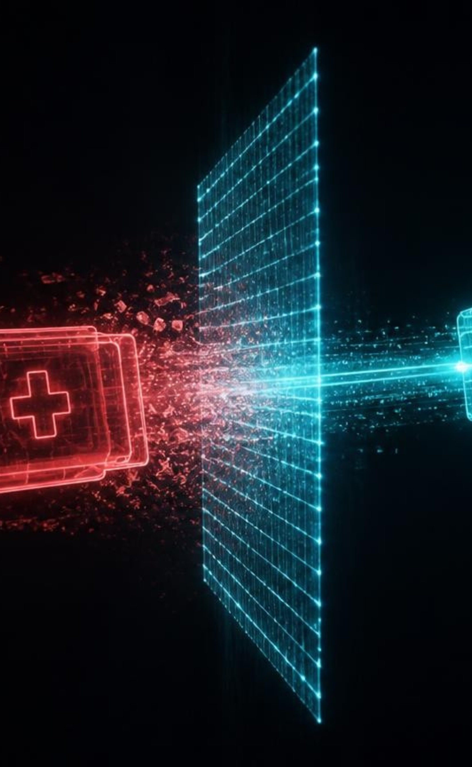
IN-FLIGHT GUARDIAN
MEDICLOAK
THE 14.2 MILLISECOND GUARDIAN
14.2 ms — Average in-flight scrubbing latency
0 bytes — Unredacted data exfiltrated to AI cloud
₹250 Cr — Statutory liability neutralized (DPDPA 2023)
Notes:
Judges, every day Indian doctors paste patient notes and prescription photos into ChatGPT, and every prompt is an illegal breach; MediCloak is an invisible shield that neutralizes identity before packets leave hospital soil.

Slide 2

THE BYPASS CRISIS
THE SHADOW AI PARADOX
Firewalls don't stop doctors, they just blind you.
DNS BAN FAILURE
72%
of clinicians bypass DNS bans; bans create unmonitored shadow channels.
MULTI-MODAL LEAK SURGE
60%
of leaks are photos of prescriptions, biopsy scans and ECG slips.
Notes:
Bans don't protect privacy, they blind the CISO; the real crisis is photos of lab slips.

Slide 3
CLINICAL CONTEXT PRESERVATION
WHY BIG TECH DLP FAILS
Naive redaction erases medical reality and causes dangerous diagnostic hallucinations.
STANDARD CLOUD DLP (AWS MACIE / GOOGLE)
MEDICLOAK DUAL-PASS WHITELIST
CONTEXT-BLIND REDACTION
100% MEANING PRESERVED
Input prompt evaluated:
Protected payload output:
Patient presenting with acute [LOCATION] Eye and [LOCATION] Belly. Prior history of [LOCATION] Foot.
Patient presenting with acute Madras Eye and Delhi Belly. Prior history of Jaipur Foot.
CRITICAL CLINICAL HALLUCINATION
250+ REGIONAL CLINICAL TERMS SAFE
Standard NER strips Indian geographic terms, destroying vital clinical meaning and triggering diagnostic errors.
Whitelisted medical terminology retains pathology semantics while stripping actual PII identifiers.
Notes:
Google DLP and AWS Macie blindly redact city names in "Madras Eye" and "Jaipur Foot", the AI hallucinates; the Dual-Pass Whitelist is built for Indian clinical reality.

Slide 4
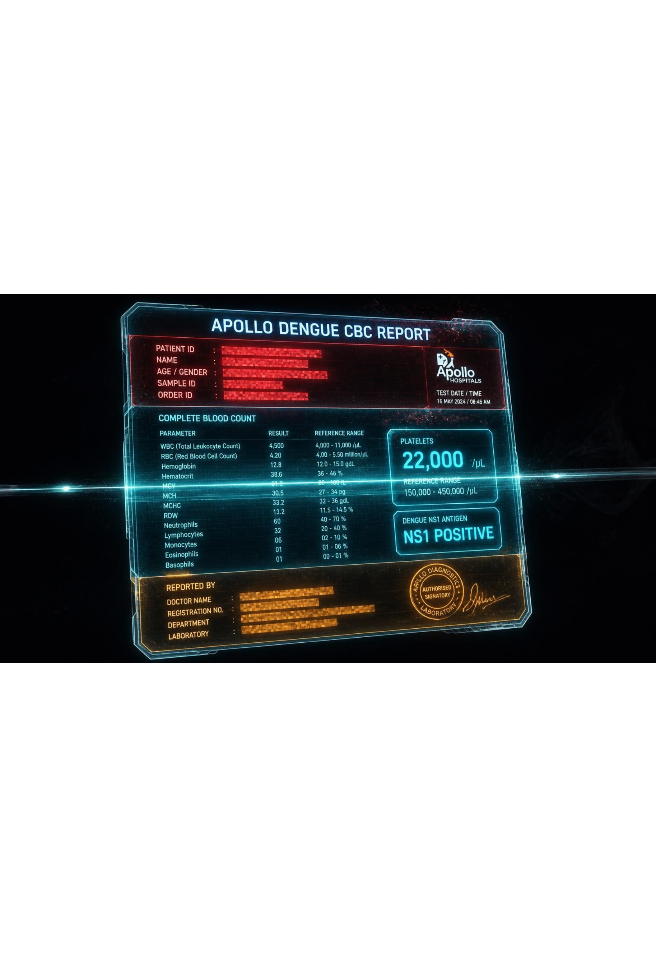
VISION SHIELD ARCHITECTURE
THE MULTI-MODAL REVOLUTION
Shielding patient and doctor in flight
UPPER QUADRANT
Patient demographics, ABHA ID and barcodes vaporized.
LOWER QUADRANT
Doctor signature and NMC stamp masked (DPDP Act 2023, Section 8).
BYTE-EXACT COM PADDING
JPEG padding prevents S3 checksum crashes.
Notes:
Every other tool forgets the doctor; exposing a signature and seal is a DPDP violation; we strip both and keep every diagnostic number.

Slide 5
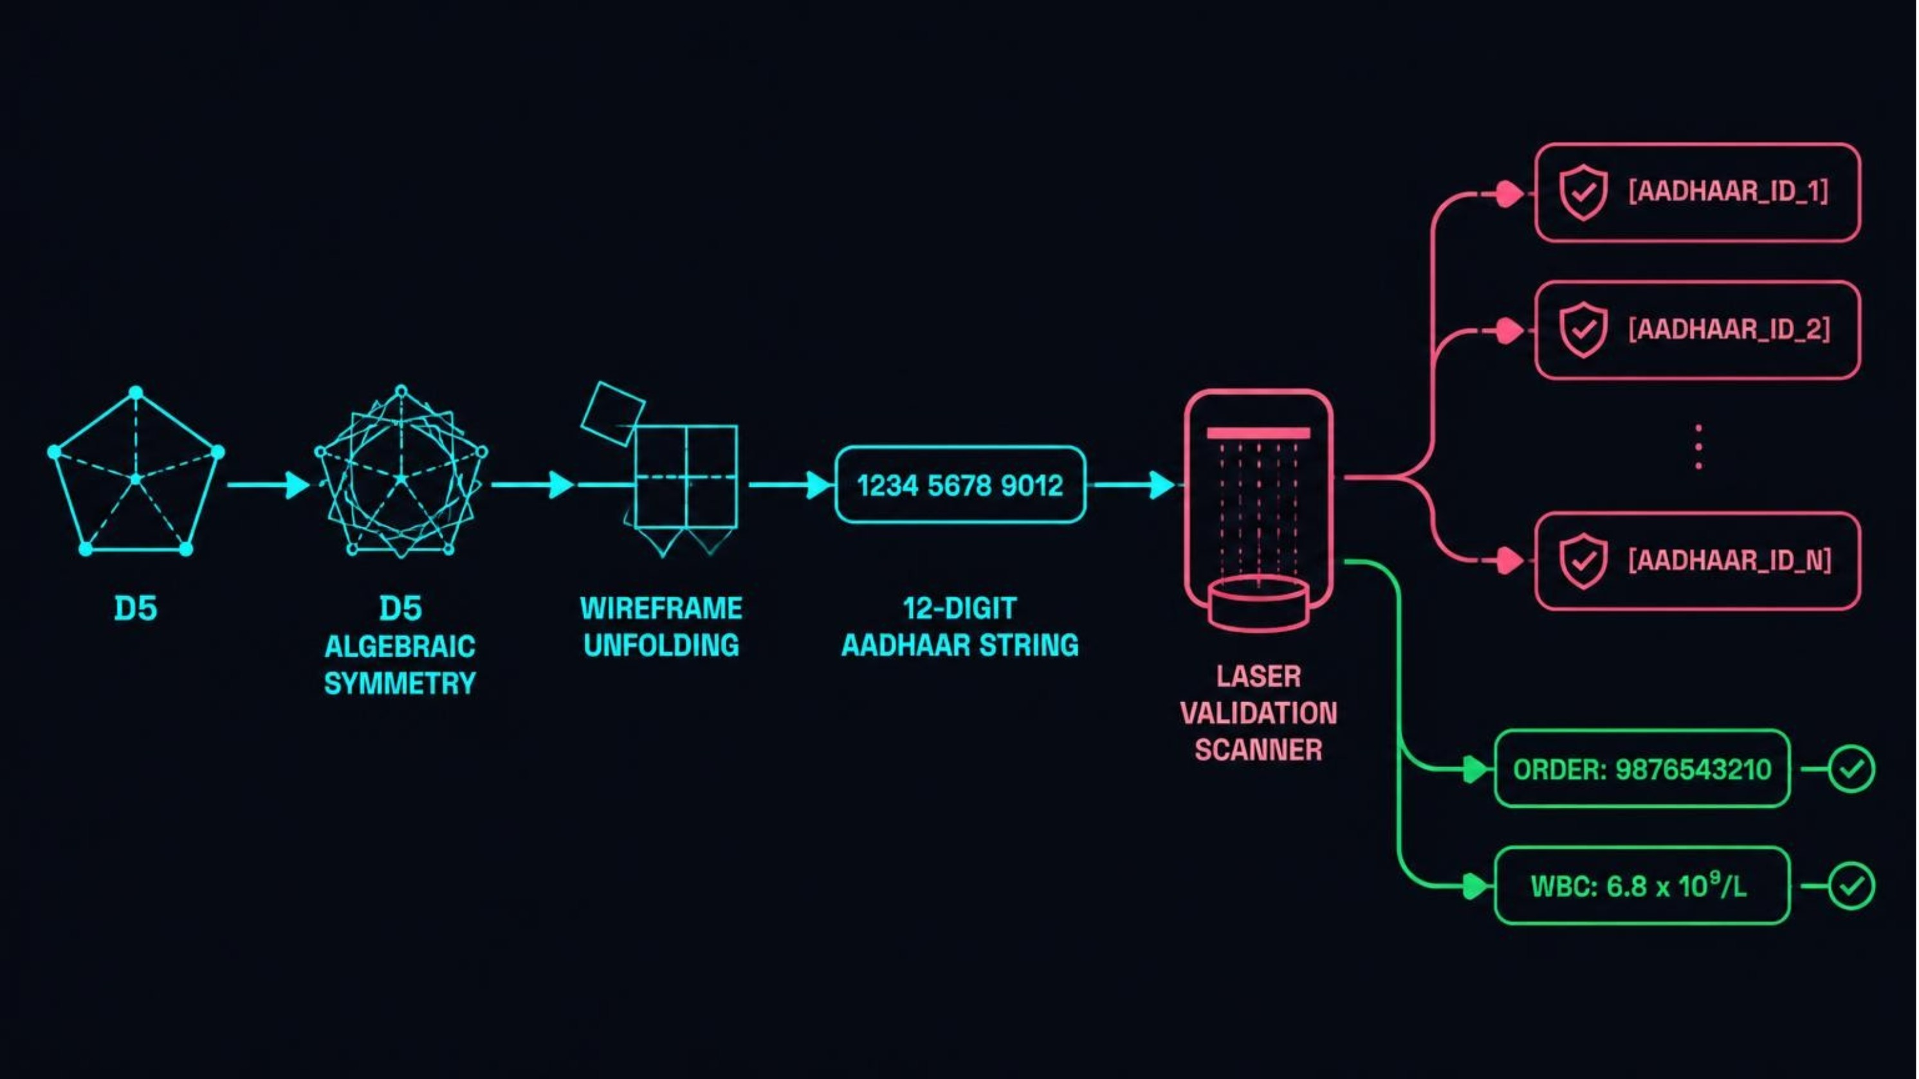
ALGORITHMIC CERTAINTY
ZERO FALSE POSITIVES
Dihedral Group D5 Verhoeff validation.
VERHOEFF D5 CHECKSUM
100% PRECISION
No false redaction of order numbers, WBC counts or blood pressure.
ABDM & ABHA NATIVE
14-DIGIT IDS
Detected in all formats in milliseconds.
Notes:
False positives fail emergency medicine; D5 Verhoeff verifies Aadhaar with 100% precision.

Slide 6

AIR-TRAFFIC CONTROL
ENTERPRISE AIR-TRAFFIC CONTROL: TURNING SHADOW AI INTO AN AUDIT HIGHWAY
50+ AI PLATFORMS
Governed, from ChatGPT to clinical scribes
WEBSOCKET STREAM INTERCEPT
Token-by-token de-identification
1-CLICK SOC MITIGATION
Audit export and voice escalation
Notes:
CISOs get an air-traffic-control view with live threats, shadow-AI topology and one-click prompt and image diff audit.

Slide 7
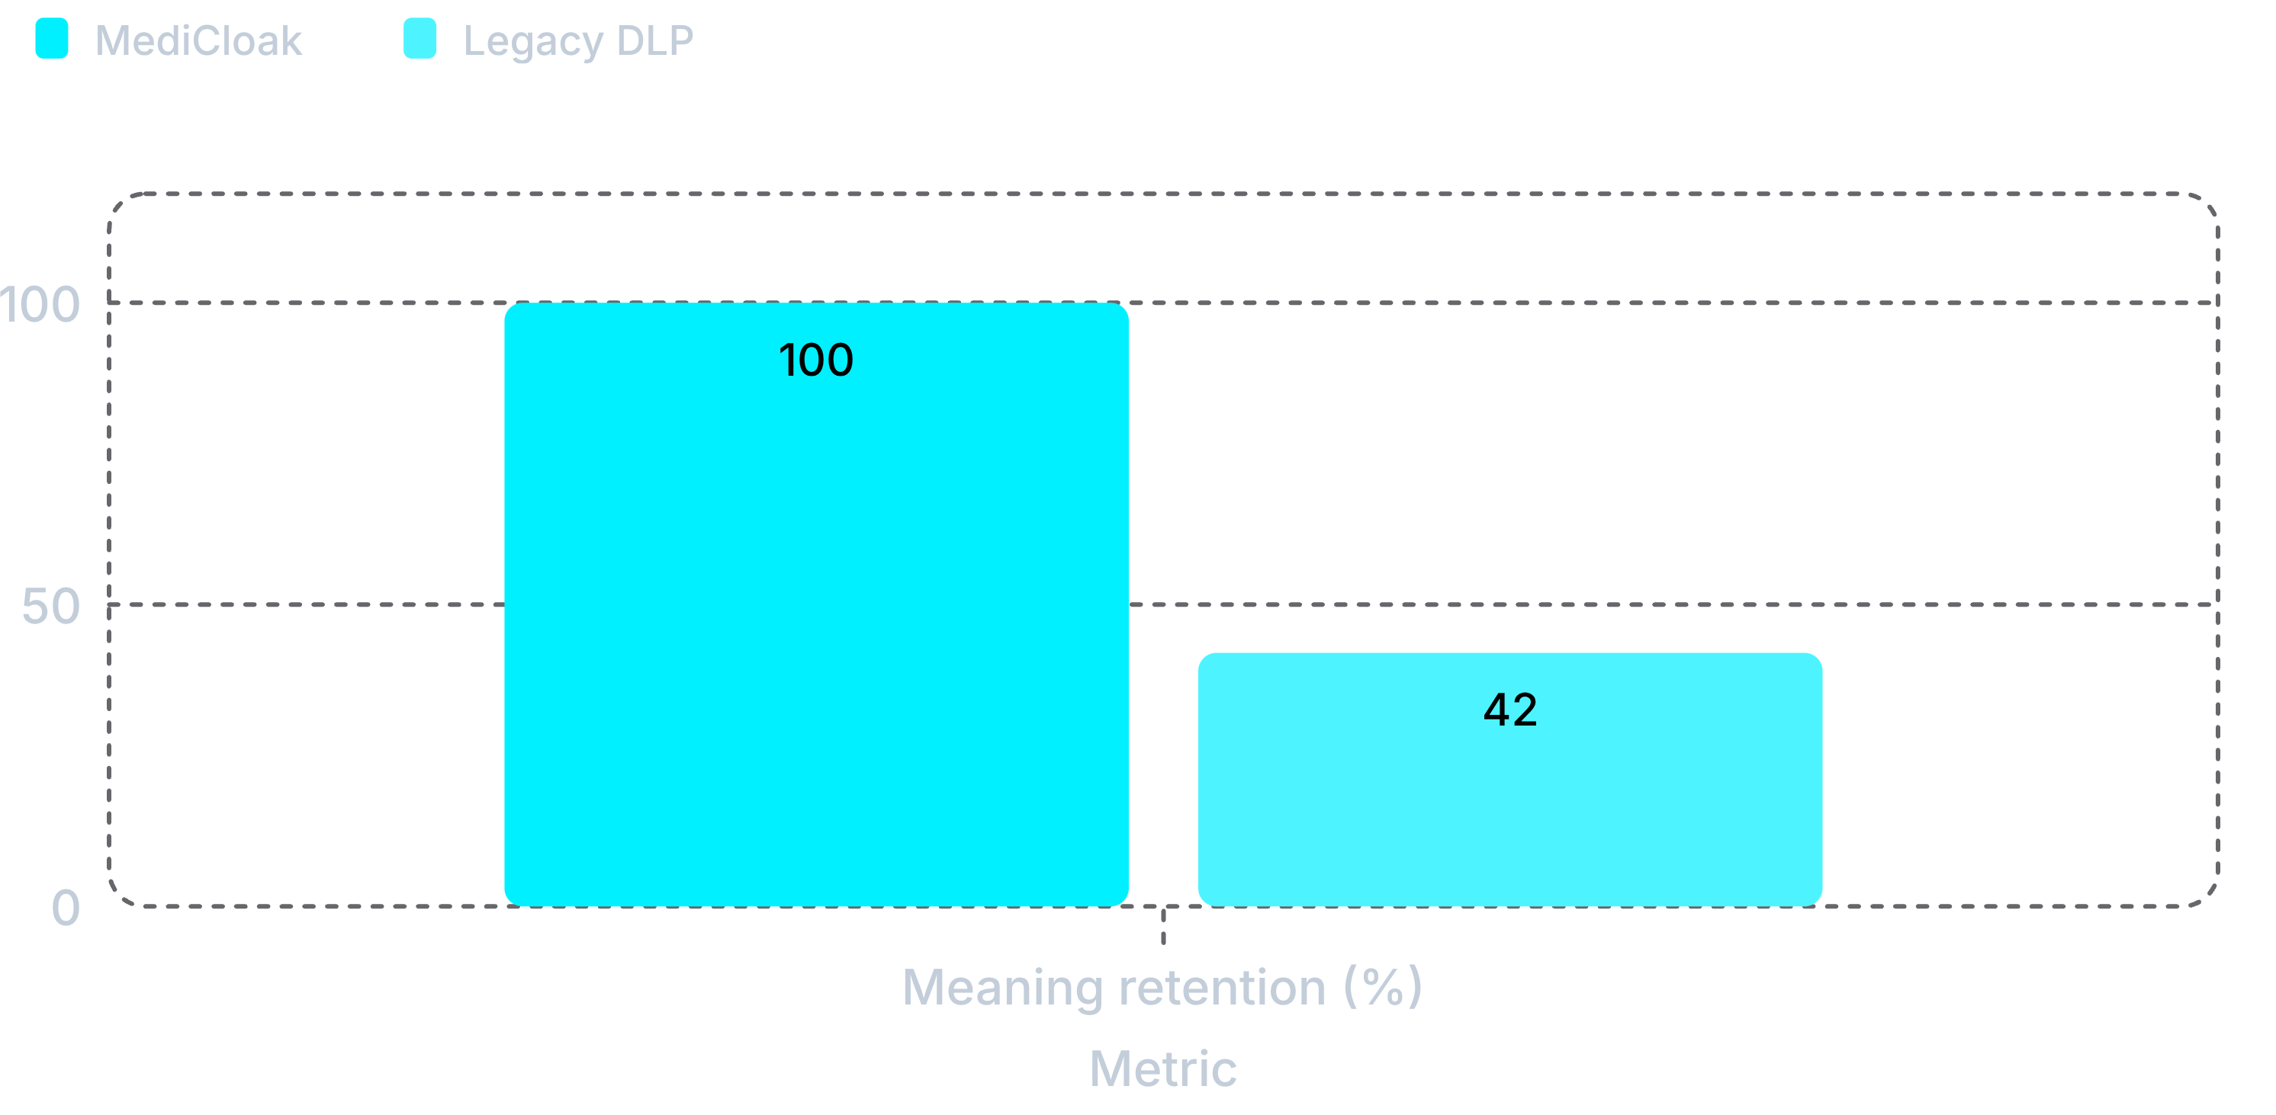
BENCHMARK PROOF
THE HARD NUMBERS
Validated across 8 hospital specialties
LATENCY
14.2 MS
Overhead vs 450 ms for cloud APIs
HOSPITAL BENCHMARKS
CLIENT INSTALLS
0
8
Network gateway only
AIIMS, Apollo, Max, Tata Memorial
MediCloak keeps clinical meaning and is far faster. Comparison dimensions: latency, meaning retention (100% vs 42%), vision shield, doctor seal protection and deployment friction.
Notes:
Eight real workflows from AIIMS to Tata Memorial: 14.2 ms, zero installs, 100% meaning preserved.

Slide 8
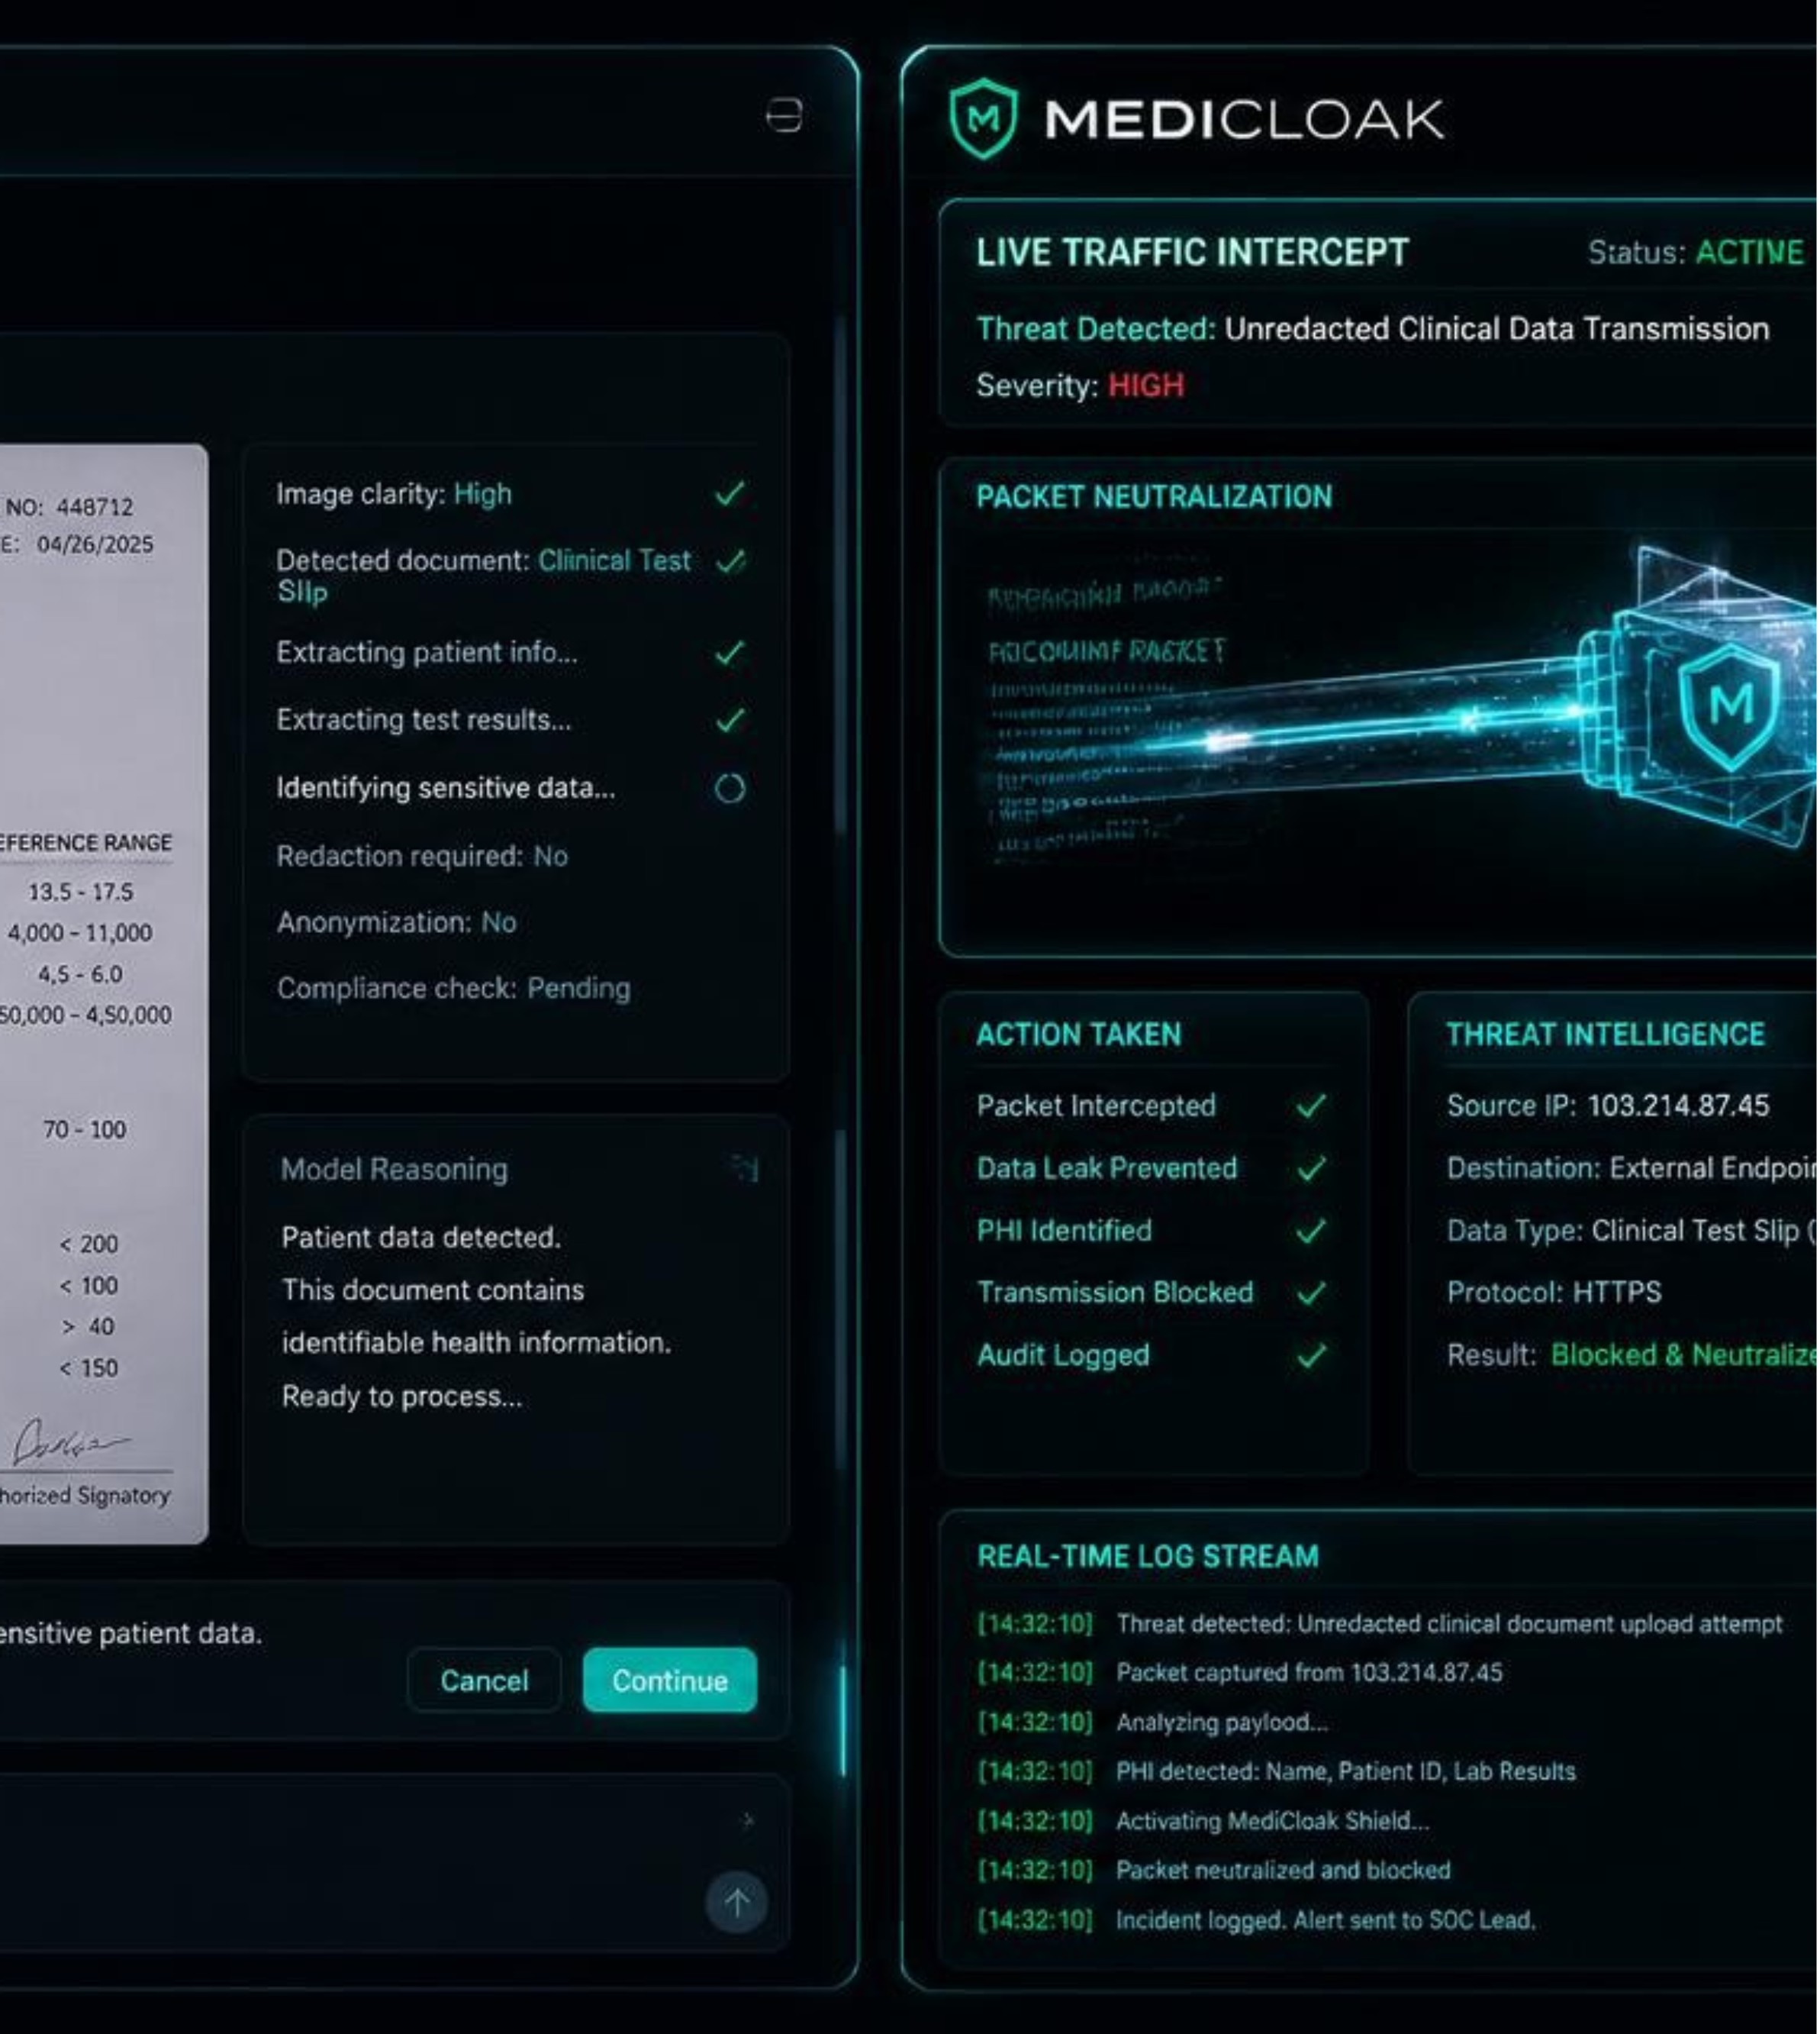
LIVE EVALUATION
REALITY, CLOAKED
Let's intercept an active breach right now in real time.
TRANSPARENT GATEWAY
PORT 8080 INLINE PROXY
Zero-friction deployment. Zero client reconfiguration. Intercepts in-flight browser and API packets.
MULTI-MODAL LIVE PROMPT
READY FOR ANY DOCUMENT
Upload handwritten prescriptions, Dengue CBC slips, or complex Hinglish clinical notes immediately.
SCAN TO TEST YOUR OWN HOSPITAL REPORT
Notes:
Enough talk; on my left a doctor using ChatGPT, on my right MediCloak; I'll upload a critical report and show the cloak live.

