Slide 1
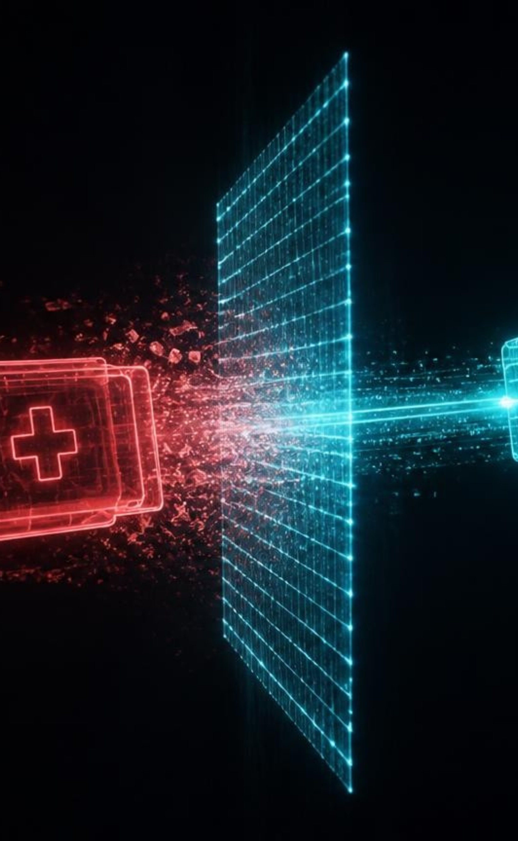
IN-FLIGHT GUARDIAN
MEDICLOAK
ZERO-TRUST IN-FLIGHT HEALTHCARE AI GOVERNANCE
14.2 ms — Average in-flight scrubbing latency
0 bytes — Unredacted data exfiltrated to AI cloud
₹250 Cr — Statutory liability neutralized (DPDPA 2023)
Notes:
Judges, every day Indian doctors paste patient notes and prescription photos into ChatGPT, and every prompt is an illegal breach; MediCloak is an invisible shield that neutralizes identity before packets leave hospital soil.

Slide 2
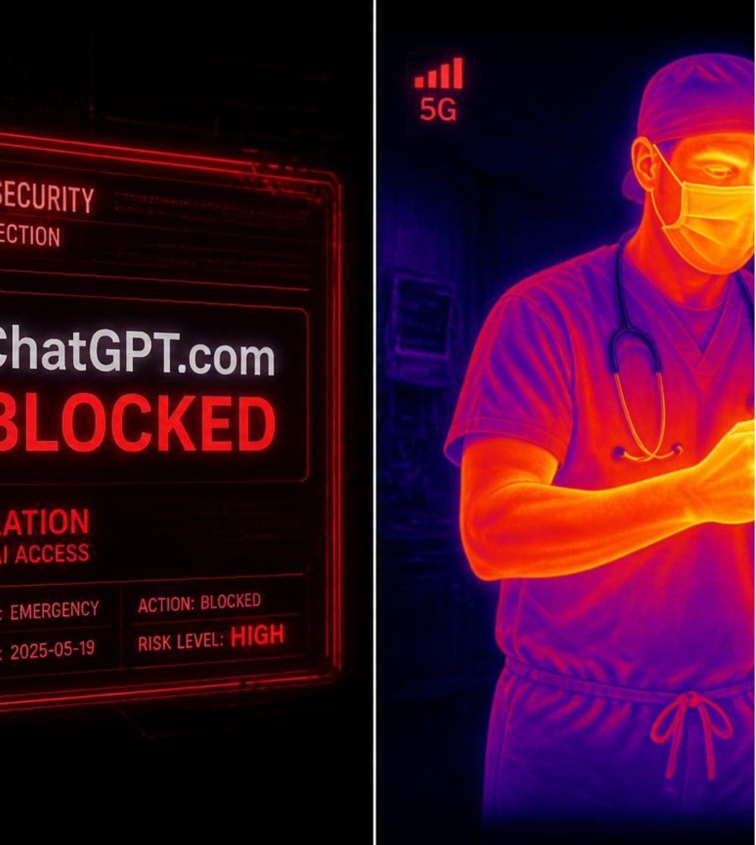
THE BYPASS CRISIS
THE SHADOW AI PARADOX
Firewalls don't stop doctors, they just blind you.
DNS BAN FAILURE
72%
of clinicians bypass DNS bans; bans create unmonitored shadow channels.
MULTI-MODAL LEAK SURGE
60%
of leaks are photos of prescriptions, biopsy scans and ECG slips.
Notes:
Bans don't protect privacy, they blind the CISO; the real crisis is photos of lab slips.

Slide 3
CLINICAL CONTEXT PRESERVATION
WHY BIG TECH DLP FAILS
Naive redaction erases medical reality and causes dangerous diagnostic hallucinations.
STANDARD CLOUD DLP (AWS MACIE / GOOGLE)
MEDICLOAK DUAL-PASS WHITELIST
CONTEXT-BLIND REDACTION
100% MEANING PRESERVED
Input prompt evaluated:
Protected payload output:
Patient presenting with acute [LOCATION] Eye and [LOCATION] Belly. Prior history of [LOCATION] Foot.
Patient presenting with acute Madras Eye and Delhi Belly. Prior history of Jaipur Foot.
CRITICAL CLINICAL HALLUCINATION
250+ REGIONAL CLINICAL TERMS SAFE
Standard NER strips Indian geographic terms, destroying vital clinical meaning and triggering diagnostic errors.
Whitelisted medical terminology retains pathology semantics while stripping actual PII identifiers.
Notes:
Google DLP and AWS Macie blindly redact city names in "Madras Eye" and "Jaipur Foot", the AI hallucinates; the Dual-Pass Whitelist is built for Indian clinical reality.

Slide 4
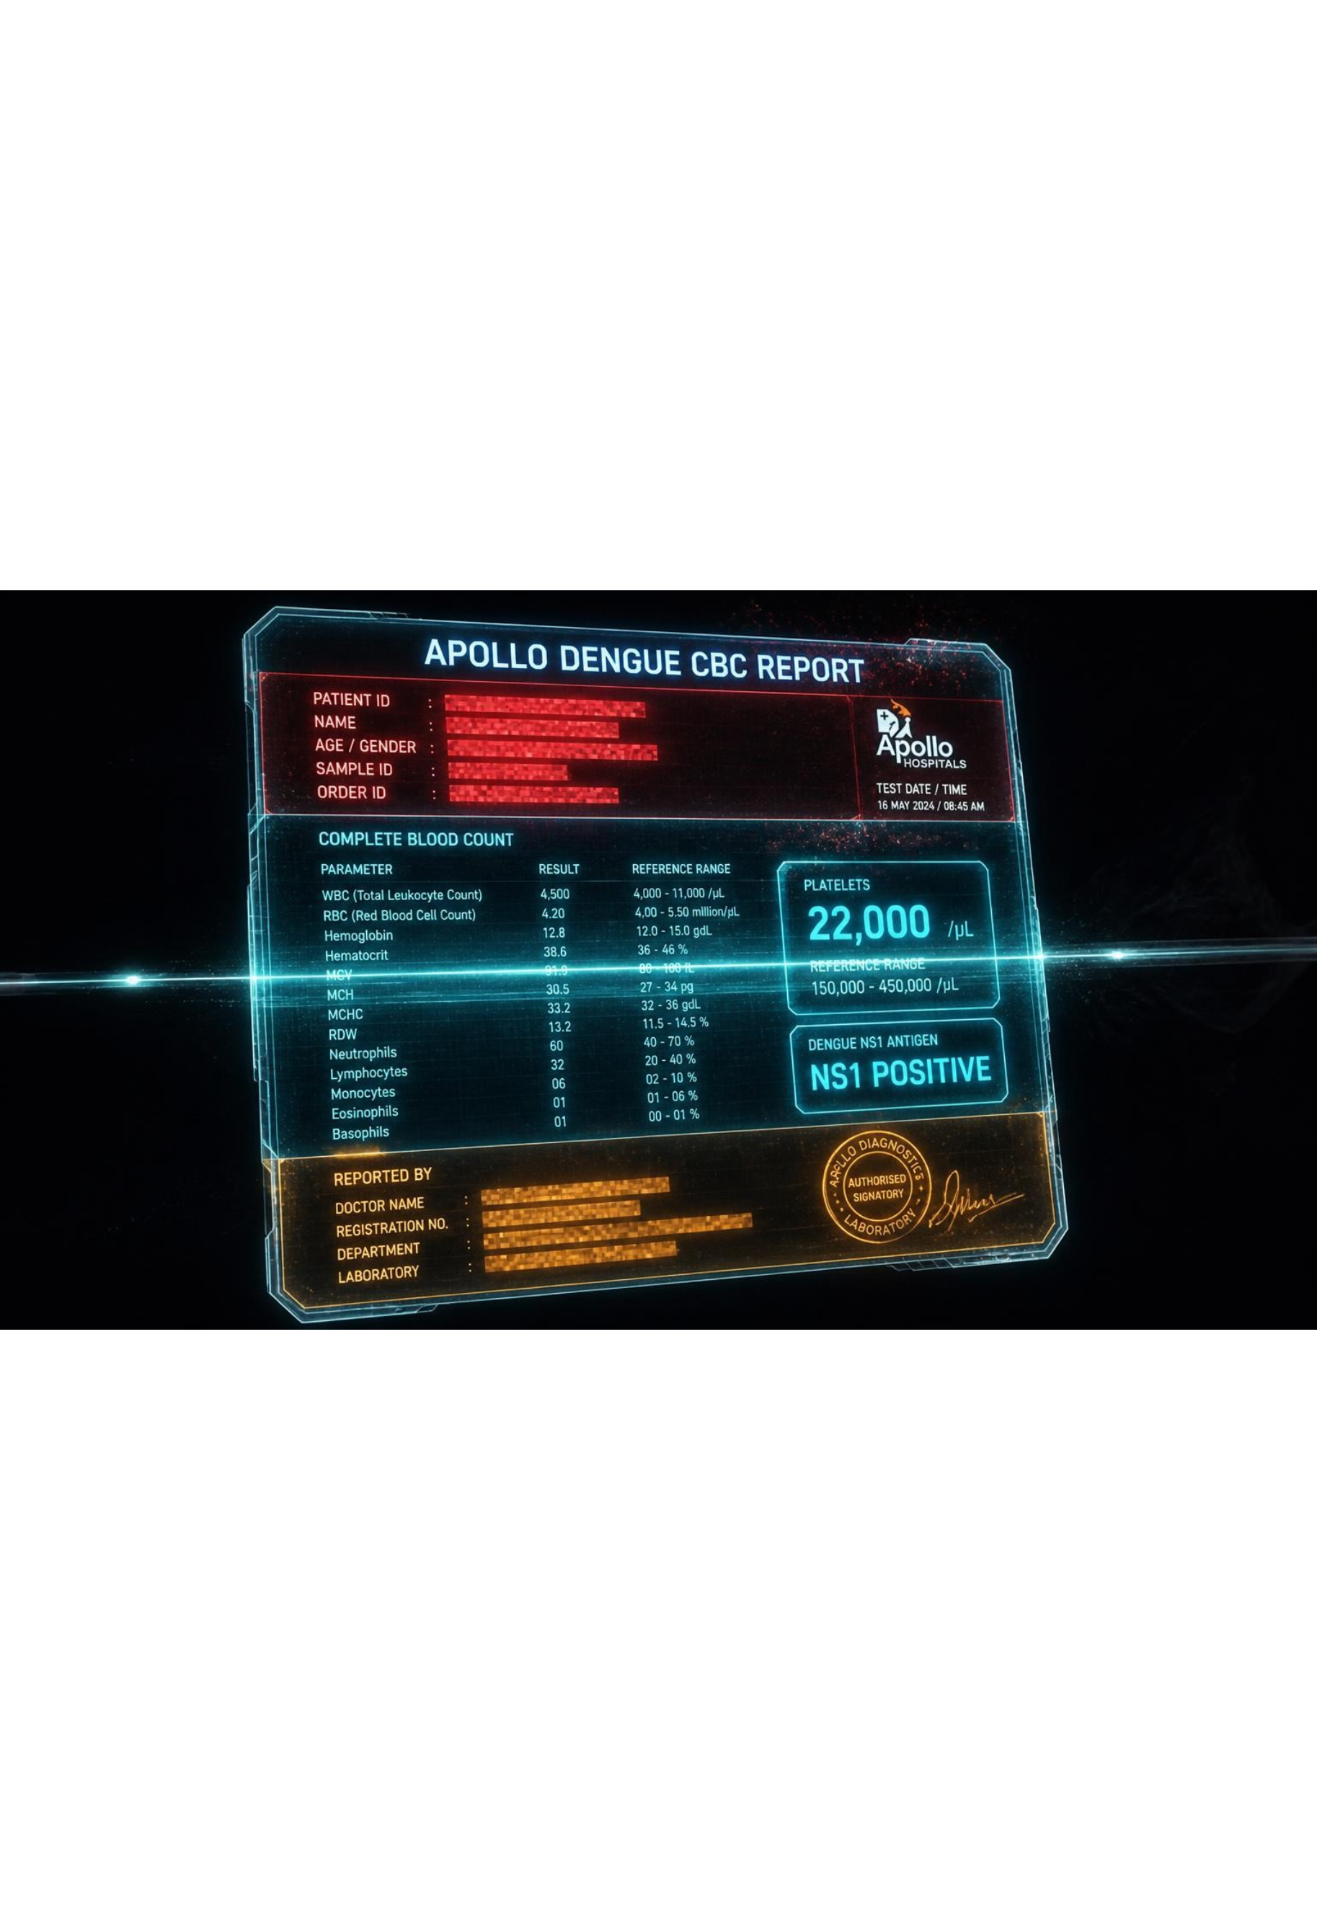
VISION SHIELD ARCHITECTURE
THE MULTI-MODAL REVOLUTION
Dual-Quadrant In-Flight De-Identification: Patient & Clinician Shielded in RAM
UPPER QUADRANT
Patient demographics, ABHA ID, CR No & barcodes vaporized in RAM.
LOWER QUADRANT
Doctor signature, NMC/GMC Reg No & hospital seal masked under DPDP Act 2023.
BYTE-EXACT COM PADDING
Non-destructive JPEG markers eliminate AWS S3 Content-Length mismatch errors.
Notes:
Every other tool forgets the doctor; exposing a signature and seal is a DPDP violation; we strip both and keep every diagnostic number.

Slide 5
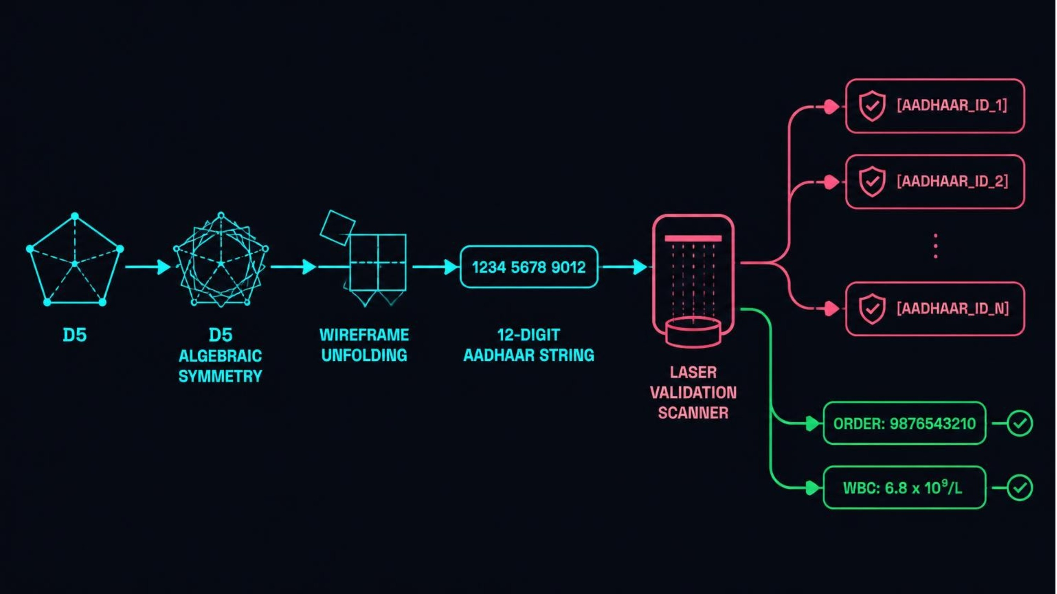
ALGORITHMIC CERTAINTY
ZERO FALSE POSITIVES
Algorithmic Verification via Dihedral Group D5 Checksum
VERHOEFF D5 CHECKSUM
100% PRECISION
No false redaction of order numbers, WBC counts or blood pressure.
ABDM & ABHA NATIVE
14-DIGIT IDS
Detected in all formats in milliseconds.
Notes:
False positives fail emergency medicine; D5 Verhoeff verifies Aadhaar with 100% precision.

Slide 6
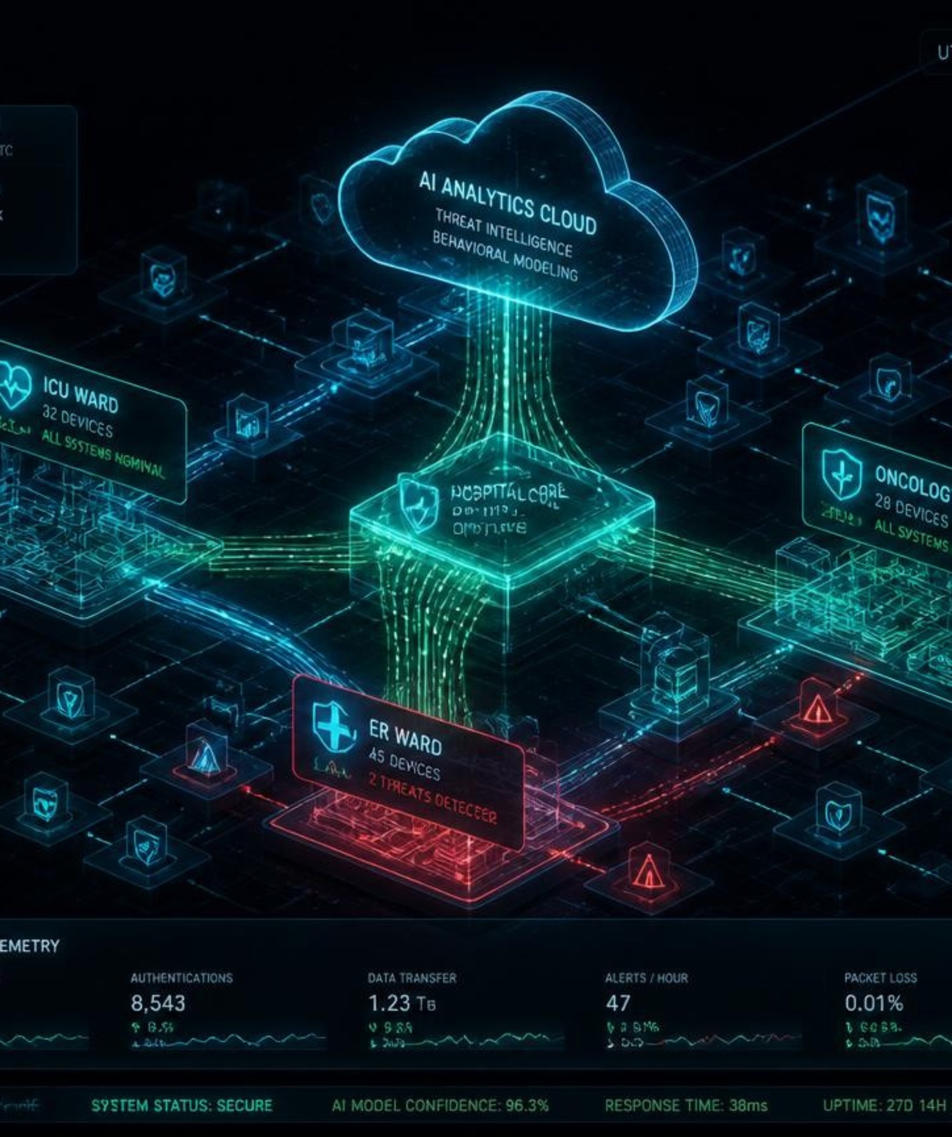
AIR-TRAFFIC CONTROL
THE CISO AIR-TRAFFIC CONTROL
50+ AI PLATFORMS
Governed in real-time, from ChatGPT to clinical scribes.
WEBSOCKET STREAM INTERCEPT
Token-by-token de-identification for bidirectional AI streams.
1-CLICK SOC MITIGATION
Side-by-side prompt & scan diffs, audit logs & voice escalation.
Notes:
CISOs get an air-traffic-control view with live threats, shadow-AI topology and one-click prompt and image diff audit.

Slide 7
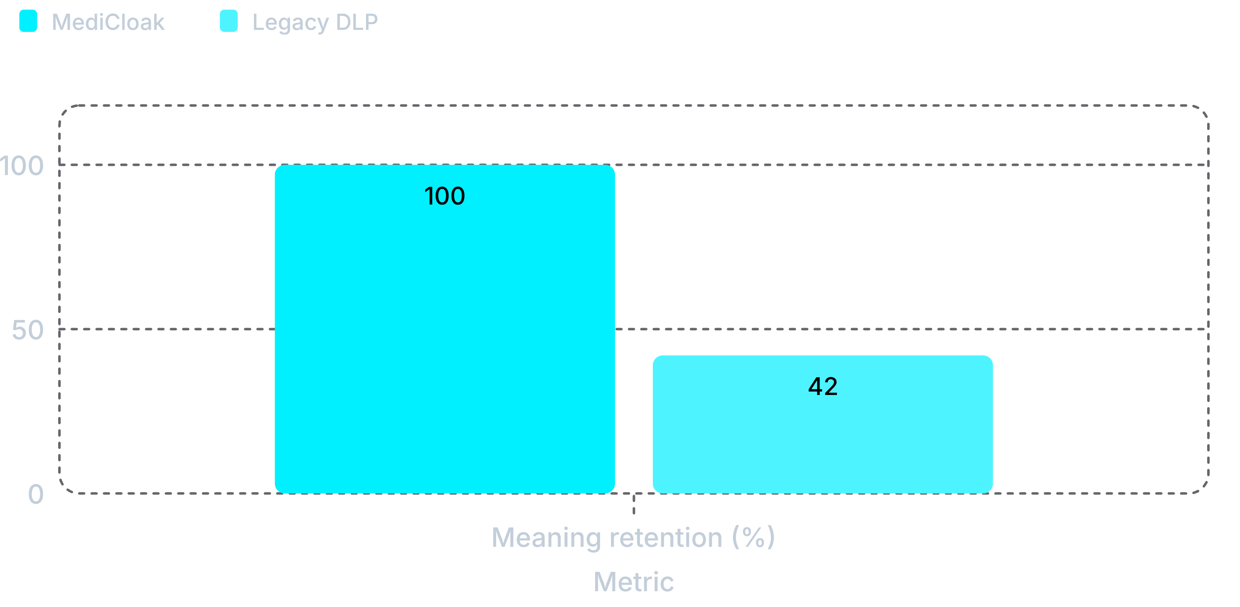
BENCHMARK PROOF
THE HARD NUMBERS
Validated across 8 hospital specialties
LATENCY
14.2 MS
Overhead vs 450 ms for cloud APIs
HOSPITAL BENCHMARKS
CLIENT INSTALLS
0
8
Transparent Layer-7 proxy (zero endpoint software)
AIIMS, Apollo, Max, Tata Memorial, Fortis, Medanta
MediCloak keeps clinical meaning and is far faster. Comparison dimensions: latency, meaning retention (100% vs 42%), vision shield, doctor seal protection and deployment friction.
Notes:
Eight real workflows from AIIMS to Tata Memorial: 14.2 ms, zero installs, 100% meaning preserved.

Slide 8
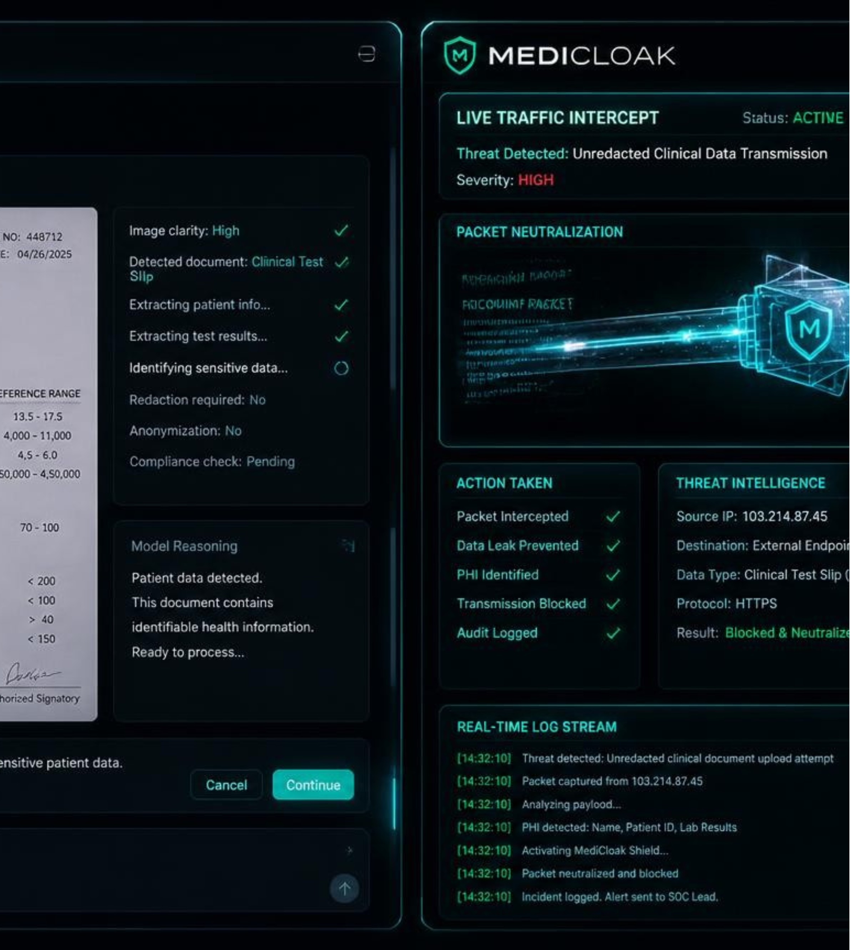
LIVE EVALUATION
REALITY, CLOAKED
Let's intercept an active breach right now in real time.
TRANSPARENT GATEWAY
PORT 8080 INLINE PROXY
Zero-friction deployment. Zero client reconfiguration. Intercepts in-flight browser and API packets.
MULTI-MODAL LIVE PROMPT
READY FOR ANY DOCUMENT
Upload handwritten prescriptions, Dengue CBC slips, or complex Hinglish clinical notes immediately.
SCAN TO TEST YOUR OWN HOSPITAL REPORT
Notes:
Enough talk; on my left a doctor using ChatGPT, on my right MediCloak; I'll upload a critical report and show the cloak live.

