Slide 1
Glioma Grade Classification
Comparing four machine learning models
Can clinical and mutation features predict the dataset's LGG or GBM label?
839
23
4
30
original records
input features
models
shared splits
An educational study, not a medical diagnostic system.
DSC 201 | Tarun Vigneswaran | Educational comparison
1/7
Notes:
I wanted to compare four common classification models on the
same dataset. The question is which model gives the best results under the same
evaluation process. This project predicts labels in existing glioma records;
it does not diagnose people.

Slide 2
What are we trying to distinguish?
CLASS 0
CLASS 1
Lower-Grade Glioma
LGG
Glioblastoma
GBM
All records are from people with glioma. We are predicting grade labels,
not deciding whether someone has a brain tumor.
GBM is the positive class for precision, recall, and F1.
DSC 201 | Tarun Vigneswaran | Educational comparison
2/7
Notes:
There are two labels in this dataset. We are distinguishing
between those labels, rather than deciding whether someone has a brain tumor.
For precision, recall, and F1, I treated GBM as the class the models are trying
to identify. This makes it clear what those scores mean.

Slide 3
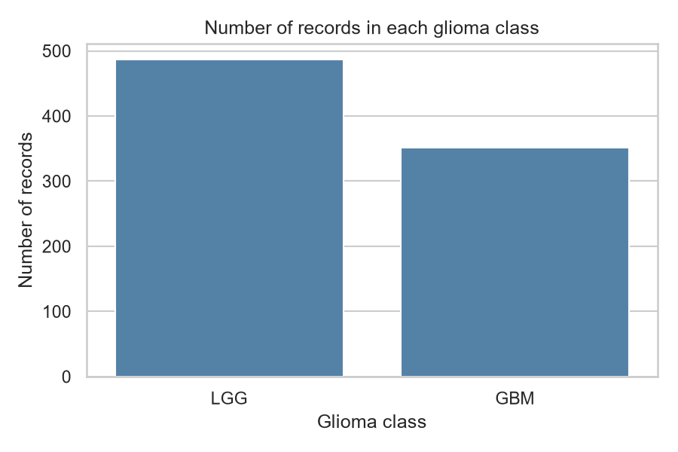
The approved UCI dataset
839 original records
20 gene-mutation features
3 clinical features: age, gender, race
487 LGG and 352 GBM records
Tasci and colleagues (2022) | UCI dataset 759
DOI: 10.24432/C5R62J
DSC 201 | Tarun Vigneswaran | Educational comparison
3/7
Notes:
The approved dataset has 23 input features. Most are yes/no
gene-mutation indicators. There are more LGG than GBM cases, so I did not rely
on accuracy alone. The original file and variable dictionary are saved with
the project so the source can be checked.

Slide 4
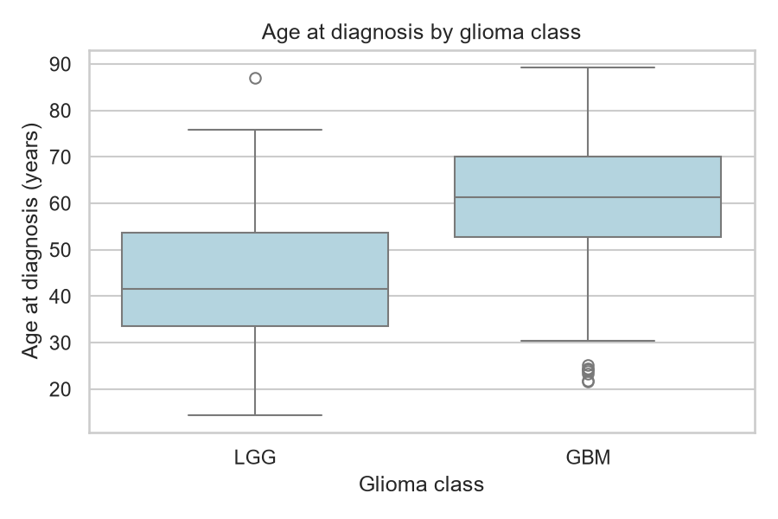
Explore first, then prepare the data
No missing values to fill
Remove one exact repeat: 838 rows
Keep all ages: no IQR flags
Encode Race with yes/no columns
GBM records tend to be older here, but age ranges overlap.
A pattern in this sample does not establish cause and effect.
DSC 201 | Tarun Vigneswaran | Educational comparison
4/7
Notes:
I checked the data before cleaning it. Since there were no
missing values, I did not fill anything in. I removed one exact repeat to avoid
identical records being split between training and testing. Without patient IDs,
that is a judgment rather than proof of a repeated person. The box plot shows
an age difference in this sample, but age cannot perfectly separate the classes.

Slide 5
Four models, the same fair test
Logistic Regression
Random Forest
AdaBoost
XGBoost
1. Split
80% train / 20% test; same people for all models
2. Tune
Small grids; five-fold CV on training data only
3. Evaluate
Held-out test accuracy, precision, recall, and F1
Repeat the complete process 30 times.
Scale Logistic Regression inside its pipeline; GBM F1 selects settings.
DSC 201 | Tarun Vigneswaran | Educational comparison
5/7
Notes:
Every model got the same split within a repetition. I tuned
settings using only the training set and chose them by GBM F1. The test set was
used afterward. I repeated the full process 30 times because one split can give
a misleading picture. Scaling stayed inside the Logistic Regression pipeline
so validation and test data did not set the scaling values.

Slide 6
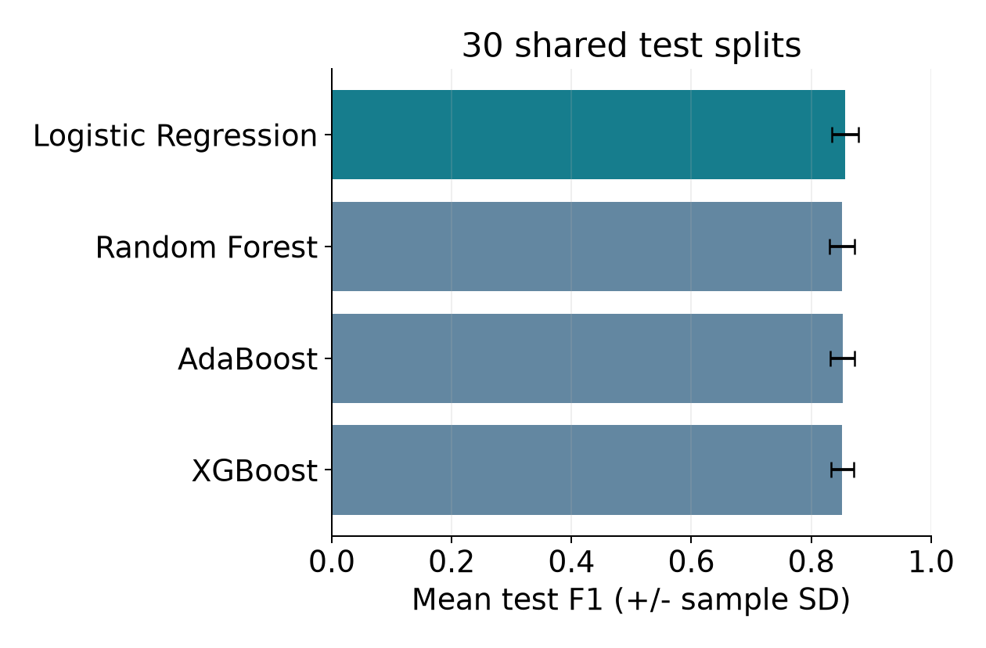
Results: similar scores, a small lead
Model | Accuracy | F1
Logistic Regression | 0.8706 | 0.8566
Random Forest | 0.8655 | 0.8514
AdaBoost | 0.8633 | 0.8523
XGBoost | 0.8641 | 0.8517
Mean test scores across 30 splits.
Clinical features improved mean F1
for only 1 of the 4 models.
Logistic Regression leads mean F1 by just 0.0043. This is not proof of a universal winner.
DSC 201 | Tarun Vigneswaran | Educational comparison
6/7
Notes:
These scores are averages across all 30 test splits. The
chart's error bars show the standard deviation across those splits.
Logistic Regression had the highest mean F1 in the main comparison, but the lead was small.
The optional comparison also shows that adding clinical features did not improve
every model. The separate confusion-matrix figure shows seed 100 only, not a
combined result across all repetitions.

Slide 7
What we can conclude
A simple model was competitive with the tree ensembles.
Small sample
Overlapping tests
No external test
838 prepared records;
some groups are very small
30 splits are not
30 independent studies
New data and settings
could change the ranking
More testing, privacy protection, and human review are needed
before any practical medical use.
DSC 201 | Tarun Vigneswaran | Educational comparison
7/7
Notes:
The main lesson is the importance of a fair comparison and
repeated evaluation. These models showed useful patterns in this dataset, but
we have not tested them on patients from another source or checked fairness
across groups. This remains a classroom study, not a clinical decision system.

