Slide 1
Injury Risk in University Soccer Players
Predicting Injury Risk with Data
Tarun Vigneswaran & Joseph Altmann · 4/6/26 · DSC 101
Notes:
Today, I will be discussing our project on the injury risk in soccer players from universities. Our objective in undertaking this project is to gain insights into the causes of injury using data. This will enable us to find ways through which we can prevent injuries.

Slide 2
Data Background and Overview
Dataset contains data for 800 Chinese university soccer players
Includes 18 variables covering
Basic information (age, height, weight, etc.)
Physical fitness (agility, sprint speed, balance, flexibility, etc.)
Training factors (training hours, matches played, etc.)
Lifestyle Habits (sleep, stress, nutrition, warmup routine)
Injury outcome
Data obtained from Kaggle, originates from a comprehensive study done by the university using medical records, coach reports, and student surveys. Published in Scientific Reports (2025)
Notes:
The database consists of details about 800 university football players in China. The dataset is composed of 18 attributes that include basic physical characteristics of the participants such as age, height, and weight; fitness indicators such as agility and balance; factors related to training and lifestyle, such as sleeping patterns, stress level, and nutrition; and finally the presence of an injury among the players.

Slide 3
Research Objectives
Research Questions
Which physical characteristics and fitness measures are most strongly associated with an increased risk of future injury?
What lifestyle habits or routines are most strongly linked to an increased likelihood of future injury?
Does previous injury, poor warmup, or over-training actually raise the likelihood of an injury
Does a player's position put them at higher risk of an injury
Notes:
The primary objective of this study will be to investigate various determinants and the relationship of these with the likelihood of sustaining an injury, including training volume, past history of injuries, physical conditioning, and lifestyle practices. The purpose will be to determine those factors that have the greatest impact on injury incidence.​

Slide 4
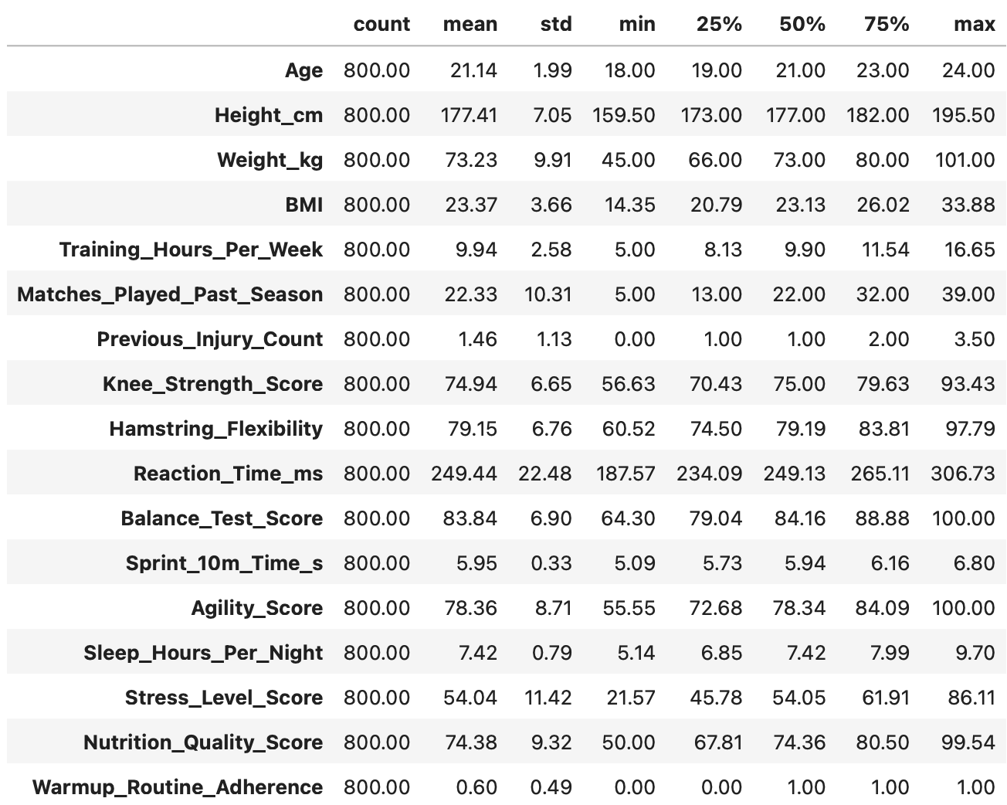
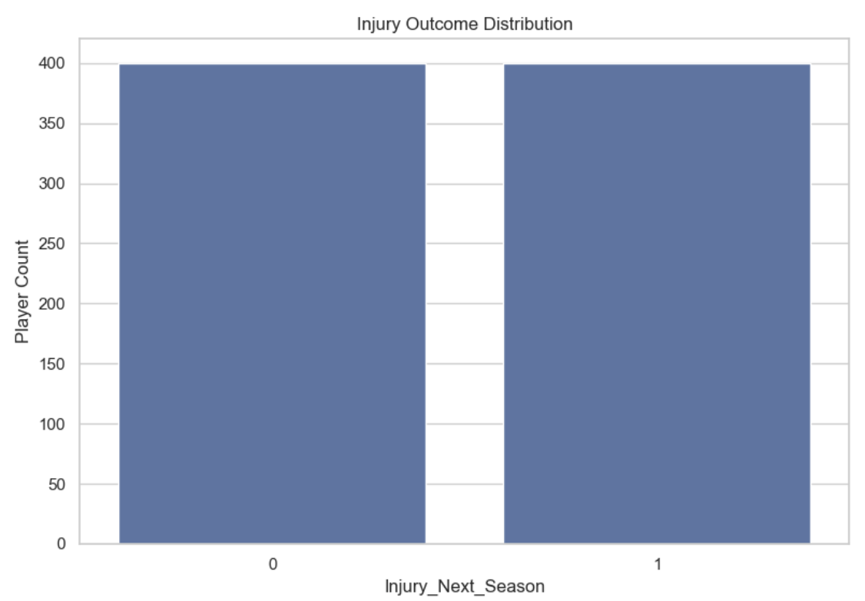
Exploratory Data Analysis
[ Image ]
Each variable has a numeric value associated with it to compare each player effectively
Descriptive Statistics for Numerical Variables
Notes:
This slide presents descriptive statistics of all numeric variables from the dataset. It allows us to grasp general characteristics of the data distribution, including means and ranges of different metrics. For instance, the slide demonstrates the mean number of hours spent on training, fitness scores, and many more interesting details. This part is essential as it creates a basis for further analysis.​

Slide 5
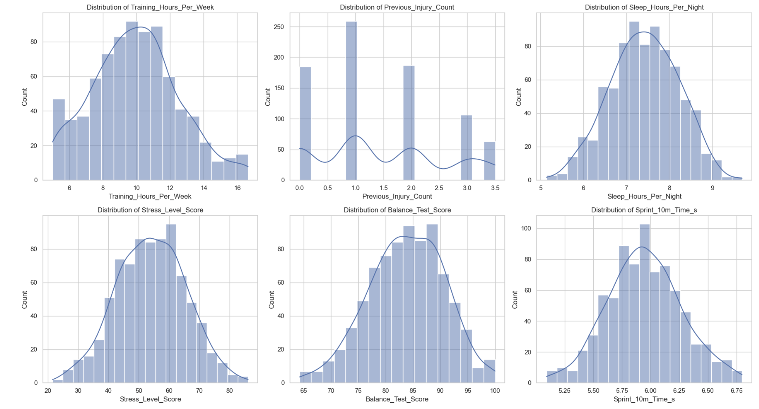
Key Variable Value Distribution
[ Image ]
Notes:
Here, the distribution of key variables through histograms is considered. The majority of the key variables have a normal distribution pattern, meaning that the data set has a balanced distribution and is ideal for analysis. Moreover, this assists in determining the average value of key variables for players.​

Slide 6
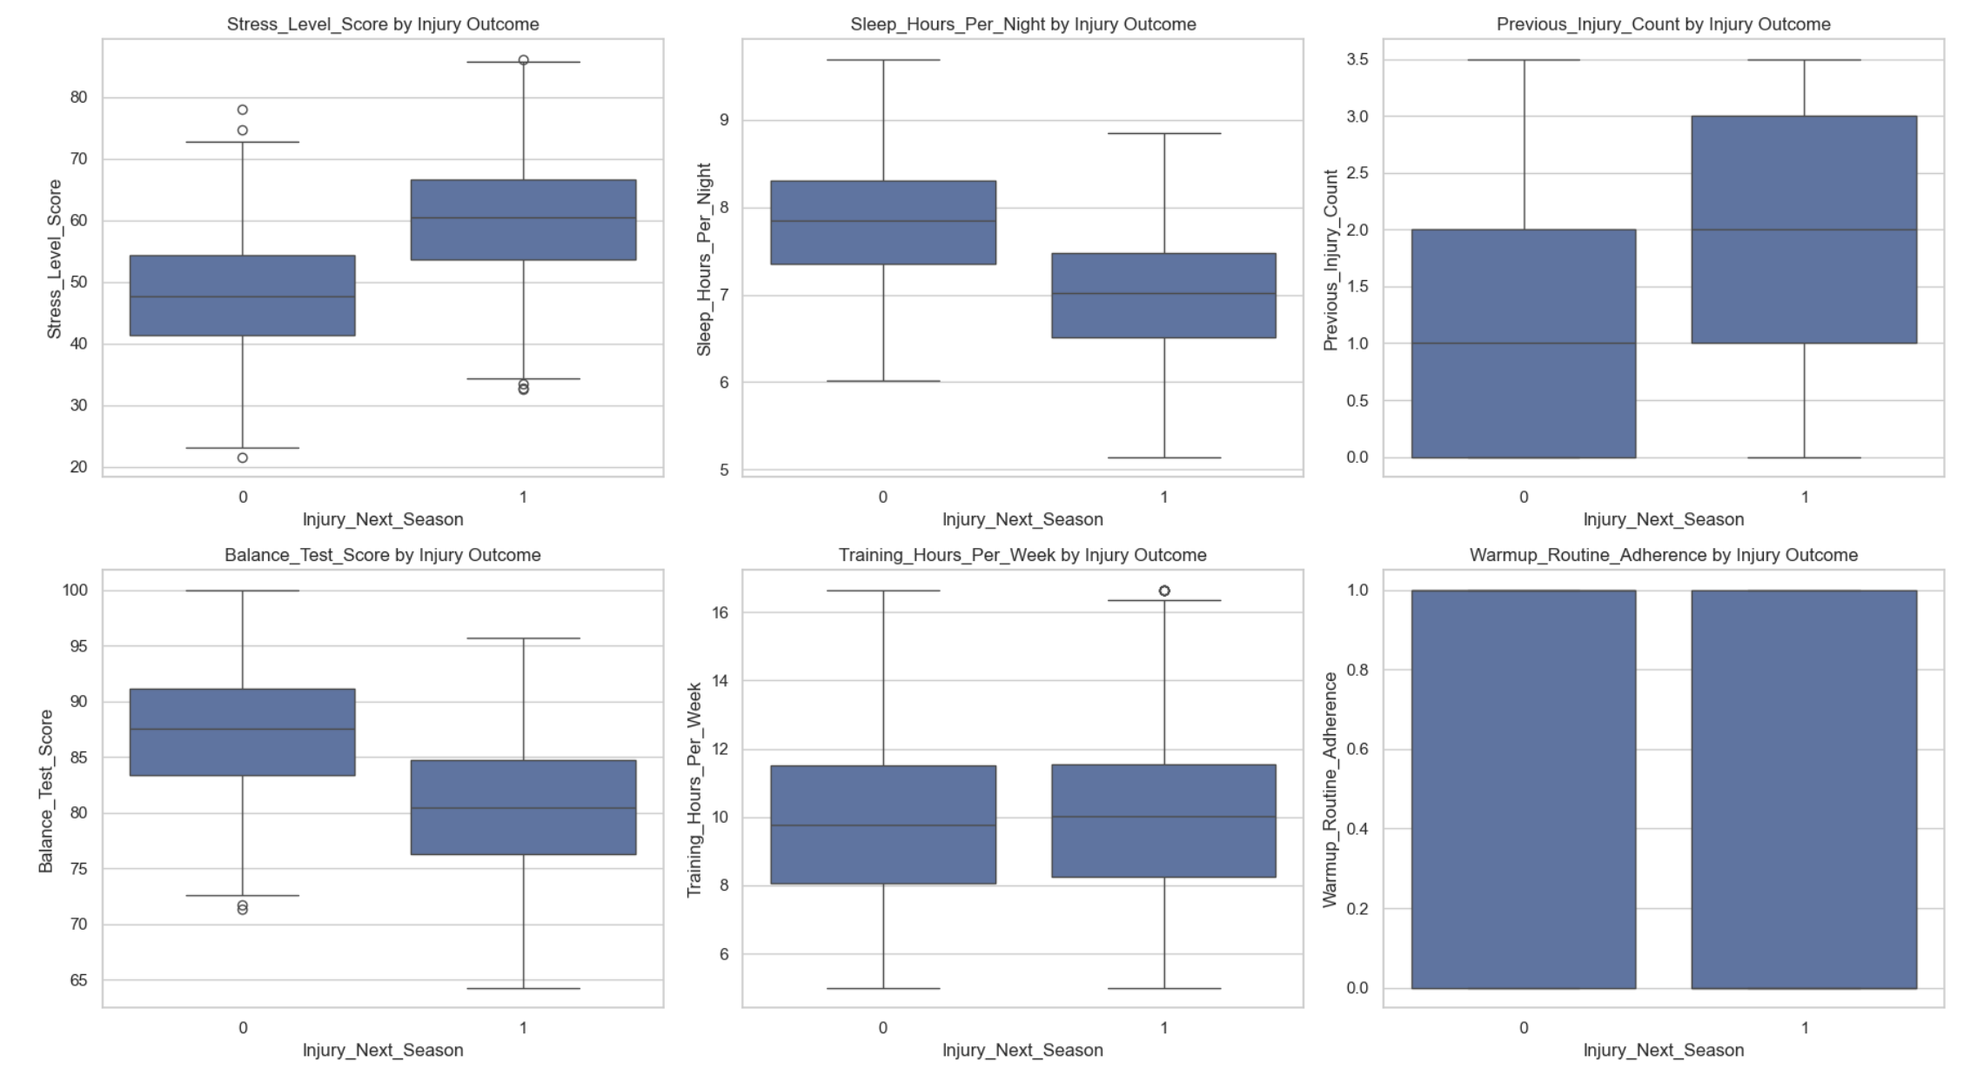
Boxplots
[ Image ]
Notes:
The box plots show the comparison between players who were injured and those who were not. It is clear that there are notable differences between the two groups. The stress levels for players who sustained injuries are relatively higher, while their sleep and balance abilities are lower.​

Slide 7
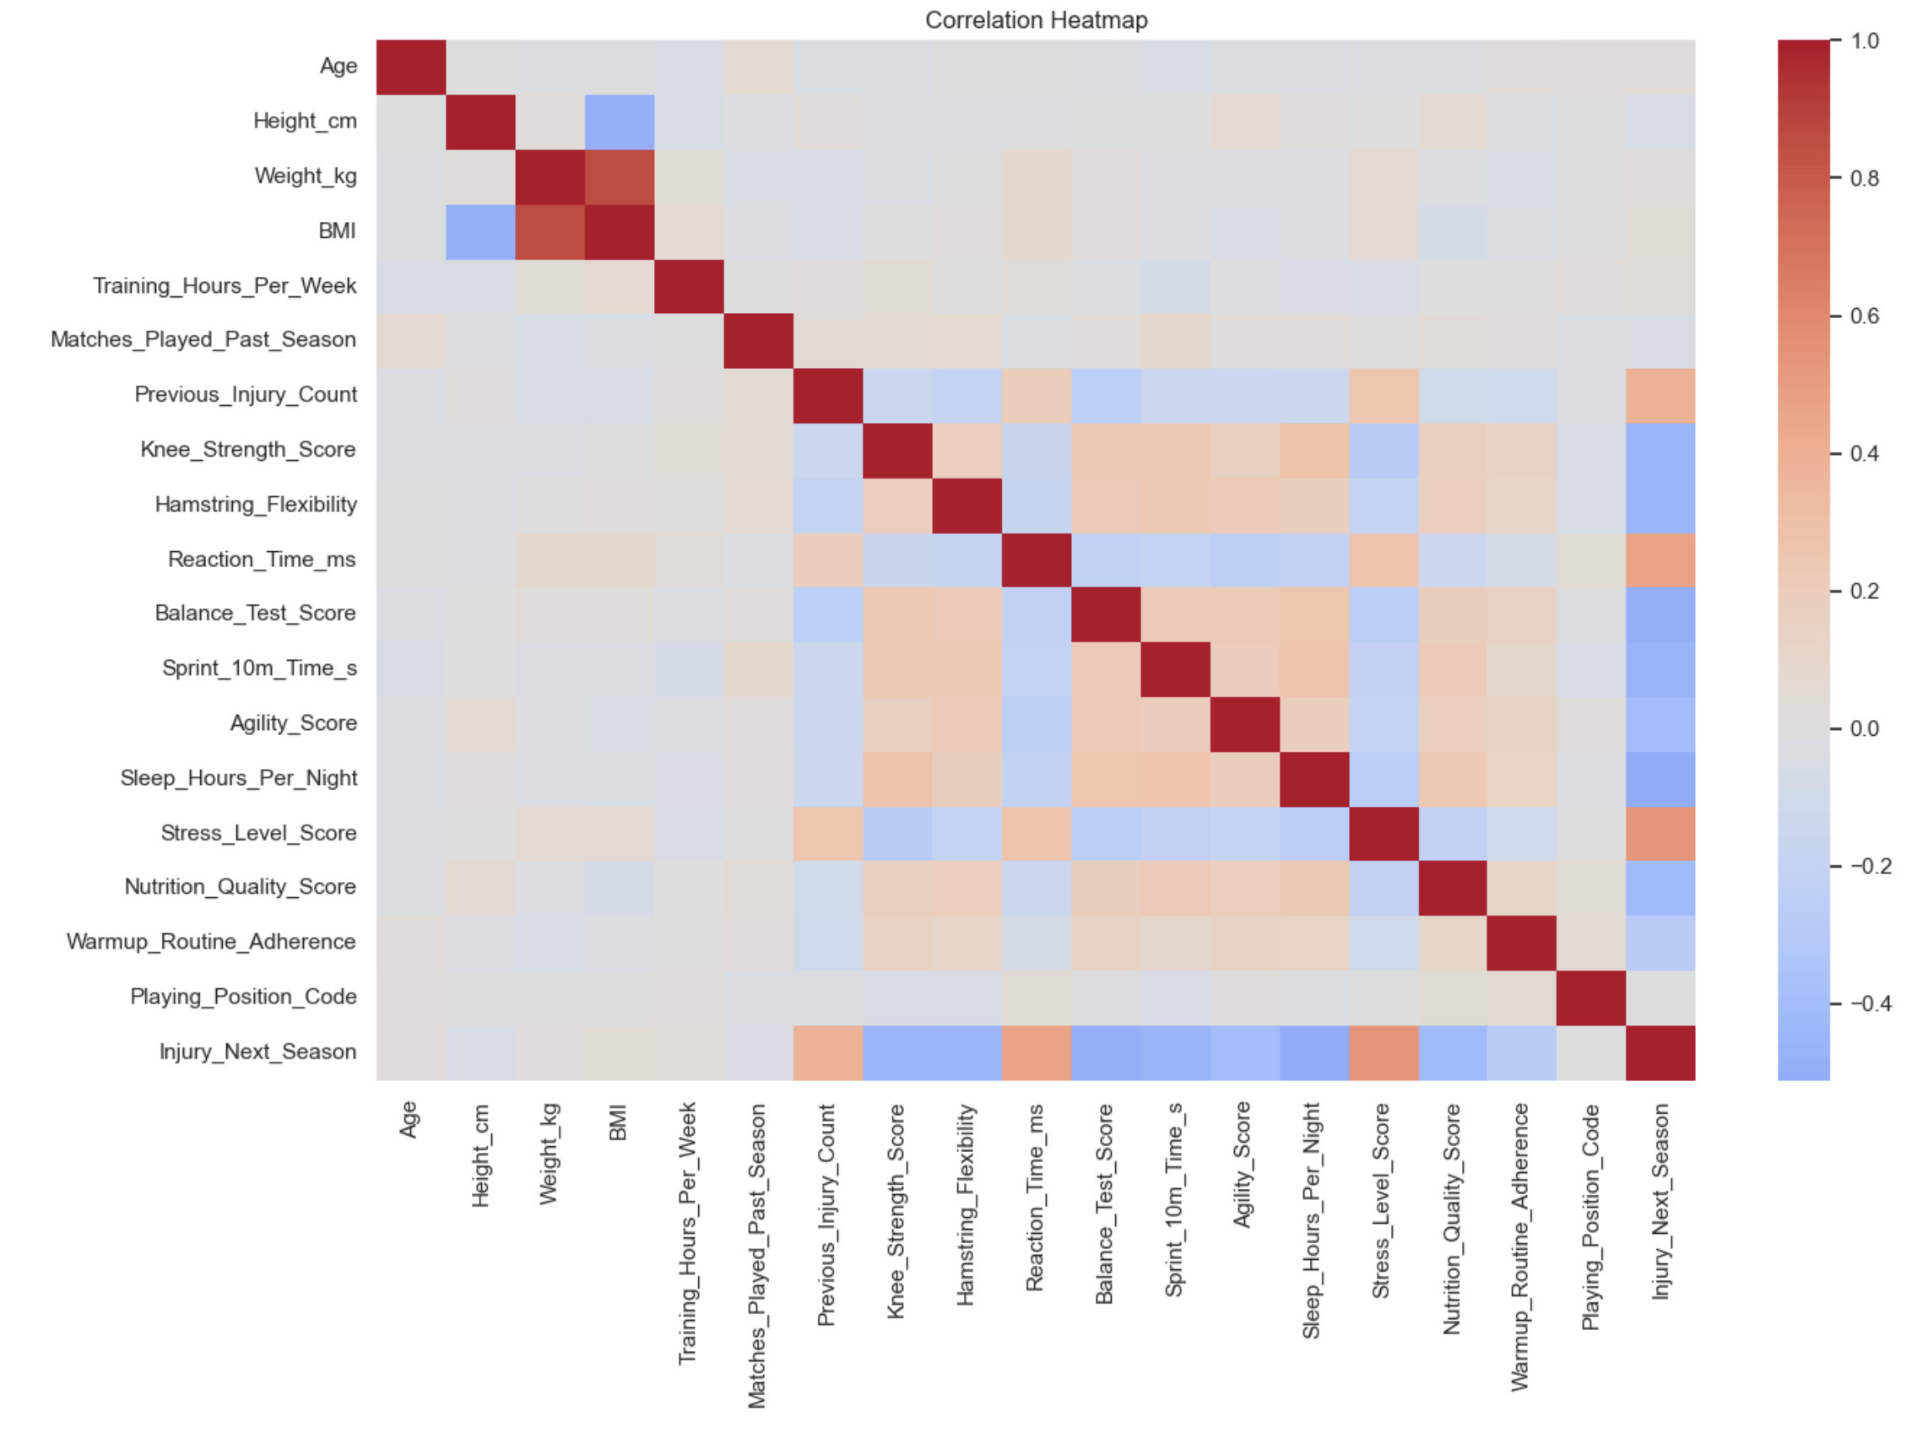
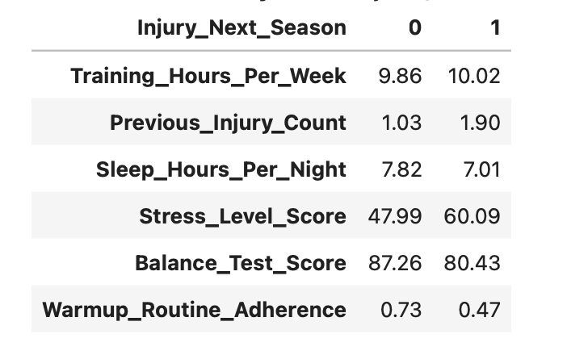
Correlations
[ Full-width Image ]
Red Boxes = Positive Correlation
Ex. High stress levels correlate with injury
Blue Boxes = Negative Correlation
Ex. Poor nutrition leads to injury
Notes:
This correlation matrix demonstrates the relationship between various variables. The color red signifies a positive correlation, and the color blue shows a negative correlation. It is clear from this correlation matrix that high levels of stress increase the likelihood of injuries, while proper nutrition and healthy behaviors decrease the likelihood of injuries.​

Slide 8
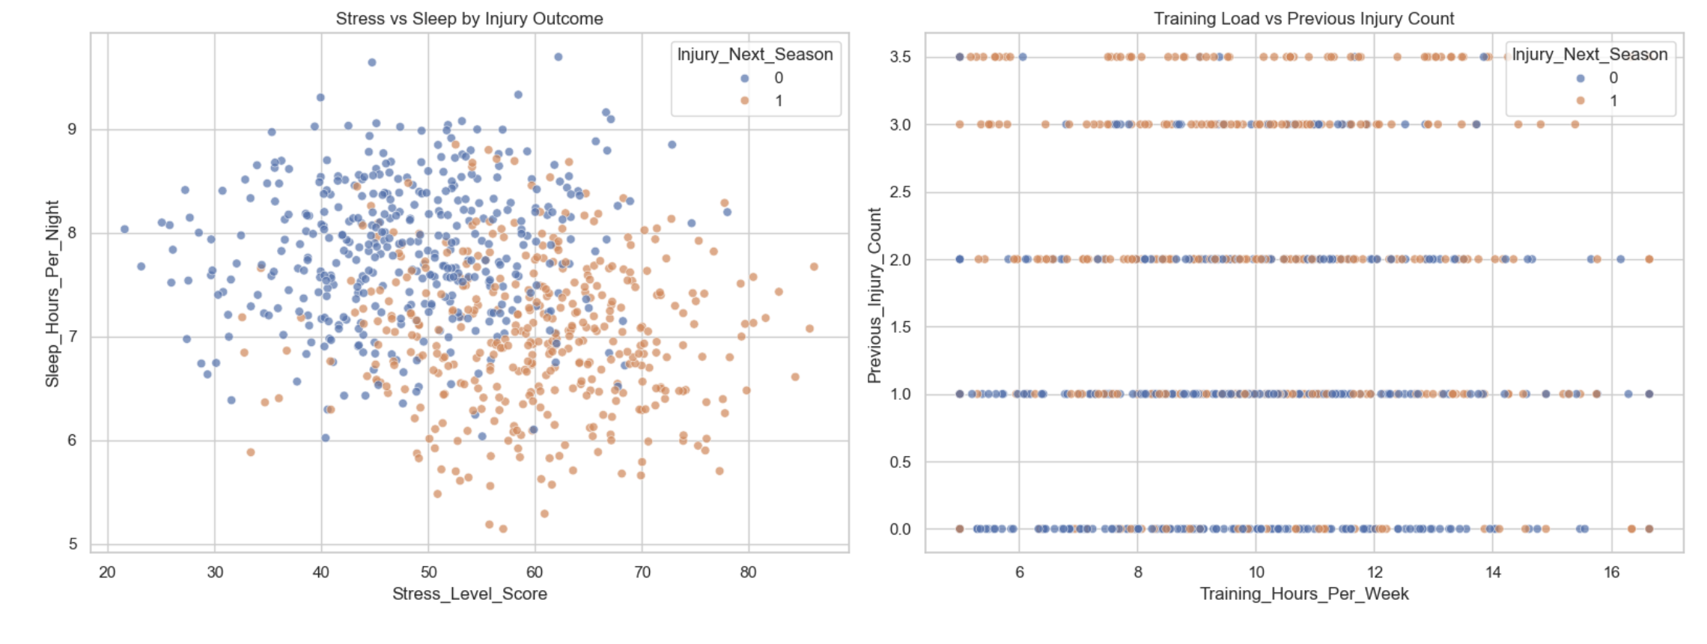
Scatterplots
[ Image ]
Notes:
These graphs provide a more in-depth understanding of the relationship between variables. For instance, we get to understand the relationship between stress and sleep and the difference between them depending on whether the athletes have sustained injuries.​

Slide 9
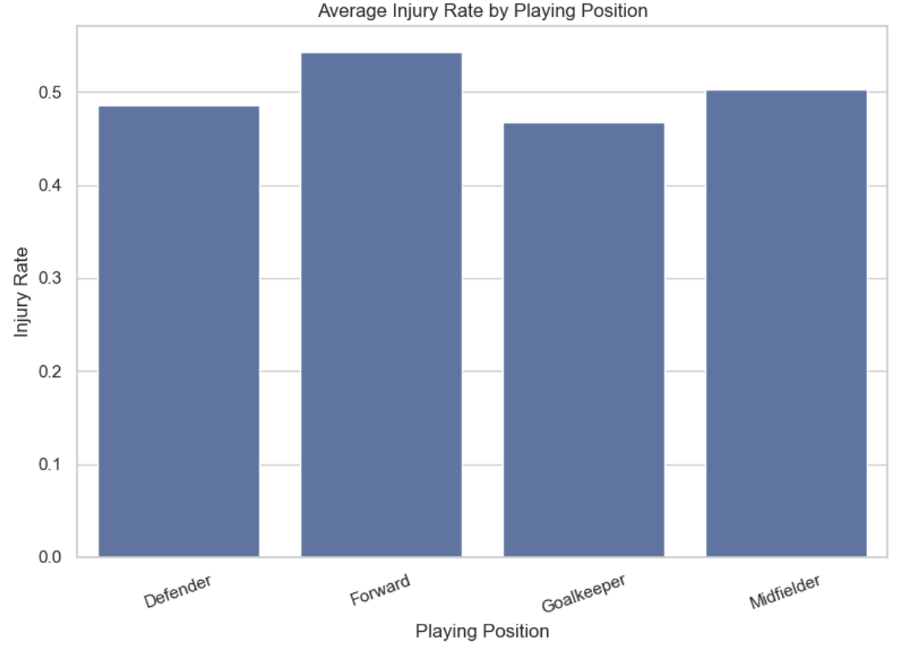
Positional Risk
Notes:
This slide presents injury incidence by playing positions. It is apparent that forwards and midfield players experience a higher rate of injuries than defenders and goalkeepers. This may be due to the fact that these players need to be faster and more mobile while playing.​

Slide 10
Findings
Factors that lead to injury…
Lifestyle: High stress levels, inadequate sleep, and poor nutrition
History: Previous injury count strongly predictive
Physical: Low lower body balance, flexibility, and strength
Behavioral: Inconsistent training and poor warmup adherence
Positional: Forwards and Midfielders at a higher risk of injury than Defenders and Goalkeepers
Notes:
In general, it can be stated that a number of variables may increase the possibility of injuries. First of all, lifestyle-related characteristics, including stress, sleep problems, and improper nutrition, have been shown to significantly affect the chances of injuries. Second, the history of previous injuries plays an important role in predicting future injuries.​

Slide 11
Ethical Concerns
Privacy and Data Security
Athlete health is highly sensitive
High security measures required
Fairness and Equity
Avoid stigmatization of “high-risk” players
Responsible Implementation
Avoid overreliance on prediction models
Informed consent for data use
Transparent communication with athletes
Notes:
Moreover, there are several ethical implications related to the use of this kind of information. Health-related data of athletes is extremely sensitive, and, therefore, security and privacy become crucial elements. Additionally, it is essential not to classify players as high-risk individuals and cause harm to them. The primary goal of such models is to assist in decision-making and not substitute humans, informing athletes of all data usage aspects.​

Slide 12
Conclusion
This research is of high value to athletes and sport clubs to see what they should and shouldn’t do in order to prevent injury
Business is better for sport clubs when their athletes are healthy and playing the sport for fans to watch. Teams will being more fans in when their favorite athletes are healthy
In the future…
Potentially stretch research to multiple seasons
Diversify populations
Implementation of research
Notes:
To conclude, this study offers important information that can assist in lowering injury rates among sportsmen and sport teams. Improved health results in improved performance and enjoyment on the part of sportsmen and spectators. This study can be further developed by considering several sport seasons and introducing the information gained into practice.​

