Slide 1
PROJECT 1 • DSC 201
Edmunds Car
Recommender System
reviews
similarity
preference
Turning 226,931 consumer reviews into relevant, personalized vehicle recommendations
CONTENT-BASED
COLLABORATIVE SVD
HYBRID
ranked cars
Tarun Vigneswaran
Structured Edmunds Car Reviews Dataset
01
Notes:
For this project, I built a car recommender system using the Structured Edmunds Car Reviews dataset. The goal was to turn consumer reviews and ratings into useful vehicle recommendations. I developed three approaches: a content-based model, a collaborative SVD model, and a hybrid model that combines both.

Slide 2
PROJECT FRAMING
2
What problem are we solving?
A single dataset must support content, collaborative, and hybrid recommendation.
THE QUESTION
Which vehicle should this user explore next?
Use what reviewers wrote, how they rated vehicles, and the selected vehicle context.
Content relevance
01
Find vehicles described with similar review language.
Personal preference
02
Learn user–vehicle patterns from repeated ratings.
Grading alignment
● Clear dataset, features, and goal
● Substantial cleaning and preprocessing
● Three required recommender functions
● Efficiency, evaluation, and limitations
Practical ranking
03
Blend both signals and return useful metadata.
Source: Kaggle • Structured Edmunds Car Reviews Dataset
DSC 201 • Project 1
02
Notes:
The main question is: which vehicle should a user explore next? The content-based model identifies vehicles described similarly in reviews. Collaborative filtering learns from users’ rating behavior, while the hybrid model combines relevance and personal preference into one ranked result.

Slide 3
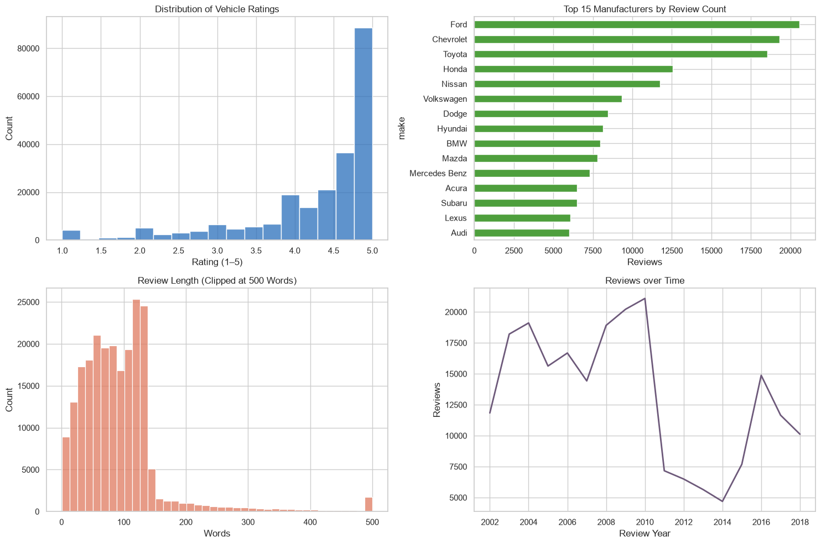
DATASET
3
226K reviews across the vehicle market
Text supports content filtering; author–vehicle ratings support collaborative filtering.
226,931
RAW REVIEWS
50
29,128
MANUFACTURERS
VEHICLE TITLES
1–5
7
RATING RANGE
RAW COLUMNS
Author • vehicle title • review title • review text • rating • date • manufacturer
DSC 201 • Project 1
03
Notes:
The original dataset contains 226,931 reviews covering 50 manufacturers and more than 29,000 vehicle titles. Ratings range from one to five. Review text supplies the descriptive information needed for content filtering, while authors, vehicle titles, and ratings create the user-item interactions needed for collaborative filtering.

Slide 4
PREPROCESSING
4
Cleaning was a modeling decision—not a formality
The workflow protects privacy, removes scrape artifacts, and creates stable user–item interactions.
1
Combine
2
Validate
3
Normalize
4
De-duplicate
5
Anonymize
50 manufacturer CSV files
Ratings constrained to 1–5
Text, dates, makes, model years
Repeated scraped reviews removed
Authors mapped to stable user IDs
224,444
155,074
29,039
15,797
CLEAN REVIEWS
ANONYMOUS USERS
CLEAN VEHICLES
USERS WITH 2+ REVIEWS
2,487 rows removed
Why it matters
Content text becomes comparable; duplicate ratings no longer overweight an item; raw reviewer names never appear in recommendations.
DSC 201 • Project 1
04
Notes:
Data cleaning was especially important because this information came from scraped reviews. I combined the manufacturer files, validated rating values, normalized text and vehicle information, removed duplicate reviews, and replaced author names with anonymous user IDs. The final cleaned dataset contains 224,444 reviews, 155,074 users, and 29,039 vehicles.

Slide 5
SYSTEM DESIGN
5
One cleaned dataset → three recommendation paths
Each model answers a different user need; the hybrid re-ranks content candidates with personalization.
TF–IDF
review language
CLEAN DATA
HYBRID
RANKED CARS
reviews + ratings
55% content
45% collaborative
titles + scores + metadata
SPARSE SVD
user–item ratings
content_based_recommender(title, n)
collaborative_recommender(user_id, n)
hybrid_recommender(title, user_id, k)
Required interfaces completed and demonstrated in the executed notebook
DSC 201 • Project 1
05
Notes:
All three models use the same cleaned dataset. The content model converts review language into TF-IDF features. The collaborative model applies sparse SVD to the user-vehicle rating matrix. The hybrid model retrieves similar vehicles using content and then reranks them using the user’s predicted preference.

Slide 6
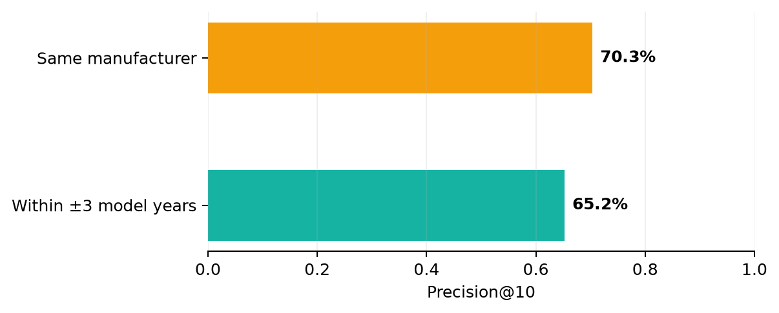
MODEL 1
6
Content-based recommendations are coherent and explainable
TF–IDF unigrams/bigrams + cosine similarity over aggregated review language.
QUERY VEHICLE
2002 Acura RSX Type-S
Top recommendations
1. 1999 Acura Integra GS-R
2. 2004 Acura RSX Type-S
3. 1998 Acura Integra GS-R
4. 2002 Acura RSX Hatchback
5. 2006 Acura RSX Hatchback
18,287
12,000
CONTENT-ELIGIBLE VEHICLES
TF–IDF FEATURES
Interpretation
The nearest neighbors stay within the same product family and nearby model years—strong evidence that review text captures meaningful vehicle similarity.
DSC 201 • Project 1
06
Notes:
The content model aggregates the reviews for each vehicle and represents the text using TF-IDF unigrams and bigrams. Cosine similarity is then used to find vehicles with similar review language. For the 2002 Acura RSX Type-S example, the model recommends other Acura RSX and Integra models, which indicates that it identifies a meaningful product family.
The same-manufacturer precision at 10 was 70.3%, and 65.2% of recommendations were within three model years. This model is explainable and can recommend vehicles even when little user-rating information is available.

Slide 7
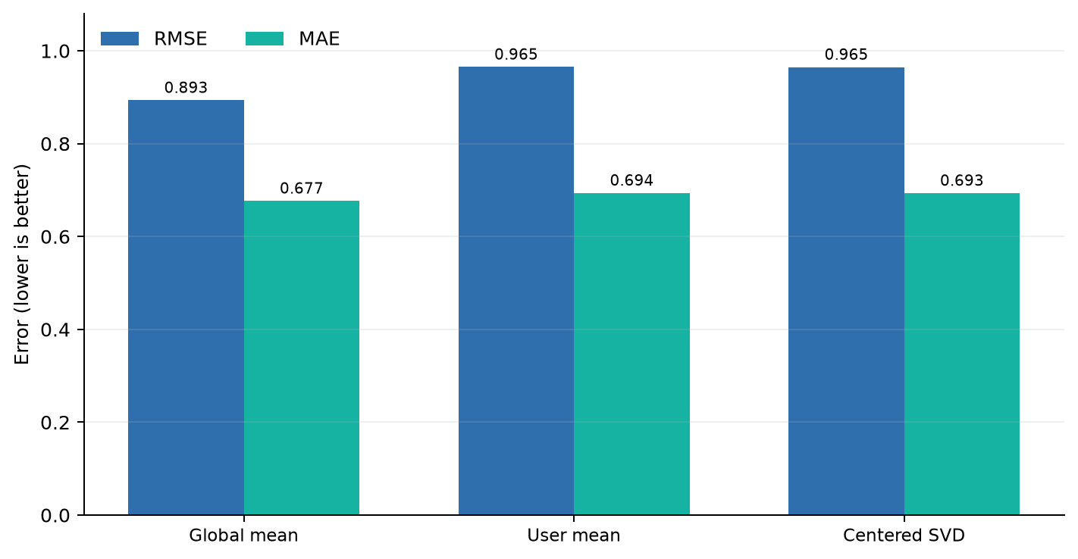
MODEL 2
7
Collaborative SVD adds personalization—but sparsity dominates
User-centered sparse SVD is evaluated honestly against simple rating baselines.
26,662
2,378
K-CORE INTERACTIONS
SUPPORTED USERS
3,384
0.302%
SUPPORTED VEHICLES
MATRIX DENSITY
50
0.384
LATENT FEATURES
EXPLAINED VARIANCE
Honest result
SVD RMSE = 0.965; global-mean RMSE = 0.893. The global average wins because most users rated only one vehicle and ratings are concentrated near 4–5 stars.
Value retained: personalized ranking, not superior rating prediction.
DSC 201 • Project 1
07
Notes:
For collaborative filtering, I created a k-core subset so that the matrix contained users and vehicles with enough rating activity. The final matrix had 26,662 interactions, 2,378 users, and 3,384 vehicles, but its density was only about 0.302%, so it remained extremely sparse.
The centered SVD model used 50 latent features. Its RMSE was approximately 0.965, while the global-mean baseline achieved 0.893. Therefore, SVD did not improve rating-prediction error in this dataset. This is an important result rather than something to hide: most users submitted only one review, and ratings were heavily concentrated near four and five stars. I retained SVD because it still provides a personalized ranking signal for the hybrid model.

Slide 8
MODEL 3
8
Hybrid ranking balances relevance and preference
Retrieve content neighbors first, then re-rank with the user’s SVD score.
HYBRID SCORE
Example ranked output
0.55 × content + 0.45 × preference
Vehicle
Year
Pred.
Hybrid
WHY THIS DESIGN?
Content keeps results relevant to the selected vehicle.
SVD personalizes ordering within that candidate pool.
Previously rated vehicles are excluded.
k controls how many latent features contribute.
2006 Chevrolet TrailBlazer • SUV • LS 4dr • SUV • (4.2L 6cyl 4A)
2006
3.92
0.889
2006 Chevrolet TrailBlazer • SUV • LT 4dr • SUV • 4WD (4.2L 6cy…
2006
3.92
0.879
2004 Chevrolet TrailBlazer • SUV • LS 4WD 4dr • SUV • (4.2L 6cy…
2004
3.92
0.789
2004 Chevrolet TrailBlazer • SUV • LT 4WD 4dr • SUV • (4.2L 6cy…
2004
3.92
0.752
2005 Chevrolet TrailBlazer • SUV • LT 4WD 4dr • SUV • (4.2L 6cy…
2005
3.92
0.702
2007 Chevrolet TrailBlazer • SUV • LT 4dr • SUV • 4WD (4.2L 6cy…
2007
3.92
0.683
≈96 ms
The top results remain closely related while SVD subtly changes their ordering.
EXAMPLE HYBRID QUERY
DSC 201 • Project 1
08
Notes:
The hybrid score gives 55% weight to content similarity and 45% to collaborative preference. Content filtering first creates a pool of relevant vehicles. The SVD prediction then changes the order of those candidates according to the user’s estimated preferences.
The output includes vehicle titles, model years, predicted ratings, and final hybrid scores. Previously rated vehicles are excluded. The parameter k controls how many SVD latent features contribute to the personalized score.

Slide 9
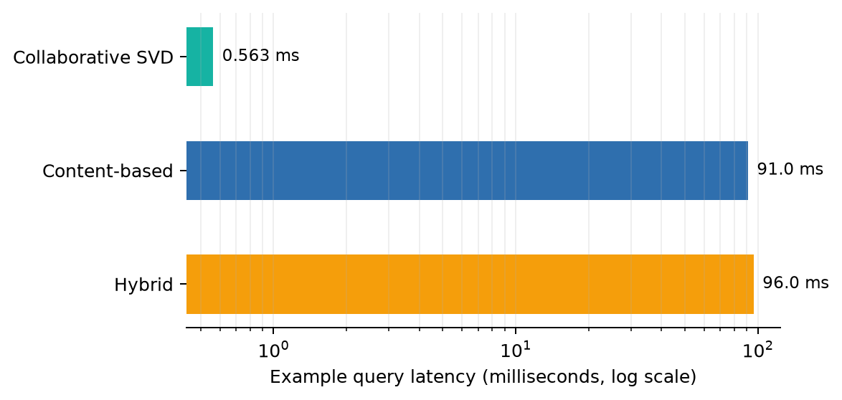
PRACTICALITY
9
Fast queries, different coverage trade-offs
Sparse representations keep all three models usable on a standard Colab runtime.
18,287
3,384
CONTENT CATALOG
COLLABORATIVE CATALOG
9.96%
TOP-10 COVERAGE / 50 USERS
MODEL
INPUT
STRENGTH
LIMITATION
Content
Any supported vehicle
Explainable / cold-start item
No personal signal
SVD
Repeat-user ratings
Very fast personalization
Sparse users and items
Hybrid
Vehicle + user
Best practical balance
Two models + weight choice
DSC 201 • Project 1
09
Notes:
The collaborative calculation is very fast, at about half a millisecond. Content retrieval takes approximately 91 milliseconds, and the complete hybrid query takes about 96 milliseconds. These times make the system practical for an interactive recommendation application.
The content catalog supports 18,287 vehicles, while collaborative filtering supports only 3,384 because it requires sufficient rating history. The models therefore have different strengths: content filtering provides coverage and explainability, SVD provides personalization, and the hybrid approach offers the best practical balance.

Slide 10
RESPONSIBLE INTERPRETATION
10
What the models can—and cannot—claim
Recommendation quality depends on data coverage, identity quality, and the evaluation target.
CURRENT LIMITATIONS
• Median user has only one review
• Author names are imperfect account identifiers
• Ratings are strongly concentrated near 4–5
• K-core filtering improves reliability but removes rare vehicles
• RMSE does not measure diversity or user satisfaction
NEXT ITERATION
• Add explicit onboarding preferences for new users
• Tune hybrid weights using validation or user studies
• Track precision@k, recall@k, diversity, and novelty
• Monitor popularity and manufacturer exposure
• Retrain as new vehicle reviews arrive
Key principle
A useful recommender is not only accurate—it is relevant, diverse, fast, explainable, and honest about uncertainty.
DSC 201 • Project 1
10
Notes:
The system has several limitations. The median user has only one review, author names are imperfect user identifiers, and ratings are highly concentrated near the positive end of the scale. K-core filtering makes SVD more reliable but removes uncommon vehicles.
Future improvements could include collecting onboarding preferences, tuning the hybrid weights through validation or user studies, and measuring ranking metrics such as precision, recall, diversity, and novelty. A production system should also monitor whether certain manufacturers receive too much exposure.

Slide 11
CONCLUSION
The hybrid model is the strongest practical answer
Content provides coherent candidates. SVD adds user preference. The hybrid keeps both signals visible and measurable.
70.3%
18,287
≈96 ms
same-make precision@10
content catalog vehicles
hybrid example query
Deliverables completed
✓ content_based_recommender(title, n) ✓ collaborative_recommender(user_id, n) ✓ hybrid_recommender(title, user_id, k)
GitHub: github.com/tarun-vignes/DSC201-Project-I
11
Notes:
My main conclusion is that the hybrid model is the strongest practical solution for this dataset. Content filtering supplies coherent and explainable candidates, while SVD adds a personalized signal when sufficient user history is available.
The content model achieved 70.3% same-manufacturer precision at 10, covered 18,287 vehicles, and the hybrid query completed in approximately 96 milliseconds. All three required recommender functions were completed and tested. Thank you.

