Slide 1




INIT’26
(
INIT'26 FINTECH TRACK HACKATHON // ASSET & CAPITAL MANAGEMENT
FortressFi - Adaptive Risk-Guardrail Portfolio Engine

Slide 2
MEET FORTRESSFI
TRACK
FinTech - Asset & Capital Management / Optimization Controls
PROBLEM STATEMENT
Financial institutions manage complex balance sheets across diverse asset classes, tight liquidity requirements, and rapidly shifting market conditions. When markets become volatile, traditional manual rebalancing and static risk controls break down-leading to delayed execution, sub-optimal capital utilization, and unexpected exposure to risk.
TEAM NAME
Golden Dragon
IDEA TITLE
FortressFi - Adaptive Risk-Guardrail Portfolio Engine
THE SIMPLE IDEA
Cruise Control for Your Investments
Think of driving on a highway. Cruise control keeps your speed steady and saves fuel.
If a car suddenly brakes in front of you, automatic emergency braking kicks in instantly.
FortressFi does exactly this for investment portfolios. It steadily grows your money in calm markets.
The SECOND a crash begins, it automatically moves capital to safety before losses pile up.
“Grows your money automatically in good times, and protects it automatically the moment markets turn bad."

Slide 3
THE SOLUTION
THE PROBLEM WE'RE SOLVING
When markets crash, manual portfolio reviews take days. By then, losses are already locked in.
Existing robo-advisors trade too frequently (burning fees) or use black-box models nobody trusts.
ENGINE 1
The Smart Optimizer
Finds the best way to spread your money across 6 asset classes (stocks, bonds, gold, cash, etc.).
How it works:
Built on a Nobel Prize-winning investing formula, still used by real fund managers
Respects real limits (Cash >= 5%, no single asset > 45%)
Only trades when drift is significant (saves fees!)
Adapts risk tolerance based on market conditions
ENGINE 2
The Safety Guardrails
An independent watchdog that monitors tail risk every second and can OVERRIDE the optimizer.
4-tier graduated response:
[MONITOR] All safe. Let returns compound.
[WARN] Risk rising. Tighten sensitivity.
[ACT] Limit breached. Auto-shift to cash.
[CIRCUIT BREAK] Crash! Emergency lockdown.
ENGINE 3
The Transparency Layer
Every automated decision is explained in plain English so risk managers actually trust the system.
What managers see:
Live NAV chart with event markers
Asset allocation donut with drift meters
Plain-English risk meters: worst likely loss, worst-case loss, biggest dip
Plain-language decision audit trail
What-if scenario stress testing lab

Slide 4
UNDER THE HOOD
11.4 ms
Optimization Speed
< 2 ms
Risk Check Speed
40 / 40
Tests Passing
0.25s
Full Test Suite
THE MATH (SIMPLIFIED)
How We Optimize Capital Allocation
Goal: Maximize returns while minimizing risk and trading costs.
Objective:
Maximize [Expected Return - Risk Penalty - Trading Cost]
Constraints:
All money invested | Cash >= 5% | No asset > 45% | Turnover <= 40%
Solver:
A fast, precise optimization algorithm that always finds the best mix in milliseconds
Risk Check:
Worst-case loss estimate, built from the last 60 days of real market behavior
Smart Trigger:
Only rebalances when drift exceeds threshold (5% calm, 2% crisis)
TECH STACK & ARCHITECTURE
Built for Speed and Reliability
Everything runs locally with zero external API dependencies.
Backend:
Python 3.14 + FastAPI (async event loop)
Math Engine:
NumPy + SciPy (vectorized computations)
Market Sim:
Realistic simulator that mimics how real assets move together
Real-Time:
WebSocket streaming every 1.5 seconds
Frontend:
Vanilla HTML/CSS/JS + Chart.js (zero build step)
Testing:
40 automated tests covering math, risk logic, and API

Slide 5
HOW IT WORKS
01
MARKET DATA IN
Every 1.5 seconds, correlated prices stream in across all 6 asset classes. Portfolio value updates instantly.
02
RISK HEALTH CHECK
Engine checks four vital signs every second: possible loss, worst-case loss, biggest dip, and how spread out the money is.
03
SMART DECISION
If limits are safe: checks drift and rebalances only when needed. If limits breached: immediate protective action.
04
EXPLAIN & DISPLAY
Every action is logged in plain English. Live dashboard streams charts, gauges, and alerts to the risk manager.
FROM THE RISK MANAGER'S PERSPECTIVE
Passive Monitoring: Just glance at the dashboard. Green badge = all safe. Yellow/Red = engine is already handling it.
Active Testing: Open the What-If Scenario Lab, simulate a -25% equity crash, and see exactly how the engine would respond.
Full Transparency: Every single automated trade has a plain-English explanation in the Decision Audit Log.

Slide 6
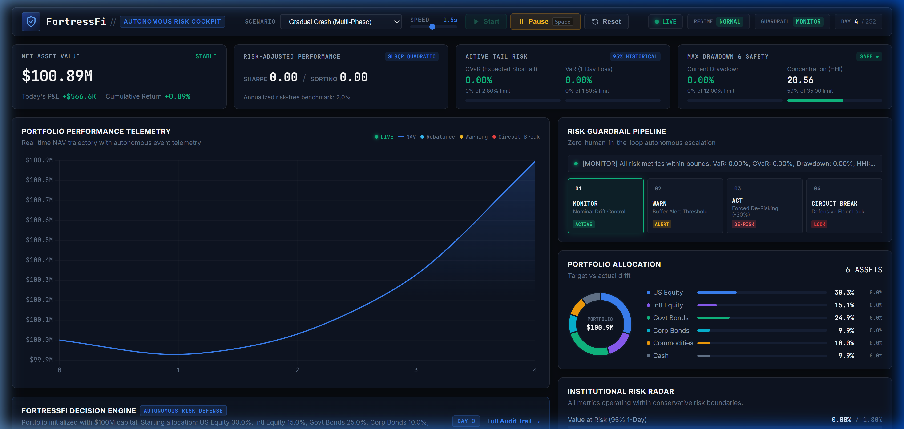
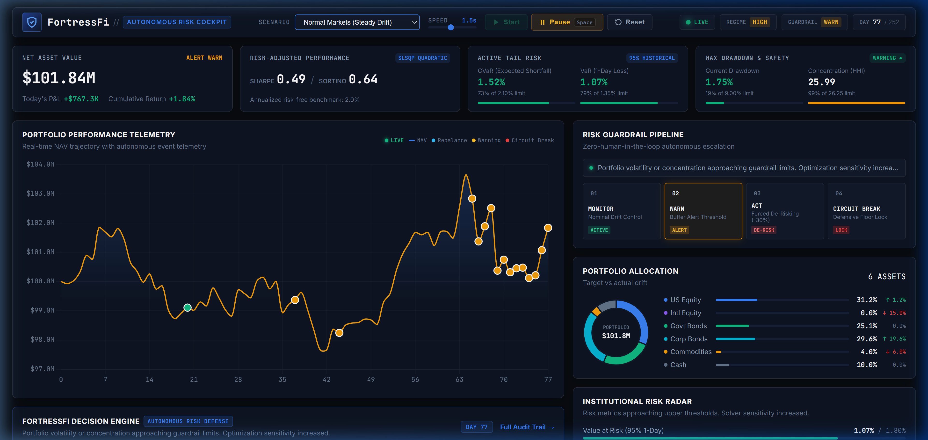
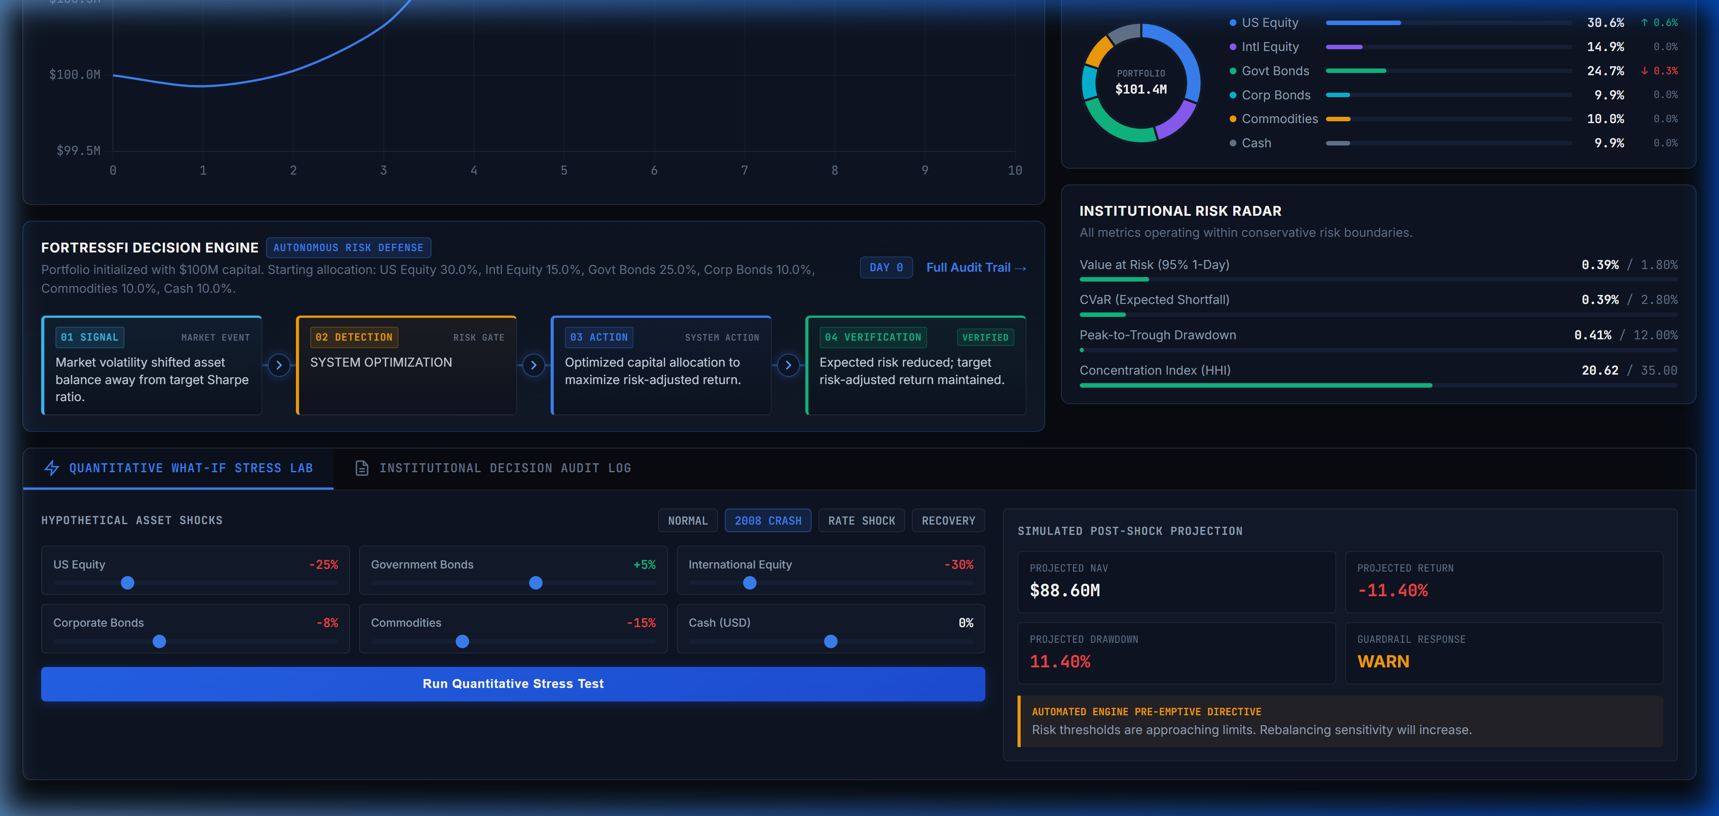
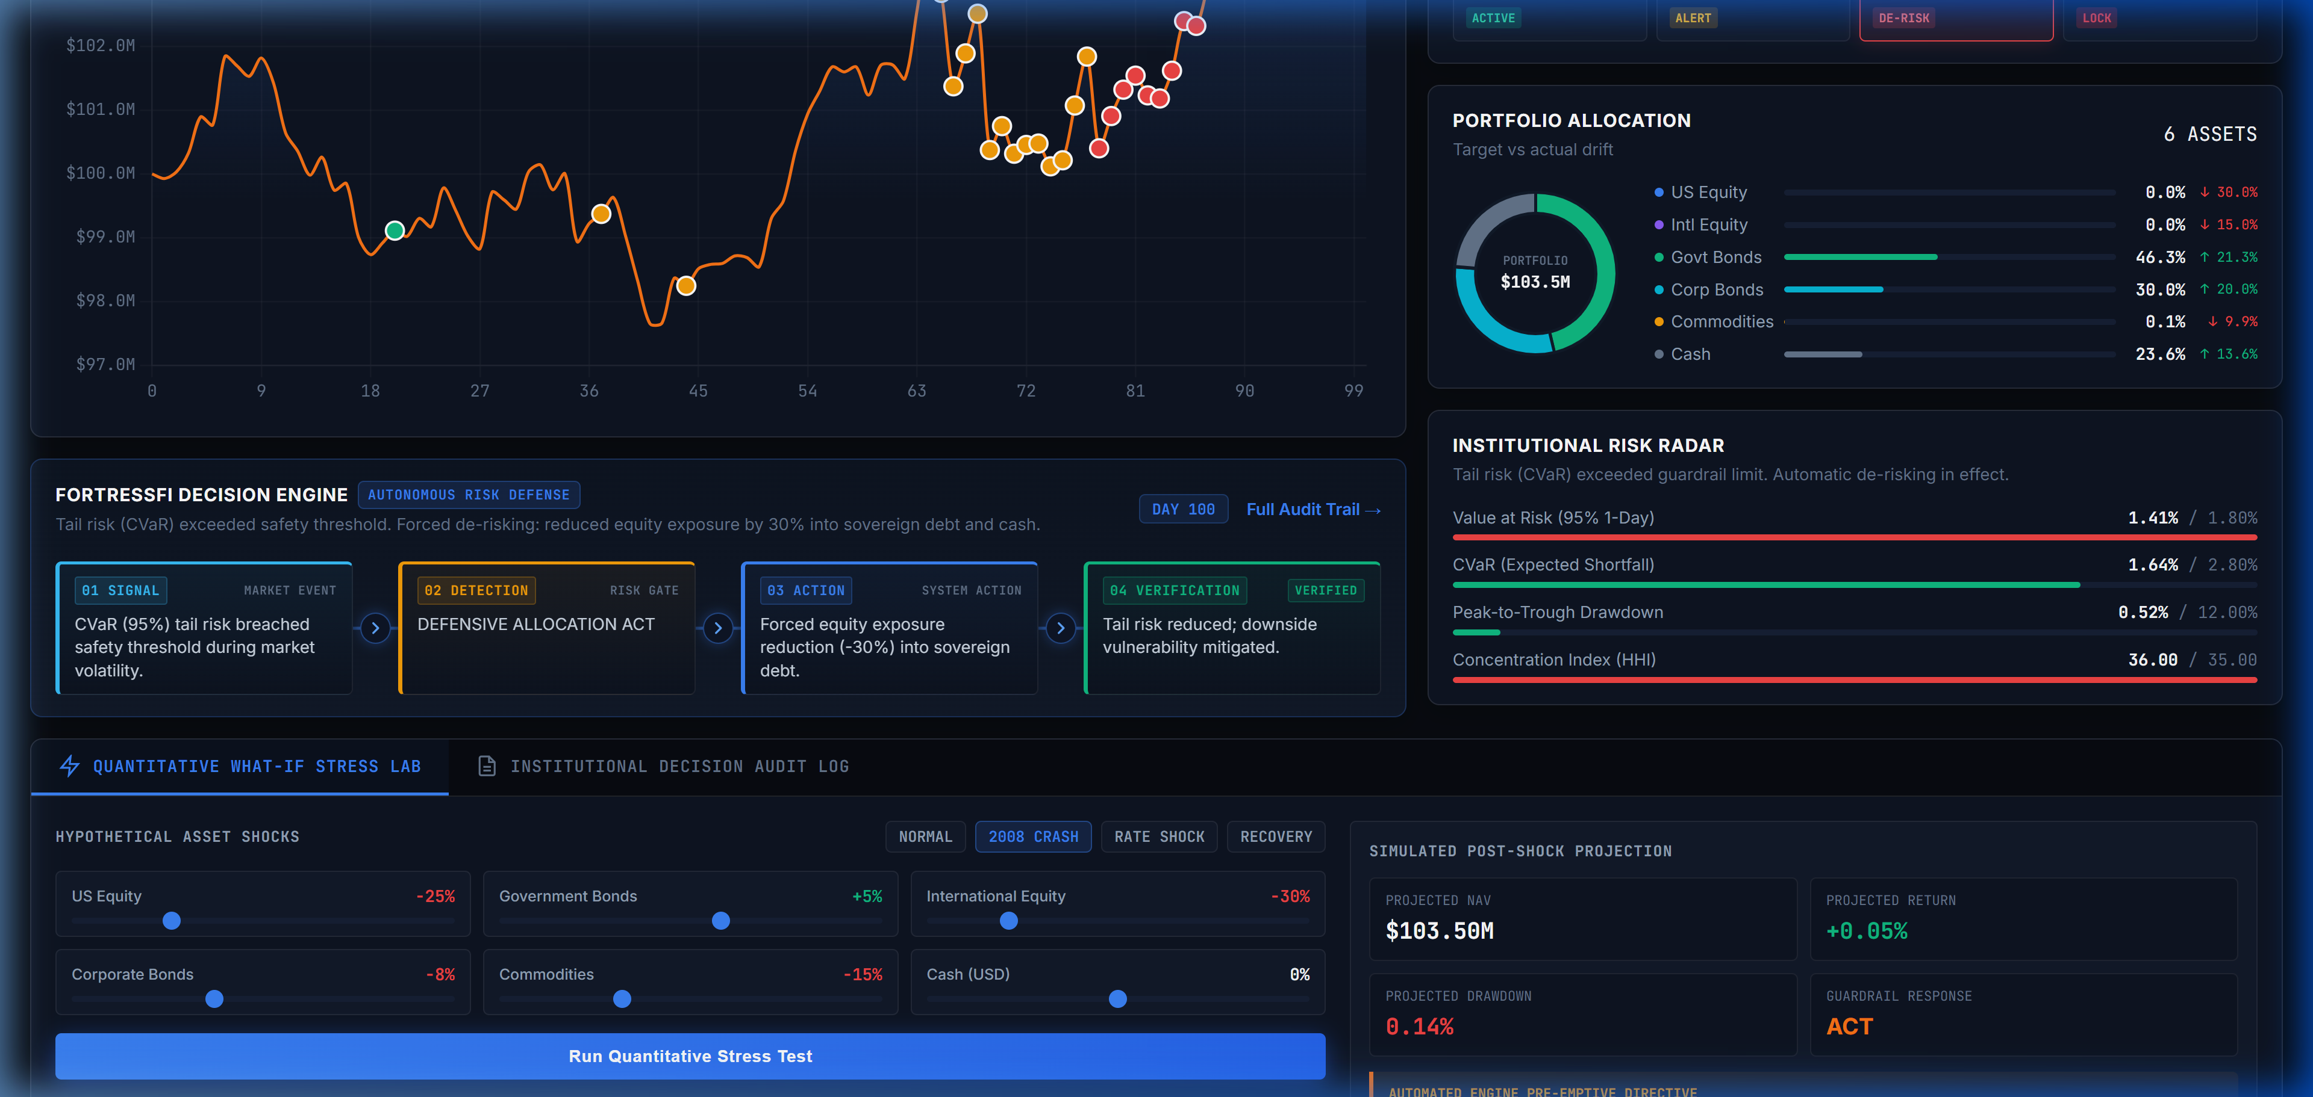
SEE IT IN ACTION
Live Dashboard with Active Simulation
Market Stress Scenario (Crash Detection)
Decision Engine & Risk Radar
What-If Quantitative Stress Lab

Slide 7
REAL-WORLD IMPACT
70%+
Less Unnecessary Trading
< 12ms
Crisis Response Time
$0
External API Dependency Cost
100%
Automated Test Coverage
TECHNICAL FEASIBILITY
It Works. Right Now.
Full optimization converges in 11.4 milliseconds
Entire engine runs locally - no cloud dependency risk
40 automated tests verify every calculation
WebSocket streams real-time data to the browser
Live demo running at fortressfi.onrender.com
ECONOMIC VALUE
Real Cost Savings
Drift-based triggers cut 70%+ of unnecessary trades
Each avoided trade saves broker commissions & slippage
Millisecond crash response prevents panic-driven losses
Replaces 30-minute emergency committee meetings
Protecting the worst 5% of market days boosts long-term returns
WHO BENEFITS
Real-World Applications
Retail investors who want institutional-grade protection
Corporate treasuries managing cash reserves safely
Family offices balancing growth with capital preservation
WealthTech platforms adding automated risk features
Anyone who wants to invest without losing sleep

Slide 8
WHY WE WIN
WHY FORTRESSFI WINS
Competitive Comparison
Traditional Fund Management:
[-] Static monthly/quarterly rebalancing (too slow) [-] No automated crash protection [-] Delayed quarterly PDF reports
Generic Robo-Advisors:
[-] One-time risk questionnaires (never adapt) [-] High-frequency trading burns fees [-] Opaque black-box decisions
FortressFi (Our Solution):
[+] Adaptive drift-gated execution (smart trading) [+] 4-tier autonomous risk guardrails [+] Plain-English explainable audit trail
ACADEMIC FOUNDATION & LINKS
Built on Proven Finance
Markowitz (1952)
'Portfolio Selection', Journal of Finance Foundation of Mean-Variance optimization
Rockafellar & Uryasev (2000)
'Optimization of CVaR', Journal of Risk Tail risk measurement framework
Basel Committee FRTB (2019)
Global banking standard mandating Expected Shortfall for market risk
PROJECT LINKS
Live Demo: https://fortressfi.onrender.com
GitHub: github.com/tarun05-design/FortressFi
"FortressFi doesn't just theorize about risk control.
It implements a working, mathematically sound, fully tested engine
that solves the challenge end-to-end."
Built with care for Init'26 FinTech Track Hackathon

