Slide 1

BACHELOR OF TECHNOLOGY
IN
Artificial Intelligence and Machine Learning
Batch number : ZT10
Project Guide : Prof . Sujit Das Batch Names & Roll Numbers :
Department of AIML, School of Engineering
Malla Reddy University
TITLE: Hand Gesture Recognition and Voice Conversion for Deaf and Dumb
V.Tarun Sri - 2111CS020587
J.Tharuni - 2111CS020588
G.Thejashwini - 2111CS020589
CH.Trupti - 2111CS020590
B.Uday Kiran - 2111CS020591

Slide 2
PROBLEM STATEMENT
Deaf and mute individuals face communication barriers in healthcare, leading to misinterpretations and inadequate care. Existing gesture recognition models lack accuracy, adaptability, and real-time performance, making them ineffective in medical settings. This project develops a CNN-based hand gesture recognition system using RGB, depth, and skeletal data for improved accuracy. Recognized gestures are converted into speech via a TTS module, enabling real-time, seamless communication and enhancing inclusivity and patient care.

Slide 3
INTRODUCTION
This project is to develop a CNN-based hand gesture recognition system for real-time sign language translation in healthcare settings. The system aims to enhance communication between deaf and mute individuals and healthcare providers by accurately recognizing hand gestures and converting them into speech using a text-to-speech (TTS) module. By integrating RGB, depth, and skeletal joint data, the model ensures higher accuracy, adaptability, and robustness against variations in lighting and hand positioning. The project focuses on real-time performance optimization, making the system efficient for practical use. Ultimately, this solution promotes inclusivity and accessibility in healthcare, improving patient care and overall communication.

Slide 4
LITERATURE SURVEY
S.NO | TITLE | AUTHORS | YEAR
1. | ML Based Gesture Recognition for Communication with the Deaf and Dumb. | Prasanthi Yavanamandha, B.Keerthana,P.Jahnavi, K.Venkat,Ch. RajKumar | 2023
2. | Hand Gesture recognition System for Sign Language | YNikhil ,Venkata Bhargav, Aamil Shohail, Srinivas | 2022
3. | Hand Gesture Recognition and Voice Conversion for Deaf and Dumb | Rupesh Prajapati ,Vedant Pandey ,Nupur Jamindar, Neeraj Yadav | 2018
4. | Robust Gesture Recognition Using Gaussian Distribution for Features Fitting. | Mokhtar M. Hasan and Pramod K. Mishra | 2012

Slide 5
RESEARCH GAP
The existing system is a desktop application that utilizes a computer’s webcam to capture American Sign Language (ASL) gestures and translate them into corresponding text and speech in real time. The system processes hand gestures using computer vision and machine learning techniques to recognize and convert them into readable text, which is then synthesized into speech.
Limitations:
• Lower Accuracy – Struggles with complex or ambiguous gestures, reducing recognition accuracy.
• Limited Vocabulary – May not support a comprehensive range of ASL signs, restricting effective communication.
• Lighting and Background Sensitivity – Performance is affected by variations in lighting, background noise, or occlusions.

Slide 6
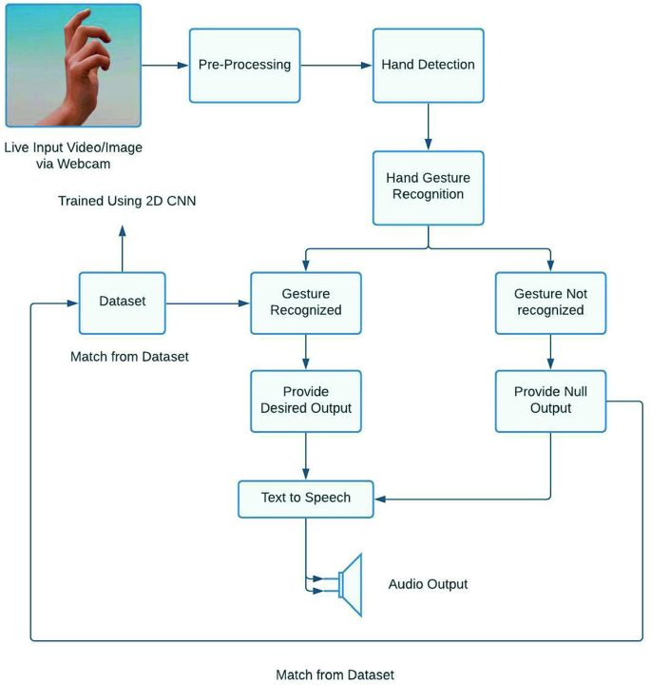
ARCHITECTURE

Slide 7
FEATURE DESCRIPTORS
1. HOG (Histogram of Oriented Gradients)
Extracts edge and gradient-based features from hand gestures.
Divides the image into small regions and detects gradient orientations.
Provides a structured feature set for accurate classification.
2. SIFT (Scale-Invariant Feature Transform)
Detects key points in hand gestures that remain stable under different scales and rotations.
Extracts distinctive features that help in gesture recognition.
Enhances robustness against variations in lighting and hand positioning.

Slide 8
ALGORITHMS
1. CNN (Convolutional Neural Networks)
Automatically learns spatial and texture-based features from gesture images.
Uses multiple layers to detect patterns at different levels of abstraction.
Provides high accuracy in classifying complex gestures.
2.CNN+LSTM(Hybrid)
CNN extracts feature over time.
LSTM learns gesture pattern over time.
Combined they recognize dynamic hand gestures.
3.SVM (Support Vector Machine)
Classifies gestures based on feature vectors extracted from HOG or SIFT.
Finds an optimal decision boundary to separate different gesture categories.
Works effectively for small to medium-sized datasets with clear gesture classes.

Slide 9
OBSERVATIONS
Gesture Acquisition: Captures real-time hand gestures effectively but is affected by lighting and background noise.
Feature Extraction: SIFT ensures scale and rotation invariance, HOG captures edge and shape, while CNN learns complex spatial patterns for better recognition.
Classification: SVM is efficient for small datasets, but CNN provides higher accuracy with large datasets. A hybrid approach improves performance.
Text Conversion: Converts gestures into text dynamically, but accuracy depends on classification quality.
Speech Synthesis: TTS provides real-time audio output, enhancing accessibility, but may mispronounce if gestures are misclassified.
System Performance: Real-time execution requires powerful hardware; environmental factors like lighting and hand occlusion affect accuracy.

Slide 10
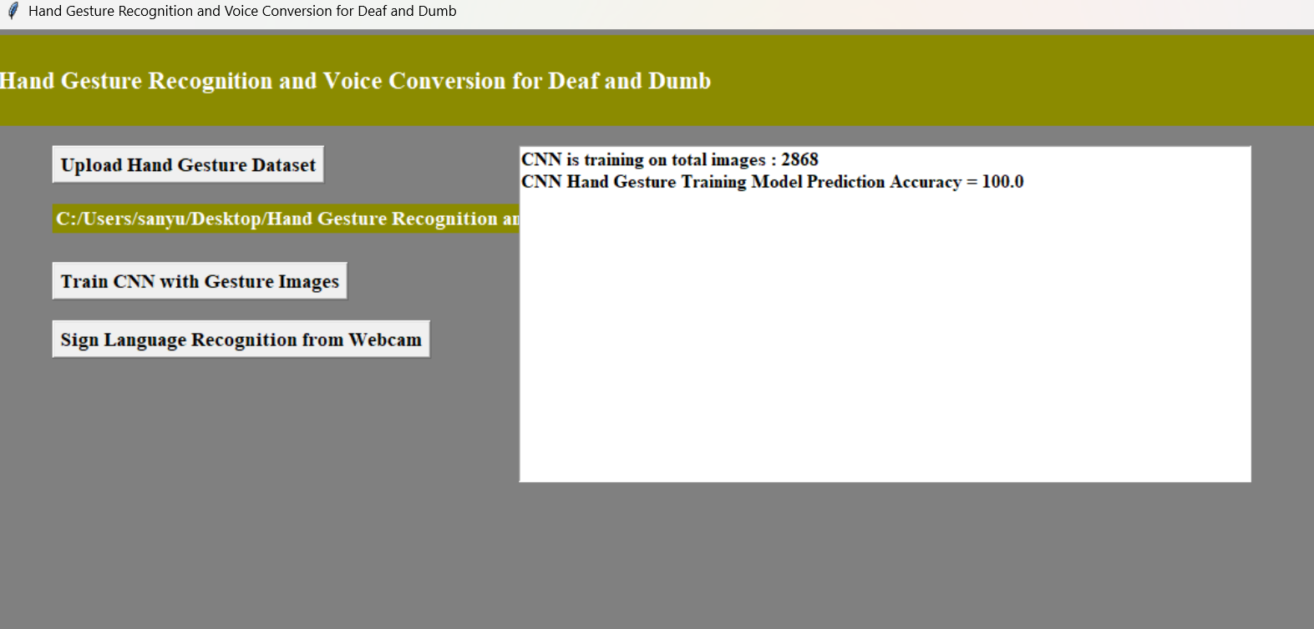
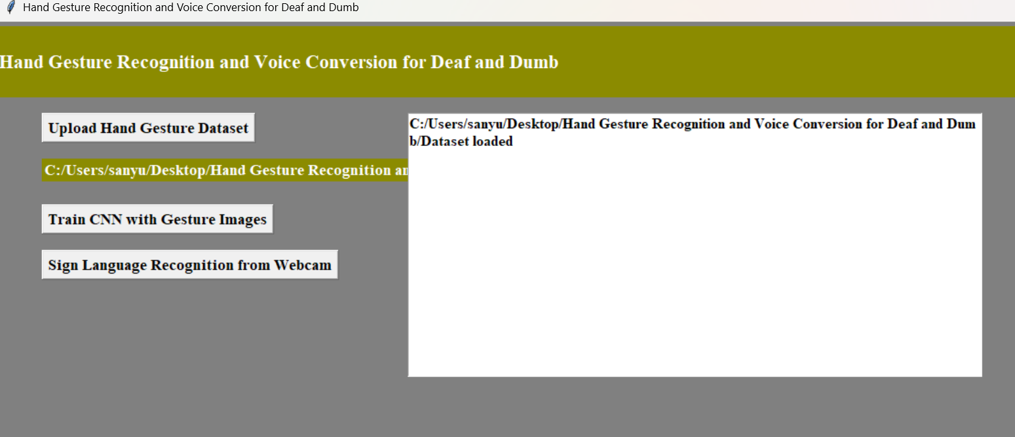
RESULTS

Slide 11
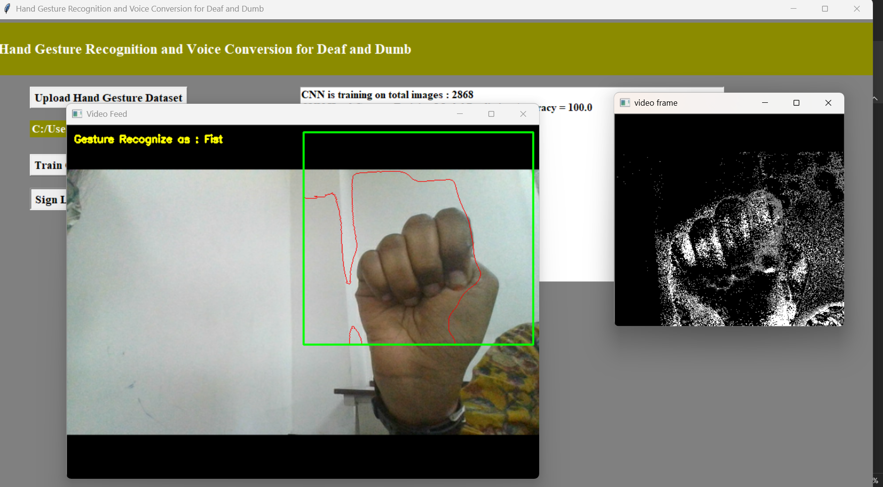
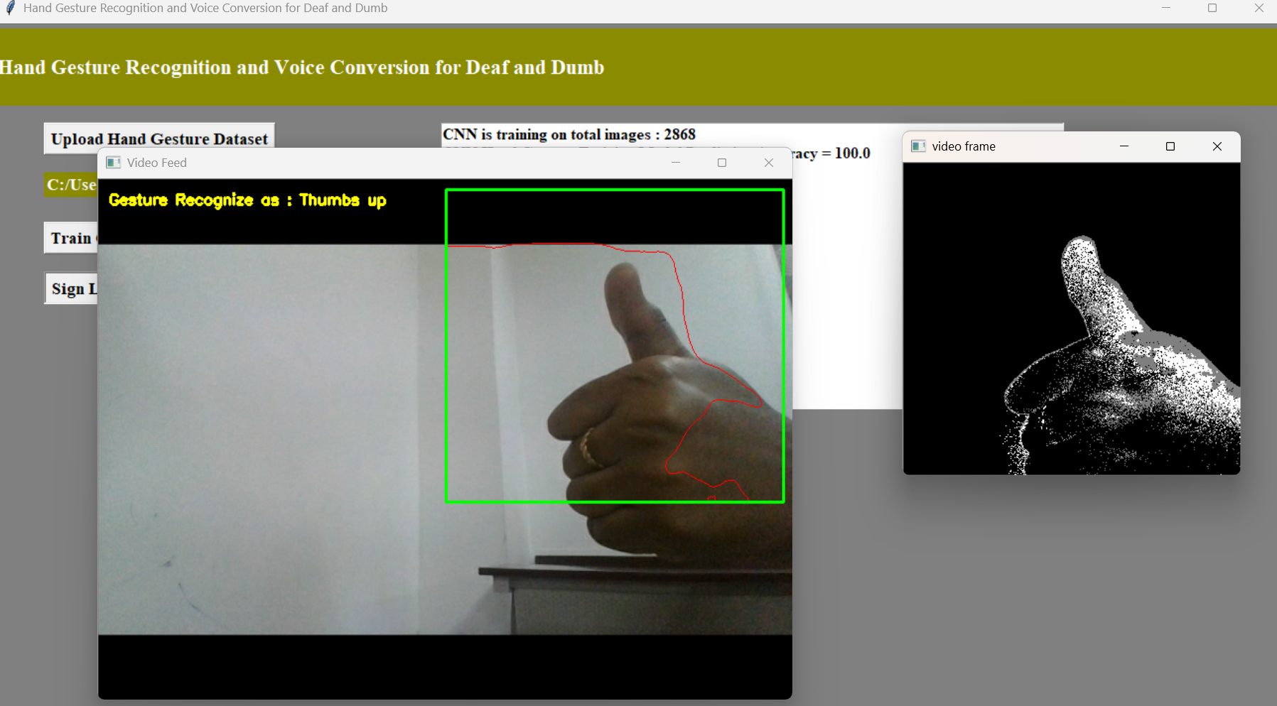
RESULTS

Slide 12
CONCLUSION
The project successfully developed a system that uses hand gesture recognition and voice conversion to assist deaf and mute individuals in communicating. By utilizing deep learning models and a user-friendly interface built with Kivy, the system accurately recognizes gestures and converts them into speech. It demonstrated high accuracy and reliability, with potential for future improvements such as expanding the gesture vocabulary and adding multilingual support. The undertaking is a straightforward showing of how CNN can be utilized to tackle PC vision issues with a very serious level of precision. A finger spelling gesture based communication interpreter is gotten which has a precision of 100 percent. The venture can be reached out to other communications through signing by building the relating dataset and preparing the CNN. Overall, the system provides an innovative solution to enhance communication accessibility for the deaf and mute community.

Slide 13
THANK YOU

