Slide 1
WEEKLY MEAL PLANNER
& GROCERY GENERATOR
Java Console-Based Project
2620040014 - Yagnesh Krishna
2620030073 - Tarun
Faculty: Dr. Madhavi Karumudi

Slide 2
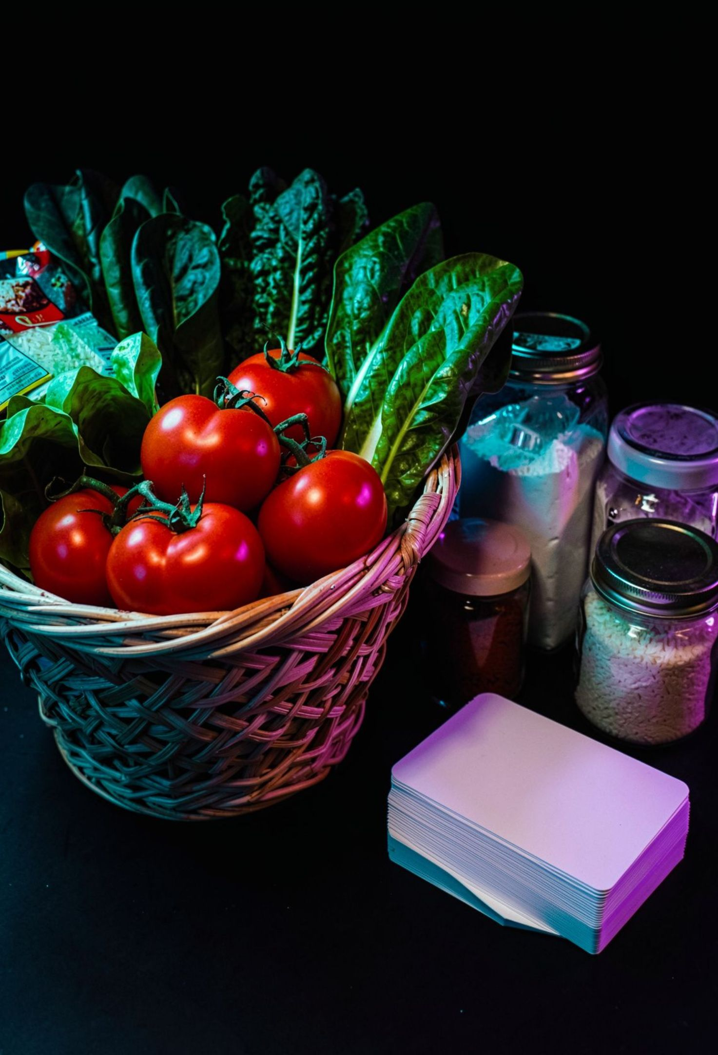
ABSTRACT
The Weekly Meal Planner and Grocery Generator is a Java console application designed to simplify weekly meal planning and grocery preparation. Users can plan meals for different days of the week, and the application generates a grocery list based on the selected meals and ingredients. The project reduces the effort of deciding meals and preparing shopping lists manually while demonstrating important Java programming concepts.
The problem
Daily meal planning takes time.
Grocery lists are often prepared manually.
Ingredients can be forgotten.
A simple automated solution can make planning easier.
02

Slide 3
Simple planning, from meals to ingredients
OBJECTIVES
KEY FEATURES
TECHNOLOGY
Plan meals for the entire week.
Reduce meal-planning effort.
Generate required grocery items.
Provide a simple console-based solution.
Weekly meal schedule
Breakfast/Lunch/Dinner planning
Ingredient mapping
Grocery-list generation
Simple console interaction
Java
Scanner
Arrays
Methods
Loops
Conditional statements
Switch case
03

Slide 4
From user choice to grocery list
1
2
3
4
START
USER INPUT
SELECT MEALS
CREATE WEEKLY PLAN
5
6
7
8
PROCESS MEALS
IDENTIFY INGREDIENTS
GENERATE GROCERY LIST
DISPLAY RESULT
The application collects a meal choice for each day, stores the weekly plan, maps meals to ingredients, and prints the final grocery list.
04

Slide 5

The core loop builds a seven-day plan
String[] plan = new String[7];
System.out.println("=== WEEKLY MEAL PLANNER ===");
for (int i = 0; i < days.length; i++) {
System.out.println("\n" + days[i]);
System.out.println("Choose a meal:");
for (int j = 0; j < meals.length; j++)
System.out.println((j + 1) + ". " + meals[j]);
int choice = sc.nextInt();
if (choice >= 1 && choice <= meals.length)
plan[i] = meals[choice - 1];
else
plan[i] = "Not selected";
}
displayPlan(plan);
generateGroceryList(plan);
}
import java.util.*;
public class WeeklyMealPlanner {
static Scanner sc = new Scanner(System.in);
static String[] days = {
"Monday", "Tuesday", "Wednesday",
"Thursday", "Friday", "Saturday", "Sunday"
};
static String[] meals = {
"Idli", "Rice", "Chapati", "Dosa",
"Biryani", "Pulao", "Upma"
};
public static void main(String[] args) {
05

Slide 6
Methods turn the plan into a shopping list
JAVA CODE
static void displayPlan(String[] plan) {
System.out.println("\n=== WEEKLY PLAN ===");
for (int i = 0; i < days.length; i++)
System.out.println(days[i] + " : " + plan[i]);
}
static void generateGroceryList(String[] plan) {
System.out.println("\n=== GROCERY LIST ===");
for (String meal : plan) {
switch (meal) {
case "Idli":
System.out.println("- Idli batter / rice");
break;
case "Rice":
System.out.println("- Rice");
break;
case "Chapati":
System.out.println("- Wheat flour");
break;
case "Dosa":
System.out.println("- Dosa batter");
break;
case "Biryani":
System.out.println("- Rice, vegetables, spices");
break;
case "Pulao":
System.out.println("- Rice, vegetables");
break;
case "Upma":
System.out.println("- Semolina, vegetables");
break;
}
}
}
06

Slide 7
Sample output from the planner
SAMPLE OUTPUT
=== WEEKLY PLAN ===
Monday : Idli
Tuesday : Rice
Wednesday : Chapati
Thursday : Dosa
Friday : Biryani
Saturday : Pulao
Sunday : Upma
=== GROCERY LIST ===
- Idli batter / rice
- Rice
- Wheat flour
- Dosa batter
- Rice, vegetables, spices
- Rice, vegetables
- Semolina, vegetables
07

Slide 8
A practical foundation with room to grow
ADVANTAGES
FUTURE SCOPE
CONCLUSION
Saves time
Simple to use
Reduces manual grocery planning
Easy to customize
Demonstrates practical Java programming
The project shows how a simple Java console application can make weekly meal planning and grocery preparation faster, clearer, and easier to customize.
GUI version
Mobile application
Nutrition/calorie tracking
Grocery quantity calculation
Cost estimation
Database integration
Personalized meal recommendations
08

Slide 9
Plan smarter. Shop better.
Thank you
Questions?
Weekly meal planning
Ingredient mapping
Automated grocery generation

