Slide 1

Advancing Healthcare: Harnessing Machine Learning for Heart Disease Prediction

Slide 2


Introduction
Advancing Healthcare: Harnessing Machine Learning for Heart Disease Prediction

Slide 3

Agenda
Understanding Heart Disease Role of Machine Learning
Data Collection and Preprocessing Feature Selection and Engineering Machine Learning Algorithms Model Training and Evaluation Performance Metrics
Challenges and Limitations
Real-World Applications Future Directions
Case Studies Conclusion

Slide 4

Understanding Heart Disease
Heart disease refers to a range of conditions that affect the heart's structure and function. It is a leading cause of death globally. Risk factors include high blood pressure, high cholesterol, smoking, diabetes, and obesity. Early detection and prediction of heart disease can signiﬁcantly improve patient outcomes.

Slide 5



Role of Machine Learning
Machine learning algorithms can analyze large amounts of medical data to identify patterns and make predictions. In the context of heart disease, machine learning can help in early detection, risk assessment, and personalized treatment. It can assist healthcare professionals in making informed decisions and improving patient care.

Slide 6

Data Collection and Preprocessing
Collecting relevant and high-quality data is crucial for accurate predictions. This includes medical records, lab results, and lifestyle information.
Preprocessing techniques such as data cleaning, feature scaling, and handling missing values ensure data quality and compatibility for machine learning algorithms.

Slide 7

Feature Selection and Engineering
Choosing the right features and creating new ones can improve prediction accuracy. Relevant features may include age, gender, blood pressure, cholesterol levels, and exercise habits. Feature engineering techniques like dimensionality reduction and feature extraction help in selecting the most informative
features.

Slide 8

Machine Learning Algorithms
Various machine learning algorithms can be applied for heart disease prediction, including logistic regression, decision trees, random forests, support vector machines, and neural networks.
Each algorithm has its strengths and limitations, and the choice
depends on the dataset and desired performance.

Slide 9

Model Training and Evaluation
Training a machine learning model involves dividing the data into training and testing sets. The model learns patterns from the training data and is evaluated using performance metrics like accuracy, precision, recall, and F1 score. Cross-validation techniques can also be used to assess model generalization.

Slide 10

Performance Metrics
Performance metrics quantify the effectiveness of a machine learning model. Accuracy measures overall correctness, precision measures the proportion of true positives, recall measures the proportion of actual positives correctly identiﬁed, and F1 score combines precision and recall. Choosing the right metrics depends on the speciﬁc objectives of heart disease
prediction.

Slide 11

Challenges and Limitations
Applying machine learning to healthcare has challenges such as data privacy, interpretability, and ethical considerations. Limited availability of labeled data and potential biases in the data can also affect model performance. It is important to address these challenges and ensure responsible and reliable use of machine learning in healthcare.

Slide 12

Real-World Applications
Machine learning for heart disease prediction has real-world applications, including early diagnosis, patient risk stratiﬁcation, and treatment recommendation. It can assist healthcare professionals in providing personalized care and interventions, leading to improved patient outcomes and reduced healthcare costs.

Slide 13

Future Directions
The future of machine learning in heart disease prediction looks promising. Advancements in deep learning, big data analytics, and Internet of Things (IoT) can further enhance accuracy and efﬁciency.
Integration with electronic health records and continuous monitoring
systems can enable real-time predictions and proactive interventions.

Slide 14

Case Studies
Presenting real-world case studies showcasing successful implementation of machine learning for heart disease prediction. These examples demonstrate the potential impact of machine learning in improving patient outcomes and healthcare delivery.

Slide 15
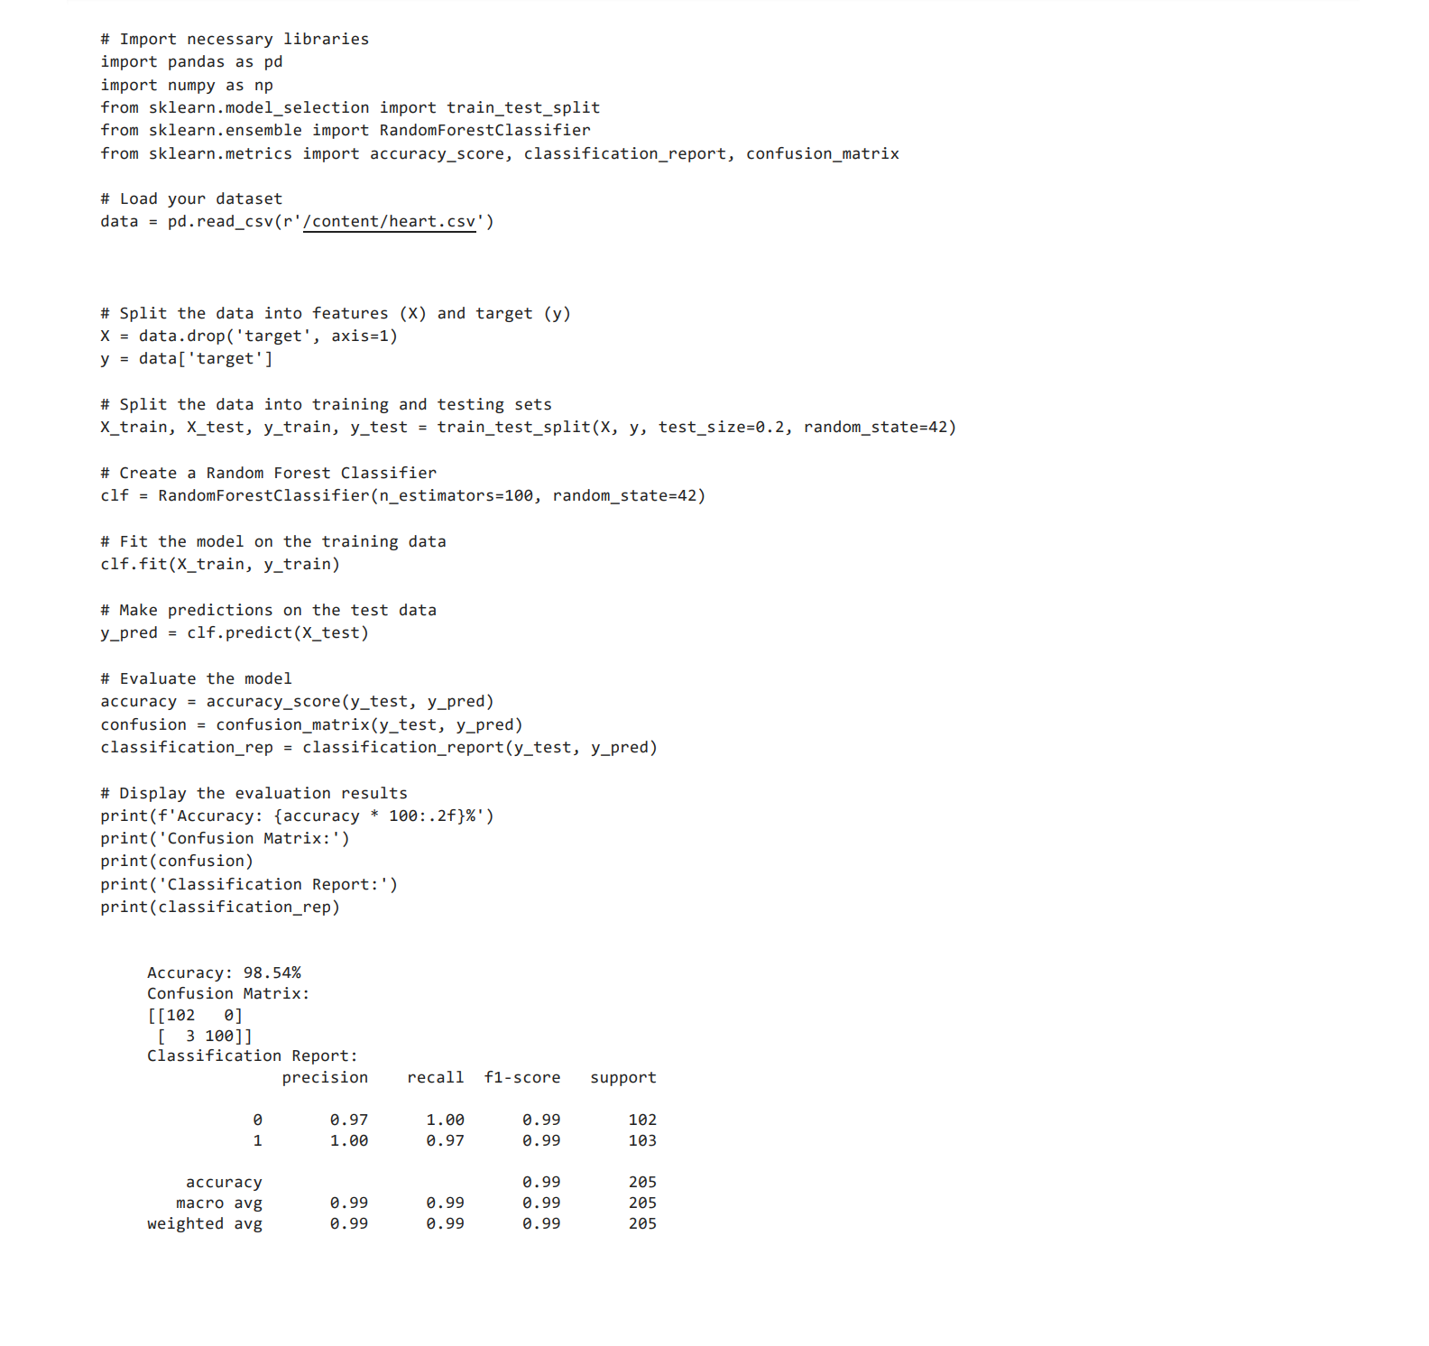
CODE IMPLEMENTATION:

Slide 16
Conclusion
Machine learning has the potential to revolutionize heart disease prediction and improve patient care. By leveraging large datasets and advanced algorithms, healthcare professionals can make more accurate predictions, facilitate early detection, and provide personalized treatment. However, challenges related to data privacy, ethics, and interpretability must be addressed for responsible and effective implementation.

