Slide 1
HostelHub
H
College hostel management system, shipped with a full DevOps pipeline
Tarun Sakala | DevOps Final Project
Notes:
Introduce the app in one line: a warden console for a college hostel. The rest of the talk follows the code from laptop to cluster.

Slide 2
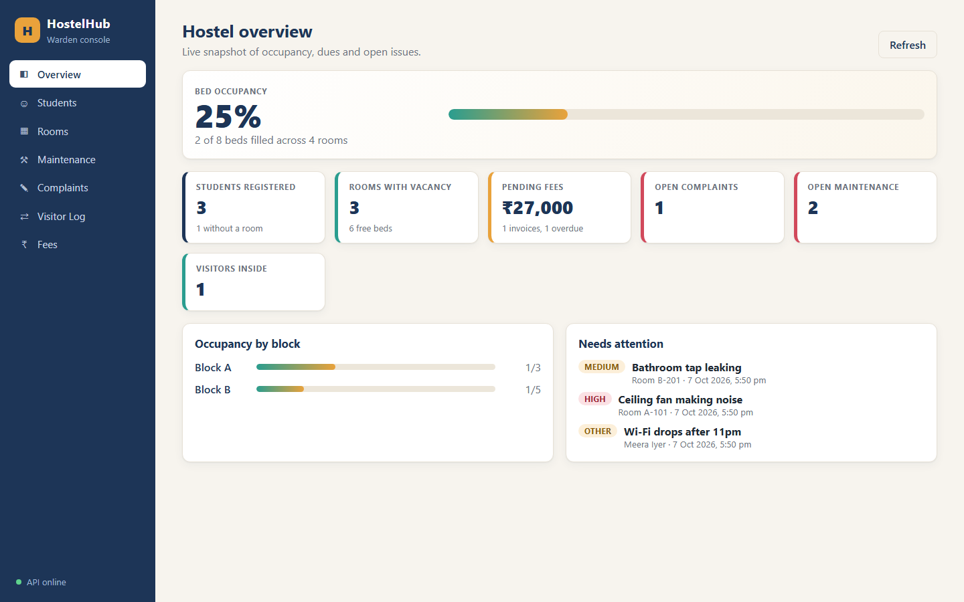
A warden console for the whole hostel
Students
Rooms
register, edit, remove
availability, allocate, vacate
Maintenance
Complaints
requests with priority + status
raise, track, resolve
Visitors
Fees
check-in / check-out log
per term, pending / paid / overdue
Dashboard: occupancy, pending fees, open issues
Notes:
Six modules, one REST API. The room allocation enforces capacity - a full room returns 409.

Slide 3
Three tiers, one request path
Browser
Frontend
Backend
Database
React + Vite UI
nginx (non-root)
proxies /api
FastAPI + SQLAlchemy
/health /ready /metrics
PostgreSQL 16
Alembic migrations
Ingress hostelhub.local
Prometheus scrapes /metrics → Grafana panels
/ → frontend /api → backend
request rate, p95 latency, 5xx rate

Slide 4
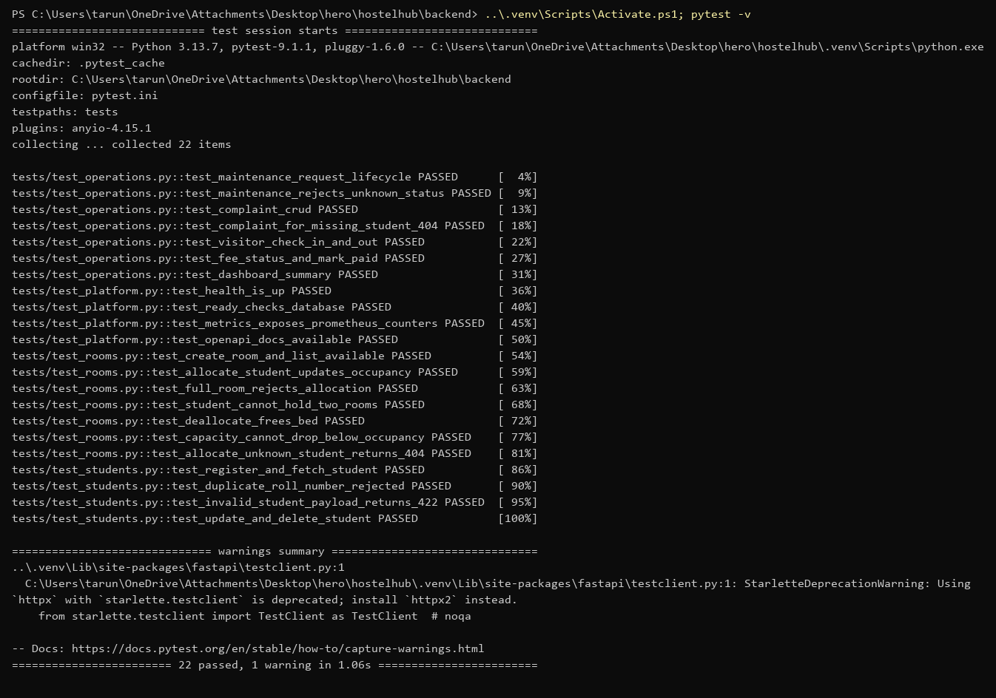
Tests run before anything is built
22
pytest cases, all passing
In-memory SQLite, never the real DB
Covers every module + /health, /metrics
Capacity rule: full room → 409
ruff lint in the same CI job

Slide 5
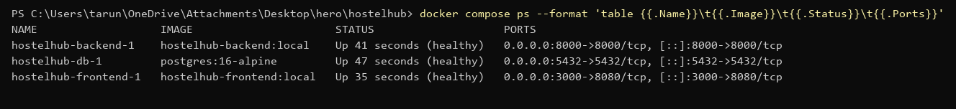
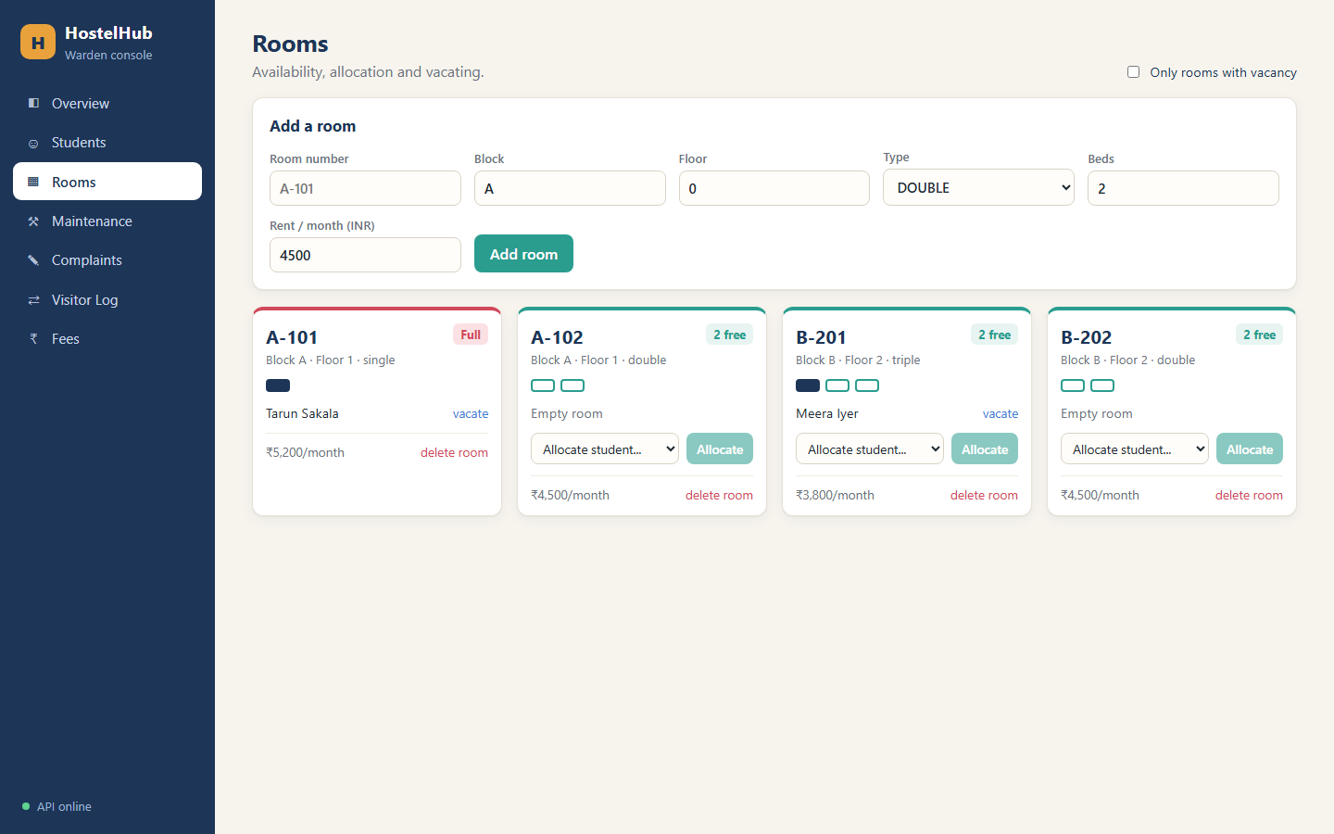
One command brings up the stack
1
Backend image
python slim, pip removed after install, uid 10001
2
Frontend image
multi-stage: node build → nginx-unprivileged, uid 101
3
Compose
db healthcheck gates backend, named volume keeps data
docker compose up -d --build

Slide 6
Every push to main runs the pipeline
1
2
3
4
5
6
Test
Frontend
Build
Trivy gate
GHCR push
Deploy
pytest + ruff
npm ci + build
both images, tag = git SHA
fail on HIGH / CRITICAL
only on main
kind + Helm, smoke /health
Only GITHUB_TOKEN is used. No secrets in the repo, no :latest tags.
.github/workflows/ci-cd.yml
Notes:
Live demo: commit a small change, push, open the Actions tab and watch the stages go green.

Slide 7
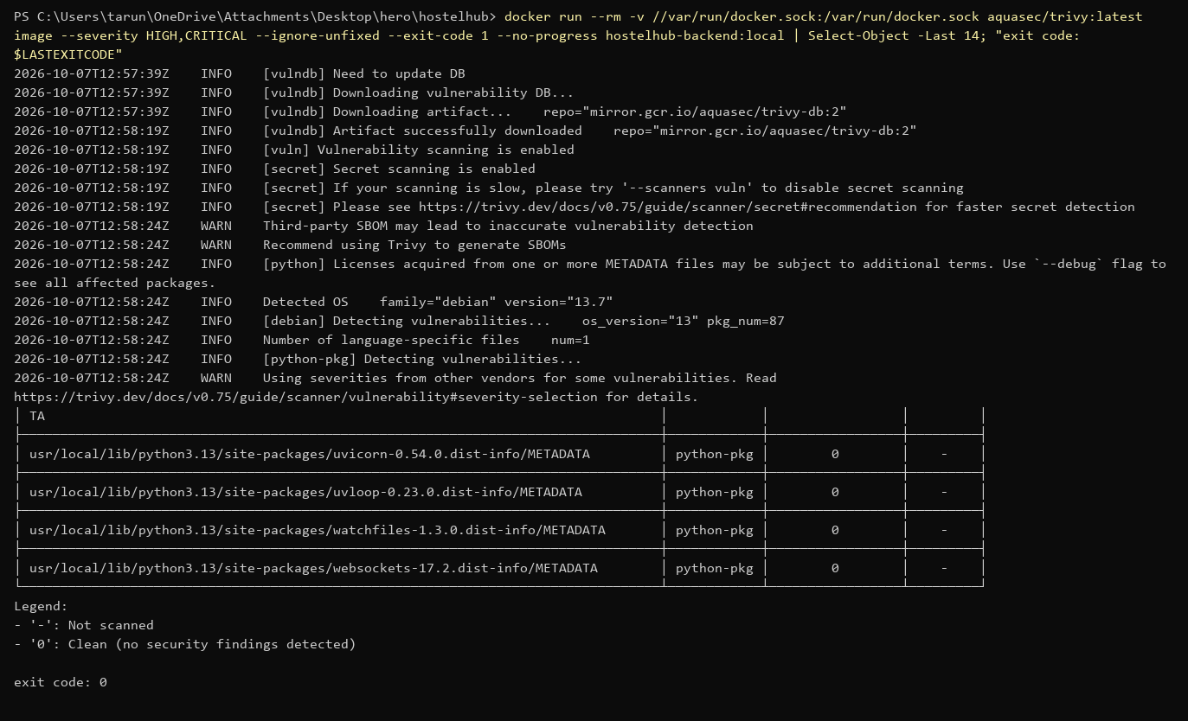
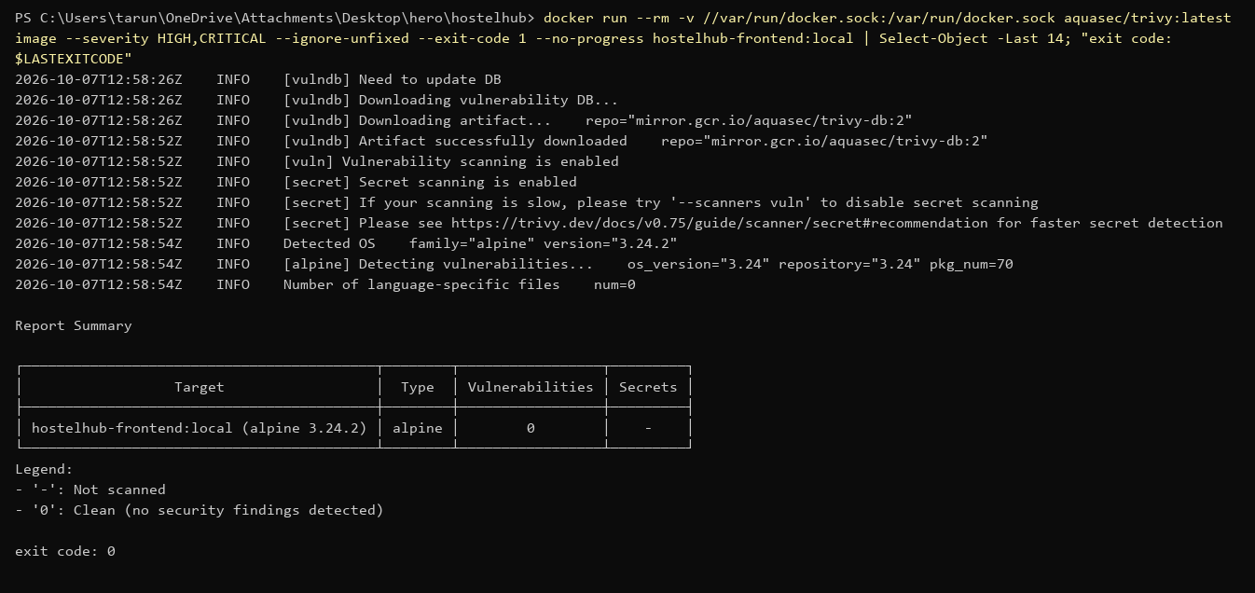
Security is a gate, not a report
0
fixable HIGH / CRITICAL CVEs in either image
First backend scan failed with 4 HIGH findings in pip's own bundled libs. Fix: uninstall pip from the runtime image. Both containers also run as non-root.

Slide 8
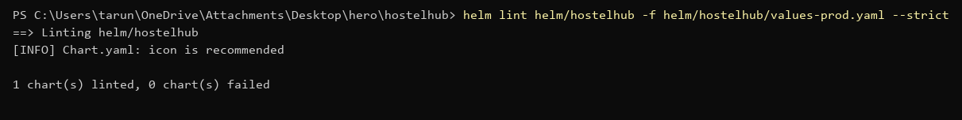
Helm packages the whole app
Deployments
Probes
Postgres
backend + frontend, 2 replicas each
liveness /health, readiness /ready
StatefulSet + PVC + Secret
Ingress
HPA
ServiceMonitor
/ → frontend, /api → backend
backend scales on CPU
Prometheus scrape config
values-dev / values-prod | helm upgrade --install | helm rollback

Slide 9
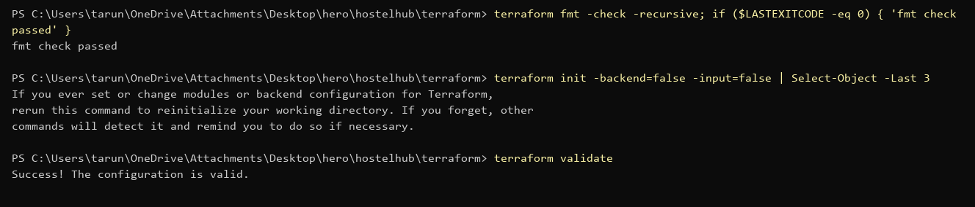
AWS infrastructure as code
VPC 10.40.0.0/16
versions.tf, variables.tf, main.tf, outputs.tf
terraform.tfvars.example only, no keys committed
fmt + init + validate pass
plan → apply → destroy run on a local AWS mock (Moto): EKS + node group ACTIVE
Public subnet A
Public subnet B
Private subnet A
Private subnet B
EKS cluster + managed node group
terraform-aws-modules vpc + eks, IGW, route tables, NAT gateway (toggle)

Slide 10
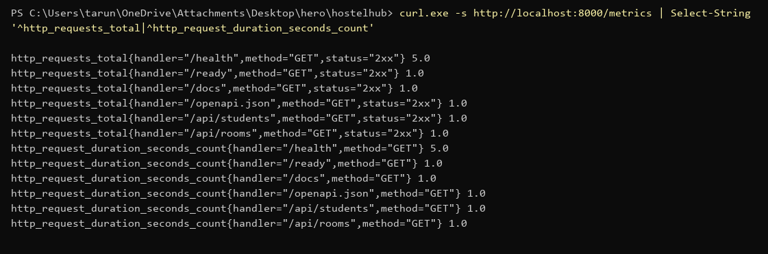
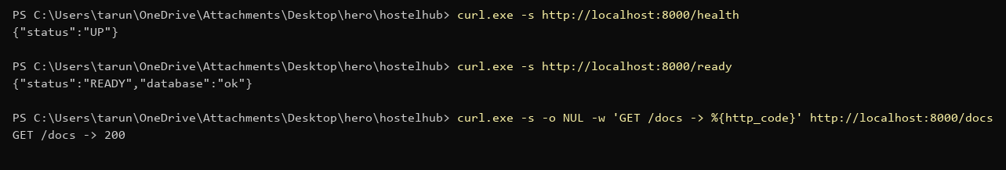
Metrics from the first request
Request rate
rate(http_requests_total[1m])
p95 latency
histogram_quantile(0.95, ...)
5xx rate
status="5xx" / all
kube-prometheus-stack values + Grafana dashboard JSON in monitoring/

Slide 11
From laptop to cluster
App, tests, Docker, CI/CD, Trivy, Helm, Terraform and monitoring live in one repo
github.com/tarun250/hostelhub
Notes:
Close with the live demo: push a change and show the pipeline and the new image tag.

