Slide 1
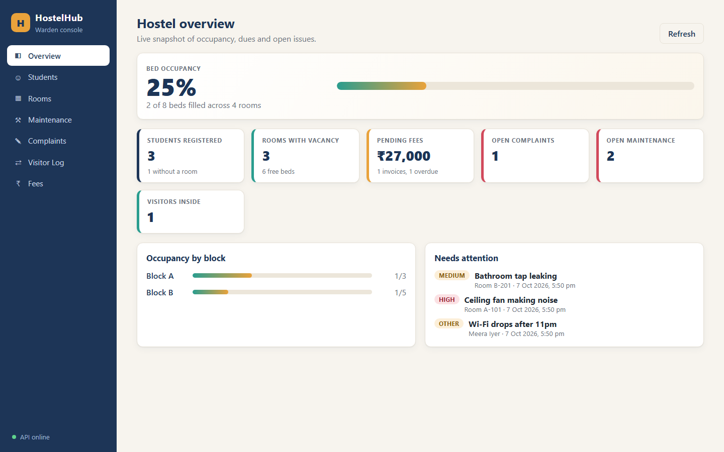
DEVOPS CAPSTONE PROJECT
HostelHub
A hostel management platform,
packaged and delivered with DevOps
FastAPI • React • PostgreSQL
Docker • GitHub Actions • Kubernetes
Project repository: github.com/tarun250/hostel_management
01

Slide 2
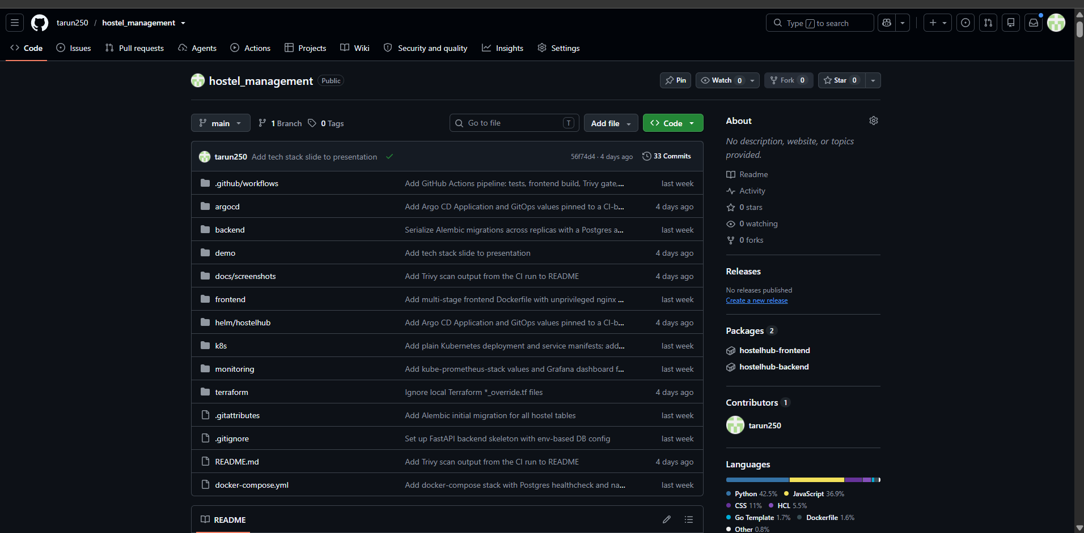
01 / SOURCE CODE
GitHub repository and project structure
Repository: github.com/tarun250/hostel_management • Frontend, backend, Compose, CI/CD, Helm, Kubernetes, monitoring and Terraform files.

Slide 3
01 / PRODUCT OVERVIEW
The problem and the solution
The problem
The solution
• Hostel operations involve several disconnected records.
• Room occupancy and available beds can be hard to track.
• Maintenance, complaints, visitors and fees need follow-up.
• Manual updates make it harder to see the current status.
• One web dashboard for common hostel workflows.
• Capacity-aware room allocation and student records.
• Track maintenance, complaints, visitors and fee status.
• A containerized application with repeatable deployment.
02

Slide 4
02 / PRODUCT FEATURES
What the application does
01
02
03
Dashboard
Students & rooms
Maintenance
Occupancy, free beds, dues and open issues.
Register students; allocate and vacate beds.
Move requests through open, in progress and resolved.
04
05
06
Complaints
Visitors
Fees
Track issues from open to review and closure.
Log check-in and check-out.
Track pending and paid fees, including overdue status.
03

Slide 5
03 / HOW THE PIECES FIT
System architecture
Browser / React UI
FastAPI backend
PostgreSQL
Local development: Docker Compose runs the frontend, backend and database together.
Delivery & operations
• GitHub Actions tests, builds, scans and publishes container images.
• Helm deploys to Kubernetes; Argo CD supports GitOps sync.
• Prometheus scrapes metrics and Grafana visualizes them.
• Terraform defines AWS VPC and EKS infrastructure.
The repository contains the code, Dockerfiles, workflow, Helm chart, monitoring config and Terraform files.
04

Slide 6
04 / STACK RATIONALE
Technology choices — and why
React + Vite
Responsive interface with fast local development.
FastAPI + SQLAlchemy
Python API, validation, generated API docs and database access.
PostgreSQL
Relational data suits students, rooms, fees and their relationships.
Docker Compose
Simple, reproducible local multi-container environment.
Kubernetes + Helm
Declarative rollout, service discovery, replicas and configuration.
GitHub Actions + Trivy
Automated checks and vulnerability scanning in the delivery path.
Prometheus + Grafana
Collect application metrics and make operational signals visible.
05

Slide 7
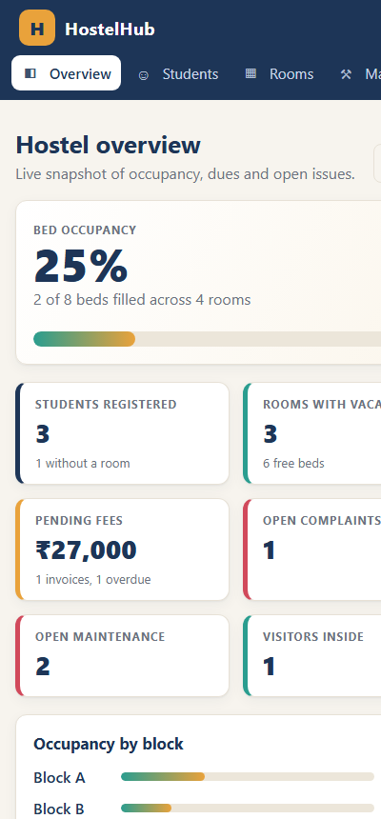
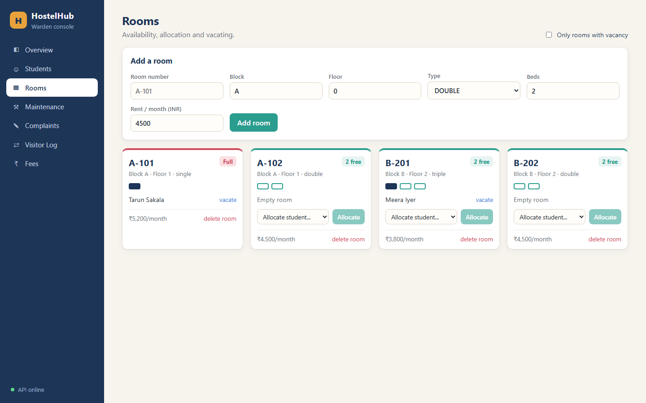
05 / USER INTERFACE
The product in action
Dashboard • mobile layout • room availability
06

Slide 8
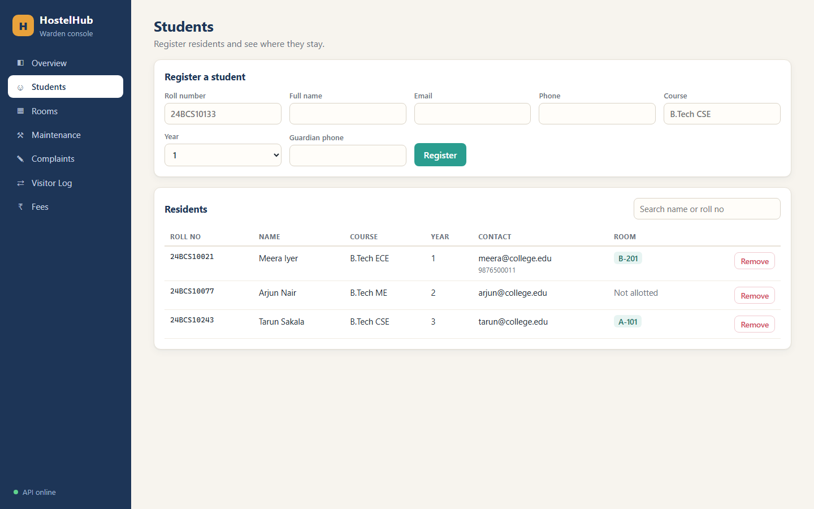
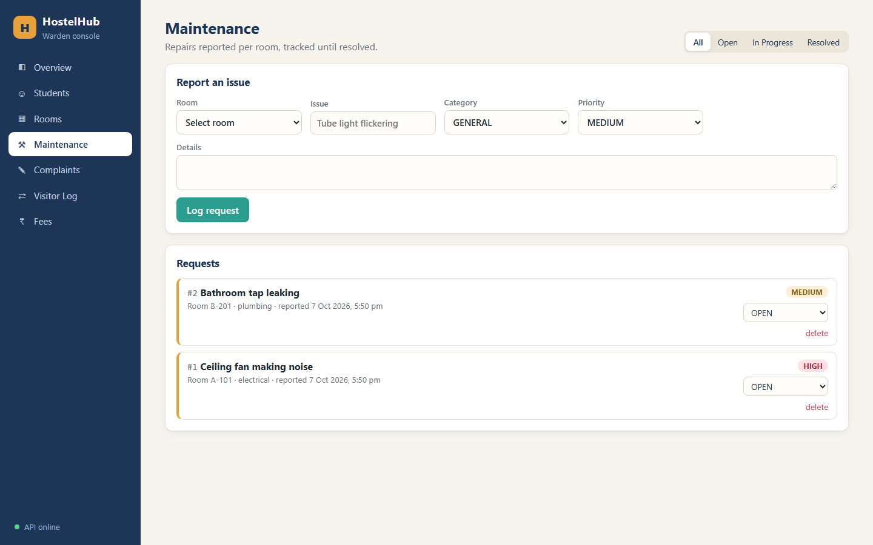
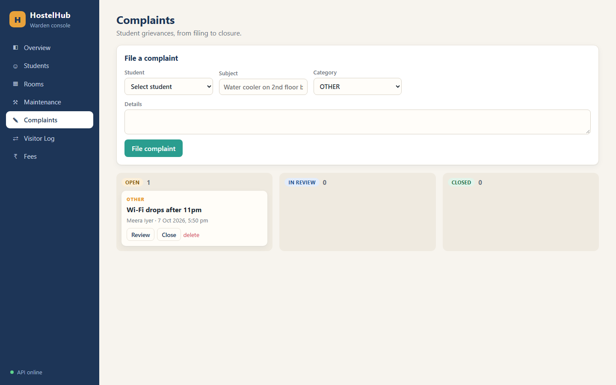
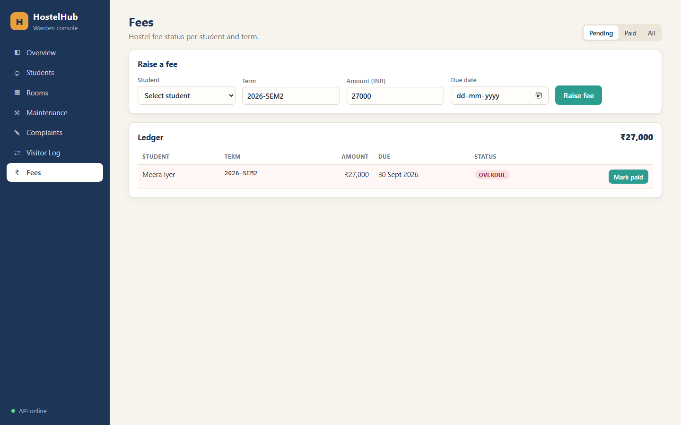
06 / REAL APPLICATION SCREENS
Core workflows
Student records • maintenance requests • complaints • fee tracking
07

Slide 9
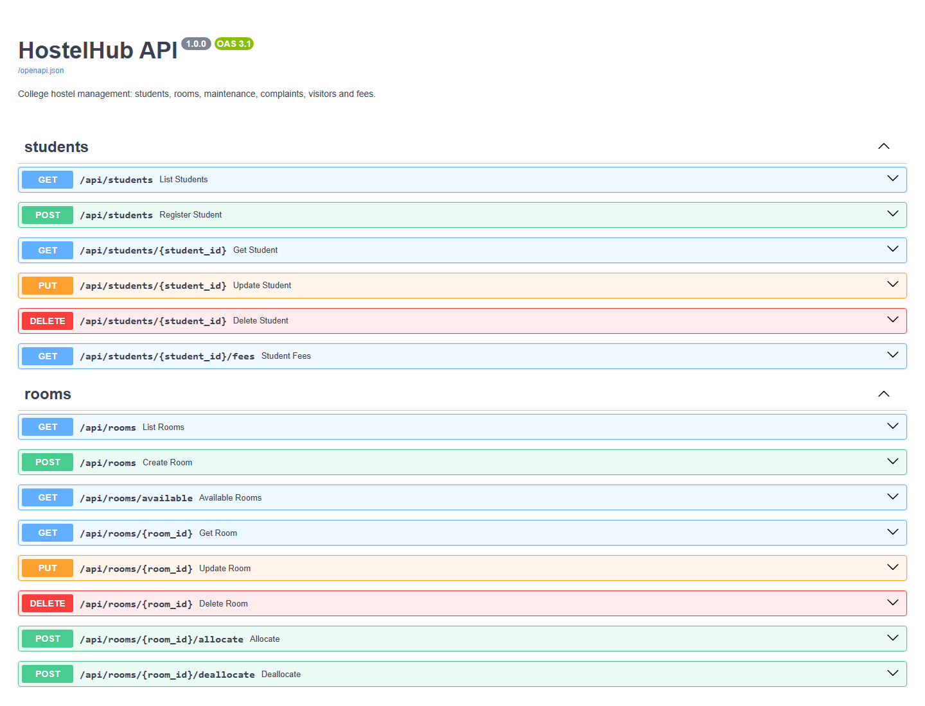
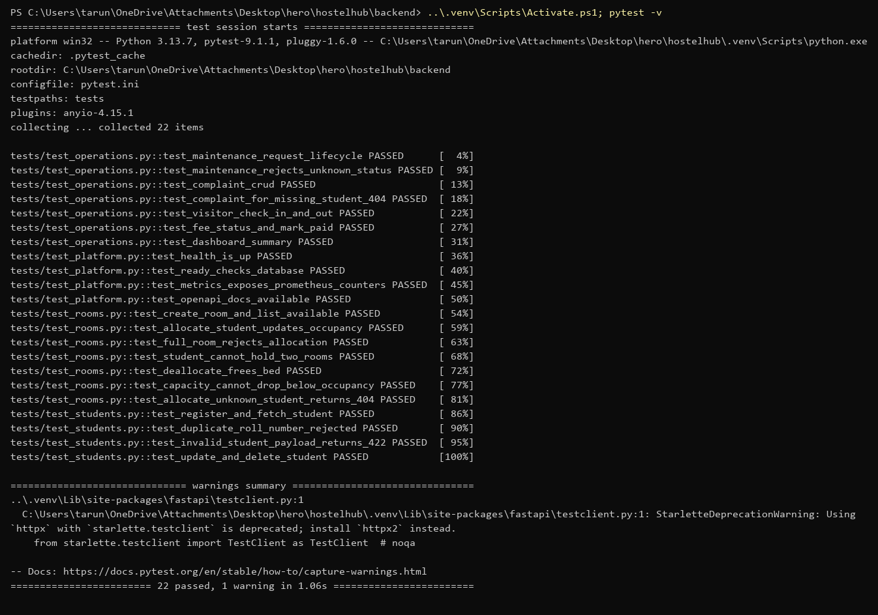
07 / CORRECTNESS
Backend API and automated tests
API checks
Health and readiness endpoints; interactive Swagger documentation.
Test suite
README reports 22 pytest tests using in-memory SQLite, not the real database.
08

Slide 10
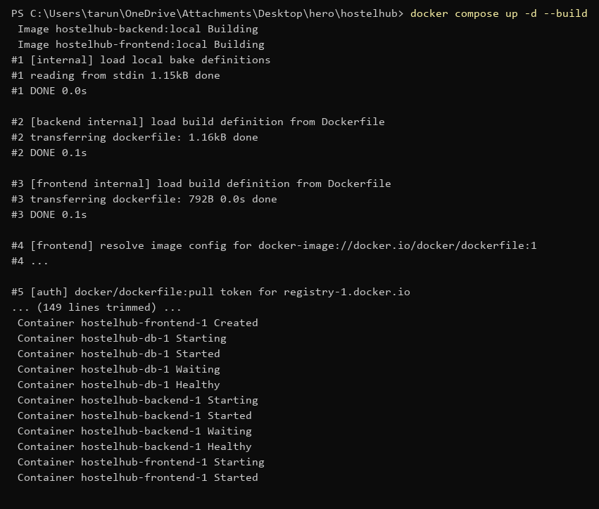
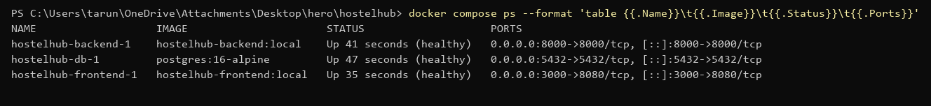
08 / REPEATABLE DEVELOPMENT
Local environment with Docker Compose
One command builds and starts the frontend, API and PostgreSQL; compose ps confirms container status.
09

Slide 11
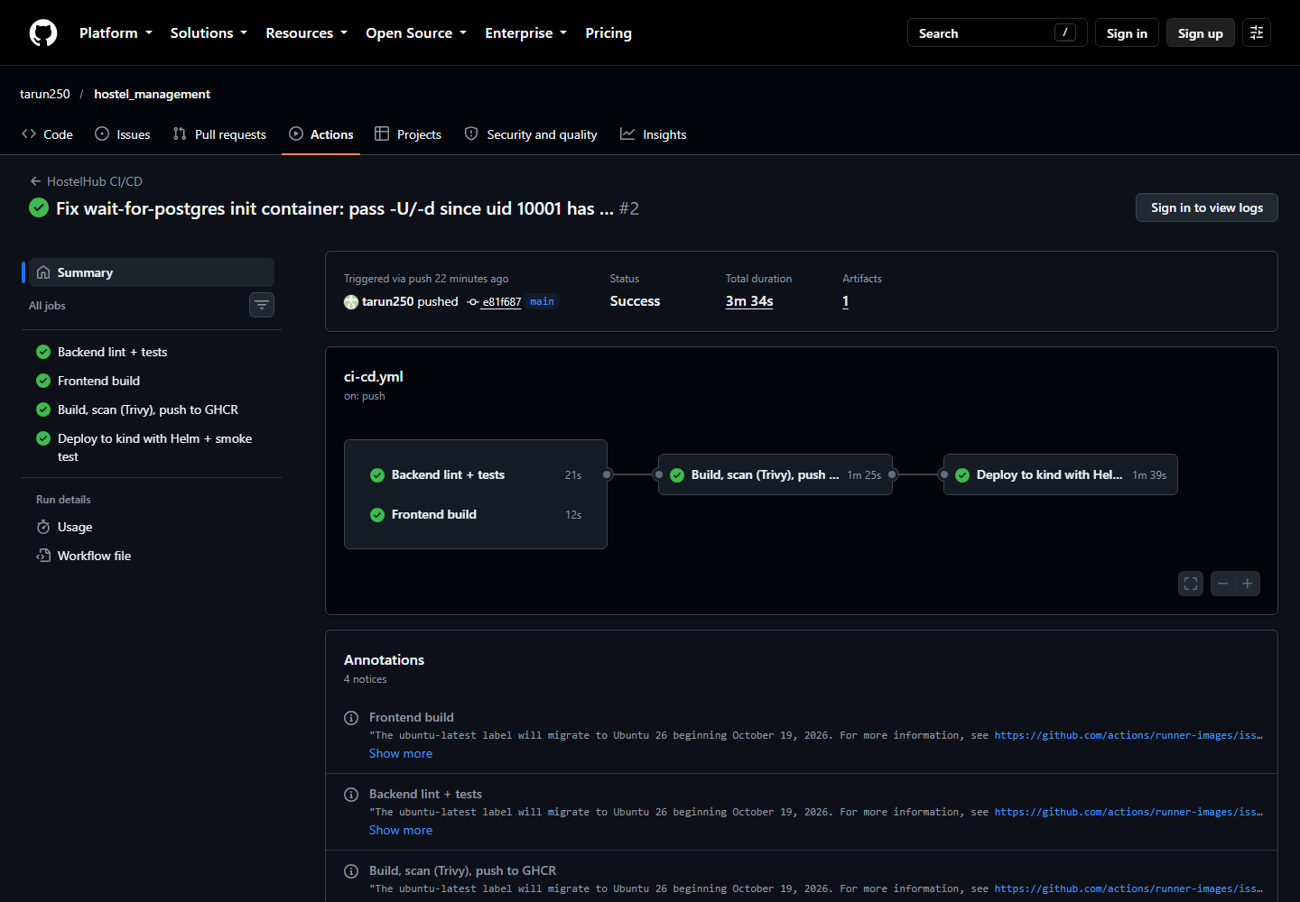
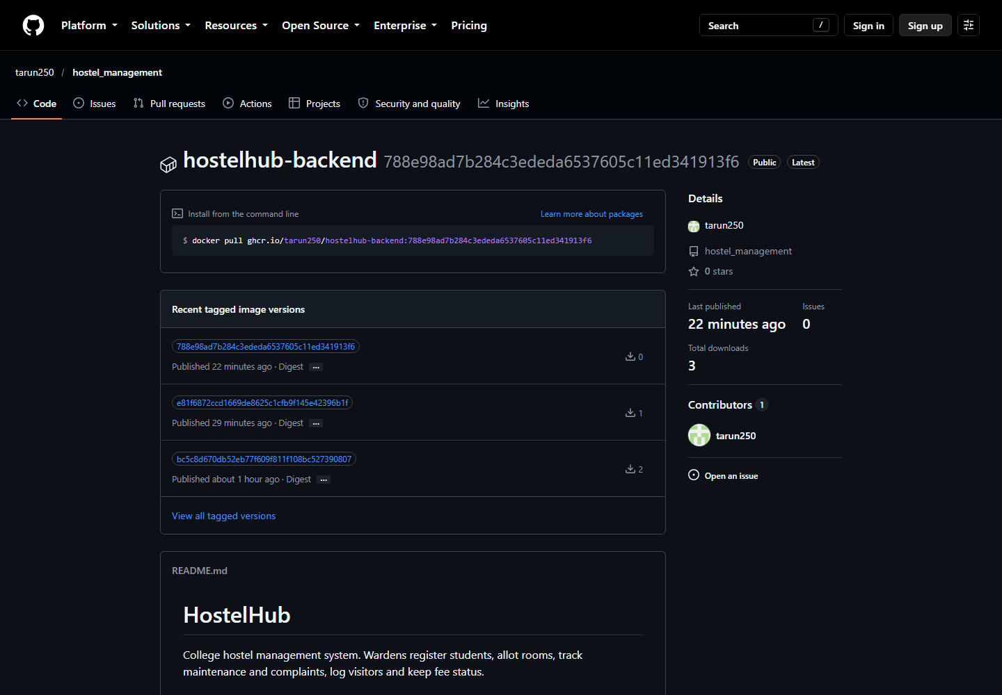
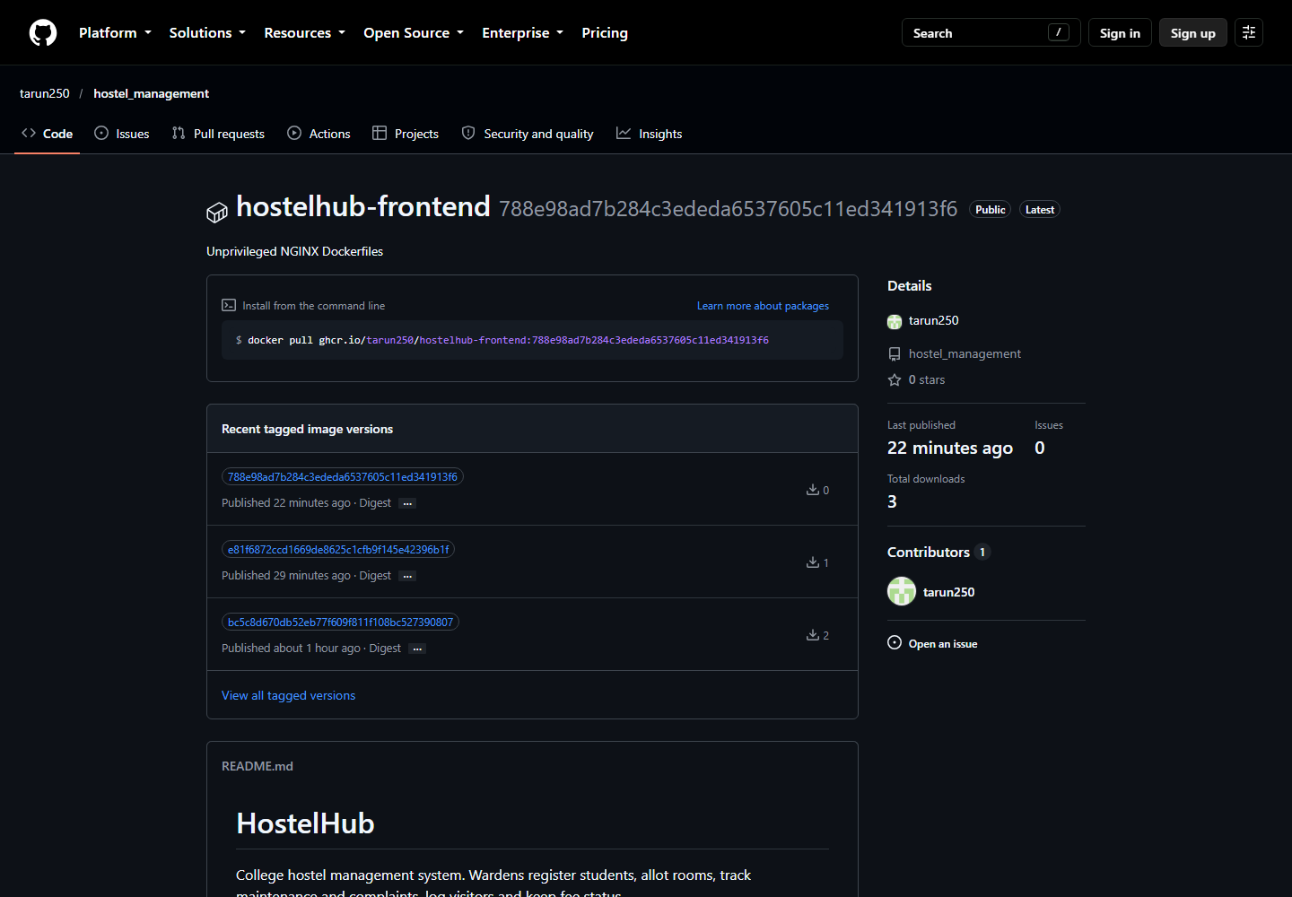
09 / FROM COMMIT TO DEPLOYMENT
CI/CD pipeline
1
2
3
4
5
Test
Build
Scan
Publish
Deploy
ruff + pytest
Frontend + images
Trivy security gate
GHCR on main
kind + Helm + smoke tests
Repository README links the latest green GitHub Actions run; images are published to GitHub Container Registry.
10

Slide 12
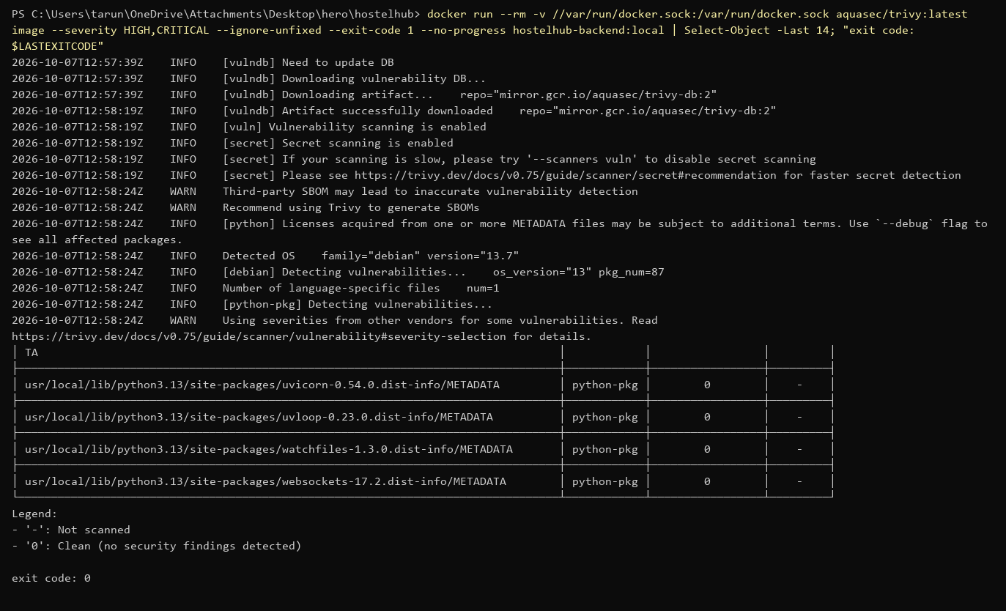
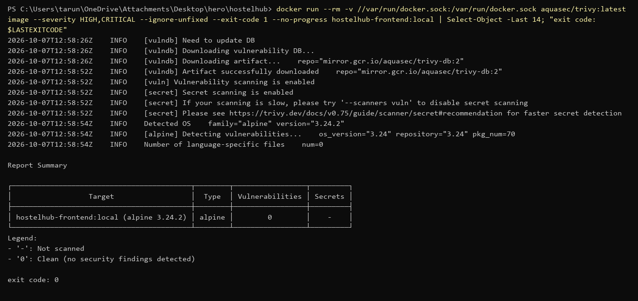
10 / IMAGE SCANNING
Security checks in the pipeline
README reports 0 fixable HIGH/CRITICAL CVEs in the final backend and frontend scans. The CI gate uses Trivy with --ignore-unfixed.
Images run as non-root users; backend runtime removes pip to reduce unnecessary packages.
11

Slide 13
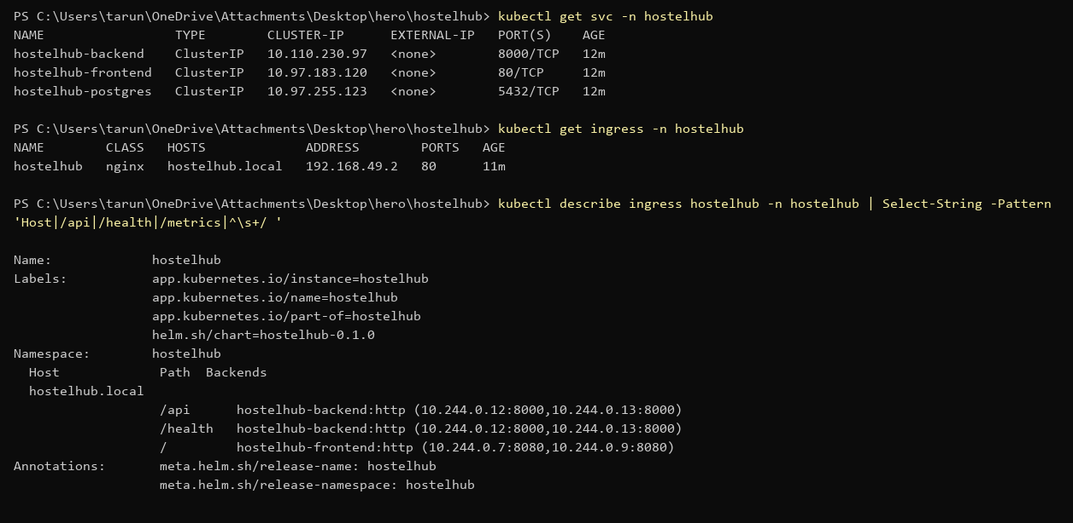
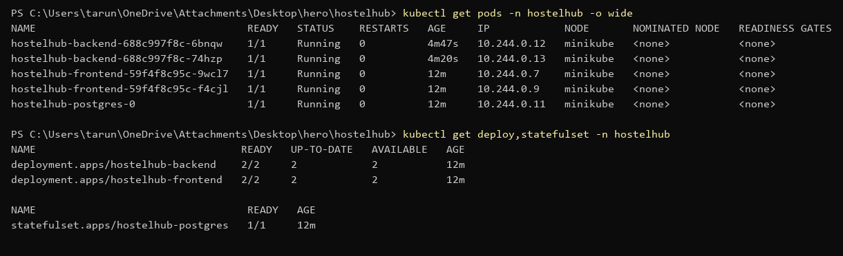
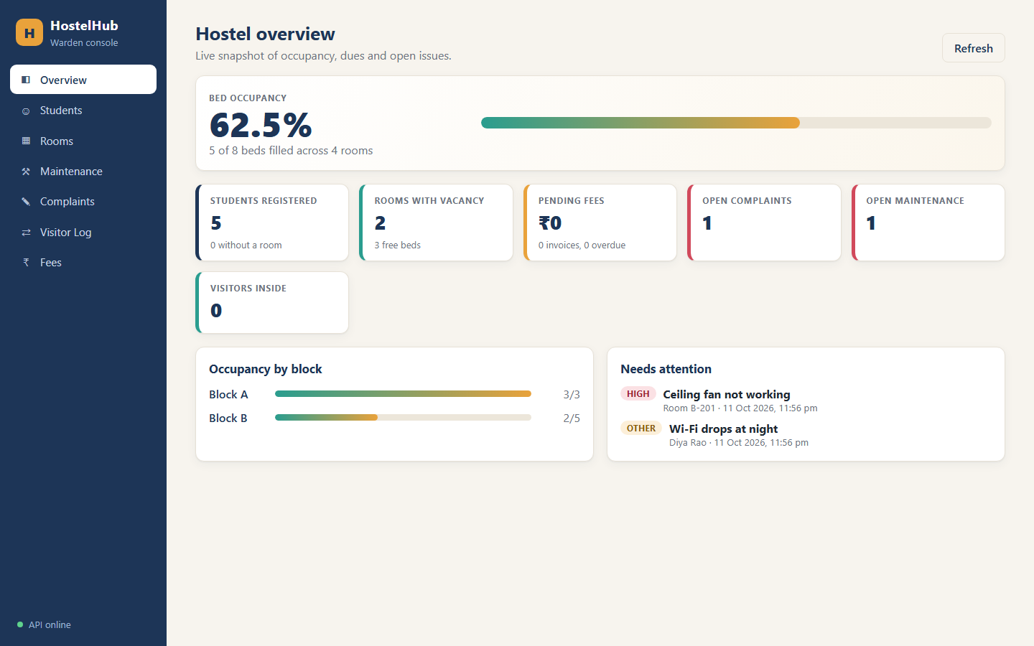
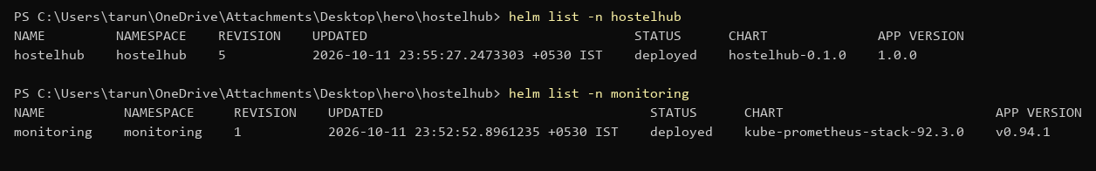
11 / ORCHESTRATION
Kubernetes deployment
Helm chart manages the application resources; Ingress routes browser traffic to the frontend and /api to FastAPI.
12

Slide 14
12 / DESIGN DECISION
Why Kubernetes instead of only Docker Compose?
Docker Compose
Kubernetes + Helm
• Best for local development and demos.
• Starts related containers with a simple config.
• Does not provide the same orchestration model for scaling and self-healing across nodes.
• Used here for the local developer experience.
• Declarative deployments and replica management.
• Services and Ingress provide stable routing.
• Supports resource-driven scaling and rollout controls.
• Helm packages resources and values for repeatable environments.
Decision: use Compose to run locally; use Kubernetes to demonstrate production-style orchestration.
13

Slide 15
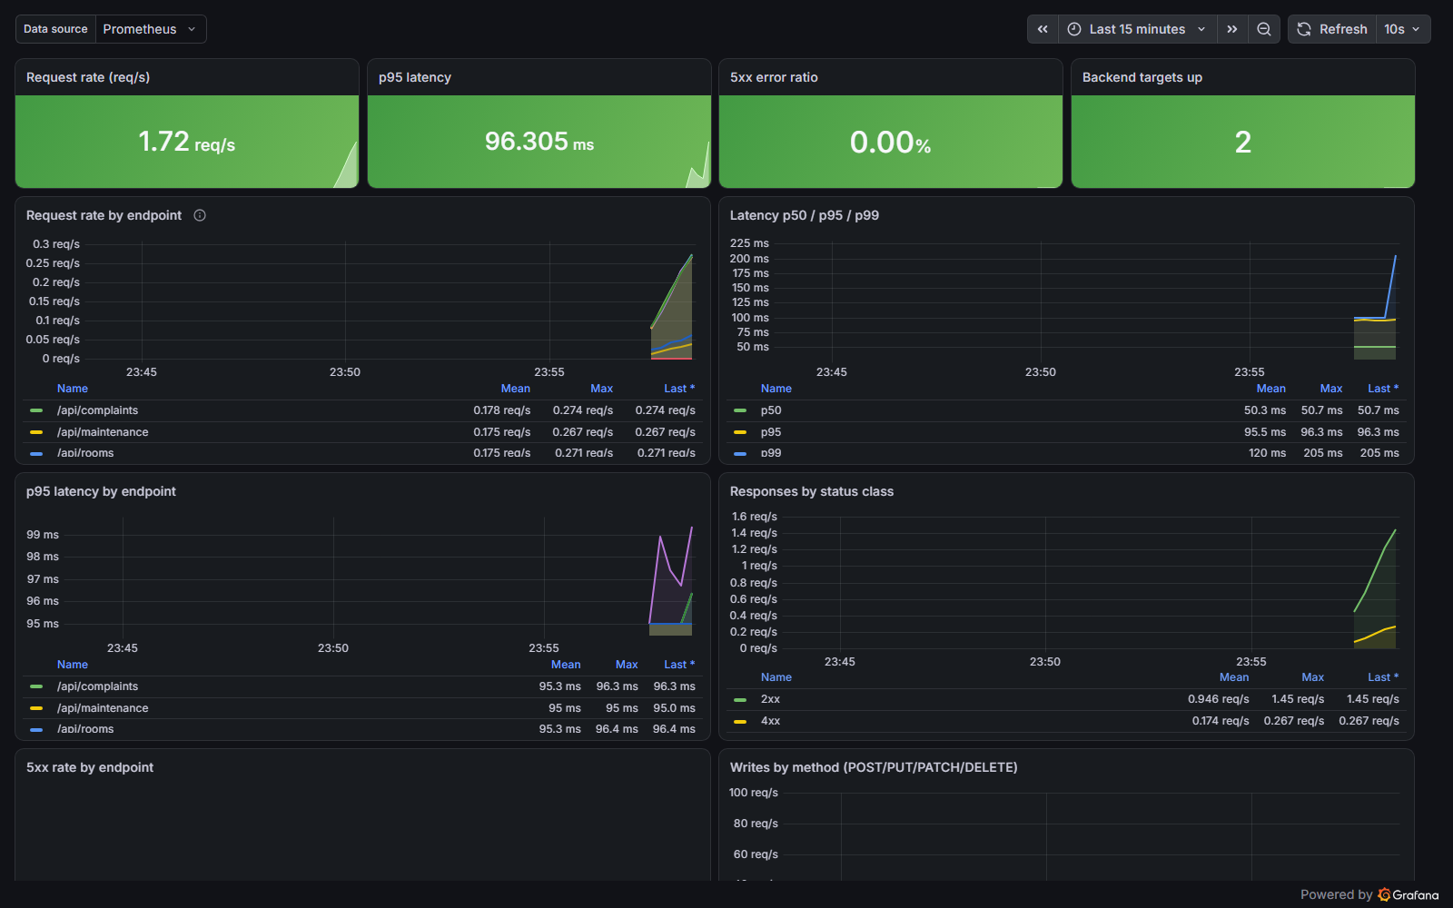
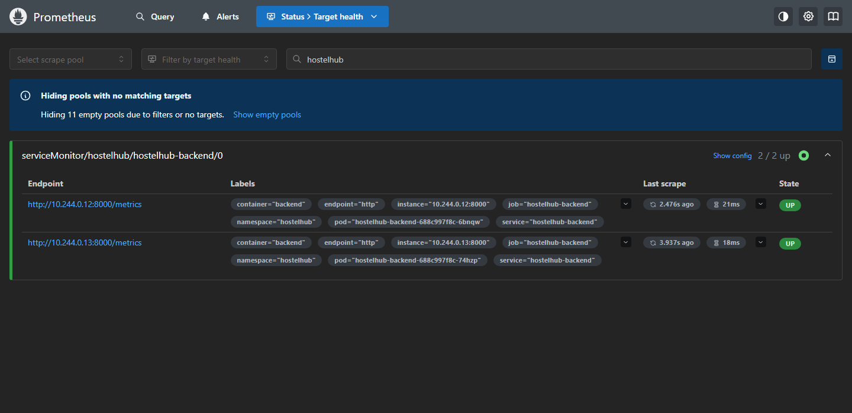
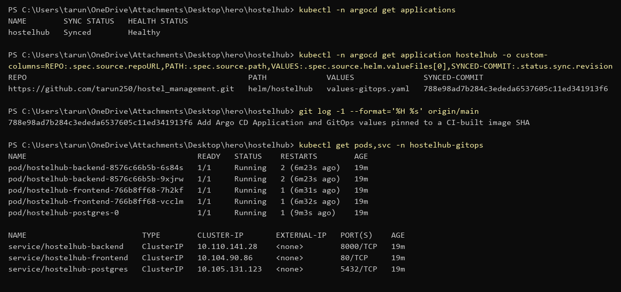
13 / OPERATE AND RECONCILE
Monitoring and GitOps
Prometheus
Grafana
Argo CD
Scrapes backend metrics at /metrics.
Visualizes request rate, latency and error signals.
Watches Helm config and syncs desired state.
Monitoring and GitOps are separate concerns: one shows system health; the other reconciles deployment configuration.
14

Slide 16
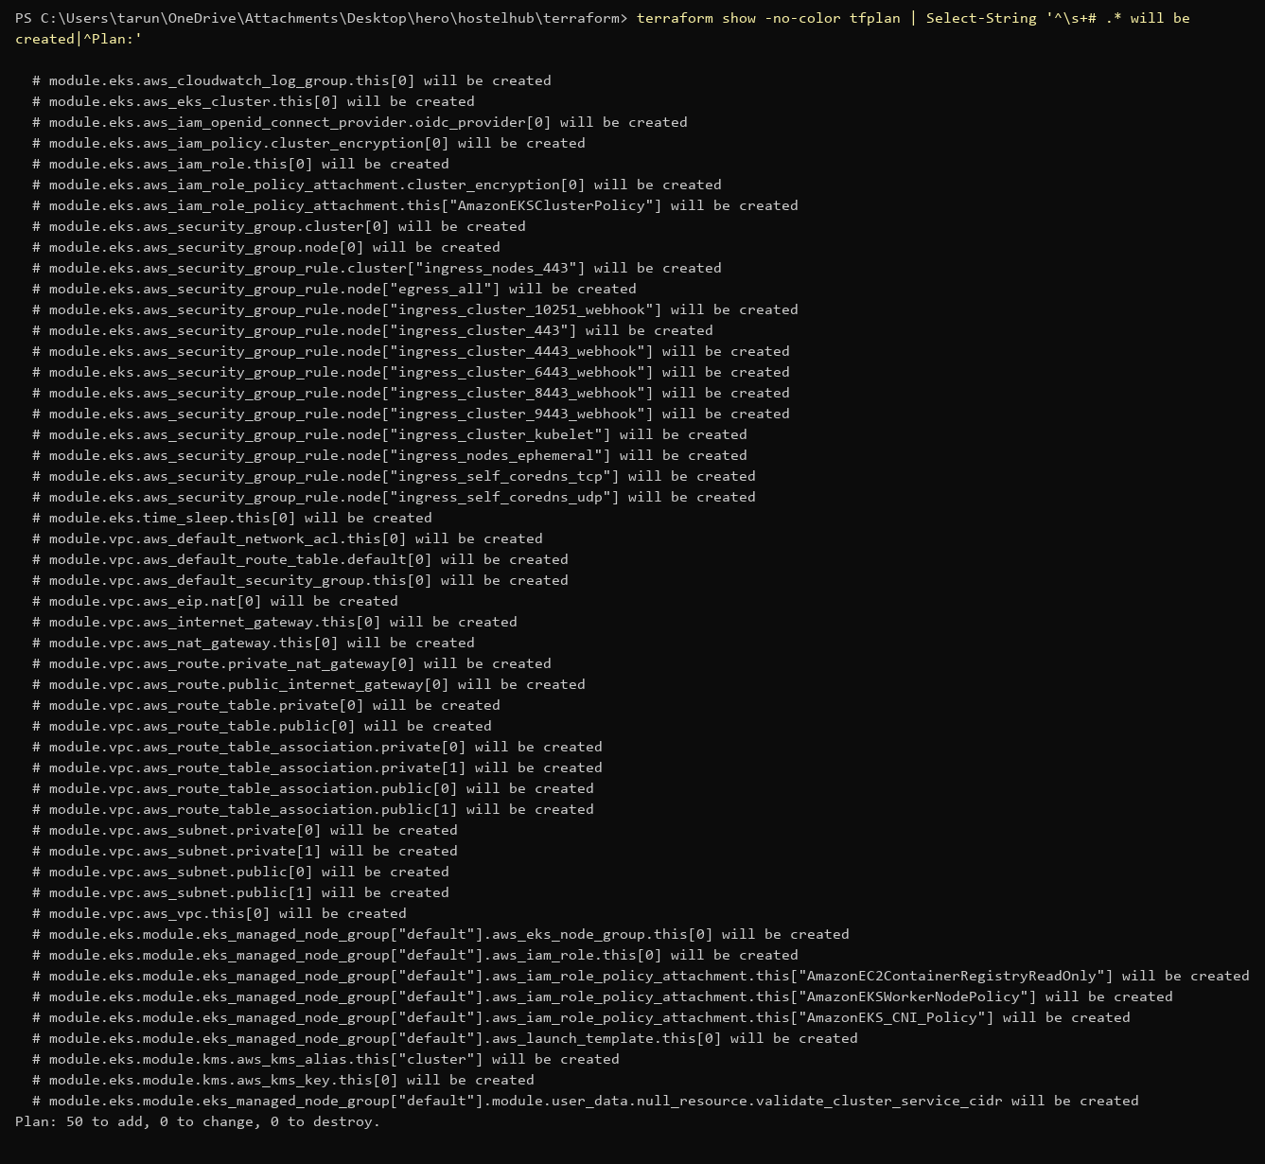
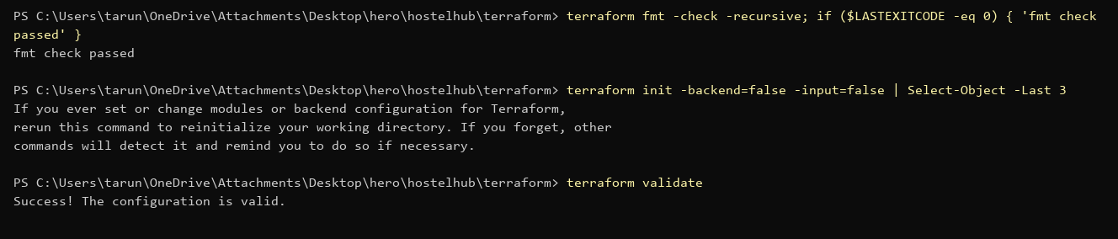
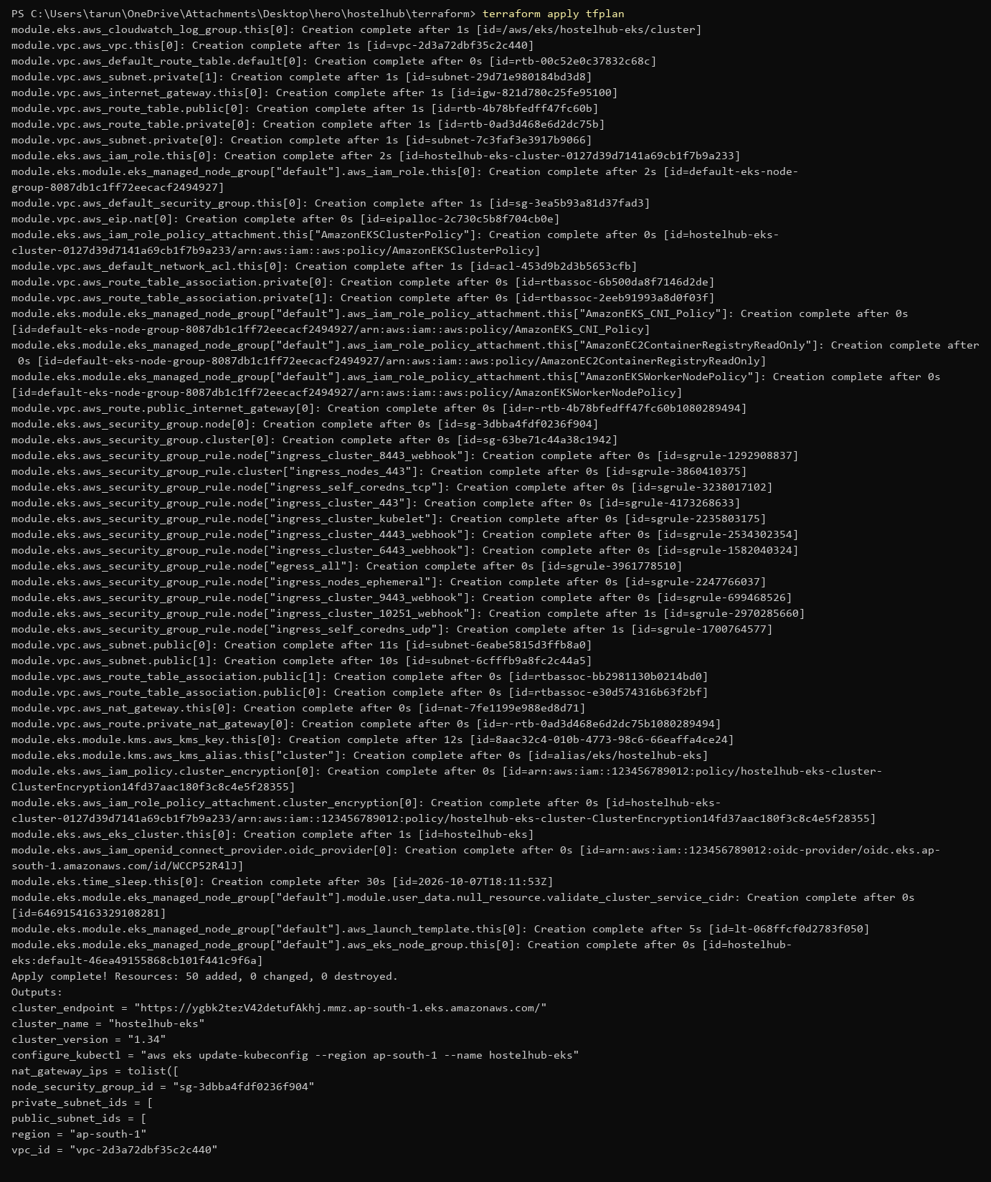
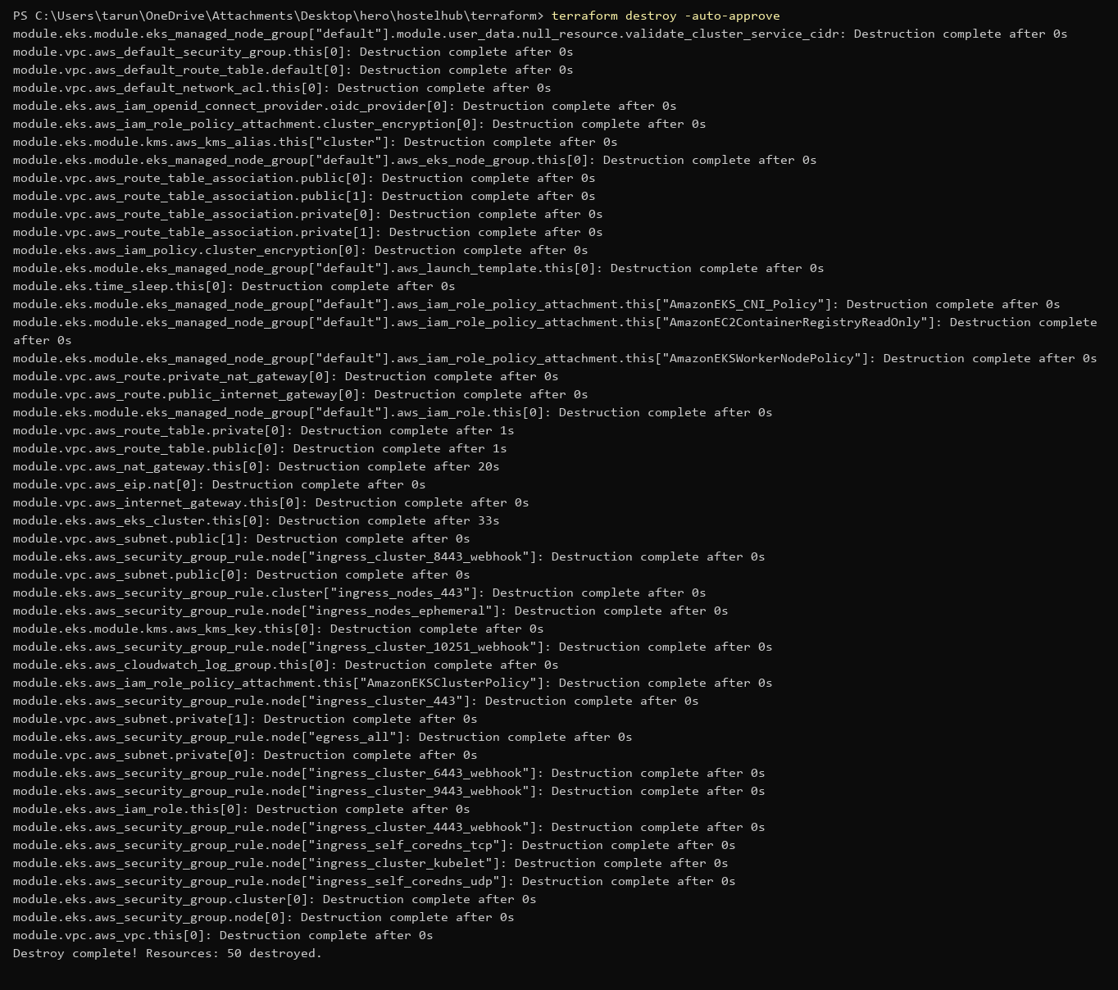
14 / CLOUD INFRASTRUCTURE
Infrastructure as code: Terraform
Important scope note: README states Terraform was exercised against Moto mock services; this is not proof of a live AWS EKS deployment.
15

Slide 17
15 / SUMMARY
What was demonstrated
Delivered
Honest boundary
• Working hostel-management UI and REST API.
• Automated backend tests and frontend build.
• Docker images and Trivy scanning in CI.
• Local Kubernetes deployment through Helm/kind or Minikube workflows.
• Prometheus/Grafana configuration and Argo CD GitOps files.
• Terraform definitions for VPC and EKS.
• The CI workflow deploys to kind for smoke tests.
• Kubernetes screenshots show local cluster runs.
• Terraform screenshots show validation and Moto-backed testing.
• No live AWS account/EKS deployment is evidenced by these screenshots.
• This separation avoids claiming a cloud deployment that was not demonstrated.
Repository: github.com/tarun250/hostel_management • README includes setup, screenshots and operational commands.
16

Slide 18
Thank you
HostelHub — a full-stack application with an automated DevOps delivery path.
github.com/tarun250/hostel_management

