Slide 1
Sign Language Application
Submitted By: Bapanapalli Tarun Sai Kumar (36110146)
Project Guide: Mrs. Mercy Paul Selvan, M.E., Ph.D.,

Slide 2
Presentation Outline
Abstract
Introduction
Features of Project
Literature Survey
Project Flow Diagram
Modules
Screenshots
Conclusion
References

Slide 3
ABSTRACT
Communication plays a very important role in day to day life of Human Beings. It is treated as a life skill. Our work helps in improving the communication with Physically Impaired Persons.
This application helps the deaf and dumb person to communicate with the rest of the world using SIGN LANGUAGE.
Speech-to-sign technology enables language translation on smart phones. The main feature of this work is that it can be used to learn Sign Language and to provide Sign Language Translation.

Slide 4
Introduction
Android application have shown a dramatic improvement in their functionality to a point where it is now possible to have Smart Phone to be able to read and write email, browse web pages and play games.
User needed to login into App by Registering into it and can send the message to any of his contacts.
User signs through Sign Language Keyboard displayed in an Application.
The Software translates signs into text by the Interpretation process.

Slide 5
Features of Project
We can communicate to each other like face to face communication.
The Sign words are assigned in the same order as letters appear in English Alphabetic Keyboard (i.e. QWERTY Keyboard)
The project prepares it’s designer to work as a interpreter facilitating and mediating communication between Deaf and Perfect people.
Accurate and appropriate transfer of a message from a source language into a target language from the point of view of style and culture

Slide 6
Literature Survey
The sole purpose of the Literature Survey is to give the brief overview of the Project and also complete information about the Reference Papers.
The goal of Literature Survey is to completely specify the technical details related to the project in a concise and unambiguous manner.
Raghavendhar Reddy.B, “Speech to Text Conversion in Android” International Journal of Engineering Research and Applications (IJERA) Vol.3 Feb 2013. This paper introduces new android application which will be able to detect the Indian sign language via mobile camera and converts into corresponding text or voice output.

Slide 7
Literature Survey (Continued)....
Sangeetha.K, Barathi.L, “Gesture Detection for Deaf and Dumb People” International Journal of Development Research Vol.4 March 2014. This paper proposes optimized approaches of implementing the famous Viola Jones Algorithm with LBP (Local Binary Pattern) features for hand Gesture recognition.
Shanmukha Swamy, “Indian Sign Language Interpreter with Android” International Journal of Computer Applications Vol.97 July 2014. In this project, through the use of speech technology, attempts to provide solutions for some of these issues by creating an interactive system.

Slide 8
Literature Survey (Continued)....
Sinora.G, “Android App on Exam Using Speech Technology for Blind People ” International Journal of Research in Computer Communication Vol.3 March 2014. We are developing this on android platform using eclipse workbench. Our Speech-to-Text system directly converts speech to text. Speech-to-Text system can also improve accessibility by providing data entry options for physically handicapped users.
Tapas.P, “Text to Speech with Phonematic Concatenation” International Journal of Electronics Communication and Computer Technology Vol.2 Sept 2012. Text-to-speech (TTS) convention transforms linguistic information stored as data or text into speech. This paper presents a method to design a Text to Speech conversion module by the use of Matlab by simple matrix operations.

Slide 9
Project Flow Diagram
LOGIN
VALIDATE DETAILS
LOGIN
FAILED
HOME PAGE
FALSE TRUE
SIGN LEARN
MESSAGE (SIGN TO TEXT)
SMS INBOX

Slide 10
Modules
LOGIN
First Module is used to help the User to install the application in their Smart phones. Once the user installs the application it asks the user to enter their user name, password and confirm password. If both the password matches the user registration gets successful and now the user is taken to the Home Page where the ASL keyboard is displayed.
SIGN TO TEXT
Second Module comprises the Sign Language input, which is displayed as the keyboard on the mobile screen. American Sign Language (ASL) is the predominant Sign Language of deaf communities in the United States. ASL is to be a Subject Verb Object (SVO) Language.

Slide 11
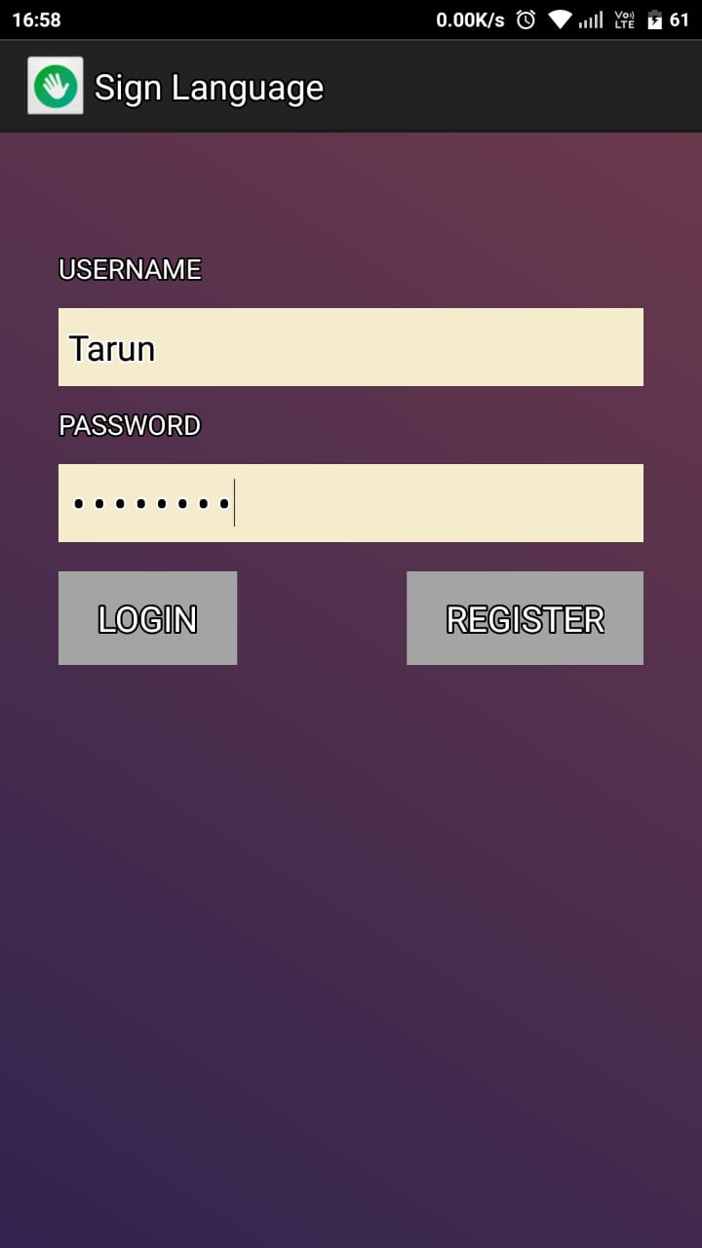
Screenshots
Login Page
To Enter into Application, User Login is Essential.
Authorisation means Validation of Username & Password.
Login Credentials are verified and next Interface is Shown.

Slide 12
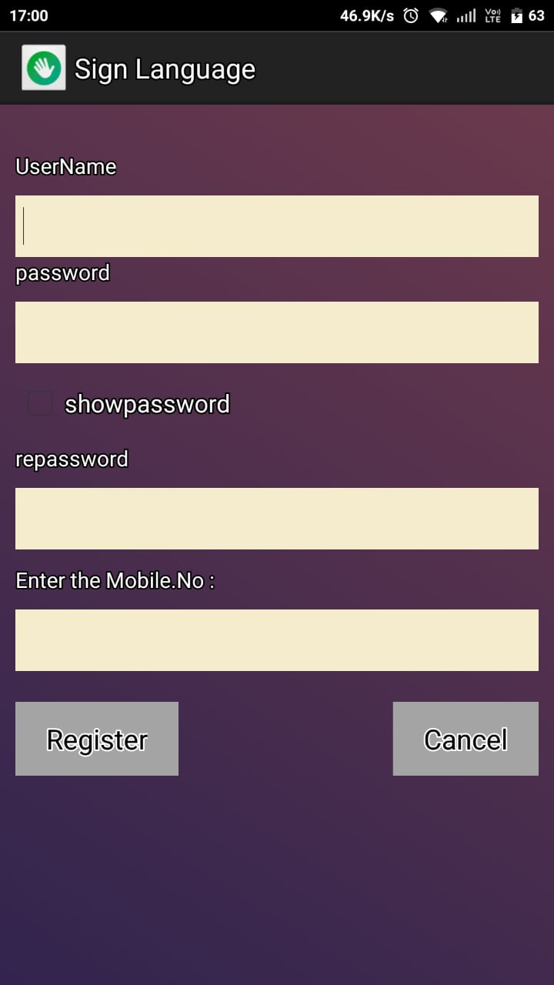
Screenshots…
Registration Page
Registration of User is Essential for using the Application. It asks the User to enter their UserName, password and repassword with Mobile Number. If both the passwords matches, then the user registration will get successful and next Interface opens.

Slide 13
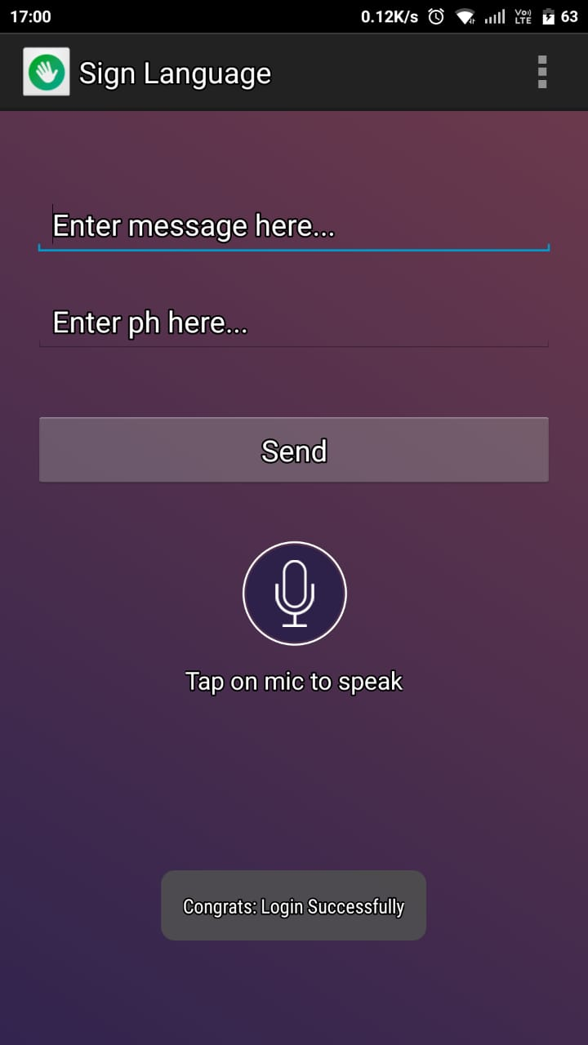
Screenshots…
Home Page
When a User Login is Successful this Interface will appear. User can type the message here and can also select the contact required to send message. User can send an Audio message by clicking on the Mic.

Slide 14
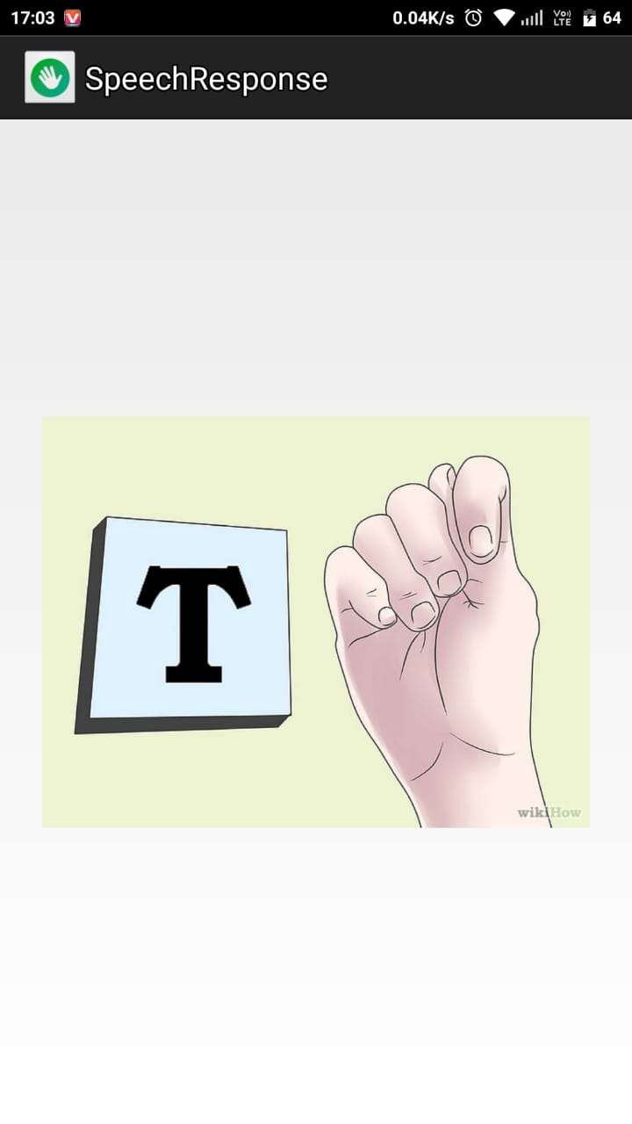
Screenshots…
Speech Response
This Interface is also be called as “SIGN LEARN”. It helps the User to understand the meanings of Keys in Sign Language Symbols of the ASL Keyboard. For the better Understanding and to avoid confusion to User the Sign Keys in Keyboard are aligned same as in English Alphabetic Keyboard (QWERTY Keyboard).

Slide 15
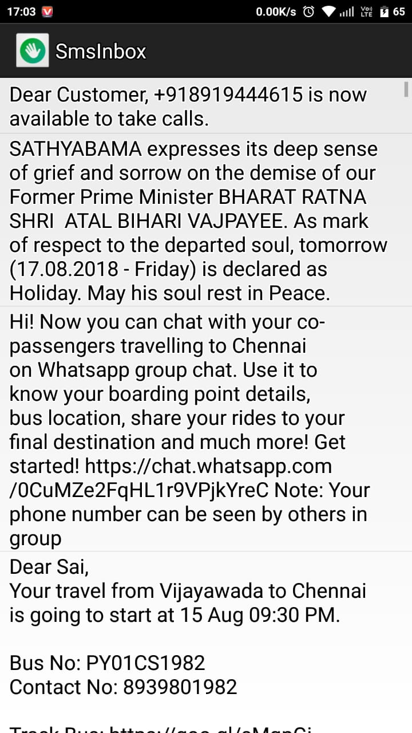
Screenshots…
SMS Inbox
User can see all the older messages here. List of all the messages appear and will be able to read by User. It contains all of Chat data sent and Received by User.

Slide 16
Conclusion
By using this application deaf person can easily interact with normal person anywhere, and he can also use this application for mobile sign translation.
In future important journals include Mimix, Outfit – 7, VRS on speech and Audio processing, computer speech and language. It involves both speech recognition and translation components.
It also includes the following special criteria:
Automatic Translation
Automotive Speech Recognition
Speech-to-Sign Transmission

Slide 17
References
Raghavendhar Reddy.B, “Speech to Text Conversion using Android Platform” International
Journal of Engineering Research and Applications (IJERA) Vol.3 January - February 2013.
Sangeetha.K, “Gesture Detection for Deaf and Dumb People” International Journal of Development Research Vol.4 March 2014.
Sinora.G, “Android App Using Speech Technology for Blind People ” International Journal
of Research in Computer and Communication Technology Vol 3 March 2014.
http//educationportal.com/articles/Sign_Language_Interpreter_Job_Description_Duties_and_Requirements.html
https//play.google.com/store/apps/details?id=me.mimix.roid&hl=en

Slide 18


