Slide 1

HEALTH AXIS
SRM INSTITUTE OF SCIENCE AND TECHNOLOGY
COLLEGE OF ENGINEERING AND TECHNOLOGY
DEPARTMENT OF NETWORKING AND COMMUNICATIONS
21CSC202J-Operating Systems , Mini-Project Presentation
K. TARUN Reg No:RA2211031010104
B. MOHITH Reg No:RA2211031010108
K. JAVALI Reg No:RA2211031010100

Slide 2
Table of contents
ABSTRACT
INTRODUCTION
PROBLEM STATEMENT
OBJECTIVE
REQUIREMENTS
ARCHITECTURE
RESULTS
REFERENCES

Slide 3
ABSTRACT
Creating Java-based healthcare applications relies on tight integration with MySQL databases for seamless storage and retrieval of user data, prioritizing user management and ensuring efficient delivery of healthcare research. This versatile application allows users to access personal content that is synchronized between a local index and a centralized database, allowing them to seamlessly navigate their health journey. Featuring an intuitive interface, the app simplifies health checks, allowing users to easily review results and actively contribute to data collection. The core program aims to streamline user interaction, collect comprehensive health-related data, and conduct in-depth qualitative analysis. Through this data-driven approach, it strives to improve the landscape of customer health management, promote informed decision-making and personal care, ultimately improving overall health outcomes.

Slide 4
INTRODUCTION
Health systems play an important role in the health of individuals and communities and form the basis of the global society. As the demand for healthcare continues to grow and evolve, so does the need for innovative solutions that transcend the limitations of traditional management systems. Promoting health management is a turning point, and we remain committed to ushering in a new era of efficiency, accessibility and accuracy of management. review medical records. The driving force behind this shift is recognition of the many challenges that plague traditional healthcare systems, from complex manual processes to communication between patients and doctors

Slide 5
PROBLEM STATEMENT
The evolution of healthcare management involves an in-depth study of the chronic challenges inherent in traditional healthcare systems. The underlying problem is the reliance on error-prone and inefficient manual procedures, leading to compromised standards of patient care. In addition, inherent limitations in direct communication channels between patients and doctors impede timely delivery of treatment and often impede optimal health outcomes. Inadequate access and dissemination of critical patient information leads to vulnerability, resulting in delays in treatment and adverse effects on overall health. As a result, the emerging system emerges as a powerful antidote to a future where healthcare management is greatly improved, errors are reduced, and patient-physician communication becomes the norm.

Slide 6
OBJECTIVE
The main goal of health management involves a multidimensional approach aimed at developing a comprehensive, user-centric platform that enables seamless interaction between patients and healthcare providers. Overall, it aims to develop a system that streamlines and improves the patient experience, provides a better understanding of the registration process for medical services, makes personal content updates, and simplifies access to drug information. This holistic approach seeks to improve the patient journey by providing a smoother and more informed experience when interacting with healthcare services.

Slide 7
REQUIREMENTS
The main goal of health management involves a multidimensional approach aimed at developing a comprehensive, user-centric platform that enables seamless interaction between patients and healthcare providers. Overall, it aims to develop a system that streamlines and improves the patient experience, provides a better understanding of the registration process for medical services, makes personal content updates, and simplifies access to drug information. This holistic approach seeks to improve the patient journey by providing a smoother and more informed experience when interacting with healthcare services.

Slide 8
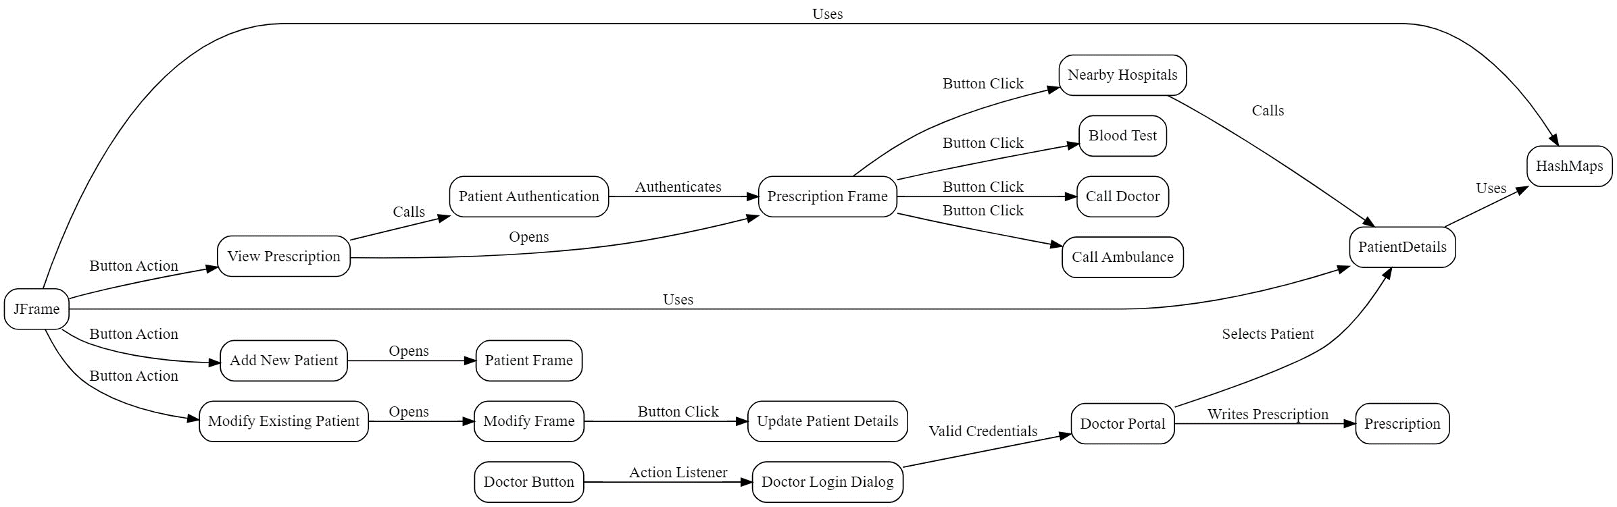
ARCHITECTURE

Slide 9
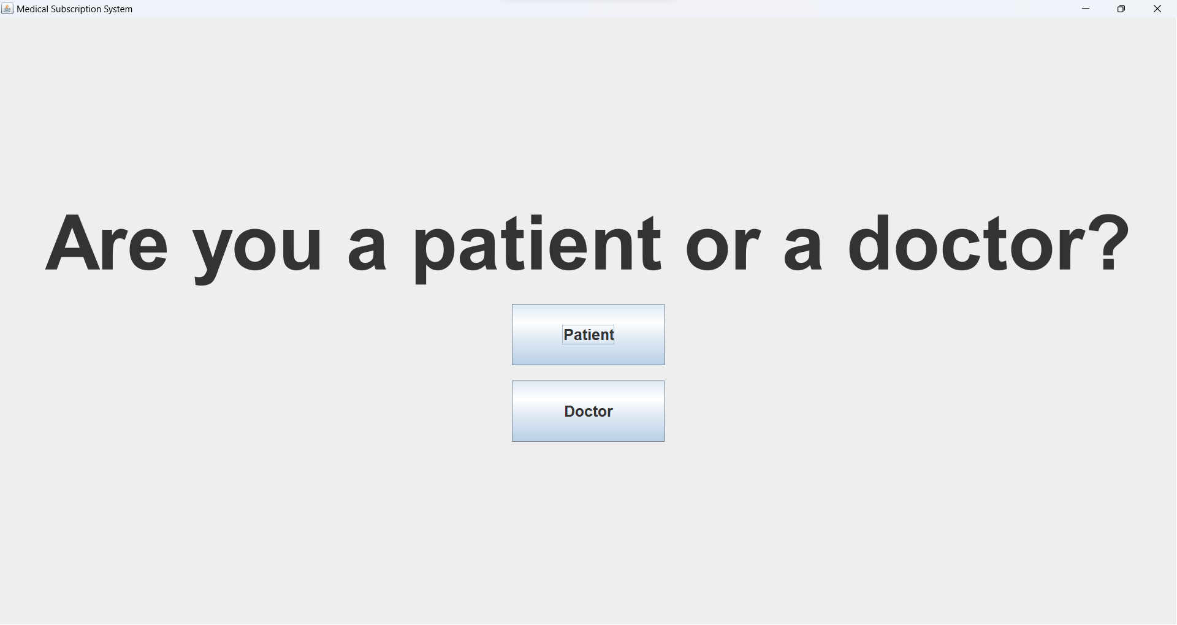
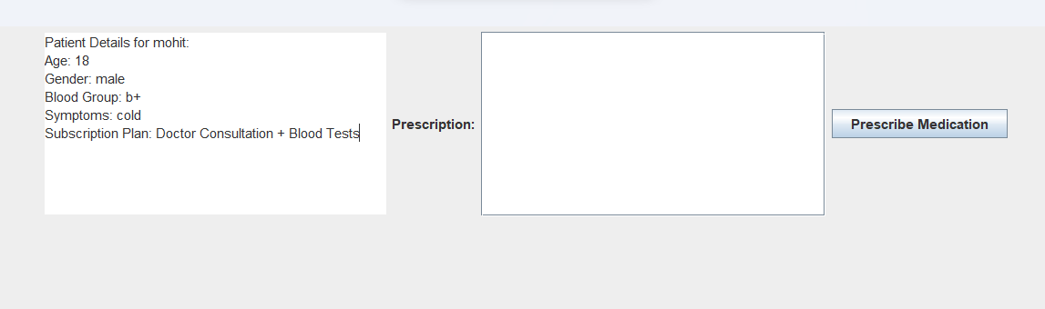
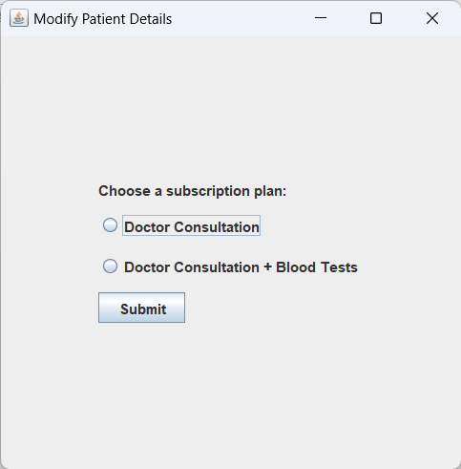
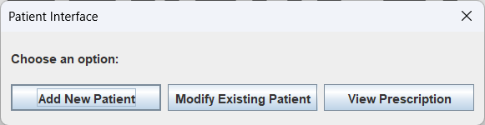
RESULTS

Slide 10
REFERENCES
Brown and A. Smale, "Management of Medical Technology - Case Study of a Major Acute Hospital," 2007 29th Annual International Conference of the IEEE Engineering in Medicine and Biology Society, Lyon, France, 2007, pp. 1778-1781, doi: 10.1109/IEMBS.2007.4352656.
L. Ren, X. Zhang, J. Wang, S. Tang and N. Gong, "Design of hospital beds center management information system based on HIS," 2017 IEEE International Conference on Bioinformatics and Biomedicine (BIBM), Kansas City, MO, USA, 2017, pp. 1093-1096, doi: 10.1109/BIBM.2017.8217808.
Y. Guo et al., "A BIM Integrated Hospital Emergency Management Framework," 2018 IEEE 22nd International Conference on Computer Supported Cooperative Work in Design ((CSCWD)), Nanjing, China, 2018, pp. 677-682, doi: 10.1109/CSCWD.2018.8465274.

Slide 11
Thanks

