Slide 1

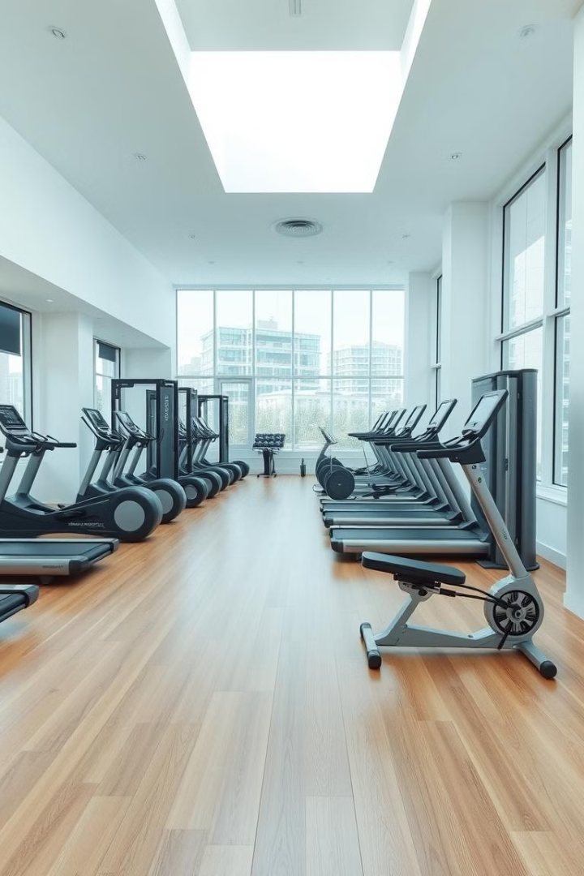

MuscleMate – Smart Fitness Solution
Tarun Prajapati
Roll No : 100
Enrolment No : 23002171310133
Batch : D3
Branch : CST

Slide 2
Key Features:
1. Shopping:
=> Product Catalog & Shopping Cart
=> Order Management with professional UI
=> User Authentication system
2. Fitness Calculators:
=> Calorie Calculator with meal plans
=> Veg/Non-veg suggestions
=> No login required
3. AI Personal Trainer:
=> Google Gemini AI integration
=> Chat-based coaching
=> Workout & nutrition advice

Slide 3

Technology Used
1
Frontend: React.js + Modern CSS
2
Backend: Django + Python
3
AI: Google Gemini API

Slide 4
Future Scope
1
Mobile App
2
Online Payment
3
Progress Tracking

Slide 5

Thank You
We appreciate your time and feedback.

