Slide 1
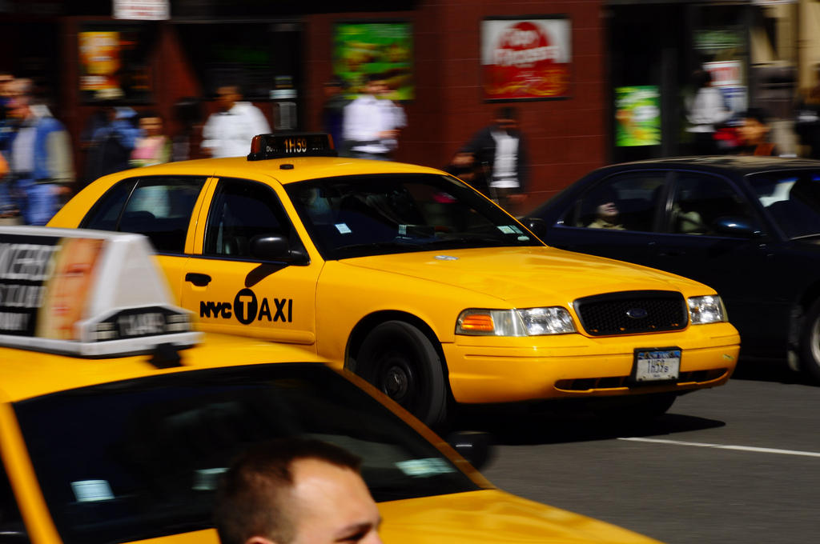
BEST TAXI BASED ON THE DISTANCE WE TRAVEL
BY
TARUN GUDELA

Slide 2
PROBLEM:
In order to find out the Best taxi based on the distance we need to find out the following
Number of taxies run by that vendor
In them how many are short Distance and the short timings
In them how many are long Distance and the long timings

Slide 3
APPROACH:
Used a map reduce function for defining the problem
I made the short distance as the distance below the 35 miles, so the below will be low distance, and above that is large distance.

Slide 4
def functi(item):
shortd=0.0
longd=0.0
shortt=0
longt=0
nos=0
for x in item:
#total+=x
nos+=1
if x >35:
longt+=1
longd+=x
else:
shortt+=1
shortd+=x
return nos,shortt,shortd,longt,longd

Slide 5
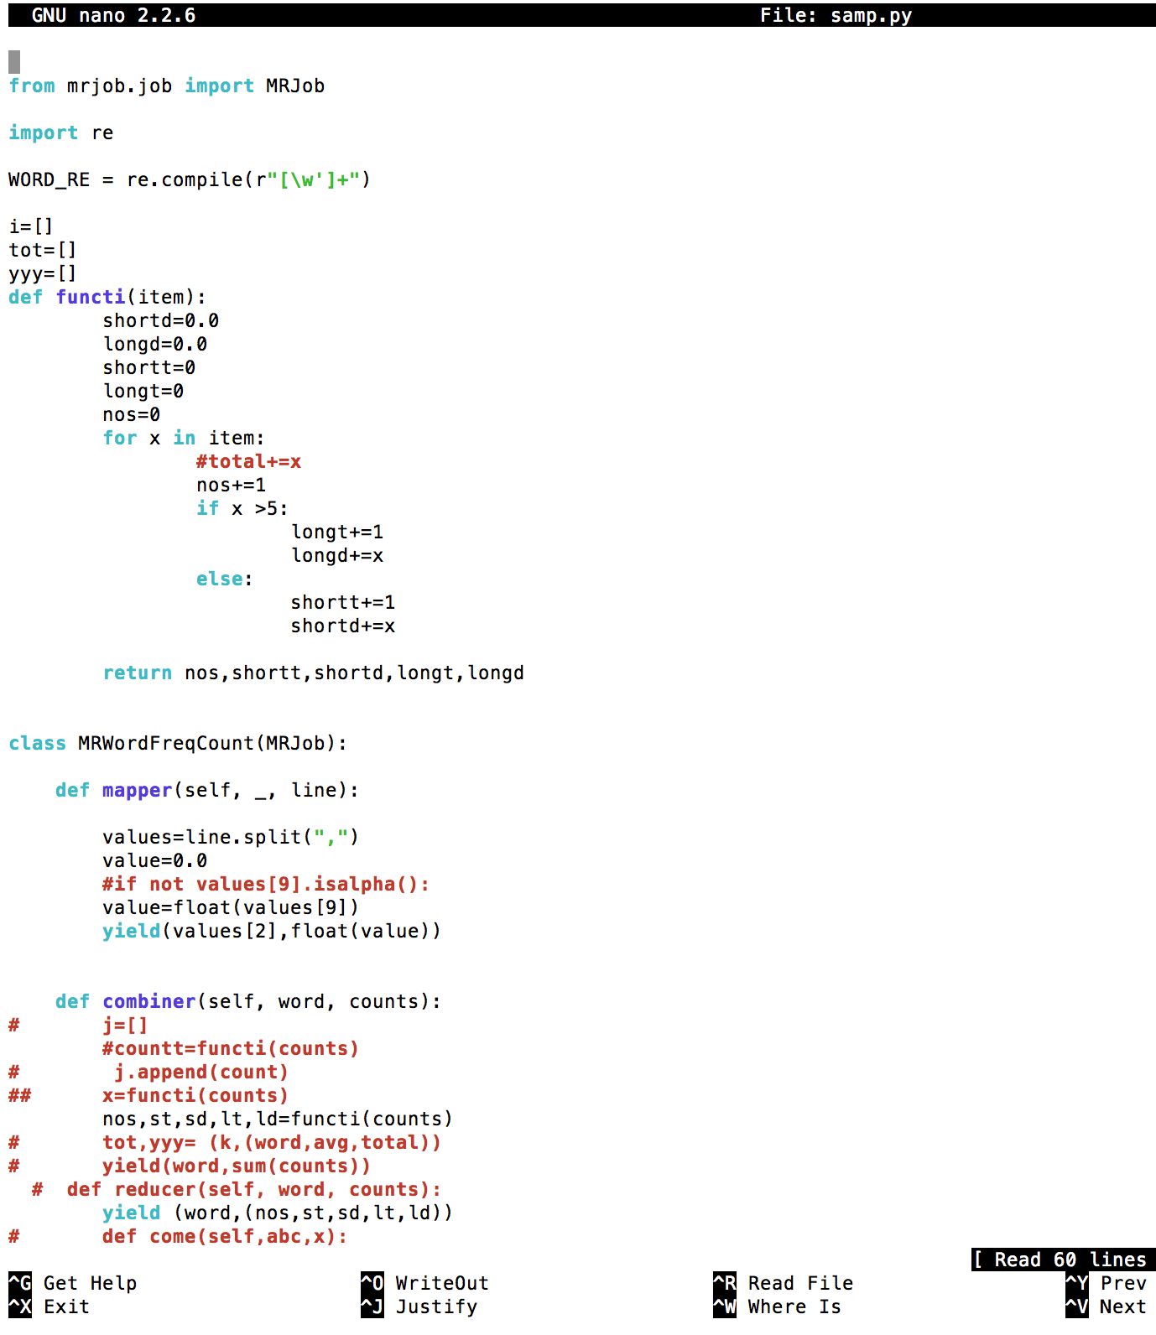
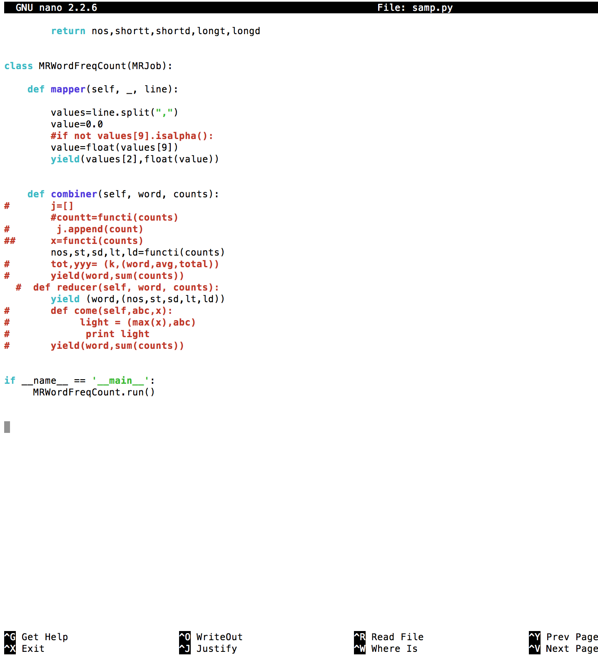

Slide 6
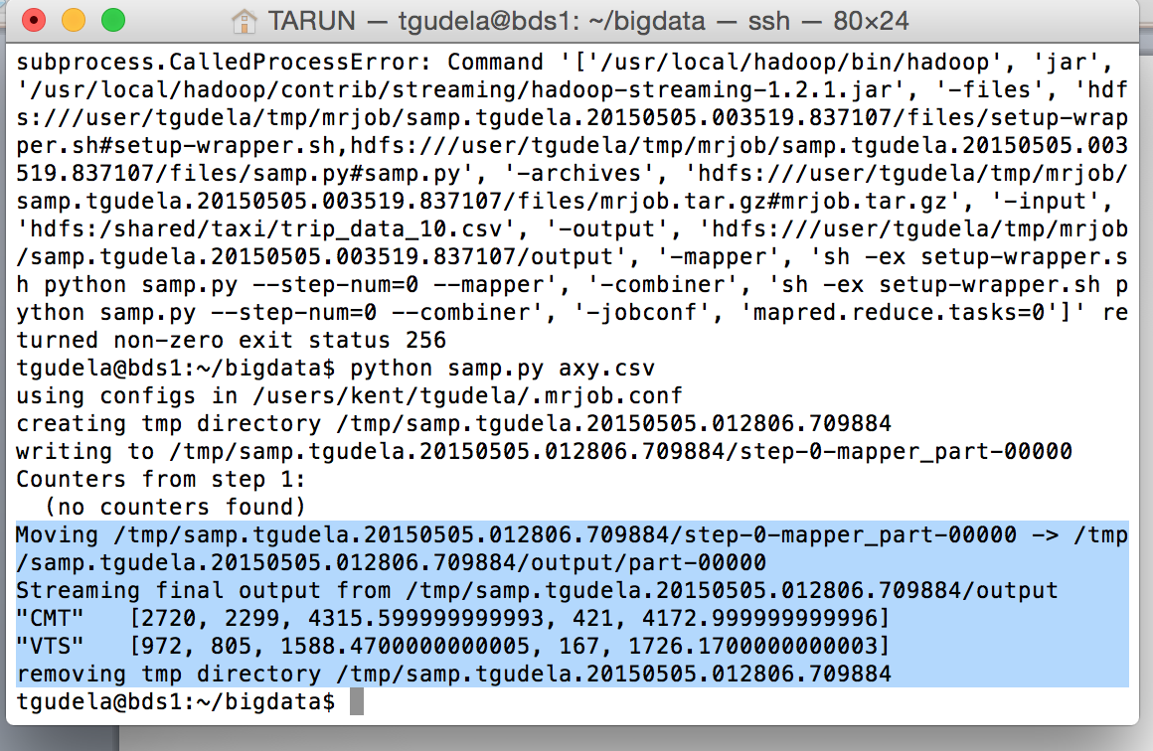

Slide 7
Future Enhancement:
We can include location and best driver for that vendor
And we can include the fare for the short distances so that the customer can check the best vendor based on the fare to

