Slide 1
Agenda
Introduction to Cluster Analysis
Demonstration on Cluster Analysis
A video on the concept
Hands-on
Examples
Q&A

Slide 2








Scenario 1

Slide 3
Scenario 1
Movies: Amir Khan
Movies: ShahRukh Khan

Slide 4










Scenario 2

Slide 5
Scenario 2
Gender: Male
Gender: FeMale

Slide 6
Scenario 2
Age: OLD
Age: Middle Age
Age: Young

Slide 7

Cluster Analysis
Finding similarities between data according to the characteristics found in the data and grouping similar data objects into clusters

Slide 8
Cluster Analysis- Methods
Hierarchical Methods
Partitioning Methods
Density-Based Methods
Grid-Based Methods

Slide 9

Case Study
Building an expert system for movie recommendation using clustering.

Slide 10
Data Schema
Sno | Column Name
1 | ID
2 | Title
3 | Release Date
4 | Video Release Date
5 | IMDB url
6 | Unknown
7 | Action
8 | Adventure
9 | Animation
10 | Children's
11 | Comedy
12 | Crime
13 | Documentary
14 | Drama
15 | Fantasy
 | Thriller
 | War
 | Western

Slide 11
Data Schema
Sno | Column Name
16 | FilmNoir
17 | Horror
18 | Musical
19 | Mystery
20 | Romance
21 | SciFi
22 | Thriller
23 | War
24 | Western

Slide 12
Data Schema
Sno | Column Name
1 | ID
2 | Title
3 | Release Date
4 | Video Release Date
5 | IMDB url
6 | Unknown
7 | Action
8 | Adventure
9 | Animation
10 | Children's
11 | Comedy
12 | Crime
13 | Documentary
14 | Drama
15 | Fantasy

Slide 13
Data Schema
Sno | Column Name
16 | FilmNoir
17 | Horror
18 | Musical
19 | Mystery
20 | Romance
21 | SciFi
22 | Thriller
23 | War
24 | Western

Slide 14
Data Schema
Sno | Column Name
1 | Title
2 | Unknown
3 | Action
4 | Adventure
5 | Animation
6 | Children's
7 | Comedy
8 | Crime
8 | Documentary
10 | Drama
11 | Fantasy

Slide 15
Data Schema
Sno | Column Name
12 | FilmNoir
13 | Horror
14 | Musical
15 | Mystery
16 | Romance
17 | SciFi
18 | Thriller
19 | War
20 | Western

Slide 16
Sample Genre matrix
1 | 2 | 3 | 4 | 5 | 6 | 7 | 8 | 9 | 10 | 11 | 12 | 13 | 14 | 15 | 16 | 17 | 18 | 19 | 20
Toy Story | 0 | 0 | 0 | 1 | 1 | 1 | 0 | 0 | 0 | 0 | 0 | 0 | 0 | 0 | 0 | 0 | 0 | 0 | 0
Golden Eye | 0 | 1 | 1 | 0 | 0 | 0 | 0 | 0 | 0 | 0 | 0 | 0 | 0 | 0 | 0 | 0 | 1 | 0 | 0
Braveheart | 0 | 1 | 0 | 0 | 0 | 0 | 0 | 0 | 1 | 0 | 0 | 0 | 0 | 0 | 0 | 0 | 0 | 1 | 0
Batman Forever | 0 | 1 | 1 | 0 | 0 | 1 | 1 | 0 | 0 | 0 | 0 | 0 | 0 | 0 | 0 | 0 | 0 | 0 | 0
Star Wars | 0 | 1 | 1 | 0 | 0 | 0 | 0 | 0 | 0 | 0 | 0 | 0 | 0 | 0 | 1 | 1 | 0 | 1 | 0

Slide 17
Toy Story
Sno | Column Name
1 | Title
2 | Unknown
3 | Action
4 | Adventure
5 | Animation
6 | Children's
7 | Comedy
8 | Crime
8 | Documentary
10 | Drama
11 | Fantasy

Slide 18
Sample Genre matrix
1 | 2 | 3 | 4 | 5 | 6 | 7 | 8 | 9 | 10 | 11 | 12 | 13 | 14 | 15 | 16 | 17 | 18 | 19 | 20
Toy Story | 0 | 0 | 0 | 1 | 1 | 1 | 0 | 0 | 0 | 0 | 0 | 0 | 0 | 0 | 0 | 0 | 0 | 0 | 0
Golden Eye | 0 | 1 | 1 | 0 | 0 | 0 | 0 | 0 | 0 | 0 | 0 | 0 | 0 | 0 | 0 | 0 | 1 | 0 | 0
Braveheart | 0 | 1 | 0 | 0 | 0 | 0 | 0 | 0 | 1 | 0 | 0 | 0 | 0 | 0 | 0 | 0 | 0 | 1 | 0
Batman Forever | 0 | 1 | 1 | 0 | 0 | 1 | 1 | 0 | 0 | 0 | 0 | 0 | 0 | 0 | 0 | 0 | 0 | 0 | 0
Star Wars | 0 | 1 | 1 | 0 | 0 | 0 | 0 | 0 | 0 | 0 | 0 | 0 | 0 | 0 | 1 | 1 | 0 | 1 | 0

Slide 19
Golden Eye(1/2)
Sno | Column Name
1 | Title
2 | Unknown
3 | Action
4 | Adventure
5 | Animation
6 | Children's
7 | Comedy
8 | Crime
8 | Documentary
10 | Drama
11 | Fantasy

Slide 20
Golden Eye(2/2)
Sno | Column Name
12 | FilmNoir
13 | Horror
14 | Musical
15 | Mystery
16 | Romance
17 | SciFi
18 | Thriller
19 | War
20 | Western

Slide 21
Sample Genre matrix
1 | 2 | 3 | 4 | 5 | 6 | 7 | 8 | 9 | 10 | 11 | 12 | 13 | 14 | 15 | 16 | 17 | 18 | 19 | 20
Toy Story | 0 | 0 | 0 | 1 | 1 | 1 | 0 | 0 | 0 | 0 | 0 | 0 | 0 | 0 | 0 | 0 | 0 | 0 | 0
Golden Eye | 0 | 1 | 1 | 0 | 0 | 0 | 0 | 0 | 0 | 0 | 0 | 0 | 0 | 0 | 0 | 0 | 1 | 0 | 0
Braveheart | 0 | 1 | 0 | 0 | 0 | 0 | 0 | 0 | 1 | 0 | 0 | 0 | 0 | 0 | 0 | 0 | 0 | 1 | 0
Batman Forever | 0 | 1 | 1 | 0 | 0 | 1 | 1 | 0 | 0 | 0 | 0 | 0 | 0 | 0 | 0 | 0 | 0 | 0 | 0
Star Wars | 0 | 1 | 1 | 0 | 0 | 0 | 0 | 0 | 0 | 0 | 0 | 0 | 0 | 0 | 1 | 1 | 0 | 1 | 0

Slide 22
Braveheart(1/2)
Sno | Column Name
1 | Title
2 | Unknown
3 | Action
4 | Adventure
5 | Animation
6 | Children's
7 | Comedy
8 | Crime
8 | Documentary
10 | Drama
11 | Fantasy

Slide 23
Braveheart(2/2)
Sno | Column Name
12 | FilmNoir
13 | Horror
14 | Musical
15 | Mystery
16 | Romance
17 | SciFi
18 | Thriller
19 | War
20 | Western

Slide 24
Sample Genre matrix
1 | 2 | 3 | 4 | 5 | 6 | 7 | 8 | 9 | 10 | 11 | 12 | 13 | 14 | 15 | 16 | 17 | 18 | 19 | 20
Toy Story | 0 | 0 | 0 | 1 | 1 | 1 | 0 | 0 | 0 | 0 | 0 | 0 | 0 | 0 | 0 | 0 | 0 | 0 | 0
Golden Eye | 0 | 1 | 1 | 0 | 0 | 0 | 0 | 0 | 0 | 0 | 0 | 0 | 0 | 0 | 0 | 0 | 1 | 0 | 0
Braveheart | 0 | 1 | 0 | 0 | 0 | 0 | 0 | 0 | 1 | 0 | 0 | 0 | 0 | 0 | 0 | 0 | 0 | 1 | 0
Batman Forever | 0 | 1 | 1 | 0 | 0 | 1 | 1 | 0 | 0 | 0 | 0 | 0 | 0 | 0 | 0 | 0 | 0 | 0 | 0
Star Wars | 0 | 1 | 1 | 0 | 0 | 0 | 0 | 0 | 0 | 0 | 0 | 0 | 0 | 0 | 1 | 1 | 0 | 1 | 0

Slide 25
Batman Forever
Sno | Column Name
1 | Title
2 | Unknown
3 | Action
4 | Adventure
5 | Animation
6 | Children's
7 | Comedy
8 | Crime
8 | Documentary
10 | Drama
11 | Fantasy

Slide 26
Sample Genre matrix
1 | 2 | 3 | 4 | 5 | 6 | 7 | 8 | 9 | 10 | 11 | 12 | 13 | 14 | 15 | 16 | 17 | 18 | 19 | 20
Toy Story | 0 | 0 | 0 | 1 | 1 | 1 | 0 | 0 | 0 | 0 | 0 | 0 | 0 | 0 | 0 | 0 | 0 | 0 | 0
Golden Eye | 0 | 1 | 1 | 0 | 0 | 0 | 0 | 0 | 0 | 0 | 0 | 0 | 0 | 0 | 0 | 0 | 1 | 0 | 0
Braveheart | 0 | 1 | 0 | 0 | 0 | 0 | 0 | 0 | 1 | 0 | 0 | 0 | 0 | 0 | 0 | 0 | 0 | 1 | 0
Batman Forever | 0 | 1 | 1 | 0 | 0 | 1 | 1 | 0 | 0 | 0 | 0 | 0 | 0 | 0 | 0 | 0 | 0 | 0 | 0
Star Wars | 0 | 1 | 1 | 0 | 0 | 0 | 0 | 0 | 0 | 0 | 0 | 0 | 0 | 0 | 1 | 1 | 0 | 1 | 0

Slide 27
Star Wars(1/2)
Sno | Column Name
1 | Title
2 | Unknown
3 | Action
4 | Adventure
5 | Animation
6 | Children's
7 | Comedy
8 | Crime
8 | Documentary
10 | Drama
11 | Fantasy

Slide 28
Star Wars(2/2)
Sno | Column Name
12 | FilmNoir
13 | Horror
14 | Musical
15 | Mystery
16 | Romance
17 | SciFi
18 | Thriller
19 | War
20 | Western

Slide 29
Sample Genre matrix
1 | 2 | 3 | 4 | 5 | 6 | 7 | 8 | 9 | 10 | 11 | 12 | 13 | 14 | 15 | 16 | 17 | 18 | 19 | 20
Toy Story | 0 | 0 | 0 | 1 | 1 | 1 | 0 | 0 | 0 | 0 | 0 | 0 | 0 | 0 | 0 | 0 | 0 | 0 | 0
Golden Eye | 0 | 1 | 1 | 0 | 0 | 0 | 0 | 0 | 0 | 0 | 0 | 0 | 0 | 0 | 0 | 0 | 1 | 0 | 0
Braveheart | 0 | 1 | 0 | 0 | 0 | 0 | 0 | 0 | 1 | 0 | 0 | 0 | 0 | 0 | 0 | 0 | 0 | 1 | 0
Batman Forever | 0 | 1 | 1 | 0 | 0 | 1 | 1 | 0 | 0 | 0 | 0 | 0 | 0 | 0 | 0 | 0 | 0 | 0 | 0
Star Wars | 0 | 1 | 1 | 0 | 0 | 0 | 0 | 0 | 0 | 0 | 0 | 0 | 0 | 0 | 1 | 1 | 0 | 1 | 0

Slide 30
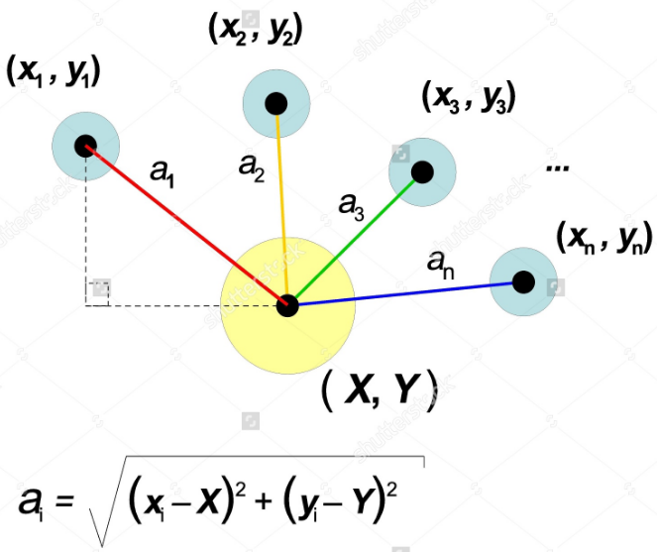

Identify distance between 2 users using Euclidean Distance
In a two dimensional space the Euclidean distance between two points is measured by using Pythagoras theorem as depicted in the figure
In a N dimensional space the Euclidean distance will be computes in a similar way with the following formula (Source Wikipedia)

Slide 31
Sample Genre matrix
1 | 2 | 3 | 4 | 5 | 6 | 7 | 8 | 9 | 10 | 11 | 12 | 13 | 14 | 15 | 16 | 17 | 18 | 19 | 20
Toy Story | 0 | 0 | 0 | 1 | 1 | 1 | 0 | 0 | 0 | 0 | 0 | 0 | 0 | 0 | 0 | 0 | 0 | 0 | 0
Golden Eye | 0 | 1 | 1 | 0 | 0 | 0 | 0 | 0 | 0 | 0 | 0 | 0 | 0 | 0 | 0 | 0 | 1 | 0 | 0
Braveheart | 0 | 1 | 0 | 0 | 0 | 0 | 0 | 0 | 1 | 0 | 0 | 0 | 0 | 0 | 0 | 0 | 0 | 1 | 0
Batman Forever | 0 | 1 | 1 | 0 | 0 | 1 | 1 | 0 | 0 | 0 | 0 | 0 | 0 | 0 | 0 | 0 | 0 | 0 | 0
Star Wars | 0 | 1 | 1 | 0 | 0 | 0 | 0 | 0 | 0 | 0 | 0 | 0 | 0 | 0 | 1 | 1 | 0 | 1 | 0

Slide 32
Distance Metric
 | Toy Story | Golden Eye | Braveheart | Batman Forever | Star Wars
Toy Story | 0 | Sqrt(6)=
Golden Eye |  | 0
Braveheart |  |  | 0
Batman Forever |  |  |  | 0
Star Wars |  |  |  |  | 0

Slide 33
Sample Genre matrix
1 | 2 | 3 | 4 | 5 | 6 | 7 | 8 | 9 | 10 | 11 | 12 | 13 | 14 | 15 | 16 | 17 | 18 | 19 | 20
Toy Story | 0 | 0 | 0 | 1 | 1 | 1 | 0 | 0 | 0 | 0 | 0 | 0 | 0 | 0 | 0 | 0 | 0 | 0 | 0
Golden Eye | 0 | 1 | 1 | 0 | 0 | 0 | 0 | 0 | 0 | 0 | 0 | 0 | 0 | 0 | 0 | 0 | 1 | 0 | 0
Braveheart | 0 | 1 | 0 | 0 | 0 | 0 | 0 | 0 | 1 | 0 | 0 | 0 | 0 | 0 | 0 | 0 | 0 | 1 | 0
Batman Forever | 0 | 1 | 1 | 0 | 0 | 1 | 1 | 0 | 0 | 0 | 0 | 0 | 0 | 0 | 0 | 0 | 0 | 0 | 0
Star Wars | 0 | 1 | 1 | 0 | 0 | 0 | 0 | 0 | 0 | 0 | 0 | 0 | 0 | 0 | 1 | 1 | 0 | 1 | 0

Slide 34
Distance Metric
 | Toy Story | Golden Eye | Braveheart | Batman Forever | Star Wars
Toy Story | 0 | Sqrt(6)= | Sqrt(6)=
Golden Eye |  | 0
Braveheart |  |  | 0
Batman Forever |  |  |  | 0
Star Wars |  |  |  |  | 0

Slide 35
Distance Metric
 | Toy Story | Golden Eye | Braveheart | Batman Forever | Star Wars
Toy Story | 0 | Sqrt(6)=2.449 | Sqrt(6)=2.449 | Sqrt(5)=2.449 | Sqrt(8)=2.82
Golden Eye | Sqrt(6)=2.449 | 0 | Sqrt(4)=2 | Sqrt(4)=2 | Sqrt(4)=2
Braveheart | Sqrt(6)=2.449 | Sqrt(4)=2 | 0 | Sqrt(5)= 2.23 | Sqrt(4)=2
Batman Forever | Sqrt(5)=2.23 | Sqrt(4)=2 | Sqrt(5)=2.23 | 0 | Sqrt(5)=2.23
Star Wars | Sqrt(8)=2.82 | Sqrt(4)=2 | Sqrt(4)=2 | Sqrt(5)=2.23 | 0

Slide 36
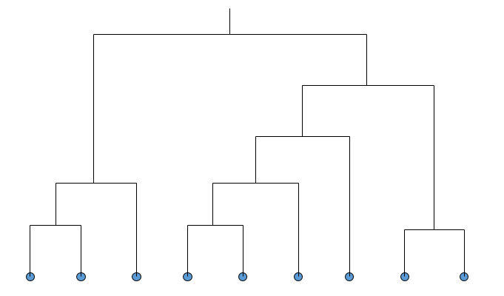
Dendogram
Decompose data objects into a several levels of nested partitioning (tree of clusters), called a dendrogram
A clustering of the data objects is obtained by cutting the dendrogram at the desired level, then each connected component forms a cluster

Slide 37
Movie Recommender Demo
Using
R

Slide 38
HANDSON Using R Language

Slide 39
Dendogram
Decompose data objects into a several levels of nested partitioning (tree of clusters), called a dendrogram
A clustering of the data objects is obtained by cutting the dendrogram at the desired level, then each connected component forms a cluster

Slide 40
Cluster Analysis-Applications
Marketing: Help marketers discover distinct groups in their customer bases, and then use this knowledge to develop targeted marketing programs
Information retrieval: document clustering
Outlier detection: Outliers are often viewed as those “far away” from any cluster

Slide 41


Slide 42

Thanks

