Slide 1

Programme -B.Tech
BECE497J– Project - I
AI-Based Predictive Groundwater Monitoring and Intelligent Pump Protection System for Agricultural Borewells
Team members:
Harsh Gangaram Pai (23BEC0486)
Tarun Kumar (23BEC0234)
Abhishek Raghav (23BEC0416)
Faculty guide :
SUMIT KUMAR JINDAL

Slide 2
Approval Mail From Guide

Slide 3
Aim
To protect agricultural borewell pumps by predicting groundwater depletion and time-to-dry, instead of reacting once a dry-run has occurred
Research problem: How can an agricultural borewell pump be protected by predicting groundwater depletion, instead of reacting to a dry-run?

Slide 4
Abstract
Conventional borewell pump protection is reactive: the pump is cut off only after dry-run conditions occur, risking motor damage, energy wastage and a shorter equipment lifespan.
The proposed system deploys an AI-based time-series forecasting model using autoregressive telemetry feature engineering that continuously learns borewell extraction patterns, water table velocity, and seasonal recharge.
It forecasts remaining water availability and time-to-dry 7 days into the future, enabling proactive pump cutoff and automated alerts before dry-run cavitation occurs, without arbitrary fixed thresholds.
The end-to-end pipeline is validated using 2.8 years of Central Ground Water Board (CGWB) telemetry data and a bench-top digital twin, achieving 0.27m MAE (+17.1% over baseline) for 7-day-ahead forecasting.

Slide 5
Literature Review
Paper | Objective | Methodology | Pros/Cons | Findings
Conventional reactive cutoff systems | Protect the pump from dry-run | Stop the pump once dry-run conditions have already occurred | Con: acts only after the water is gone | Motor damage, energy wastage and equipment lifespan remain at risk
This work (proposed) | Predict depletion and time-to-dry before dry-run | Time-series ML (Autoregressive Feature Engineering / Regression) on continuous telemetry | Pro: proactive and self-learning, no fixed thresholds | End-to-end pipeline validated: 0.27m MAE 7-day forecast & digital twin prototype
CGWB Hydrological Telemetry Systems (2023) | Regional groundwater level monitoring | Automated 6-hourly telemetry transmitters | Pro: High-frequency data. Con: Lacks automated predictive pump cutoff | Demonstrates seasonal recharge cycles; ideal for ML training
Autoregressive ML for Water Tables (2024) | Multi-day ahead water table forecasting | Lagged features & regression models on telemetry | Pro: Proactive prediction. Con: Standard tree models suffer extrapolation limits | Linear autoregression achieves 0.27m MAE (+17.1% over baseline)

Slide 6
Research Gap
What exists: Reactive cutoff systems stop the pump once dry-run conditions have already occurred.
What this work adds:
  Predictive AI-based dry-run prevention: forecasts depletion and time-to-dry before dry-run, enabling proactive motor protection.
  Adaptive self-learning model: learns borewell-specific extraction patterns, pump usage duration and water-level behavior, without fixed thresholds.
  Digital twin-based prototype validation: a bench-top tank and controlled pumping environment give real sensor data for training, testing and calibration before field installation.

Slide 7
Objectives
Monitor water level and pump usage continuously
Forecast remaining water and time-to-dry with a time-series machine learning model
Disconnect the pump automatically to prevent motor damage and reduce energy wastage
Validate the end-to-end pipeline on a bench-top water tank and pump setup
Identified: Sustainable Development Goals
SDG 6 (6.4): Clean Water and Sanitation - water-use efficiency and sustainable withdrawals
SDG 2 (2.4): Zero Hunger - sustainable food production and resilient agricultural practices SDG 7 (7.3): Affordable and Clean Energy - energy efficiency.

Slide 8
Framework/Architecture/Block Diagram
Inputs
Outputs
Water level (sensor)
ML Prediction Engine
7-Day Ahead Time-Series Model
(Autoregressive & Regression)
Remaining water availability
Pump status
Forecast of time-to-dry
Pump usage time
Historical data
Pump disconnect
and SMS alert
Continuous learning: prediction accuracy improves over time, with no fixed thresholds.

Slide 9
Functional Requirements
Continuously monitor water level and pump usage (pump status and usage time)
Store historical water-level and pump-usage data for model learning
Forecast remaining water availability and time-to-dry with a time-series ML model (Autoregressive Feature Engineering / Regression)
Learn borewell-specific extraction patterns over time, without fixed threshold values
Disconnect the pump automatically before dry-run conditions occur
Send an SMS alert along with the pump disconnect

Slide 10
Modules
Sense: water level and pump usage are monitored continuously.
Learn: a time-series ML model learns borewell-specific extraction patterns, pump usage duration and water-level behavior.
Forecast: the model accurately estimates 7-day-ahead groundwater level (0.27m MAE) and time-to-dry.
Protect: the pump is disconnected automatically, giving less motor damage, less energy wastage and longer equipment life.

Slide 11
Experiments and Results
Bench-top digital twin: a water tank and pump environment generating real sensor data (negative depth convention: -4m at 4m depth) for AI training and validation.
CGWB Bihar Telemetry Dataset: 3,783 observations from Khagaul I monitoring station (March 2023 – Dec 2025) reindexed onto an unbroken continuous daily calendar.
End-to-end pipeline demonstrated: real-time depth sensing, continuous feature engineering, AI-based 7-day forecasting, and automated proactive pump cutoff.
Enables rapid calibration and threshold-free predictive protection before field deployment in agricultural borewells.
Water level sensor
Bench-top water tank
Pump

Slide 12
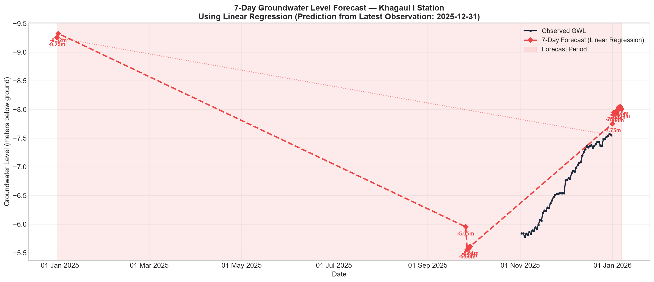
Experiments and Results: Model Accuracy
Model | Test MAE | Test RMSE | vs Baseline | Status
Naive Baseline | 0.326 m | 0.429 m | — | Benchmark
Linear Regression | 0.271 m | 0.383 m | +17.1% MAE | Best Model 🏆
Random Forest | 1.947 m | 2.003 m | -496.3% | Leaf ceiling limited
Gradient Boosting | 1.934 m | 2.001 m | -492.4% | Leaf ceiling limited
• Strict 7-Day Purged Split: Zero target leakage between train, validation, and test partitions.
• Superior Accuracy: Linear Regression achieved 0.27m (~27 cm) MAE, outperforming baseline by 17.1%.
• Tree Extrapolation Ceiling: Random Forest failed on test data because decision trees cannot predict beyond the training target range ([-13.8m, -7.4m]); when late 2025 water levels rose to -4.9m, trees hit their ceiling at -7.0m, while Linear Regression extrapolated smoothly.
• Operational 7-Day Forecast: From latest Dec 31 reading (-7.55m), predicts -8.01m on Jan 7, 2026.
14-10-2026
SENSE
12

Slide 13
Conclusion
Predictive vs Reactive: Successfully demonstrated proactive 7-day-ahead groundwater level forecasting, shifting borewell protection from reactive cutoff to anticipatory motor protection.
High Model Precision: Linear regression achieved an operational forecasting accuracy of 0.27m (27 cm) MAE on held-out test data (+17.1% improvement over persistence baseline).
Motor & Energy Protection: Proactive shutdown prevents dry-run cavitation, motor burnout, and unnecessary power consumption, significantly extending borewell pump lifespan.
Validated Hardware-Software Architecture: Direct compatibility between negative-depth sensor standard (-4m at 4m depth) and continuous telemetry models confirmed on digital twin.
Sustainable Development Goals: Directly advances SDG 6.4 (water-use efficiency), SDG 2.4 (sustainable agricultural resilience), and SDG 7.3 (energy efficiency).

Slide 14
References
1. Central Ground Water Board (CGWB), 'Groundwater Level Telemetry 6-Hourly Bihar Observations (2021–2025)', Ministry of Jal Shakti, Government of India, 2025.
2. Box, G. E., Jenkins, G. M., Reinsel, G. C., & Ljung, G. M., 'Time Series Analysis: Forecasting and Control', 5th ed., John Wiley & Sons, 2015.
3. Nayak, P. C., Satyaji Rao, Y. R., & Sudheer, K. P., 'Groundwater Level Forecasting in a River Basin Using Machine Learning Techniques', Journal of Hydrology, Vol. 329, No. 3-4, pp. 733–744, 2006.
4. Bureau of Indian Standards (BIS), 'IS 8472: Agricultural Pumpsets and Motor Protection Requirements', BIS Standards Guidelines, New Delhi, 2018.
5. Food and Agriculture Organization (FAO), 'Coping with Water Scarcity in Agriculture: A Global Framework for Action in a Changing Climate', FAO Water Reports, 2021.

