Slide 1
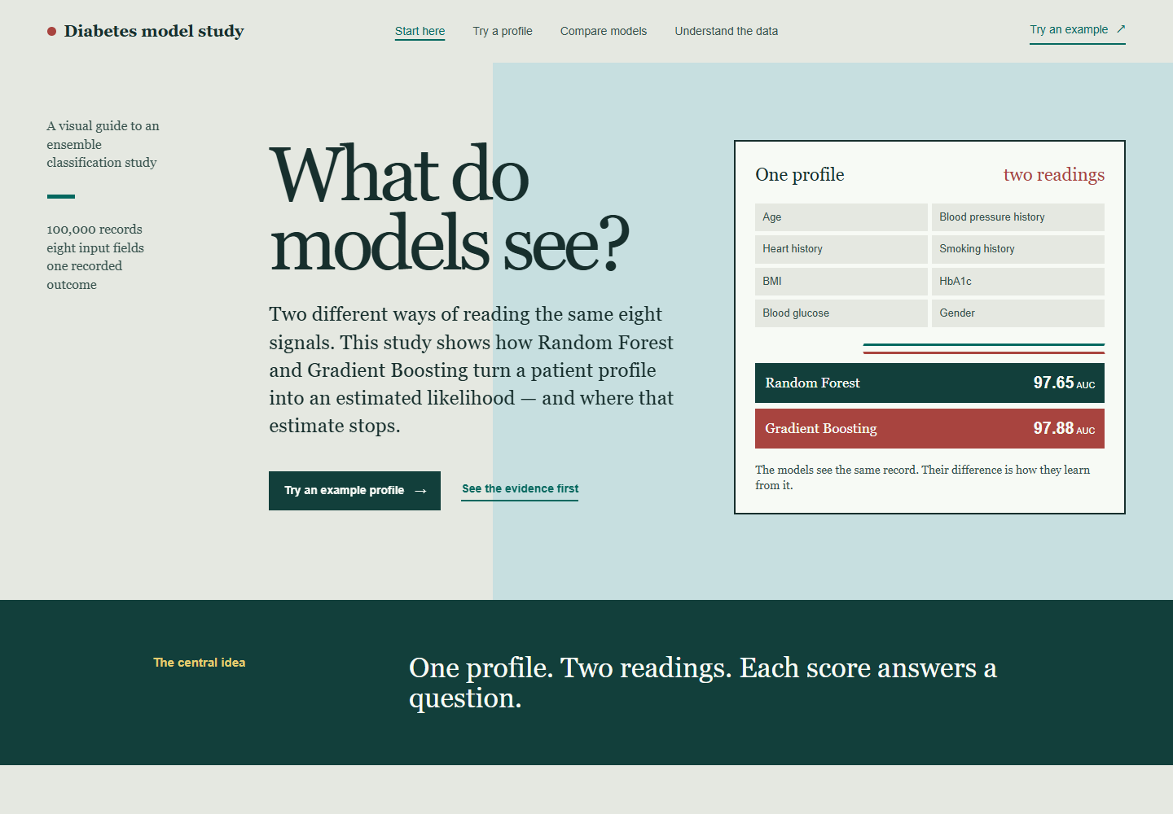
DIABETES MODEL STUDY
Overview
The app starts
with one question.
What do these models see?
The overview turns an ensemble-learning study into a visual reading: one profile, eight signals, and two different ways to combine small decisions.
Both learners read the same record.
Their learning habits are different.
Working Next.js prototype · educational use only
01 / 04

Slide 2
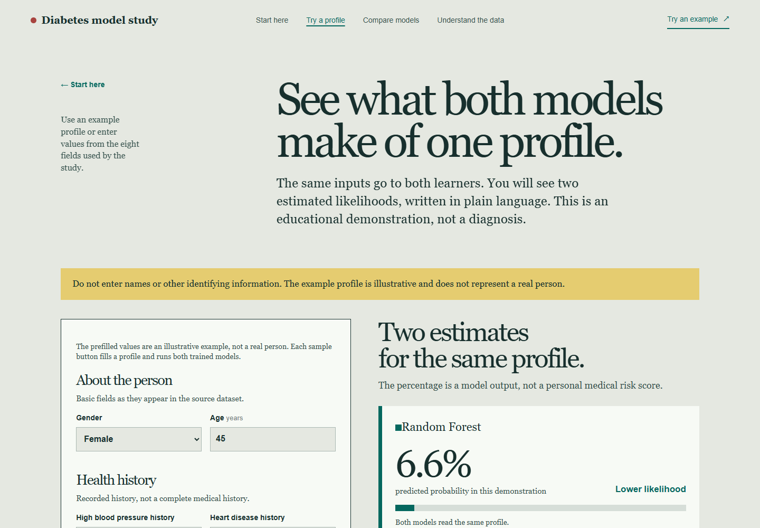
DIABETES MODEL STUDY
Prediction
One profile,
two estimates.
The working flow
•
Enter eight fields from the dataset.
•
Send the same profile to both trained models.
•
Read lower or higher likelihood in plain language.
The percentage is a model output — not a diagnosis or a personal medical risk score.
Working Next.js prototype · educational use only
02 / 04

Slide 3
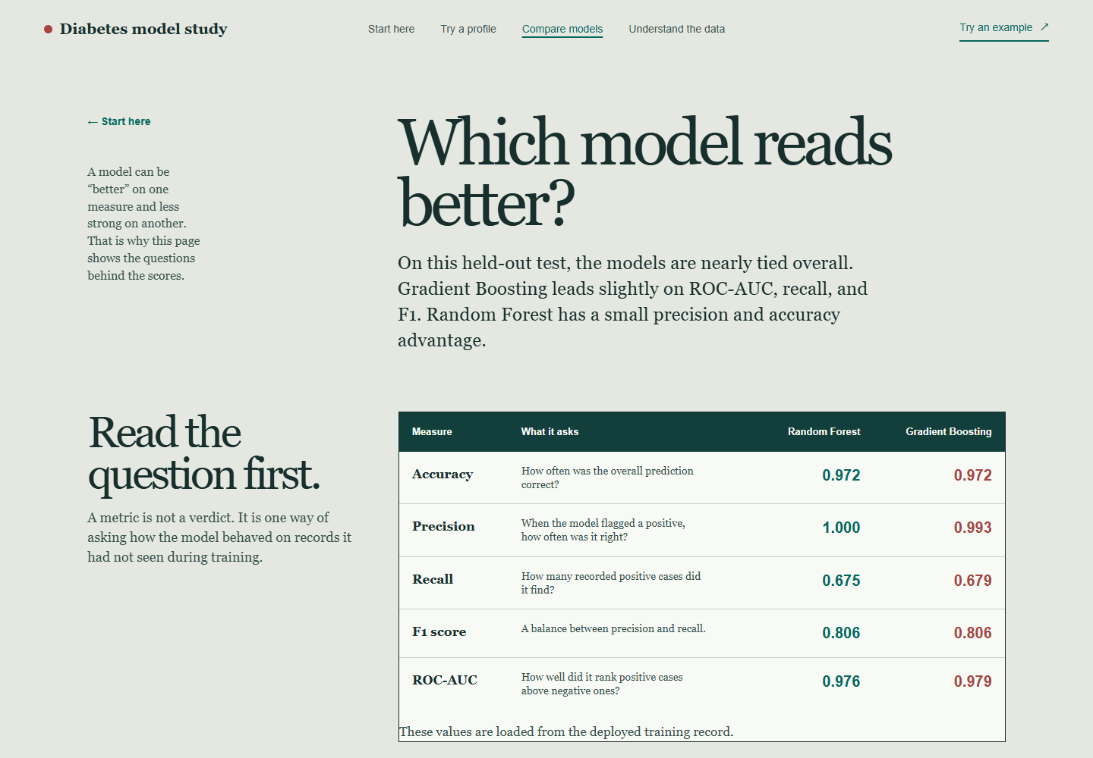
DIABETES MODEL STUDY
Compare models
A score answers
a question.
Why the table matters
Accuracy asks how often the whole prediction was correct. Precision asks how often a positive flag was right. Recall asks how many recorded positive cases were found.
In this held-out test, Gradient Boosting edges ahead on ROC-AUC and recall. Random Forest has the higher precision.
Working Next.js prototype · educational use only
03 / 04

Slide 4
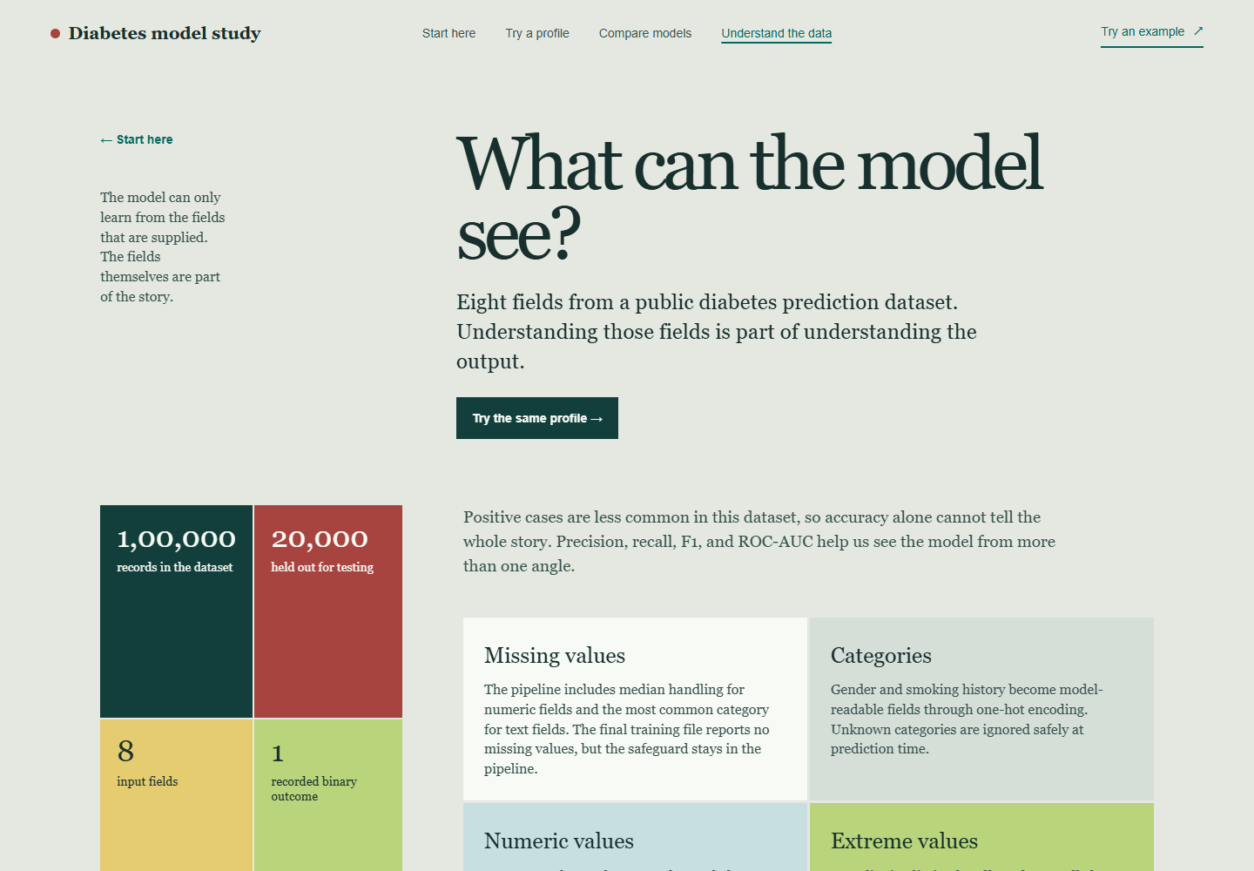
DIABETES MODEL STUDY
Understand the data
What the models
are allowed to see.
The study context
•
100,000 records and 20,000 held out for testing.
•
Eight inputs: history, categories, BMI, HbA1c, and glucose.
•
The pipeline handles categories, missing values, scale, and extremes.
Feature importance describes model reliance. It does not prove cause.
Working Next.js prototype · educational use only
04 / 04

