Slide 1
Connected Care Data Platform
Clinical interoperability and cloud analytics
933 FHIR resources 265 patients 11 resource types
01
Notes:
Source: examples-ndjson.zip, 11 selected resource types; Pasted text(1).txt transformation SQL; deck/revision/analysis.json. 933 resources including 265 Patient, 24 Medication and 3 Appointment resources. 641 records are in eight clinical categories. Coverage values are locally reproduced source-archive calculations, not a new live Snowflake query. Native FHIR examples bypass HL7 conversion.

Slide 2
Fragmented records obscure patient information
A record can exist yet fail to support the right patient or visit.
Missing links, dates and context leave reviewers unsure what is available.
02

Slide 3
Three phases connect clinical events to analytics
1 HL7 → FHIR 2 S3 ingestion 3 Snowflake
The 933-resource native FHIR dataset expands downstream coverage.
03
Notes:
Source: examples-ndjson.zip, 11 selected resource types; Pasted text(1).txt transformation SQL; deck/revision/analysis.json. 933 resources including 265 Patient, 24 Medication and 3 Appointment resources. 641 records are in eight clinical categories. Coverage values are locally reproduced source-archive calculations, not a new live Snowflake query. Native FHIR examples bypass HL7 conversion.

Slide 4
Two source paths converge in cloud analytics
HL7 events → Python mapping → Firely → authorized export
Native FHIR + exported batches → private S3 → Snowflake
04
Notes:
Source: examples-ndjson.zip, 11 selected resource types; Pasted text(1).txt transformation SQL; deck/revision/analysis.json. 933 resources including 265 Patient, 24 Medication and 3 Appointment resources. 641 records are in eight clinical categories. Coverage values are locally reproduced source-archive calculations, not a new live Snowflake query. Native FHIR examples bypass HL7 conversion. Operational Firely used local Docker with an AWS RDS backend. Later local-copy mode used local persistence.

Slide 5
FHIR preserves patient and visit context
ADT → Patient ORU → Observation SIU → Appointment
Stable IDs and references connect records.
Native FHIR extends the model to 11 resource types.
05
Notes:
Source: examples-ndjson.zip, 11 selected resource types; Pasted text(1).txt transformation SQL; deck/revision/analysis.json. 933 resources including 265 Patient, 24 Medication and 3 Appointment resources. 641 records are in eight clinical categories. Coverage values are locally reproduced source-archive calculations, not a new live Snowflake query. Native FHIR examples bypass HL7 conversion. Supported ADT, ORU and SIU fixtures map to Patient, Observation and Appointment. Conversion did not produce all 933 native FHIR records.

Slide 6
Privacy controls govern review and data handling
Verified reviewer access
OIDC/PKCE, bounded sessions and document checks
Protected cloud handling
Private encrypted S3 and certificate-validated RDS connections
06
Notes:
Evidence: 07-HIPAA-Considerations.md, CURRENT-PROGRESS-2026-10-05.md, October 3 reviewer milestone and uploaded auth source. OIDC/PKCE, token validation, resource read/search scopes, viewer expiry capped at 15 minutes. Document gates tested in earlier reviewer workflow; later local-copy mode deferred documents. Viewer/Auth HTTPS, local FHIR HTTP, certificate-validated RDS TLS. S3 server-side encryption. No compliance certification is claimed.

Slide 7
Batch identity makes ingestion repeatable
Source + batch + resource type + resource ID define one ingestion key.
MERGE INTO
RESOURCE_RAW
USING
LOAD_WORK
WHEN NOT MATCHED THEN INSERT
(...)
07
Notes:
Source: examples-ndjson.zip, 11 selected resource types; Pasted text(1).txt transformation SQL; deck/revision/analysis.json. 933 resources including 265 Patient, 24 Medication and 3 Appointment resources. 641 records are in eight clinical categories. Coverage values are locally reproduced source-archive calculations, not a new live Snowflake query. Native FHIR examples bypass HL7 conversion. The MERGE excerpt omits ON predicates and the full INSERT list for display. The actual key includes source dataset, batch ID, resource type and resource ID. Duplicate/conflicting payload checks precede MERGE.

Slide 8
Eleven resource types produce nine coverage metrics
Patient defines the denominator.
Medication supplies master data.
Nine other resource types measure linked information,
including allergies, medications and encounters.
08
Notes:
Source: examples-ndjson.zip, 11 selected resource types; Pasted text(1).txt transformation SQL; deck/revision/analysis.json. 933 resources including 265 Patient, 24 Medication and 3 Appointment resources. 641 records are in eight clinical categories. Coverage values are locally reproduced source-archive calculations, not a new live Snowflake query. Native FHIR examples bypass HL7 conversion. Patient supplies the denominator. Medication is master data. The nine counted domains are Observation, Condition, AllergyIntolerance, MedicationRequest, MedicationStatement, Encounter, DiagnosticReport, DocumentReference and Appointment.

Slide 9
Linked coverage varies across the 265 patients
Source-archive calculation: 20 patients have ≥1 linked clinical record.
09
Notes:
Source: examples-ndjson.zip, 11 selected resource types; Pasted text(1).txt transformation SQL; deck/revision/analysis.json. 933 resources including 265 Patient, 24 Medication and 3 Appointment resources. 641 records are in eight clinical categories. Coverage values are locally reproduced source-archive calculations, not a new live Snowflake query. Native FHIR examples bypass HL7 conversion. Counts are distinct patients with >=1 linked record per category. Categories overlap. A zero is information coverage, not clinical absence.

Slide 10
Coverage and visit eligibility answer different questions
Coverage: which records are linked to this patient?
Visit eligibility: which glucose results meet the configured criteria before the appointment?
10
Notes:
Source: examples-ndjson.zip, 11 selected resource types; Pasted text(1).txt transformation SQL; deck/revision/analysis.json. 933 resources including 265 Patient, 24 Medication and 3 Appointment resources. 641 records are in eight clinical categories. Coverage values are locally reproduced source-archive calculations, not a new live Snowflake query. Native FHIR examples bypass HL7 conversion. Coverage has no appointment-window filter. Separate glucose predicate uses code, numeric value, unit, final/amended/corrected status and [appointment−7days,appointment) time window.

Slide 11
Reference resolution explains inclusion and exclusion
609 of 641 clinical records resolve to a patient.
32 retain an explicit reference status for review.
REGEXP_LIKE
(reference,
'Patient/[A-Za-z0-9.-]+'
)
11
Notes:
Source: examples-ndjson.zip, 11 selected resource types; Pasted text(1).txt transformation SQL; deck/revision/analysis.json. 933 resources including 265 Patient, 24 Medication and 3 Appointment resources. 641 records are in eight clinical categories. Coverage values are locally reproduced source-archive calculations, not a new live Snowflake query. Native FHIR examples bypass HL7 conversion. Of 641 clinical records, 609 resolve. Remaining categories: 15 unresolved Patient/id references, 10 other formats, 7 missing literal references. Appointments use participant references separately.

Slide 12
Cortex questions connect clinical domains
Which observation patients have no linked allergy record?
Source benchmark: 14 of 15.
Prepared SQL retains the exact batch and patient IDs.
12
Notes:
Source: examples-ndjson.zip, 11 selected resource types; Pasted text(1).txt transformation SQL; deck/revision/analysis.json. 933 resources including 265 Patient, 24 Medication and 3 Appointment resources. 641 records are in eight clinical categories. Coverage values are locally reproduced source-archive calculations, not a new live Snowflake query. Native FHIR examples bypass HL7 conversion. Prepared query examples, not completed Cortex runs. Analyst uses a semantic model; Code can inspect and execute explicit read-only SQL.

Slide 13
All 9 visit-rule tests matched expectations
5 correctly included
Eligible timing and result status
4 correctly excluded
Outside the window, missing time or preliminary
13
Notes:
Source: firely-typed-analytics-2026-10-06.sql_2026-10-06-1204.csv. Five TRUE: amended, corrected, equivalent timezone, exactly at window start, one second before appointment. Four FALSE: exactly at appointment, missing time, before window, preliminary. Tests concern glucose predicate, not whole-platform validation.

Slide 14
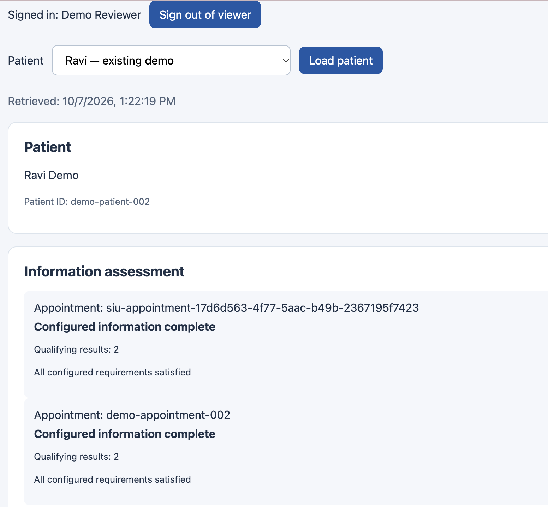
The reviewer sees status and its supporting count
Signed-in review
Patient context
Appointment status with qualifying results
14
Notes:
Actual UI image(20261007-172329).png. Historical October 7 operational capture, synthetic patient. Two qualifying results displayed here are separate from expanded source benchmarks.

Slide 15
Connected care requires traceable information
Delivered: HL7/FHIR integration, controlled cloud ingestion and patient coverage analytics.
Value: reviewers can see what information is available and why it qualifies.
15
Notes:
Source: examples-ndjson.zip, 11 selected resource types; Pasted text(1).txt transformation SQL; deck/revision/analysis.json. 933 resources including 265 Patient, 24 Medication and 3 Appointment resources. 641 records are in eight clinical categories. Coverage values are locally reproduced source-archive calculations, not a new live Snowflake query. Native FHIR examples bypass HL7 conversion. Outcomes are demonstrated capabilities, not measured clinical benefit or business savings.

