Slide 1
Connected Care Data Platform
Clinical interoperability, cloud ingestion and patient intelligence
HL7 v2 to FHIR R4
PROJECT BRIEF
Standardize clinical records, control access and explain information coverage across the patient journey.
A traceable information flow from clinical events to patient-level analytics
933
265
11
FHIR resources
Patient records
Resource types
Expanded dataset: selected official FHIR examples. Python / Firely / AWS / Snowflake
Connected Care Data Platform
01
Notes:
Local source analysis: examples-ndjson.zip, selected 11 resource files matching the October 8 load script. 933 resources, 265 Patient records. Applied the same simple Patient/id resolution and same-source/batch logic in Pasted text(1).txt. These are local benchmarks, not a live Snowflake result or proof of present S3 contents. No clinical-population inference is justified from these official examples.

Slide 2
Fragmented records limit pre-visit visibility
Patient context is fragmented
A recorded result may be unusable
Messages, laboratory results and documents do not automatically form a coherent patient record.
An incorrect patient link, status, unit or timestamp can prevent a result from supporting a visit review.
An empty count is ambiguous
Aggregate counts can mislead
Missing source data, unresolved references and an absent record can look identical in a summary.
Joining multiple detail tables can inflate counts and obscure which information is actually available.
Reviewers lack a reliable explanation of what is available, what needs follow-up, and why.
Connected Care Data Platform
02
Notes:
Problem framing for the project: information can be structurally present yet unusable for a specific patient and visit. No industry prevalence or quantified efficiency claim is made. This slide intentionally contains only the problem and its consequences.

Slide 3
Delivery across three connected phases
A common FHIR structure connects clinical integration with broader analytical coverage.
01 Interoperability
02 Cloud ingestion
03 Patient analytics
HL7 ADT, ORU and SIU mapping
FHIR identity and resource references
Native FHIR input: 11 resource types
Private S3 landing
Source and batch traceability
Expanded batch: 933 FHIR resources
Snowflake typed and curated views
Cross-domain coverage analysis
265 patients and nine metrics
The expanded dataset enters as native FHIR and broadens the downstream analytical model.
The HL7 conversion path and native FHIR ingestion path converge on a common resource model.
Connected Care Data Platform
03
Notes:
Local source analysis: examples-ndjson.zip, selected 11 resource files matching the October 8 load script. 933 resources, 265 Patient records. Applied the same simple Patient/id resolution and same-source/batch logic in Pasted text(1).txt. These are local benchmarks, not a live Snowflake result or proof of present S3 contents. No clinical-population inference is justified from these official examples.

Slide 4
Architecture from clinical events to analytics
Two source paths preserve provenance while supporting a common analytical destination.
HL7 clinical events
Firely and review
Authorized export
ADT / ORU / SIU
Python mapping into FHIR R4
→
FHIR API and resource links
Local Docker / RDS-backed mode
→
Scoped FHIR reads
Batch files and manifest
↓
Native FHIR dataset
Private S3 landing
Snowflake analytics
933 resources / 11 types
Official FHIR example archive
→
Native FHIR and export batches
Stage inputs for Snowflake
→
RAW / typed / curated views
SQL, dashboards and Cortex
Operational and native FHIR batches retain separate provenance. The later local-copy mode uses a local data store.
Connected Care Data Platform
04
Notes:
Local source analysis: examples-ndjson.zip, selected 11 resource files matching the October 8 load script. 933 resources, 265 Patient records. Applied the same simple Patient/id resolution and same-source/batch logic in Pasted text(1).txt. These are local benchmarks, not a live Snowflake result or proof of present S3 contents. No clinical-population inference is justified from these official examples. Firely is local Docker with an AWS RDS backend in the documented reviewer architecture. Native FHIR examples do not traverse HL7 conversion.

Slide 5
Phase 1: clinical data harmonization
FHIR creates a consistent resource structure for patient identity, clinical evidence and visit context.
Clinical event | FHIR output | Preserved information
ADT admission | Patient | Identifier authority and patient identity
ORU laboratory result | Observation | Patient reference, code, value, unit and time
SIU scheduling | Appointment | Visit identity, participants and scheduled time
Mapping controls
Expanded FHIR scope
Stable IDs and patient references
933 native FHIR resources across 11 types
Additional native FHIR domains include allergies, conditions, medications, encounters and diagnostic reports.
Connected Care Data Platform
05
Notes:
Local source analysis: examples-ndjson.zip, selected 11 resource files matching the October 8 load script. 933 resources, 265 Patient records. Applied the same simple Patient/id resolution and same-source/batch logic in Pasted text(1).txt. These are local benchmarks, not a live Snowflake result or proof of present S3 contents. No clinical-population inference is justified from these official examples. ADT/ORU/SIU conversion was exercised on supported fixtures. The 933-resource archive is native FHIR, not 933 converted HL7 messages.

Slide 6
HIPAA-related privacy and security controls
Implemented safeguards across reviewer identity, clinical document access and cloud data handling.
Verified reviewer identity
Protected viewer sessions
OIDC authorization code with PKCE
Token signature and claim validation
FHIR resource read/search scopes
Server-memory tokens
Secure / HttpOnly / SameSite cookies
Expiry capped at 15 minutes
Controlled document access
Protected cloud landing
Patient association and registry checks
Content type, size and SHA-256 checks
Wrong-patient access denied
Private S3 with server-side encryption
TLS certificate validation to RDS
Source and batch integrity checks
Document checks: reviewer workflow. Viewer/Auth: HTTPS. Local FHIR: HTTP. RDS: certificate-validated TLS.
Connected Care Data Platform
06
Notes:
Evidence: reviewed 07-HIPAA-Considerations.md; CURRENT-PROGRESS sections 3–7; October 3 reviewer milestone. This slide describes safeguards, not a HIPAA compliance determination. Earlier document tests relate to the reviewer mode; later local-copy mode deferred documents. Local FHIR uses loopback HTTP.

Slide 7
Phase 2: controlled ingestion into Snowflake
The ingestion SQL preserves source and batch identity for the 933-resource FHIR selection.
COMMANDS
FUNCTIONS
VALUES
FIELDS / INPUTS
933 resources / 11 types
01
MERGE
INTO
RESOURCE_RAW
t
USING
LOAD_WORK
s
02
ON
t
.
SOURCE_DATASET
=
s
.
SOURCE_DATASET
03
AND
t
.
BATCH_ID
=
s
.
BATCH_ID
Batch controls
04
AND
t
.
RESOURCE_TYPE
=
s
.
RESOURCE_TYPE
05
AND
t
.
RESOURCE_ID
=
s
.
RESOURCE_ID
Expected inventory
Missing and duplicate IDs
Conflicting payloads
Insert-only resource identity
06
WHEN
NOT
MATCHED
THEN
INSERT
07
(
SOURCE_DATASET
,
BATCH_ID
,
RESOURCE_TYPE
,
08
RESOURCE_ID
,
PAYLOAD
,
SOURCE_FILENAME
,
09
FILE_ROW_NUMBER
,
LOADED_AT
)
10
VALUES
(
s
.
SOURCE_DATASET
,
s
.
BATCH_ID
,
11
s
.
RESOURCE_TYPE
,
s
.
RESOURCE_ID
,
.
.
.
)
;
SQL excerpt. The 933-resource inventory is verified from the archive. Load counts require batch-specific query evidence.
Connected Care Data Platform
07
Notes:
Local source analysis: examples-ndjson.zip, selected 11 resource files matching the October 8 load script. 933 resources, 265 Patient records. Applied the same simple Patient/id resolution and same-source/batch logic in Pasted text(1).txt. These are local benchmarks, not a live Snowflake result or proof of present S3 contents. No clinical-population inference is justified from these official examples. Load SQL evidence: Pasted text(1).txt. Expanded inventory is source-verified locally. No fresh Snowflake execution performed for this presentation.

Slide 8
Phase 3: patient coverage model
The curated model includes allergies, medications and care encounters alongside laboratory observations.
Clinical domain | FHIR resources | Patient-level measures
Laboratory information | Observation, DiagnosticReport | Observation and report counts
Clinical history | AllergyIntolerance, Condition | Linked allergy and condition records
Medication information | MedicationRequest, MedicationStatement | Medication order and statement counts
Care context | Encounter, Appointment | Encounter and appointment counts
Supporting evidence | DocumentReference | Linked document counts
Raw JSON
Typed fields and links
Nine coverage metrics
11 types: Patient defines the denominator, Medication supplies master data, and nine types provide coverage measures.
Connected Care Data Platform
08
Notes:
Source: October 8 Pasted text(1).txt, HL7_PATIENT_COVERAGE SQL. Nine metrics: observations, conditions, allergies, medication orders, medication statements, encounters, diagnostic reports, documents and appointments. Medication master records do not directly imply a patient medication history. Parent-resource and component/participant views preserve correct aggregation grain.

Slide 9
Coverage across the expanded FHIR dataset
How many distinct patients have at least one linked record in each category?
933 resources
265 patients
11 resource types
20 of 265
patients have at least one linked clinical record. Appointments are measured separately.
Coverage reflects the structure of an example archive. It does not describe patient health.
Source-archive calculation using the project linkage rules. 265 Patient records form the denominator.
Connected Care Data Platform
09
Notes:
Local source analysis: examples-ndjson.zip, selected 11 resource files matching the October 8 load script. 933 resources, 265 Patient records. Applied the same simple Patient/id resolution and same-source/batch logic in Pasted text(1).txt. These are local benchmarks, not a live Snowflake result or proof of present S3 contents. No clinical-population inference is justified from these official examples. Coverage categories overlap and must not be added as distinct patient totals. Clinical-record coverage excludes appointments and medication master resources. 20 patients have at least one of the eight linked clinical resource categories; 245 have none.

Slide 10
Patient coverage and visit-window assessment
The platform answers both availability and timing questions with distinct analytical rules.
Patient coverage
Visit-window assessment
Question: which records are linked?
265 Patient records form the denominator
Nine categories count available records
No appointment time filter
Question: does a result qualify for a visit?
Configured glucose code, value and unit
Final, amended or corrected status
Seven days before the appointment
Coverage counts describe availability. Visit rules determine timing eligibility.
The window includes its start and excludes the appointment time. These rules support information review.
Connected Care Data Platform
10
Notes:
Local source analysis: examples-ndjson.zip, selected 11 resource files matching the October 8 load script. 933 resources, 265 Patient records. Applied the same simple Patient/id resolution and same-source/batch logic in Pasted text(1).txt. These are local benchmarks, not a live Snowflake result or proof of present S3 contents. No clinical-population inference is justified from these official examples. Coverage is calculated across the expanded batch. The separate visit predicate is the glucose rule tested in the October 6 SQL export. No claim that it was executed across all 265 patients.

Slide 11
Reference resolution explains every included record
Each clinical resource receives a status before it contributes to patient coverage.
COMMANDS
FUNCTIONS
VALUES
FIELDS / INPUTS
609 records resolved
01
WHEN
c
.
PATIENT_REFERENCE
IS
NULL
A Patient/id reference matches a Patient in the same source and batch.
02
THEN
'NO_LITERAL_REFERENCE'
03
WHEN
NOT
REGEXP_LIKE
(
04
c
.
PATIENT_REFERENCE
,
05
'Patient/[A-Za-z0-9.-]+'
06
)
THEN
'OTHER_REFERENCE_FORMAT'
32 records remain visible
07
WHEN
p
.
PATIENT_ID
IS
NULL
08
THEN
'UNRESOLVED_IN_LOADED_BATCH'
15 unresolved patient IDs
10 other reference formats
7 missing literal references
09
ELSE
'RESOLVED'
10
END
AS
LINK_STATUS
Source analysis: 641 clinical records across eight categories. Appointments use participant references separately.
Connected Care Data Platform
11
Notes:
Local source analysis: examples-ndjson.zip, selected 11 resource files matching the October 8 load script. 933 resources, 265 Patient records. Applied the same simple Patient/id resolution and same-source/batch logic in Pasted text(1).txt. These are local benchmarks, not a live Snowflake result or proof of present S3 contents. No clinical-population inference is justified from these official examples.

Slide 12
Cortex query design across clinical domains
Business questions translate into explicit SQL, stable denominators and interpretable patient cohorts.
Business question | Source benchmark | Analytical capability
Where are observations available without a linked allergy record? | 14 of 15 observation patients | Cross-domain information coverage
For PATIENT_ID = example, what records are available? | 71 observations, 4 allergies, 4 conditions and 3 appointments | Patient-level drill-down
Which clinical records contribute to coverage? | 609 resolve; 15 unresolved IDs, 10 other formats, 7 missing references | Transparent reference resolution
Cortex Analyst
Semantic questions over curated metrics
Cortex Code
Read-only SQL with exact batch and patient filters
Prepared queries and local source benchmarks. Analyst uses a semantic model; Code supports explicit SQL execution.
Connected Care Data Platform
12
Notes:
Local source analysis: examples-ndjson.zip, selected 11 resource files matching the October 8 load script. 933 resources, 265 Patient records. Applied the same simple Patient/id resolution and same-source/batch logic in Pasted text(1).txt. These are local benchmarks, not a live Snowflake result or proof of present S3 contents. No clinical-population inference is justified from these official examples. Questions and local benchmarks are prepared for execution in Cortex Code. Do not present them as live Cortex results. Use supplied Snowflake-Coverage-Demo.sql.

Slide 13
All 9 tests matched the expected visit-rule outcome
The rule included eligible glucose results and excluded results outside the configured criteria.
5 INCLUDED
4 EXCLUDED
Amended result
Corrected result
Exactly at the window start
One second before the visit
Equivalent time in another timezone
Exactly at the appointment time
One second before the window
Missing measurement time
Preliminary result status
Why it matters: the same eligibility rule behaves consistently at timing and status boundaries.
9 / 9 PASS
PASS means the SQL output matched the expected outcome, including correct exclusions.
Recorded SQL validation results
Source: SQL test export, 6 October 2026. Five expected inclusions and four expected exclusions.
Connected Care Data Platform
13
Notes:
Source: firely-typed-analytics-2026-10-06.sql_2026-10-06-1204.csv. Nine controlled SQL scenarios, five TRUE and four FALSE, all PASS. These test rule behavior, not patient health outcomes or all platform functions.

Slide 14
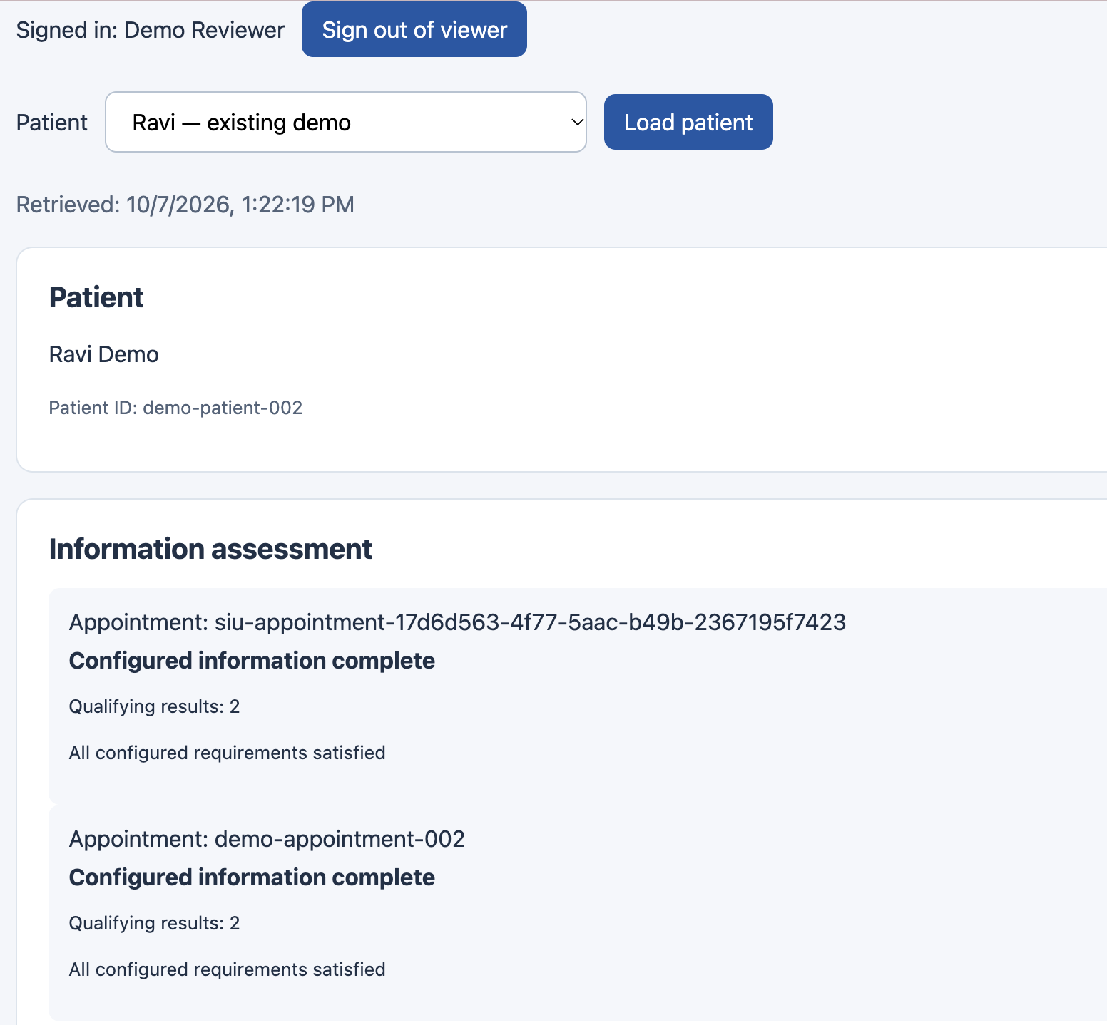
Reviewer workspace: evidence at the point of review
The signed-in reviewer can load a patient and inspect appointment information availability.
1 Authenticated session
The header identifies the signed-in reviewer and provides a sign-out action.
2 Patient context
The selector and patient ID anchor the review to the chosen record.
3 Explainable status
Each appointment shows its information status and qualifying result count.
Actual reviewer UI capture, 7 October 2026. The displayed counts belong to this operational snapshot.
Connected Care Data Platform
14
Notes:
Source screenshot: image(20261007-172329).png, uploaded October 7. Historical UI capture shows two qualifying results at that point. It is separate from the expanded 265-patient source analysis. Synthetic patient fixture.

Slide 15
Connected care through traceable information
Clinical interoperability and cloud analytics make patient information available for structured review.
Delivered capability | Technical foundation | Business relevance
Clinical interoperability | HL7 mapping and linked FHIR resources | Consistent patient and visit context
Cloud ingestion | S3 landing and batch-aware Snowflake loading | Repeatable movement of clinical information
Expanded patient analytics | 933 resources, 265 patients, nine metrics | Visibility across clinical domains
Privacy and access controls | Verified identity, viewer sessions and document gates | Controlled access to clinical information
A connected information flow with clear provenance, controlled access and explainable patient coverage.
Connected Care Data Platform
15
Notes:
Local source analysis: examples-ndjson.zip, selected 11 resource files matching the October 8 load script. 933 resources, 265 Patient records. Applied the same simple Patient/id resolution and same-source/batch logic in Pasted text(1).txt. These are local benchmarks, not a live Snowflake result or proof of present S3 contents. No clinical-population inference is justified from these official examples. Security statements refer to reviewed implemented safeguards, not certification or a claim of universal production controls.

