Slide 1
Clean energy,Clear skies: A Green India Resolution
-TARUN ADITYA TR (2021SC04328)

Slide 2
Problem statement
Air pollution poses a significant environmental and public health challenge in Chennai, India, with adverse effects on the city's residents and ecosystems.
Despite efforts to mitigate pollution levels, the city continues to grapple with deteriorating air quality, posing significant risks to the health and well-being of its residents.
To address this issue effectively, it is imperative to gain a comprehensive understanding of the root causes, major contributors, and consequences of air pollution in Chennai

Slide 3
Major Objectives
Identification of Pollution Sources: A comprehensive analysis is conducted to identify the primary sources of air pollution in Chennai, encompassing industrial emissions, vehicular traffic, construction activities, open waste burning, agricultural practices, and natural phenomena.
Assessment of Pollution Contributors: The study investigates the key sectors, industries, and demographic factors driving air pollution in Chennai, examining the role of industrial establishments, transportation systems, urban development patterns, population density, and socioeconomic factors.
Development of Mitigation Strategies: Evidence-based recommendations and policy interventions are proposed to mitigate air pollution and improve air quality in Chennai. Measures such as emission control regulations, clean energy transitions, sustainable urban planning, green infrastructure development, public transportation enhancements, and community engagement initiatives are explored.

Slide 4
Analysis
Factors of air pollution:
Industrial pollution – SO2( sulphur di oxide), PM(Particulate matter)
Vehicular pollution – CO(Carbon monoxide),NO2,SO2
Metro works –PM (Particulate matter)

Slide 5
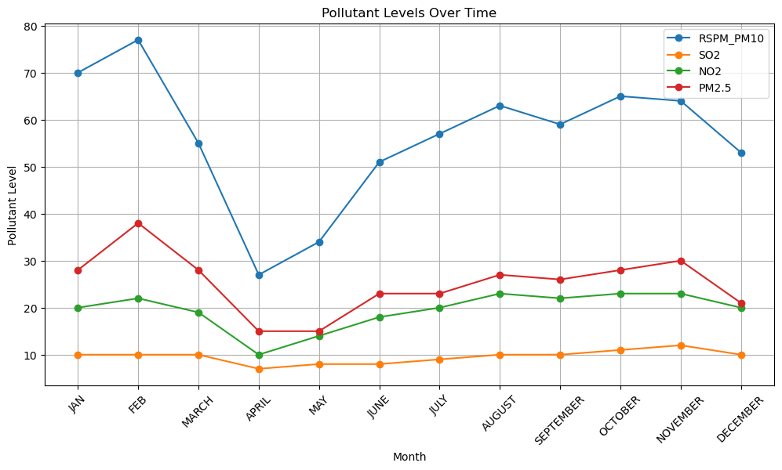
POLLUTANT LEVELS

Slide 6
Pollution level 2023
Pollution level of 2023 shows that RSPM (Respirable Suspended Particulate Matter) and PM10 (Particulate Matter) are high. These airborne particles can be inhaled into the respiratory system .
This will affect respiratory health when inhaled also it potentially reach the lungs' alveolar region.

Slide 7
Contributors
Industrial Activities: Emissions from industries such as manufacturing, construction, mining, and power generation release particulate matter into the air. This includes dust from construction sites, emissions from smokestacks, and combustion byproducts from industrial processes.
Transportation: Vehicles, especially those powered by diesel engines, are significant sources of particulate matter. Exhaust emissions from cars, trucks, buses, and other vehicles contain fine particles derived from combustion processes, tire and brake wear, and road dust resuspension.
Construction and Demolition: Dust generated during construction and demolition activities, including excavation, grading, and material handling, can contribute to particulate pollution in urban areas.
Silent contributor: One cigarette can produce up to 14gms of CO2

Slide 8
CMRL works
Starts from North Chennai – Madhavaram
CMRL phase 2 work deadline is 2025 but till now they have almost emitted 132 tonnes of carbon monoxide, 6 tonnes of PM2.5, 274 tonnes of nitrogen oxide and more than 17,000 tonnes of carbon dioxide.
All these emissions happen due to the movement of truck on account of transportation of civil construction material and waste disposal during construction.

Slide 9
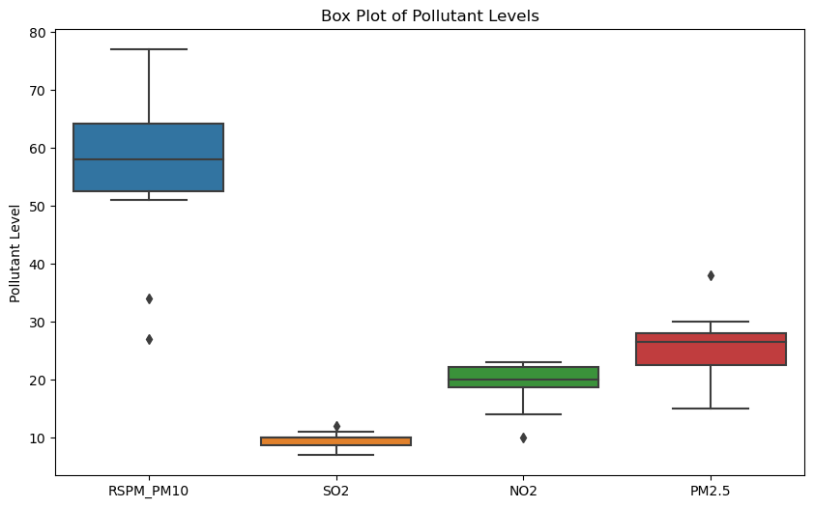
Potential challenges & risks

Slide 10
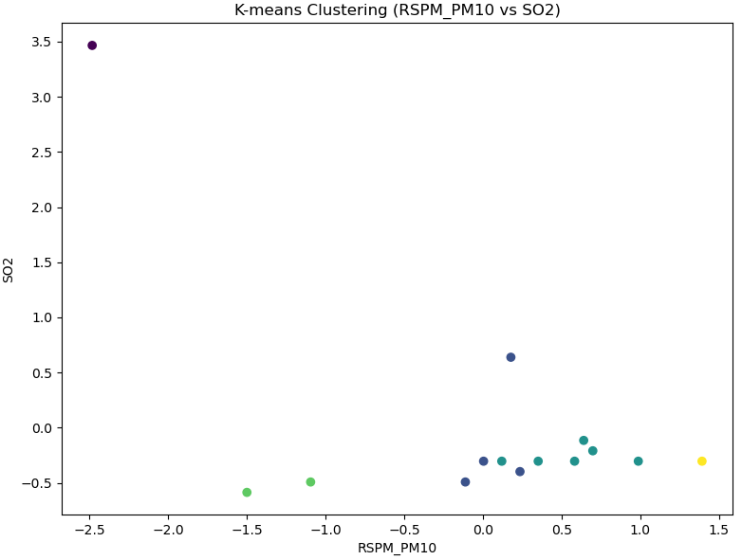
Unsupervised learning – K-means clustering

Slide 11
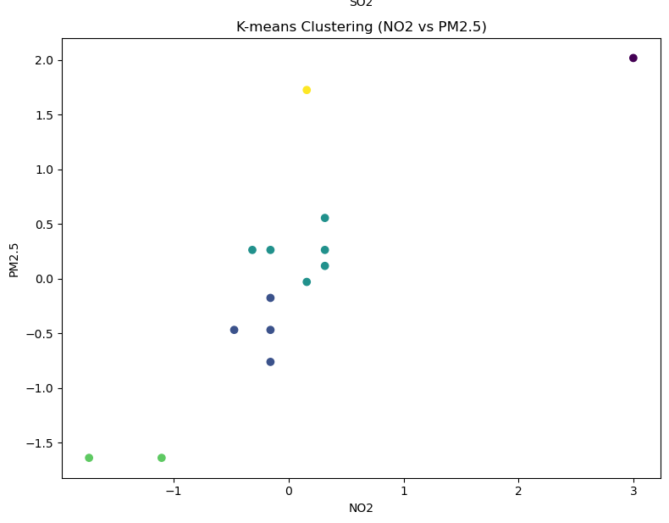

Slide 12
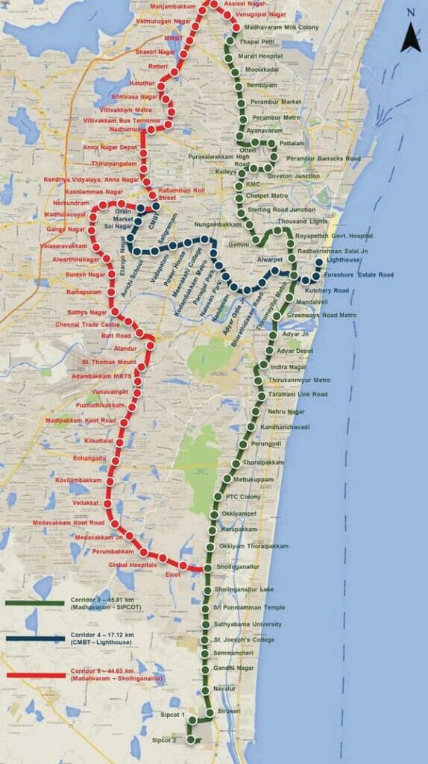
CMRL – phase 2

Slide 13
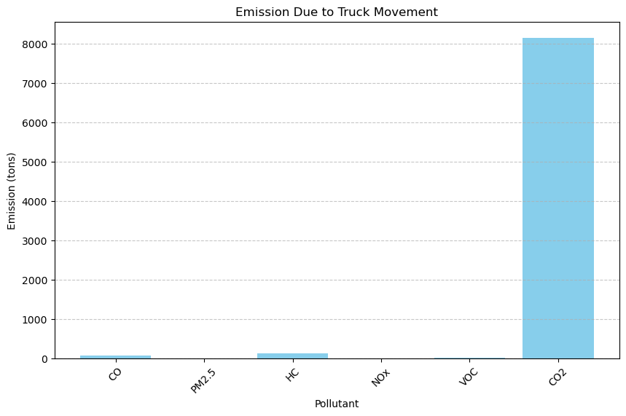

Slide 14
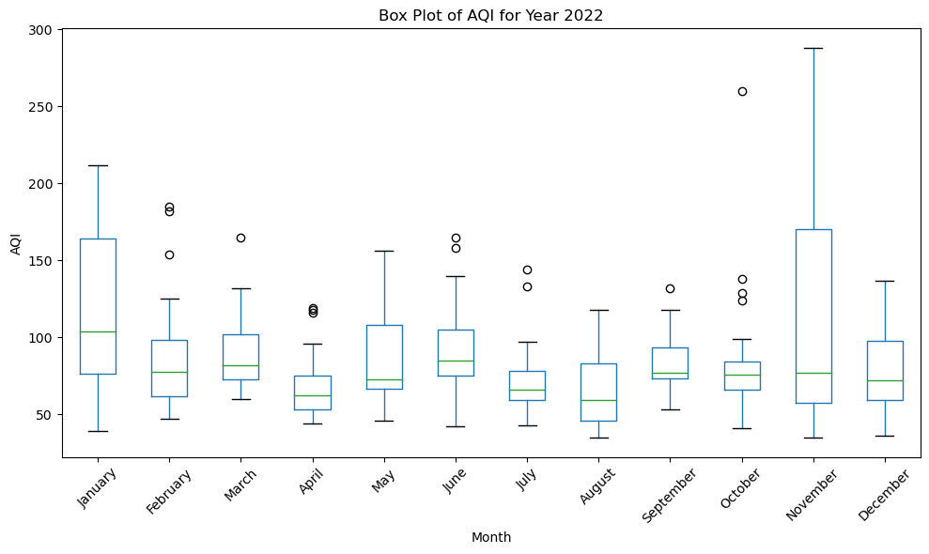

Slide 15
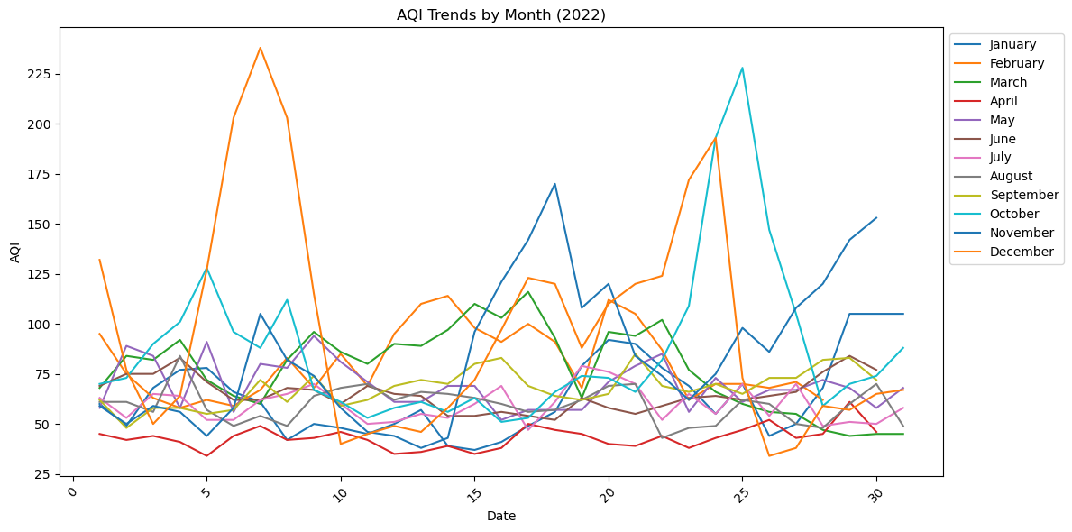
AQI for 2022

Slide 16
Analysis
CMRL plays a major role in air pollution
This patter has been the same for the past two years.
Emission of RSPM_PM10 has increased
Emission of SO2 has reduced.
Respiratory diseases has increased, and type 2 diabetes are increased
Chronic obstructive pulmonary disease has seen a spike. People living in north Chennai around 31-40 age are affected by air pollution
Vehicles contribute almost 40% pollution

Slide 17
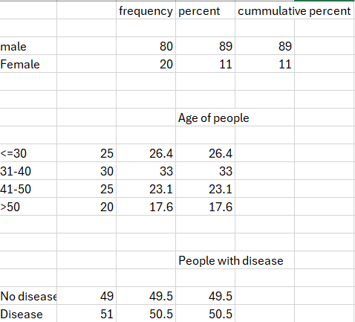
A sample survey taken in north chennai

Slide 18
How does a metro city area like North Chennai estimate the Carbon monoxide concentration?
Assuming the emission spreads in a fixed box model with height (H)=1000m
To find carbon monoxide Concentration C= b+qL/uH
u – upwind wind velocity Q - Emission rate per unit area 4*10-6 g/s.m2 H – Expected carbon monoxide dispersion height in fixed box model L – length of the road 10km(1000m) b - µ g/m3 C=(5 µ g/m3)+(4*10-6 g/m2 * 1000 / 3 m/s * 1000m)
Therefore, the carbon monoxide concentration in a 10KM road in North Chennai = 5+0.000013= 5.000013 µ g/m3 These carbon monoxide are produced majorly by cars and trucks.

Slide 19
Total number of vehicles
Govt. buses |  |  | 4514
Private buses |  |  | 4
Cars |  |  | 852080
Light vehicles |  | 29445
Maxi cab(state permit) |  | 8837
Maxi cab(national permit) |  | 1414
Travel vehicle( state permit) |  | 17601
Travel vehicle(national permit) |  | 3880
Rent vehicles |  | 128
Lorries(state permit) |  | 23829
Lorries(national permit) |  | 13034
Auto Rickshaw |  |  | 92335
Tractors |  |  | 1495
Total |  |  | 5008594
Road rollers |  | 161
Omni bus(state permit) |  | 571
Omni bus(national permit) |  | 26
Institution buses |  | 714
Private service bus |  | 280
Fire service |  | 98
Emergency vehicles |  | 1613

Slide 20
Actions
While there are multiple government projects undergoing especially CMRL, the pollution level will still be on the rise because of demolishing buildings and other construction activity.
Regular health checkup done for people residing near CMRL work area.
Govt. buses, commercial vehicles to be maintained properly . Most of these vehicles have not got the fitness certificate done.
Bikes, cars to have the emission check done on a regular basis.
We can definitely reduce the air pollution by following these processes.

Slide 21
Conclusion
Limit time spent in areas with heavy traffic congestion or industrial activity, where pollutant concentrations tend to be higher. Try to opt for less polluted routes
Use air purifiers with HEPA filters indoors to reduce indoor air pollution.
Stay informed about local air quality levels by regularly checking air quality index (AQI) reports provided by TNPCB or CPCB. Avoid outdoor activities or take precautions on days when air quality is poor, especially during high-pollution events like festivals or wildfires. Always wear Masks while travelling in these polluted areas.
After each Metro work is complete, start tree-planting initiatives and urban greening projects to enhance green infrastructure and improve air quality.

Slide 22
Further improvements
*Analysis on Health effects ( respiratory diseases , eye issues, coughing, sneezing)
*Major water bodies affected.

