Slide 1
BRIDGEGUARD ML
Structural Health Monitoring of Bridges using ML Prediction
INNOVATIVE DESIGN PROJECT
REVIEW II — AY 2026–2027
Project ID: 202600748
Institution:
VIT Chennai
Team:
N Anudeep — 25BAI1139
Avula Tarun — 25BAI1241
Ayush Sharma — 25BAI1392
Guide:
Padma J
Employee ID: 53408

Slide 2
AGENDA
01 — Introduction
02 — Literature Survey
03 — Challenges & Research Gap
04 — Project Objectives
05 — Methodology & System Architecture
06 — Initial Implementation
07 — Current Progress
08 — Future Development
BRIDGEGUARD AI | IDP Review II | Project ID: 202600748

Slide 3
INTRODUCTION
BRIDGE
↓
SENSORS
↓
DATA
↓
ANALYSIS
↓
HEALTH STATUS
Why Bridge Structural Health Monitoring?
• Bridges are continuously exposed to traffic loads and environmental conditions.
• Structural behaviour can change due to ageing, vibration, loading and deterioration.
• Conventional inspection is generally periodic and may not continuously capture changes in structural response.
• IoT-based sensing can provide continuous measurements.
• Machine learning can help identify abnormal structural behaviour from sensor data.
PROJECT IDEA
BridgeGuard AI aims to combine IoT sensing, signal feature extraction and machine learning to monitor
bridge behaviour and identify abnormal conditions.
BRIDGEGUARD AI | IDP Review II | Project ID: 202600748

Slide 4
LITERATURE SURVEY
Study / Year | Focus | Key takeaway
Entezami et al. (2022) | Structural health monitoring and damage detection | ML/data-driven approaches can support structural damage detection.
Soltani et al. | Bridge structural monitoring | Sensor-based monitoring can capture structural response.
Chakali et al. (2024) | Structural monitoring / ML | Data-driven approaches can support SHM.
Railway Bridge IoT Digital Twin (2024) | IoT + bridge monitoring | IoT enables continuous monitoring and digital representation.
Physics-Informed ML Review (2025) | Machine learning for structures | ML is increasingly combined with engineering knowledge.
OUR DIRECTION
IoT Sensing + Feature Extraction + Machine Learning + Abnormal Behaviour Detection
BRIDGEGUARD AI | IDP Review II | Project ID: 202600748

Slide 5
CHALLENGES & RESEARCH GAP
CHALLENGES
• Real bridge sensor data is difficult to collect at student-project scale.
• Sensor signals can contain noise.
• Environmental conditions affect measurements.
• Raw vibration signals are difficult to interpret directly.
• Different structural conditions can produce different responses.
• Physical hardware integration is still under development.
RESEARCH GAP
Scope for a low-cost academic prototype combining
IoT sensing, feature extraction and ML-based
abnormal-behaviour detection.
EXISTING APPROACHES
↓
Monitoring / Sensing / ML
↓
OUR DIRECTION
↓
Low-cost IoT + Feature Extraction + ML + Dashboard
BRIDGEGUARD AI | IDP Review II | Project ID: 202600748

Slide 6
PROJECT OBJECTIVES
01 FEATURE EXTRACTION
Extract useful features from sensor signals (RMS, Peak, StdDev, Dominant Freq, Tilt, Temp).
02 ML-BASED DETECTION
Develop a Random Forest classifier for abnormal structural-behaviour detection.
03 HEALTH INDICATION
Generate a simple prototype health score and condition indication.
BRIDGEGUARD AI | IDP Review II | Project ID: 202600748

Slide 7
PROPOSED METHODOLOGY & SYSTEM ARCHITECTURE
PHYSICAL BRIDGE
↓
SENSORS (MPU6050 + Environmental)
↓
ESP32 (Wi-Fi / IoT)
↓
SENSOR DATA
↓
SIGNAL PROCESSING & FEATURE EXTRACTION
(RMS, Peak, StdDev, Freq, Tilt, Temp)
↓
RANDOM FOREST CLASSIFIER
↓
NORMAL / ABNORMAL
↓
BRIDGEGUARD AI DASHBOARD
↓
HEALTH STATUS / ALERT / TREND
BRIDGEGUARD AI | IDP Review II | Project ID: 202600748

Slide 8
RESULTS / INITIAL IMPLEMENTATION
CURRENT PROGRESS — APPROX. 20%
COMPLETED
✓ Web-based BridgeGuard AI dashboard
✓ Bridge health visualization
✓ Simulated sensor inputs
✓ Prototype health-score calculation
✓ Vibration response visualization
✓ System architecture
✓ Real-world SHM dataset identified
REAL-WORLD DATASET
Vänersborg Bridge SHM Dataset — Sweden
• 64 monitored bridge-opening events
• Acceleration / vibration data
• Strain & inclination measurements
• Measurements surrounding a verified structural fracture
Source: Zenodo — DOI 10.5281/zenodo.8300495
Used as a real-world reference for abnormal structural-behaviour detection.
IN PROGRESS
→ Vänersborg dataset preprocessing
→ Feature extraction
→ Random Forest training & evaluation
→ ESP32 + MPU6050 integration
→ Live sensor integration
BRIDGEGUARD AI | IDP Review II | Project ID: 202600748

Slide 9
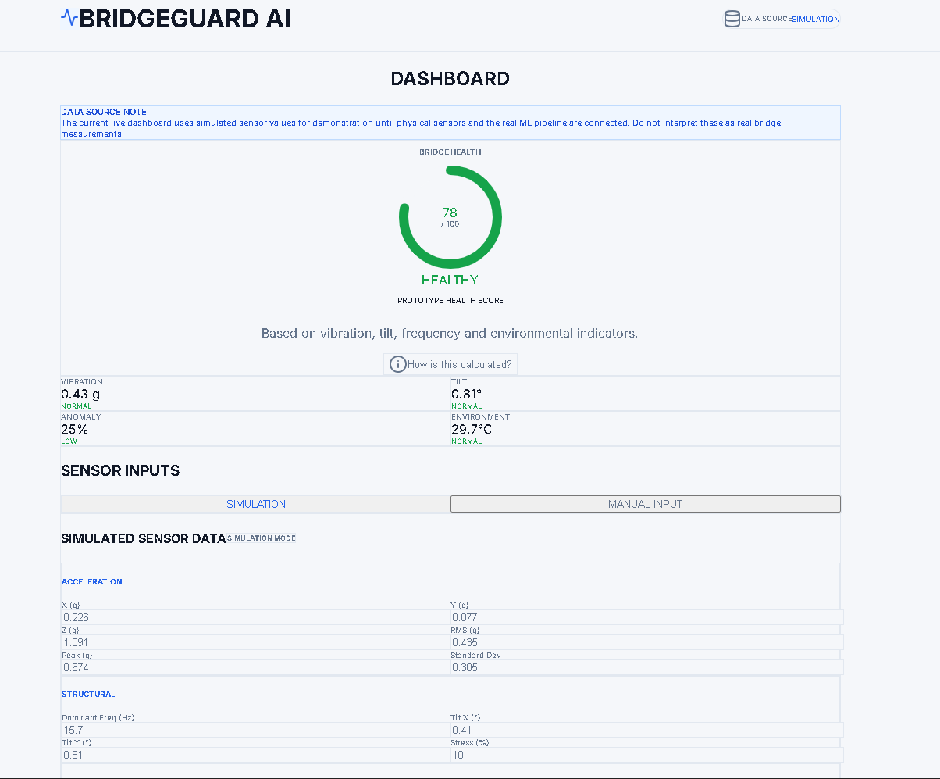
RESULTS / INITIAL IMPLEMENTATION
CURRENT PROGRESS — APPROX. 20%
CURRENT STATUS
Dashboard ✓
Simulation ✓
Architecture ✓
Dataset Identified ✓
→ ML Training
→ Hardware Integration
LIVE PROTOTYPE SIMULATION MODE
WORKING PROTOTYPE
Web-based Bridge Structural Health Monitoring dashboard with simulated sensor inputs, prototype health scoring and visualization.
Live Demo:
bridgeguard-ai-alpha.vercel.app
BRIDGEGUARD AI | IDP Review II | Project ID: 202600748

