Slide 1
Future of Banking Hackathon
Team Lambda
Tarun Bhavnani
Shubham Aggarwal

Slide 2
ESG Practices Can Offer Companies A Competitive Advantage
ESG metrics are used to assess a company’s exposure to a range of environmental, social and governance risks.
These metrics can be used for a range of ESG integration approaches, such as benchmarking and scenario analysis.
SOLID METRICS IN ESG RESULTED IN…
88% of companies showcased better operational performance
80% of companies showed positively-influenced stock price performance
90% of companies showed lowered the cost of capital
<number>

Slide 3
Main Issues with ESG Ratings
Data is self-reported
Omissions, unsubstantiated claims and inaccurate figures can be hard to identify and verify
Complications with the way issues are aggregated
Setting up policies is different from measurable impact
<number>

Slide 4
Business challenge
1
Better assessment of our counterparties through the lenses of E(nvironmental) S(ocial) and G(overnance)
<number>

Slide 5
THE PROBLEM
Large volumes of data
Unstructured Data
Manual intervention is time-consuming
No timely capture
<number>

Slide 6
<number>
THE PROMISE
Deliver sentiment analysis over a timeline that can reflect impact on business objectives and inform future actions

Slide 7




THE IDEA
Capture the news about each company and perform a litmus test on how they score across ESG parameters
Compare them to the market and industry standards to determine where they stand against the competition
Calculate the sentiment against each news item, year-on-year to witness peaks and troughs
Visualize data points with dynamic tools to base data-driven business decisions that promise to drive higher impact
<number>

Slide 8
THE APPROACH
The Dow Jones News data which is unsupervised for ESG tags
We listed down key words and patterns through research to tag the data for ESG. We were able to tag around 6 lacks records out of around 24 lack records we have. We used Regex on the body of the news articles.
We built a CNN based deep learning text classification model on the 6 lack records we were able to tag earlier. The test accuracy is around 93 percent. This model ws used to tag the rest of the data points.
We did a sentiment analysis on the new snippets to get a sentiment score of each news article. We did en empirical study to check accuracy of our results.
We calculated the mean sentiment score for each day for every company and industry in the data provided.
From this data we have created some tableau views to see how the sentiment scores vary E/S/G for differnt companies and Industries a time scale.
<number>

Slide 9
FEATURES
Updated overview of ESG performance of companies
Automated tagging for continuous, scalable insight models
Public sentiment scores based on public news sources
Time-stamped references and cross-referenced information
Easy visualization and user-friendly toggles for in-depth views
Actionable insights and future-ready solutions
<number>

Slide 10
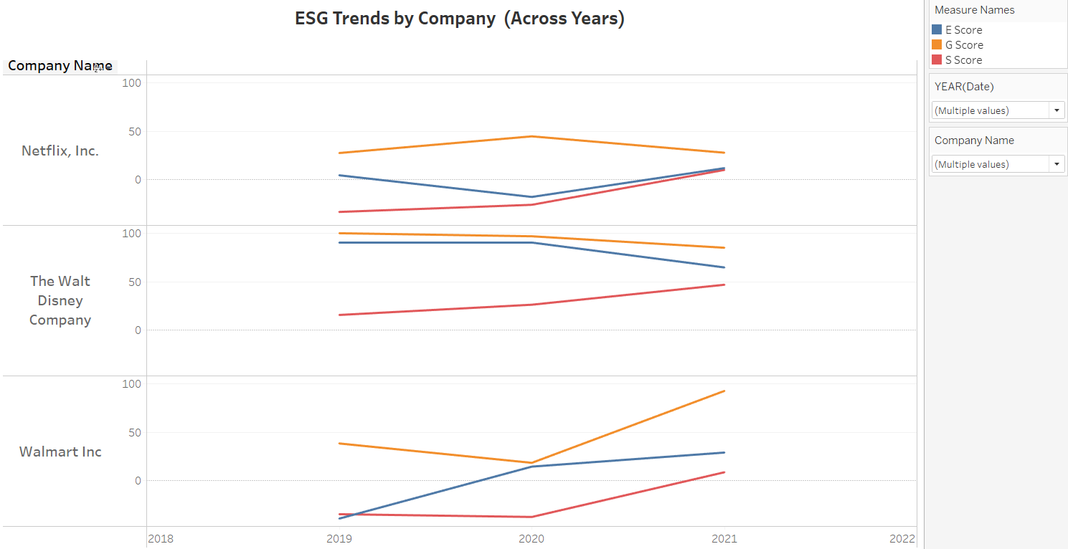
<number>

Slide 11
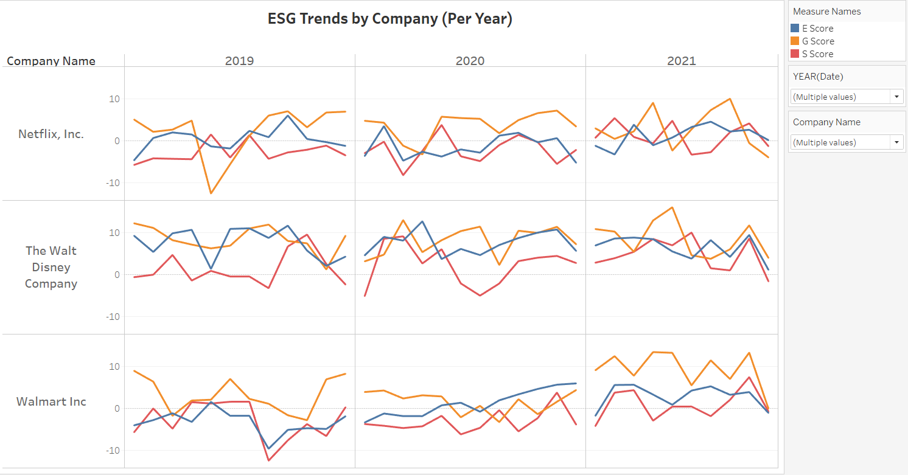
<number>

Slide 12
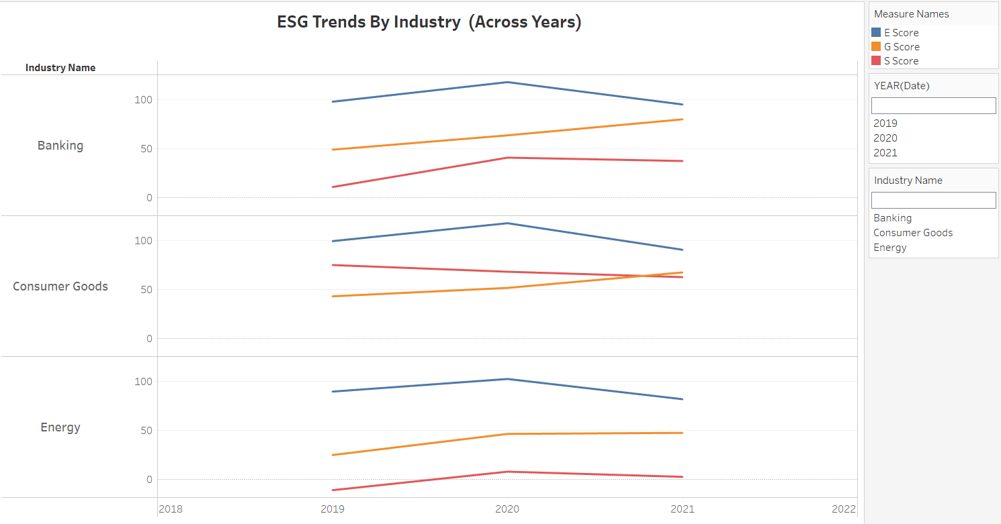
<number>

Slide 13
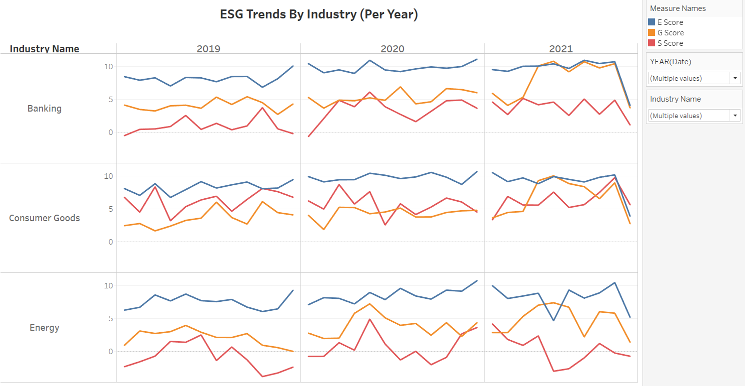
<number>

Slide 14
<number>

Slide 15
xxxx
xxxxx
xxxxxxxx
xxxxxx
xxxxxxxxx
<number>

Slide 16
In two or three columns
Yellow
Is the color of gold, butter and ripe lemons. In the spectrum of visible light, yellow is found between green and orange.
Blue
Is the colour of the clear sky and the deep sea. It is located between violet and green on the optical spectrum.
Red
Is the color of blood, and because of this it has historically been associated with sacrifice, danger and courage.
<number>

Slide 17
xxxxxx
xx
xxx
xxx
<number>

