Slide 1
Future of Banking Hackathon
Team Lambda
Tarun Bhavnani
Shubham Aggarwal

Slide 2
ESG Practices Can Offer Companies A Competitive Advantage
SOLID METRICS IN ESG RESULTED IN…
88% of companies showcased better operational performance
80% of companies showed positively-influenced stock price performance
90% of companies showed lowered the cost of capital
ESG metrics are used to assess a company’s exposure to a range of environmental, social and governance risks.
These metrics can be used for a ESG integration approaches, such as benchmarking and scenario analysis.

Slide 3
Main Issues with ESG Ratings
Data is self-reported
Omissions, unsubstantiated claims and inaccurate figures can be hard to identify and verify
Complications with the way issues are aggregated
Setting up policies is different from measurable impact

Slide 4
Business Challenge
1
Better assessment of our counterparties through the lenses of E(nvironmental) S(ocial) and G(overnance)

Slide 5
THE PROBLEM
Large volumes of data
Unstructured Data
Manual intervention is time-consuming
No timely capture

Slide 6
THE PROMISE
Deliver sentiment analysis over a timeline that can reflect impact on business objectives and inform future actions

Slide 7
USE CASES
Public and regulatory expectations are changing. Competitive banks are developing customised product offerings to meet the new demand.
Advisory
Sustainability Strategy
Finance
Exploring competitive advantage | Best practices & ROI | Risk analysis
Current baseline | Monitoring competitor landscape | Identifying market trends
Setting up an integrated sustainable finance strategy | Risk radar

Slide 8




THE IDEA
Capture the news about each company and perform a litmus test on how they score across ESG parameters
Compare them to the market and industry standards to determine where they stand against the competition
Visualize data points with dynamic tools to base data-driven business decisions that promise to drive higher impact
Calculate the sentiment against each news item, year-on-year to witness peaks and troughs

Slide 9
THE APPROACH
We used the Dow Jones News data which is unsupervised. We listed down keywords using Sustainability Accounting Standards Board, and tracked patterns through research to tag the data for ESG. We were able to tag around 6 lakh records out of around a total of 24 lakh records.
We used Regex on the body of the news articles. We built a CNN-based deep learning text classification model on the 6 lack records we were able to tag earlier. The test accuracy is around 93% This model was then used to tag the rest of the data points.
We did a sentiment analysis on the new snippets to get a sentiment score of each news article. We did an empirical study to check accuracy of our results. We calculated the mean sentiment score for each day for every company and industry in the data provided.
From this data, we created a Tableau visualization to see how the sentiment scores vary E/S/G for different companies and Industries on a time scale.

Slide 10
FEATURES
Updated overview of ESG performance of companies
Automated tagging for continuous, scalable insight models
Public sentiment scores based on validated news sources
Time-stamped references and cross-referenced contextual information
Easy visualization and user-friendly toggles for in-depth views
Actionable insights and future-ready solutions

Slide 11
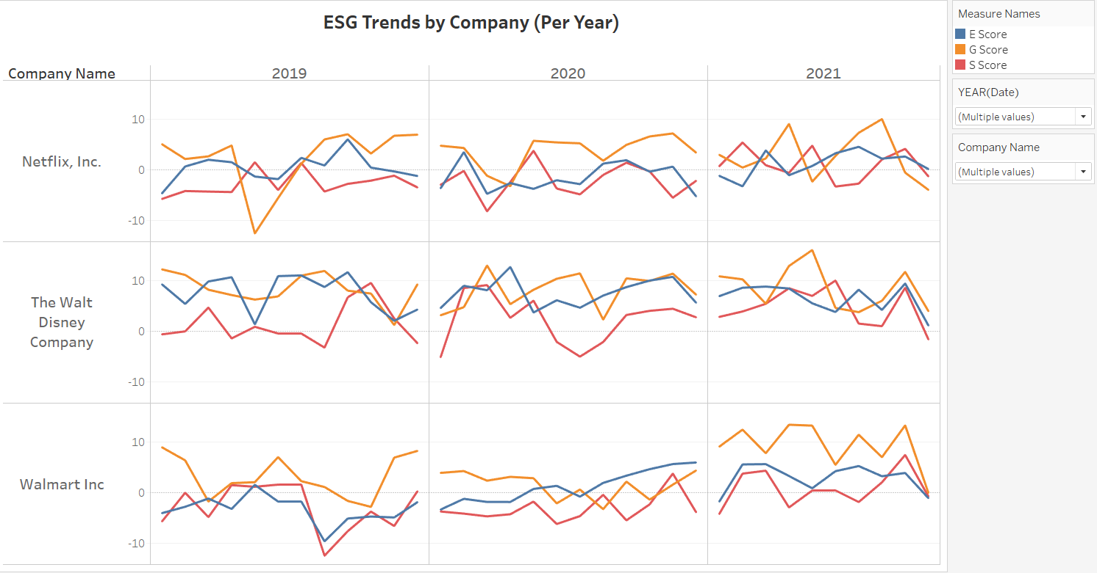

Slide 12
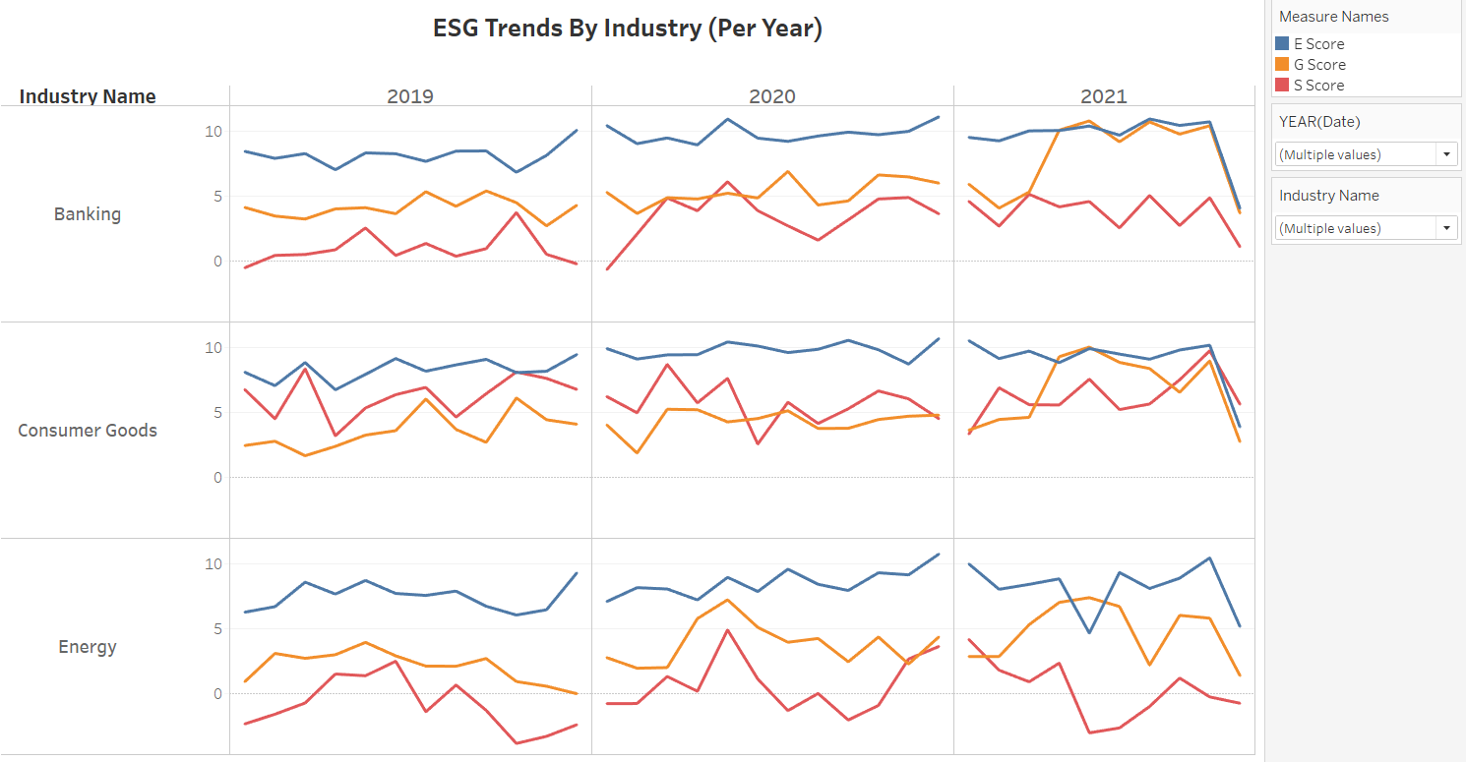

Slide 13
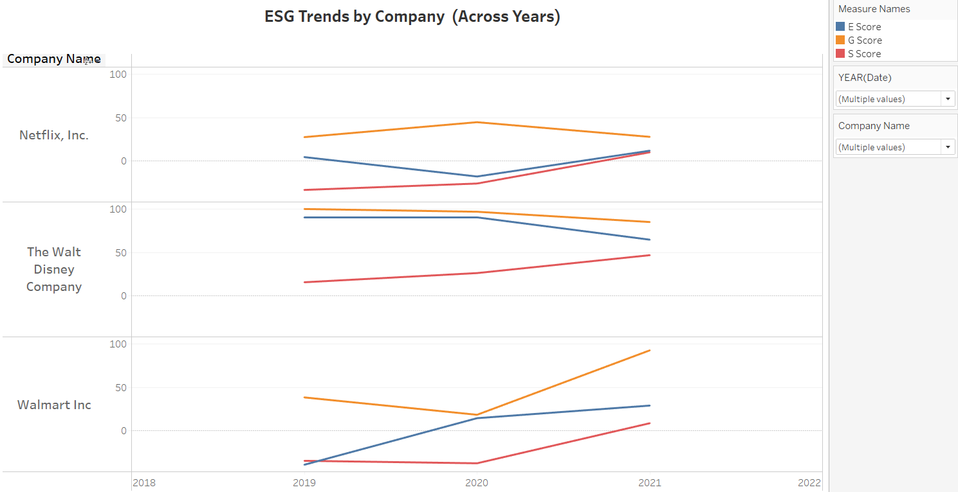

Slide 14
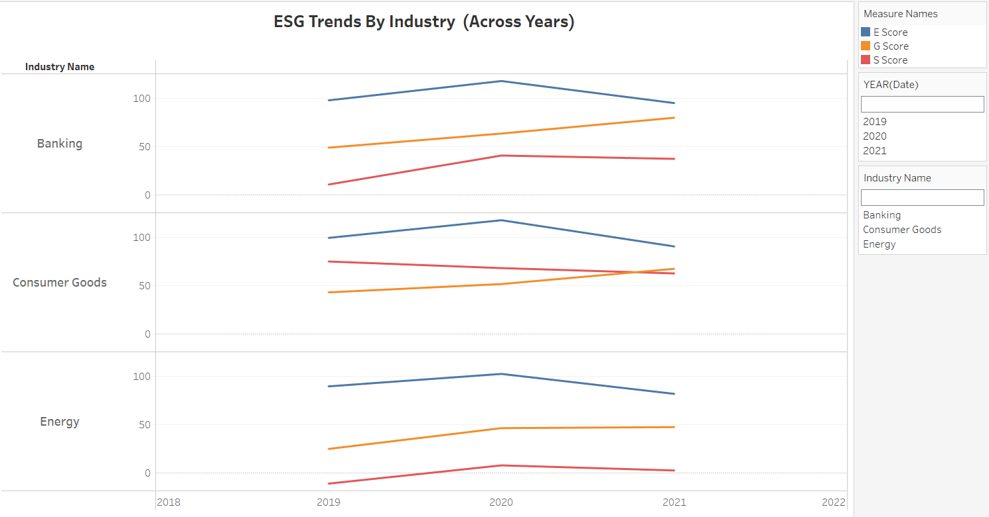

Slide 15
FUTURE SCOPE
More data
Scale up to handle more data, more varied sources and rigorous tagging improvements
Better scoring
Fine-tuning the models to improve sentiment scores, spot trends and track it to market events
Real-time trackers
Develop data pipelines for Live exploration into reasons for peaks and troughs

Slide 16

Open to questions…

