Slide 1
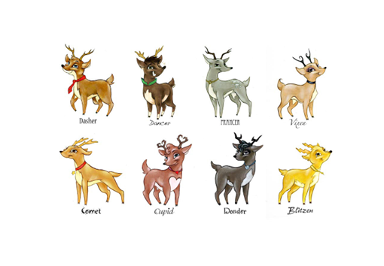


A secret santa project - 2023
Objective: Need to pick-up Santa from North Pole to Bengaluru, India on X-Mas eve as due to a secret reason few of his Reindeers denied to fly the night sky this year!
Created by: An Honest Learner, 22nd Dec2023

Slide 2


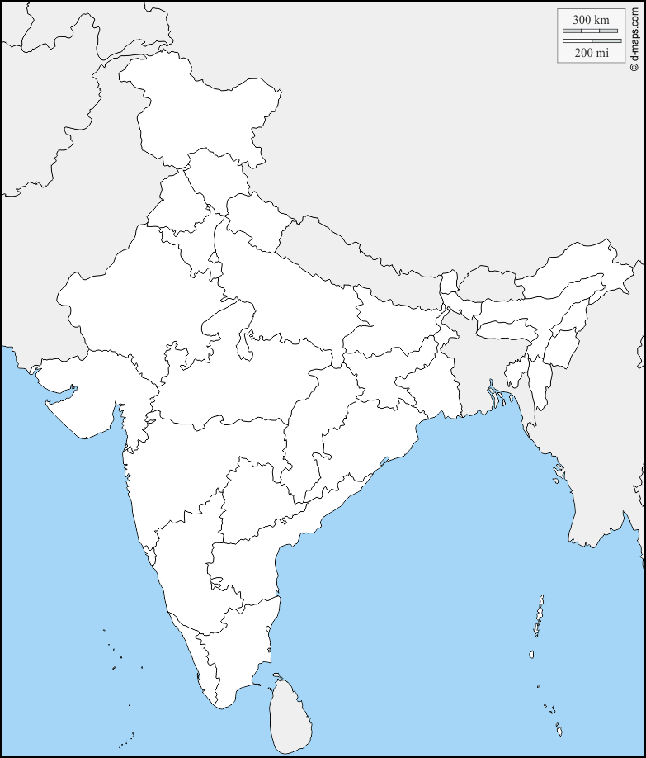
A secret santa project - 2023
Disclaimer:
It’s a hobby project developed during X-Mas vacation
True objective is to create an awareness / interest on upcoming big happening of Automotive Electronics called SDV (Software Defined Vehicle)
It just a Model Project where Laptop emulates a car’s mock ECUs
Inspired by:
HARMAN IEEE VTS SIG Kick-off – SDV – 13th Dec2023
(VTS - Vehicular Technology Society, SIG – Special Interest Group)
Project name: SANTA CAR

Slide 3
Software defined vehicle (SDV) – ref
Definition: A Software Defined Vehicle is any vehicle that manages its operations, adds functionality, and enables new features primarily or entirely through software.
Ref:
BlackBerry-QNX SDV Architecture Link
ChatGPT-> Search “Software Defined Vehicle” Link
A typical SDV controls
CCU - Central computing unit
Sensors / Data Fusion
Lidar, Cameras, GNSS
…
NAV
ADAS
HMI
Cyber Security
Controls
Brake, Steering
Vehicle states
…
Aggregators
SDV topology diagram of a NA OEM
Auto Drive-train Mgmnt
CANs, Elec devices
ETH
HWs / sensors ….
Display
CCU
MCU Farm
Connectivity Gateway
SOC 1
MCU 1
Radar / Lidar
SOC 2
MCU 2
Cloud, V2X, BLE, Projection….
Camera
SOC n
MCU n
ETH

Slide 4
SANTA Car - features
HMI
Central
Compute
Connectivity
System
Ethernet
Cloud
Sensor
MCU FARM
Tester / Mock
SANTA Car Mechanics:
One Central Compute - Connects / Controls all MCU in Farm
One Connectivity MCU - Can scan Hotspots (WLANS)
One System MCU - Can scan device’s remain battery power %
One Cloud Connect MCU - Can scan Weather data from Web
One Sensor MCU - Under development
One HMI - Shows Central Compute processed data
Communication - Communicates with Ethernet TCP/IP
Time to build:
14th to 22nd Dec2023
~52 hrs total
Conceptualization – 4hrs
Architecture – 4hrs
Web research – 8hrs
Central Compute – 8hrs
Setup & 1st Code – 4hrs
Connectivity – 6hrs
System – 2hrs
Cloud – 4hrs
HMI – 2hrs
Modularity – 2hrs
Presentation – 6hrs
SANTA Car Dev Platform:
Language: Visual C++, Win32 App
LOC: ~1200
Environment: Win 11 PC

Slide 5
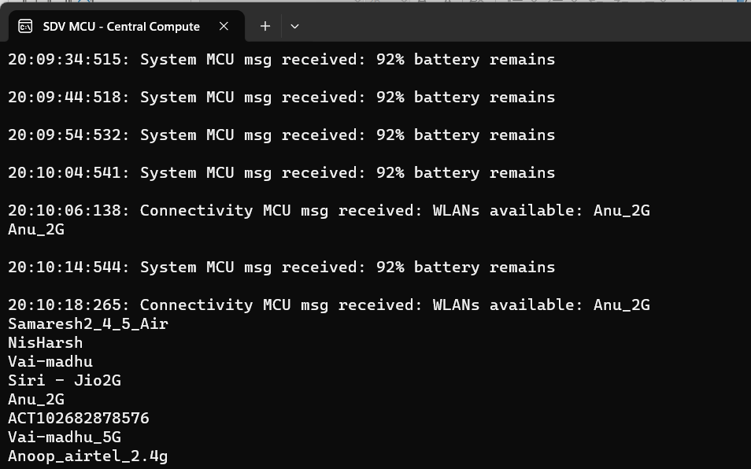
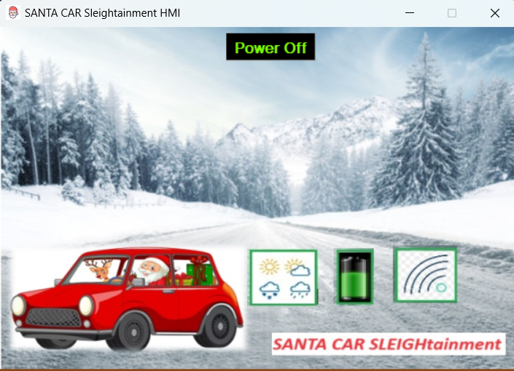
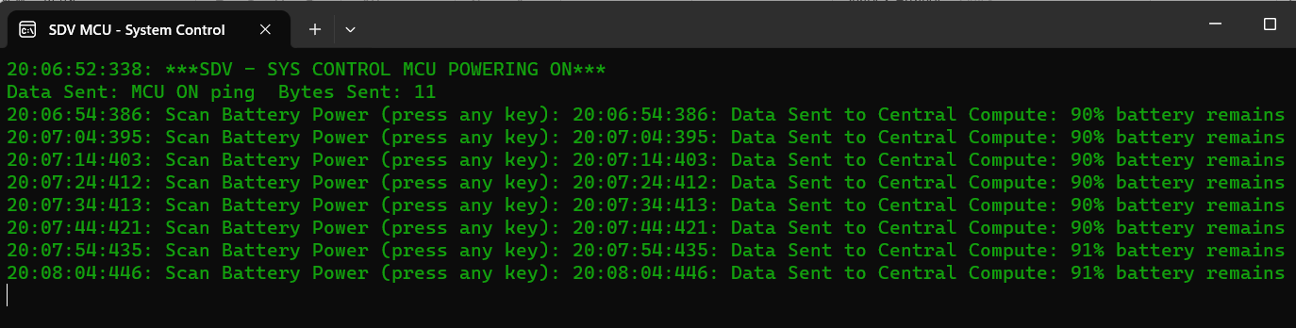
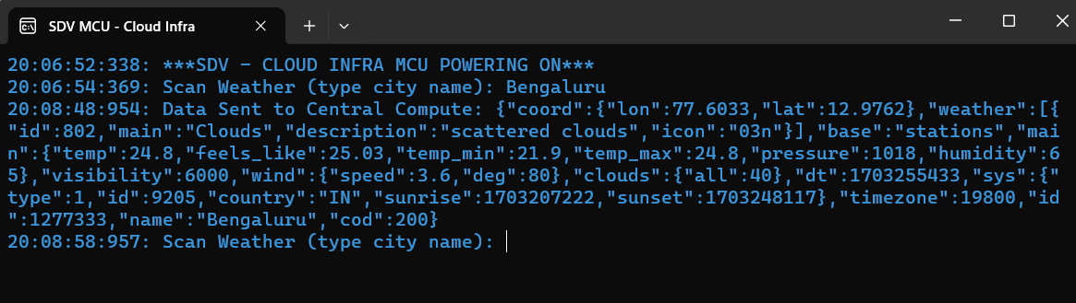
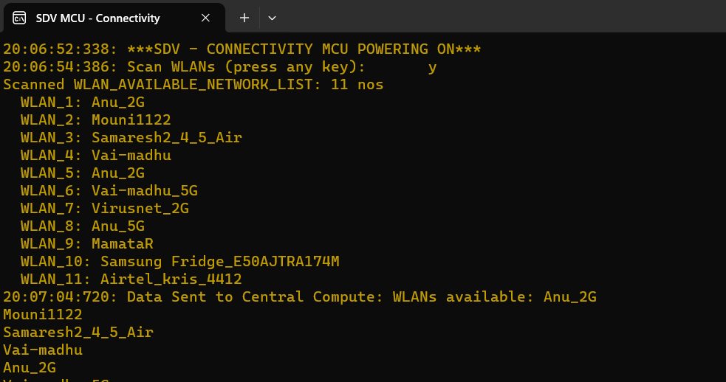
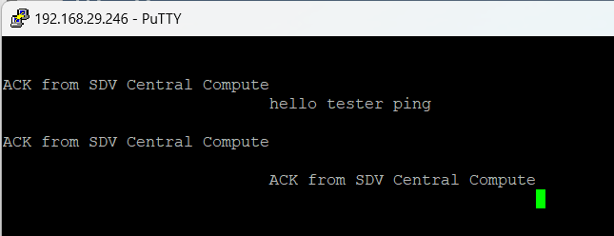
SANTA Car - demo
Scans Device’s remain battery in configured heartbeat
System Control
2
Central Compute
1
HMI
6
Connects all MCUs & implements main logics
MOCK HMI to show CC processed data
Manually test CC via SSH msg
Cloud
3
Connects Web API of OpenWeather for Weather forecast
Tester / Mock
5
Scans WLANs / Wifi Hotspots
Connectivity
4

Slide 6
SANTA Car - references
Win Socket code ref from Microsoft
(Central Compute is Server & all MCUs are multi-client)
https://learn.microsoft.com/en-us/windows/win32/winsock/complete-server-code
Free Weather Web API from OpenWather
(Create an a/c & generate a Key to call APIs)
https://openweathermap.org/
WLAN Interfaces
(Nested loop to get SSIDs & then fetch Wifi / Hotspot names)
https://cpp.hotexamples.com/examples/-/-/WlanEnumInterfaces/cpp-wlanenuminterfaces-function-examples.html
Curl – C++ wrapper & examples (free HTTP page scrapper lib)
https://curl.se/libcurl/c/example.html
SANTA CAR
Mechanic by: Tarun Chatterjee, PMP
(an honest learner)
Email: taruncha@gmail.com
Cell: +91 7406290004
December - 2023

